Slide 1
CSC343H Project Presentation
Yiyun Ding, Jianhong Guo Group 0005

Slide 2
Domain
The data is mainly about courses of recreational programs offered by the city of toronto. Information such as course name, location, restrictions and facilities is included.

Slide 3
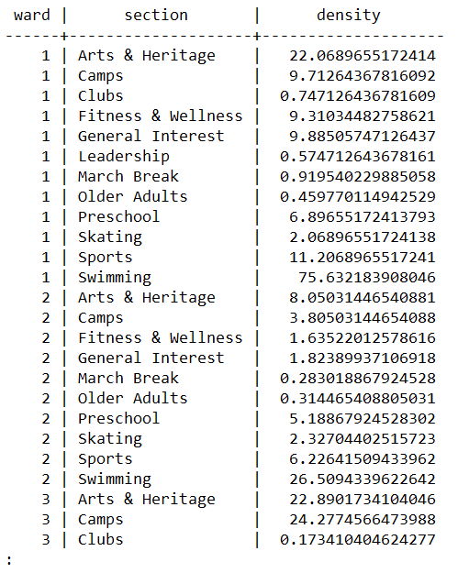
Result 1: Course Density and
Missing Section in a Ward
Density is calculated by dividing the number of the courses by the area of wards.
Missing section is defined when the density is 0.
The swimming courses section in Ward 13 has the highest density.
Skiing courses are the rarest with only two wards having skiing courses.
ward 40 is the only ward that does not have courses with section “Swimming”.

Slide 4
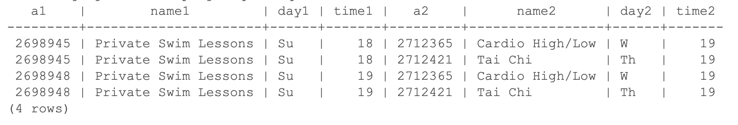
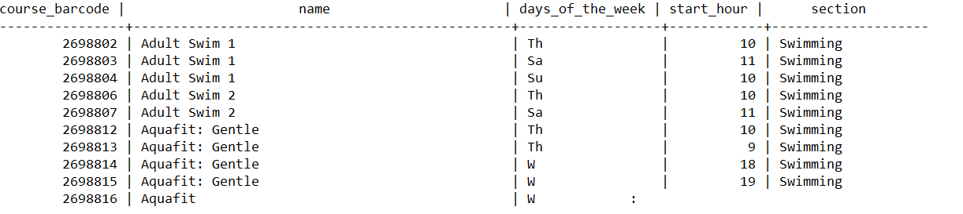
Result 2
The following courses all start in April holding in Agincourt Recreation Centre once a week, and allow people who are 82 years old to attend. Result has 36 rows.
Based on that, we write several queries to further investigate it.
A swimming course on Sunday, and a non-swimming course another day results in 22 combinations.
If only private swim lessons in the afternoon are specified, there are 4 combinations of courses left to choose from.

Slide 5

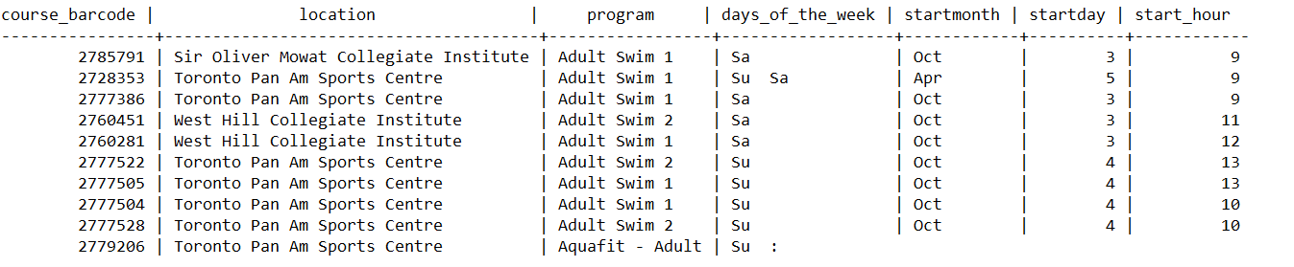
Result 3
How working adults have access to recreational courses in Toronto is investigated here.
A special case is created.
There are 17 rows that satisfies all the requirements.
The courses’ start_hour are all between 9 to 13, and most courses’ location (14 in 17) is Toronto Pan Am Sports Centre.

Slide 6
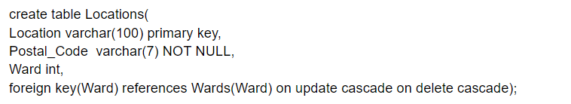
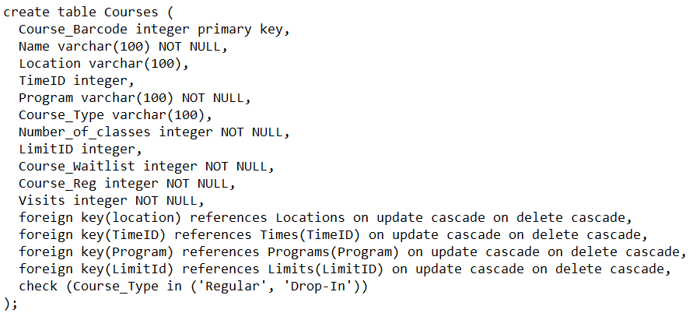
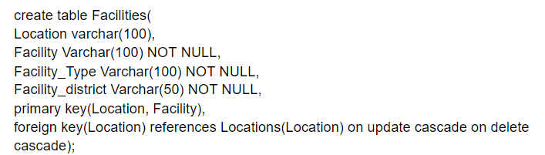
Evolution
We changed our schema for the courses table over the project. While we were trying to write queries related to facility, we suddenly found that we are unable to find the facility for a specific course base on our schema, which we can do this by looking at the original table. It induces a lossless joint problem.

Slide 7
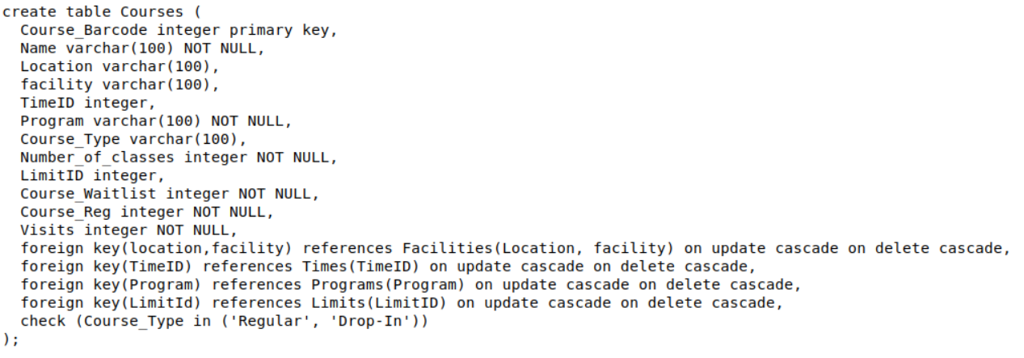
Evolution
We were thinking to use facility instead of location in courses table, but there also has a problem.
Therefore, we modified the schema by adding facility variable in courses table, and kept location as well to solve the problem.

Slide 8
Lessons
We should be really careful when dealing with databases, since a small mistake might cause significant result differences.
I learned some skills while dealing with data, for example, I learned how to modify the schema in psql, how to add a new key to separate a big table to smaller tables if we can not find a proper key, and I learned how to convert a XLSX file to csv file and txt file.

Slide 9
Any Questions ?
All Questions are welcomed :)

