Slide 1
Max’s Photo Album
Amy Albrecht
[TEK Global] 2021 -Java Developer 01
Full Stack Application Case Study Presentation
April 12, 2021

Slide 2
Concept
A place where relatives can go to upload pictures of my son, Max, if they’re uncomfortable using social media

Slide 3
User Stories
Login/Logout User Stories
As a user, I want to create a user account with an email and password so that I can access the website to look at and upload photos.
As a user, I want to login to my account so that I am able to securely look at photos.
As a user, I want to be able to logout so that no one else can access my account when I’m done using the site.

Slide 4
User Stories
Photo User Stories
As a user, I want to upload photos so that I can share photos with the rest of Max’s family.
As a user, I want to add captions to my photos so that I can add more context to my photos.
As a user, I want to edit the caption of a photo that I have uploaded so that I can fix typos or add more context.
As a user, I want to see all the photos that have already been updated by everybody so that I can see more pictures of Max!
As a user, I want to put tags on my photos so that I can search photos by tag. (stretch goal)
As a user, I want to put tags on other people's photos so that I can fix an error or add a tag I think is missing.

Slide 5
User Stories
Photo Album User Stories
As a user, I want to view all the photo albums on one page so that I can choose from the album I want to view.
As a user, I want to view all the photos of an album while I'm in an album so that I can look at all the photos in one space.

Slide 6
User Stories
Misc.
As a user, I want to see more info about Max and what he's up to so that I can catch up with Max and his family.
As a user, I want to see an error page if an error occurs so that I can know what’s going on during an error and go back to the home page if I want.

Slide 7
Demo
Database (MariaDB)
Core Java
Spring MVC
Spring Data JPA
Spring Boot (the final project is Spring Boot)
HTML5/CSS3
JUnit
JSP
Maven 4.0.0
Eclipse IDE version 2020-12 (4.18.0)
HeidiSQL 11.2.0.6250
Tomcat v9.0

Slide 8
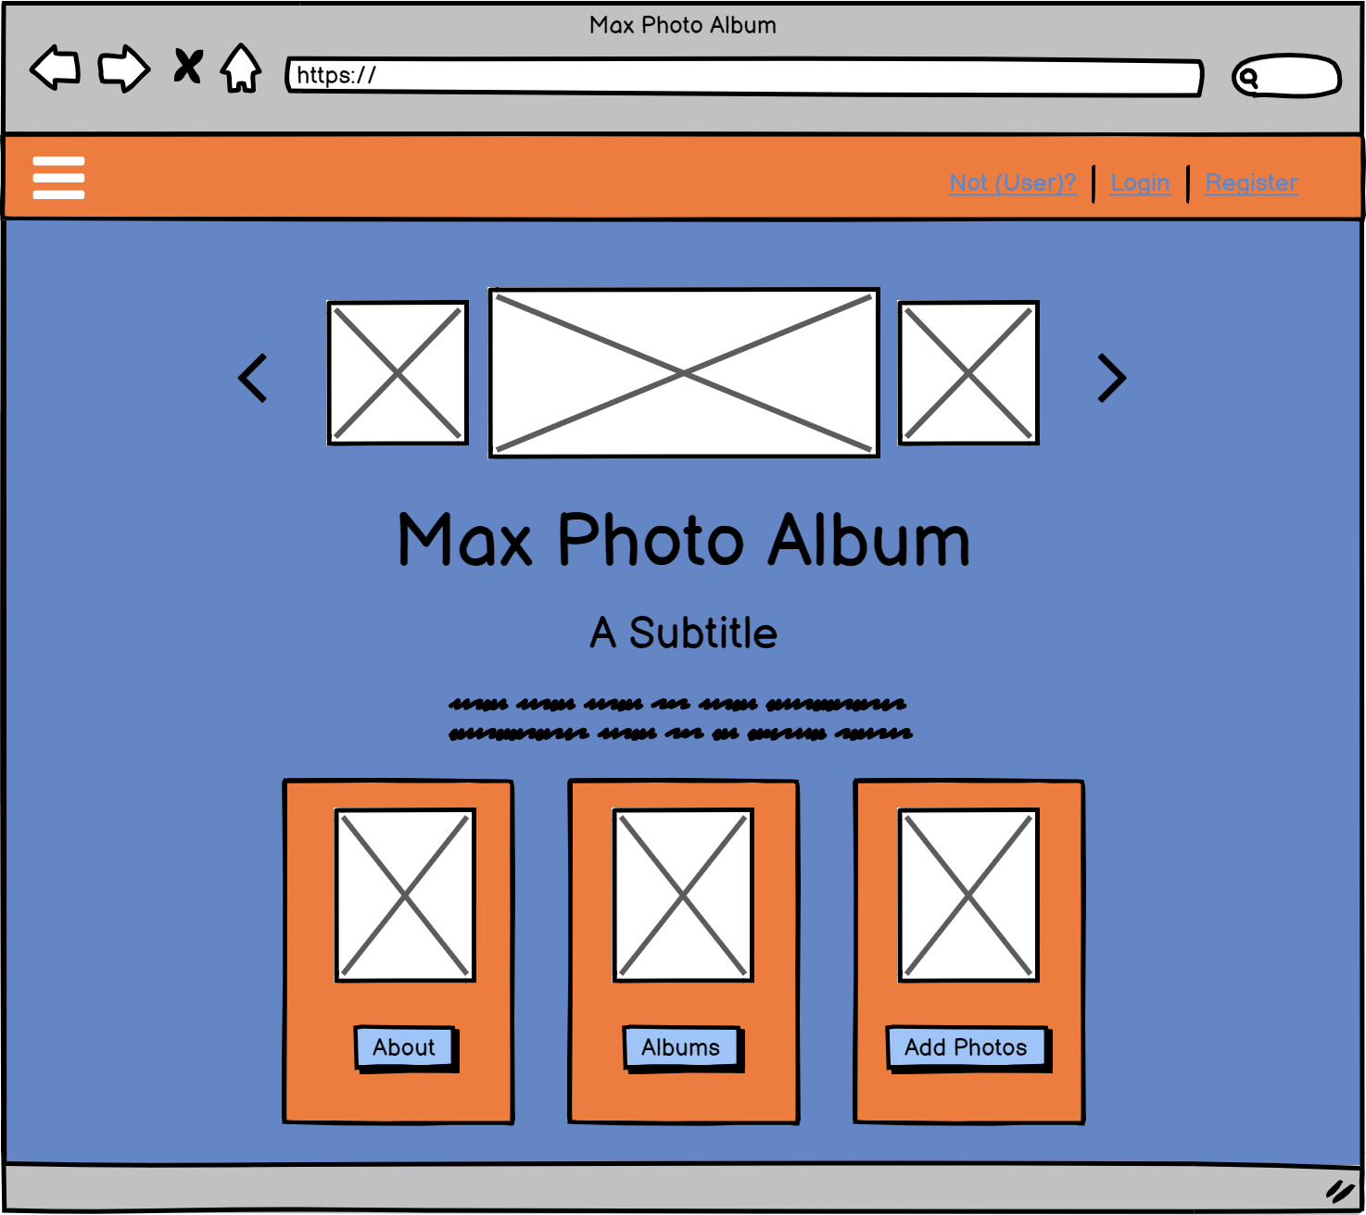
Wireframes

Slide 9
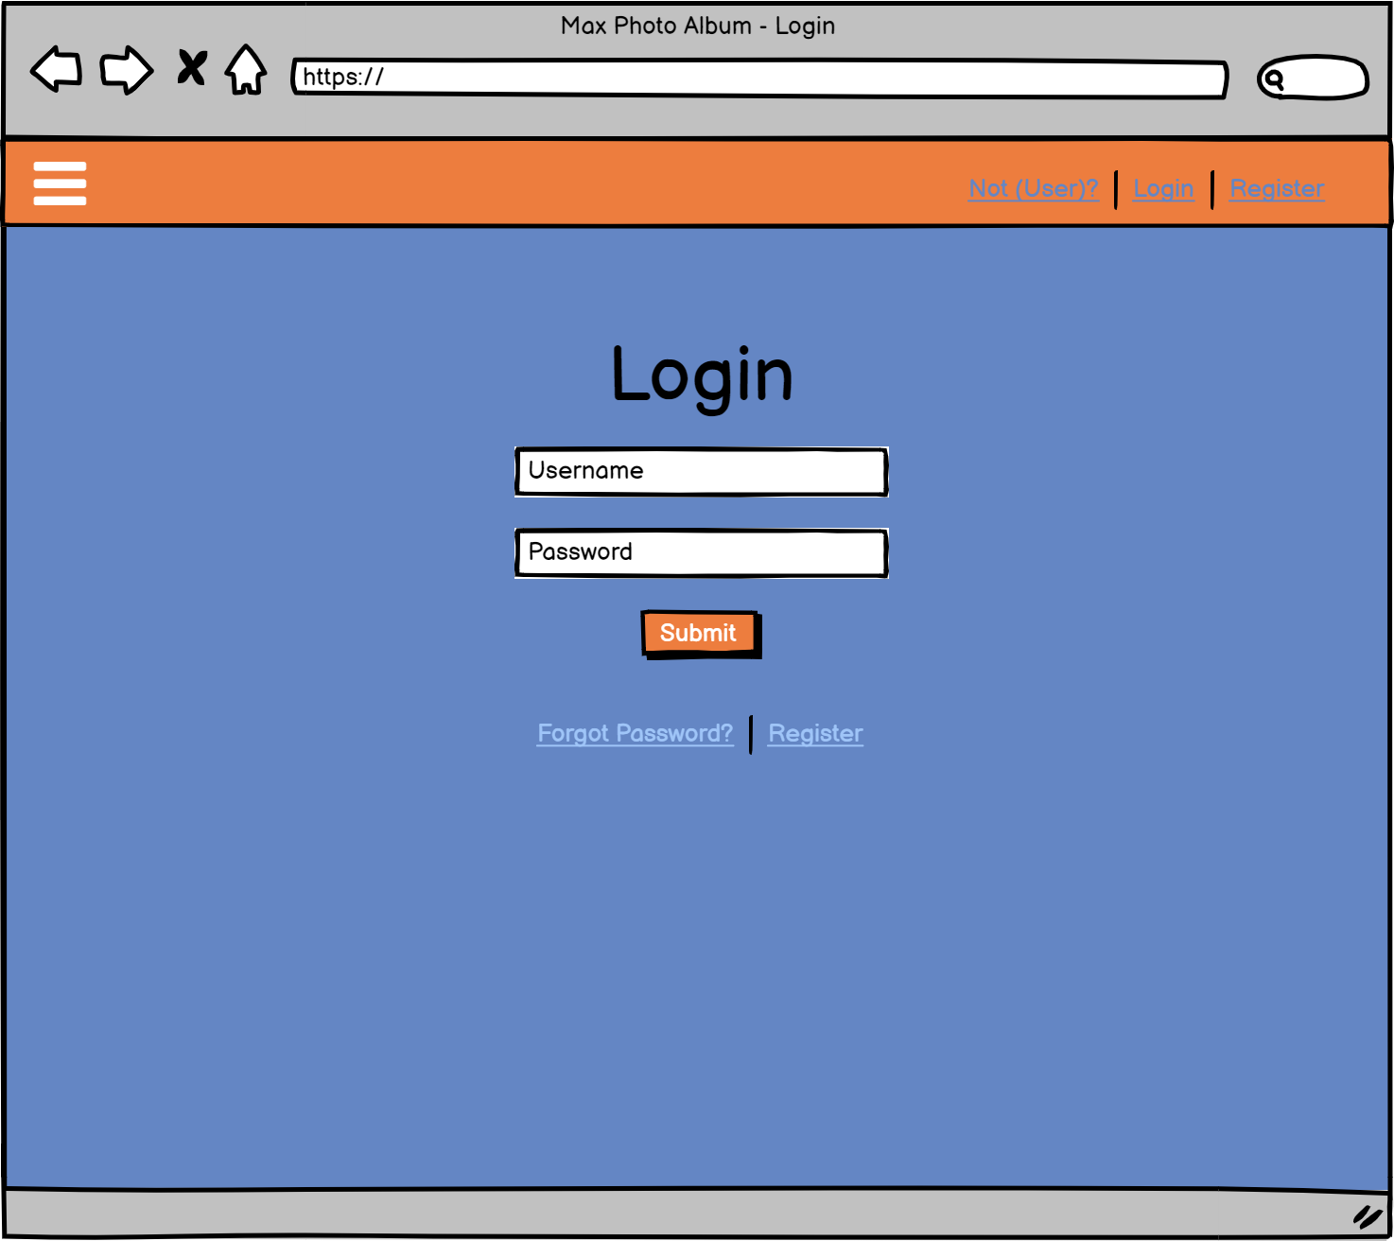
Wireframes

Slide 10
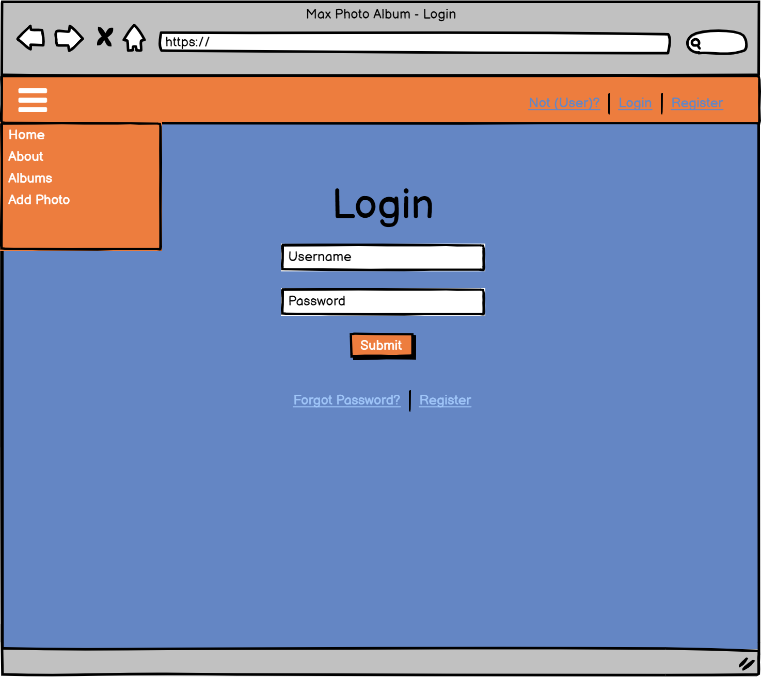
Wireframes

Slide 11
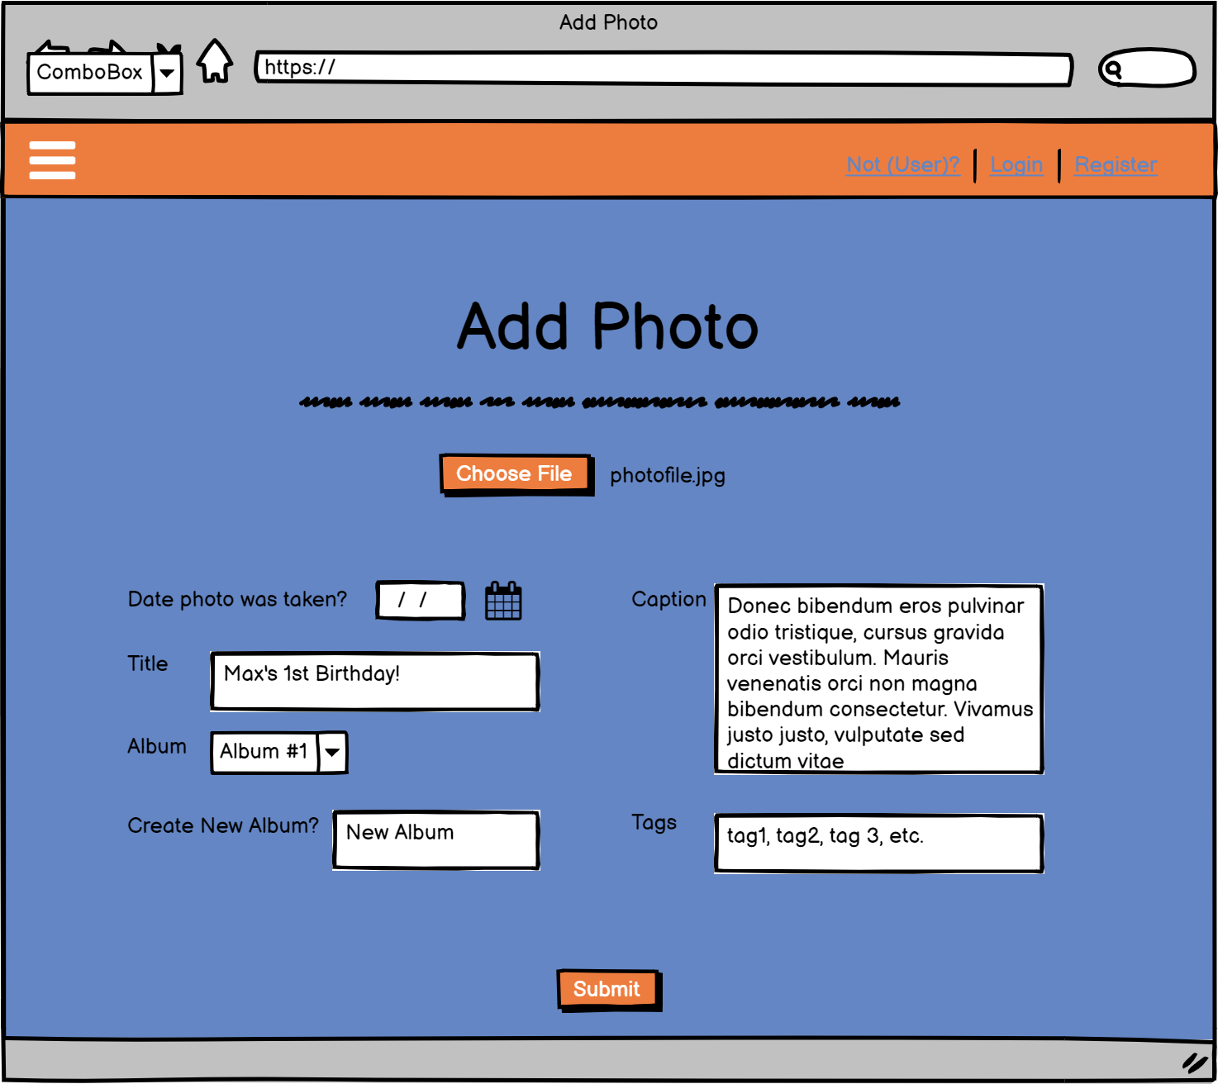
Wireframes

Slide 12
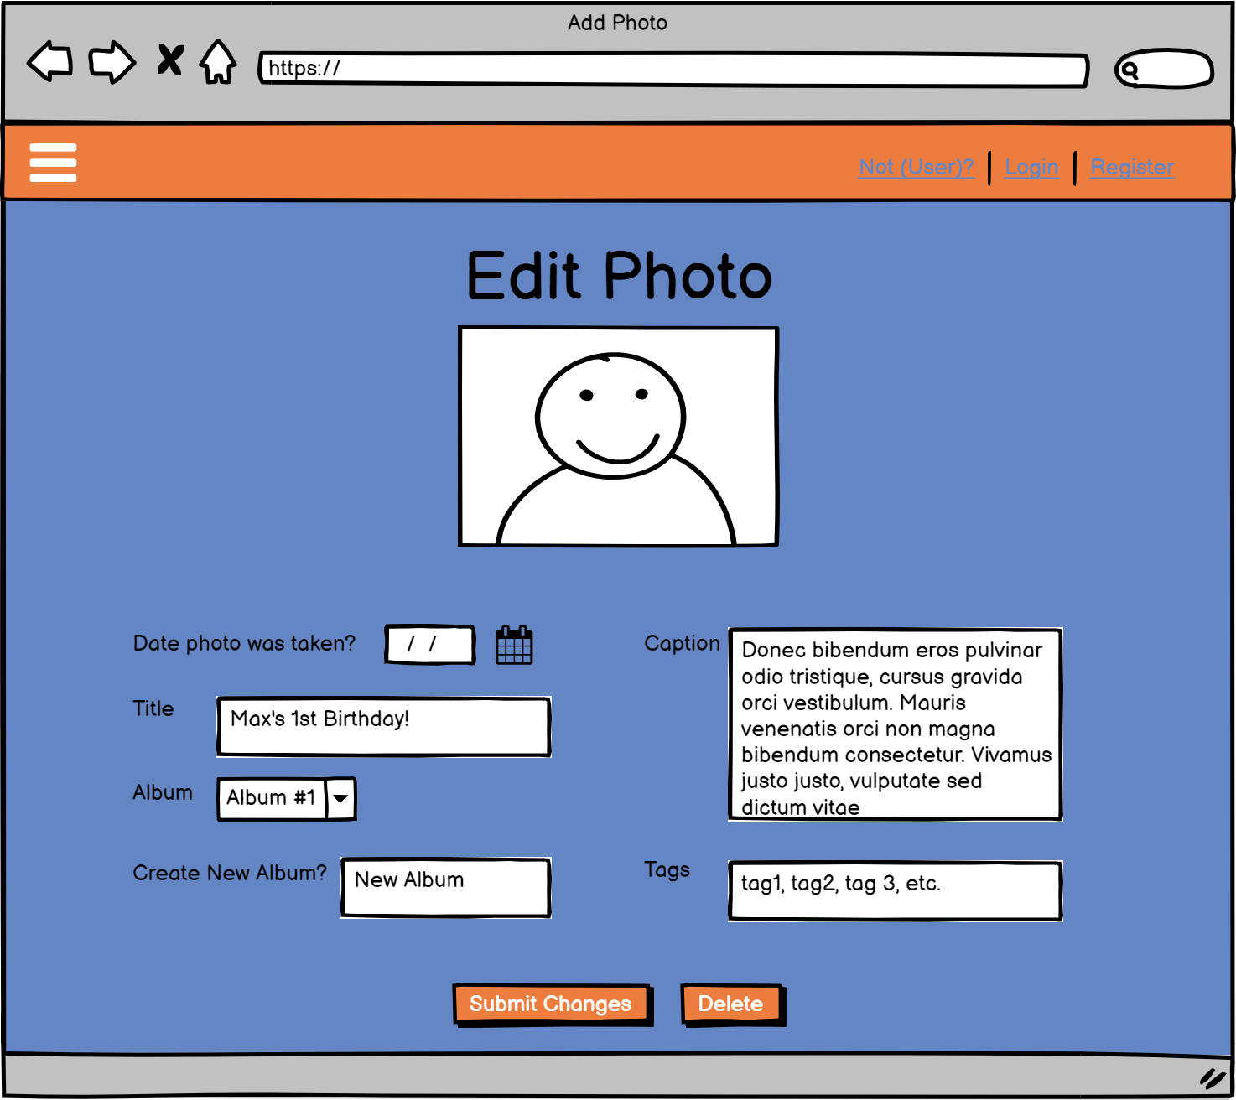
Wireframes

Slide 13
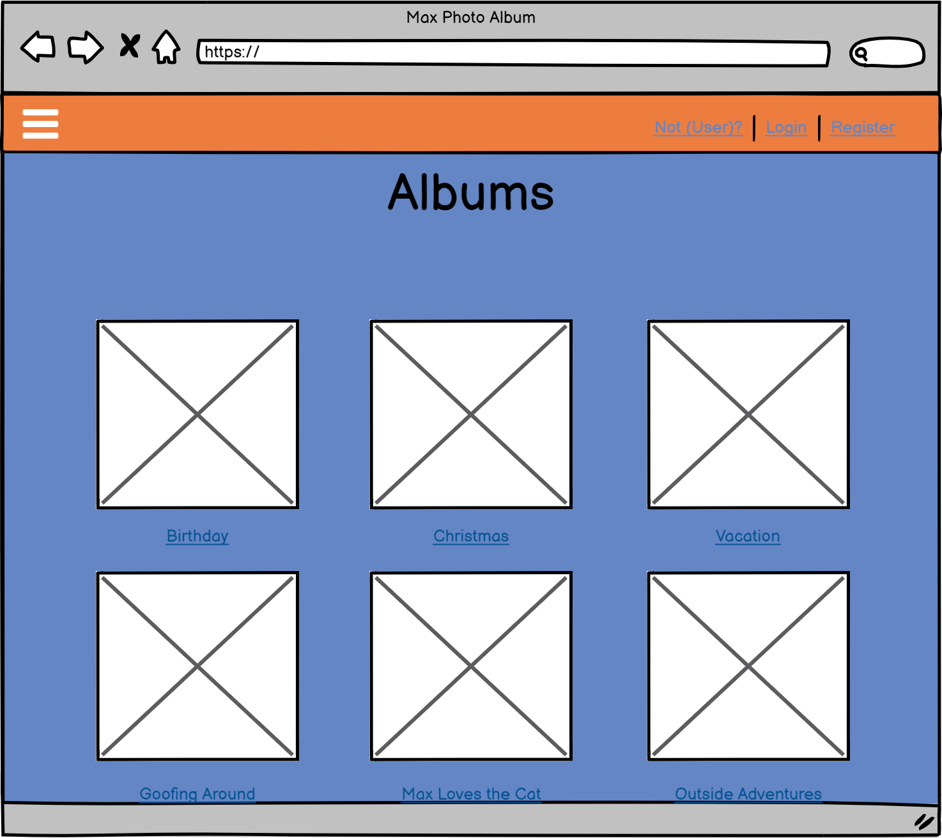
Wireframes

Slide 14
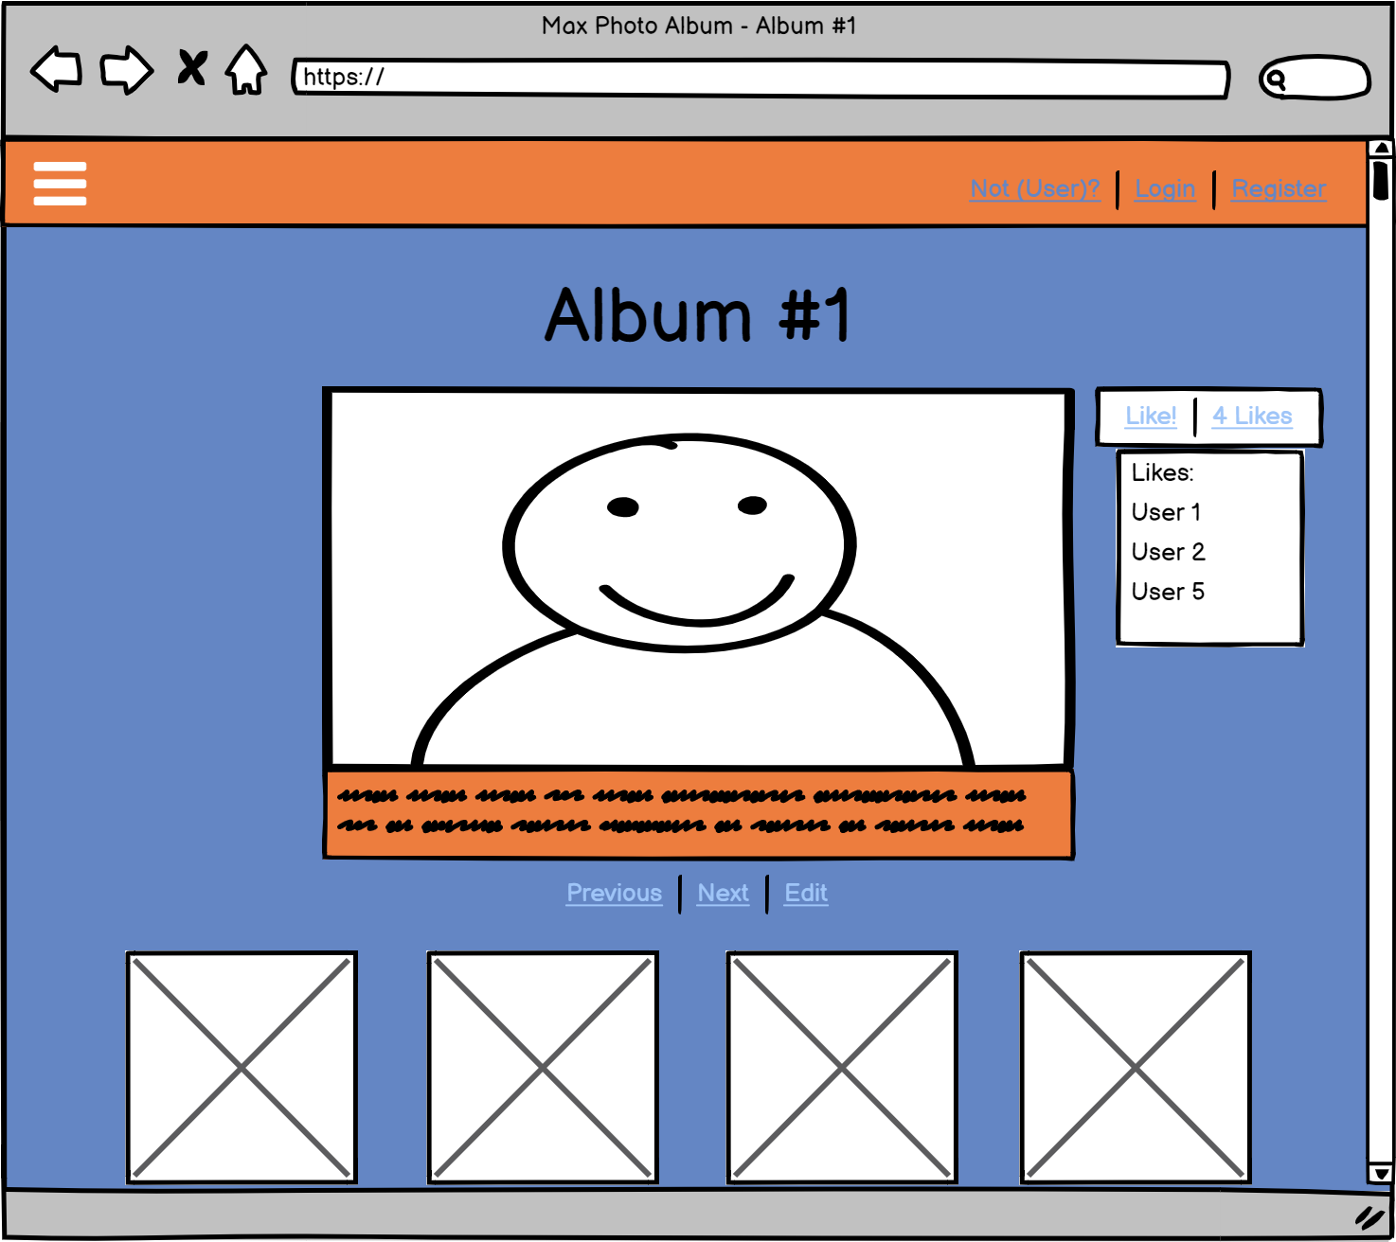
Wireframes

Slide 15
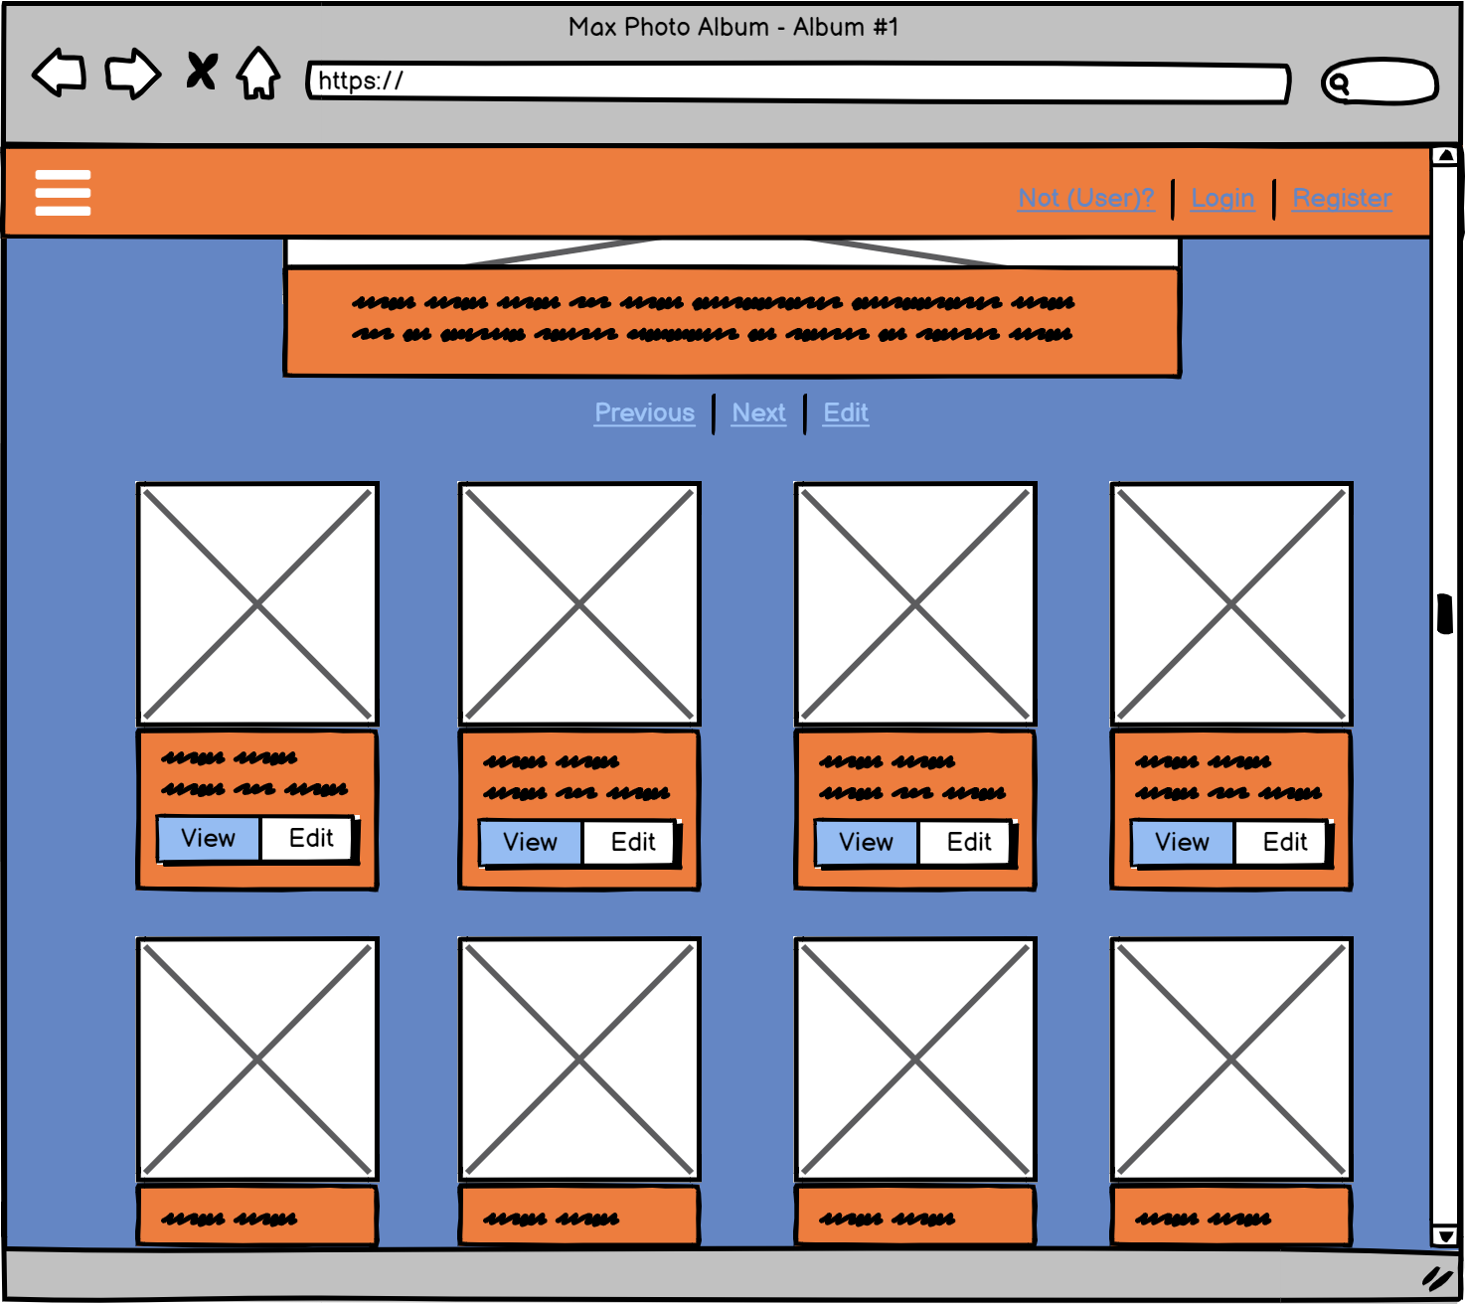
Wireframes

Slide 16
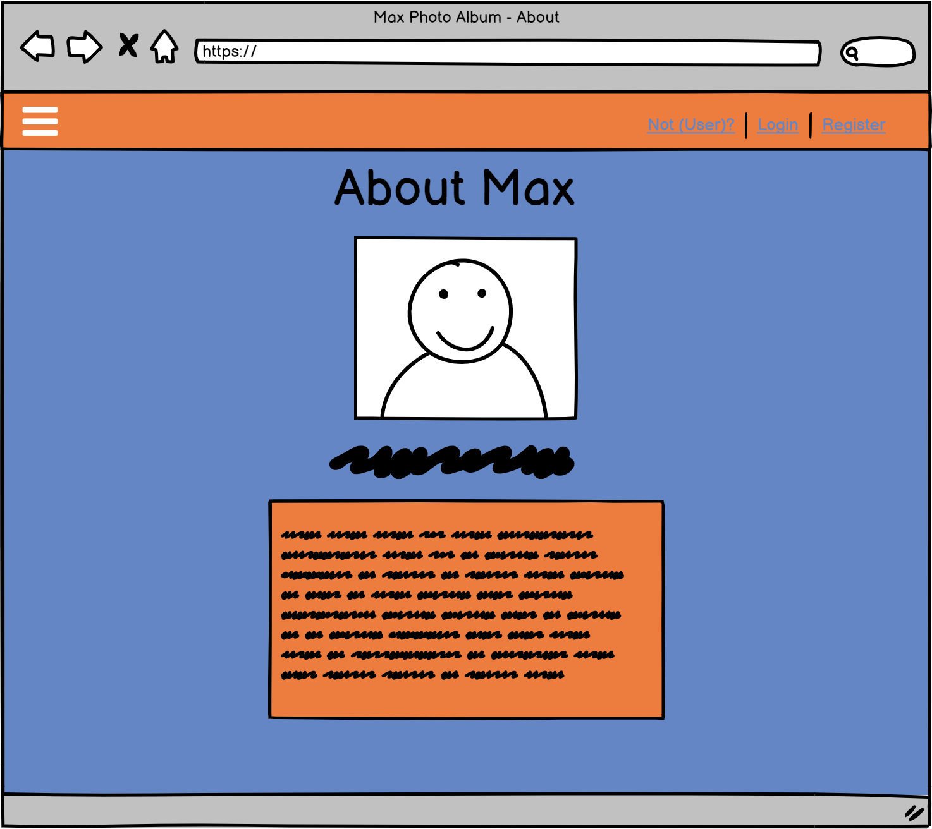
Wireframes

Slide 17
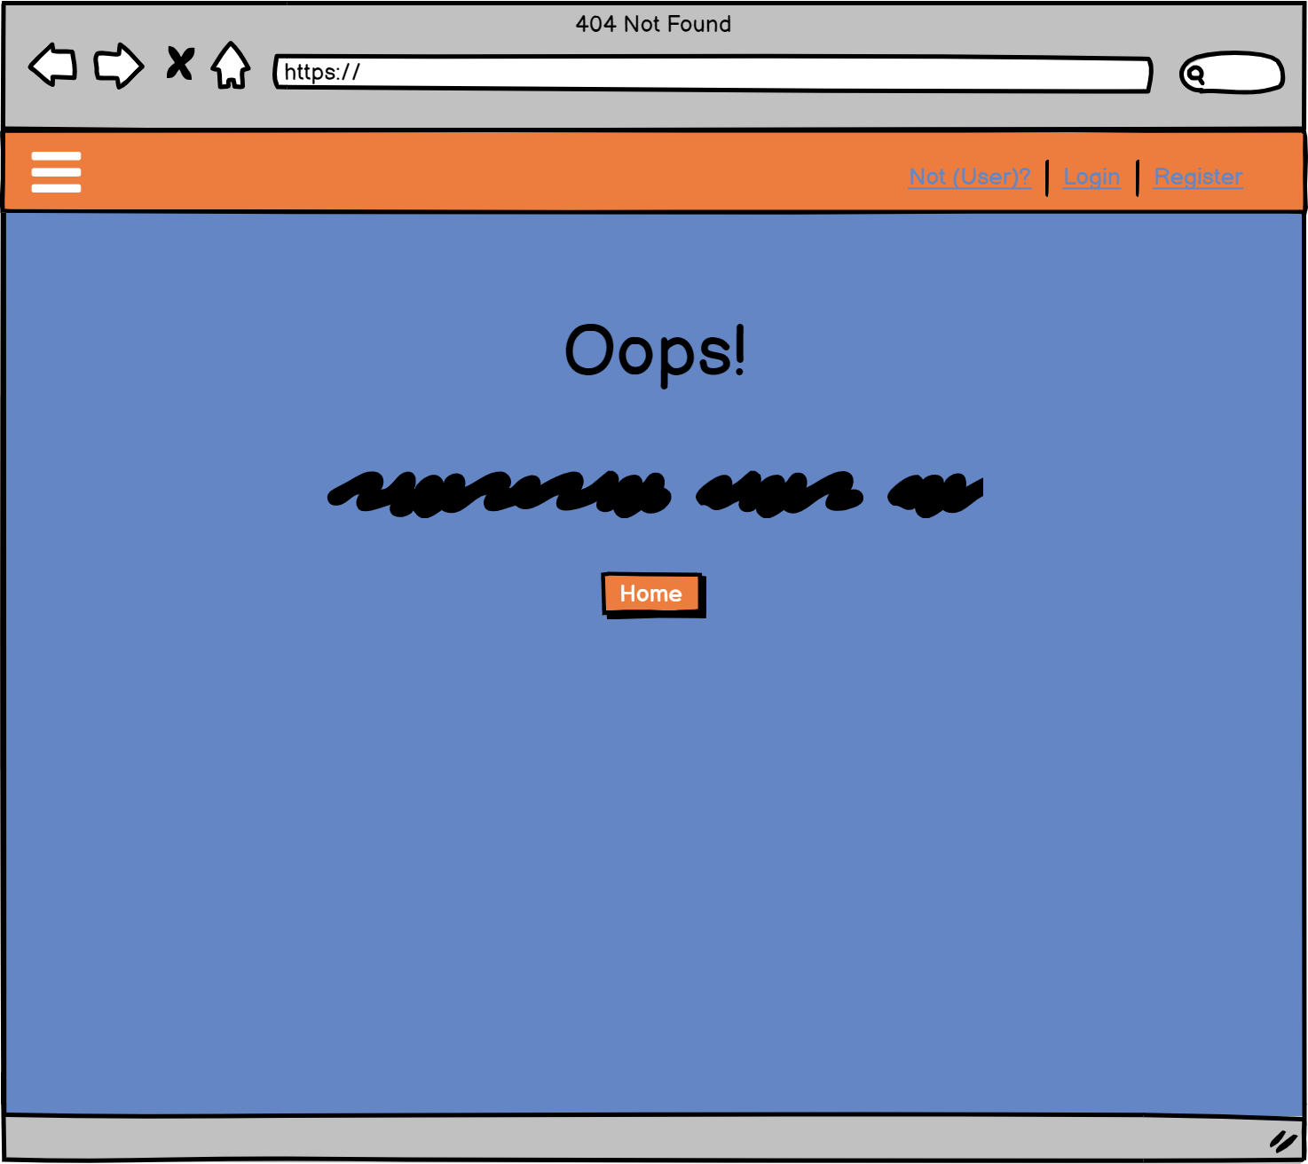
Wireframes

Slide 18
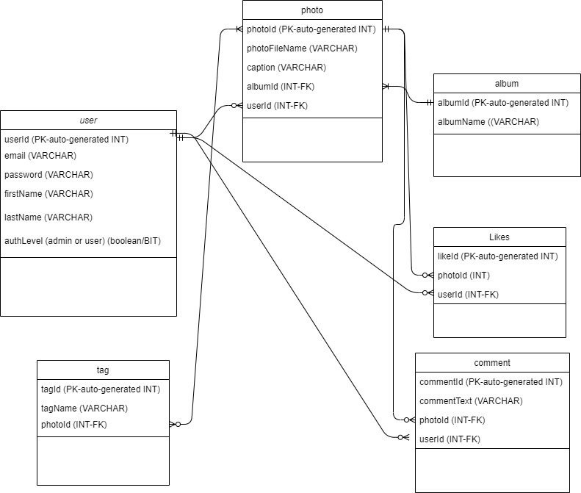
DB Schema

Slide 19
Technical Issues
GitHub
JUnit
User validation
Stretch goals
CRUD functionality for User model
CRUD functionality for Album model
Update and Delete functionality for Tag model
Authorization levels for Users
Comments and Likes for each Photo
Date Created field for Photo and Album
search for photos by Tag
Carousel in Bootstrap

