Slide 1
Perceptron
Humayun Irshad
Lead Scientist
Machine Learning & Computer Vision
CrowdFlower, Inc

Slide 2
Linear Boundary / Classification
20
18
16
14
12
10
8
6
4
2
BOUNDARY: A LINE (WX + B)
2X₁ + X₂ -18 = 0
X₁ = Test
X₂ = Grade
2*Test + Grade – 18 = Score
PREDICTION:
Score >= 0 Accept
Score < 0 Reject
GRADES
2 4 6 8 10
TEST
Example: What is prediction of a student who got 4 on the test and 8 on the grades?
Answer: 2 x 4 + 8 – 18 = 16 - 18 = -2

Slide 3
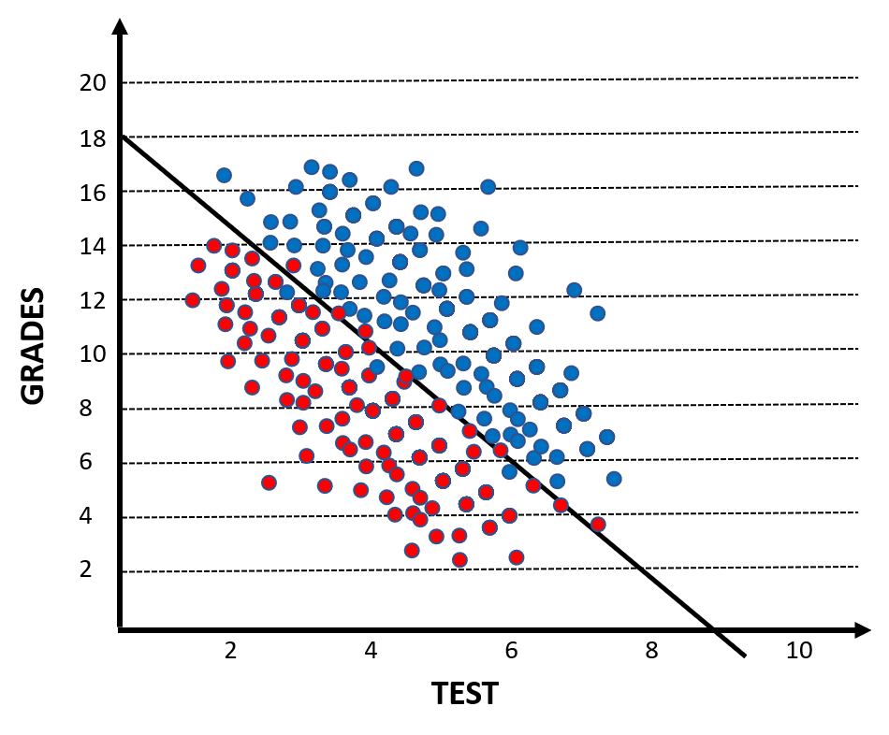
Perceptron
Test = 4
2
Accepted or Rejected
Grades = 8
1
18
Bias

Slide 4
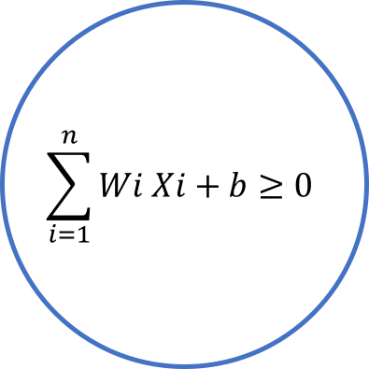
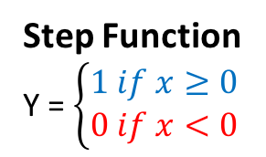
Perceptron
Step Function
Y = $\left\{\begin{matrix}1 if x≥0 \\ 0 if x<0\end{matrix}\right.$
y
x
X₁
W₁
$$\sum_{i=1}^{n}{Wi Xi+b≥0}$$
X₂
W₂
y
Accepted
or
Rejected
W₃
x
X₃
.
.
W_{n}
X_{n}
b
Bias

Slide 5
How to select the weights and bias – called TRAINING the Perceptron
3X₁ + 4X₂ – 10 = 0
Misclassified Point: (8,3)
3 4 -10
8 3 1
-5 1 -11
x₂
Positive Area
-
3X₁ + 4X₂ – 10 = 0
3X₁ + 4X₂ – 10 = 0
Misclassified Point: (8,3)
Learning Rate = 0.1
3 4 -10
8x0.1 3x0.1 1x0.1
2.2 3.7 -10.1
New Line: 2.2X₁ + 3.7X₂ – 10.1 = 0
Negative Area
x₁
-

Slide 6
How to select the weights and bias – called TRAINING the Perceptron
3X₁ + 4X₂ – 10 = 0
Misclassified Point: (8,3)
3 4 -10
8 3 1
-5 1 -11
x₂
Positive Area
-
2.2X₁ + 3.7X₂ – 10.1 = 0
3X₁ + 4X₂ – 10 = 0
Misclassified Point: (8,3)
Learning Rate = 0.1
3 4 -10
8x0.1 3x0.1 1x0.1
2.2 3.7 -10.1
New Line: 2.2X₁ + 3.7X₂ – 10.1 = 0
Negative Area
x₁
-

Slide 7
How to select the weights and bias – called TRAINING the Perceptron
2.2X₁ + 3.7X₂ – 10.1 = 0
Misclassified Point: (2,6)
Learning Rate = 0.1
2.2 3.7 -10.1
2x0.1 6x0.1 1x0.1
2.4 4.3 -10
New Line:
2.4X₁ + 4.3X₂ – 10 = 0
x₂
Positive Area
+
2.2X₁ + 3.7X₂ – 10.1 = 0
Negative Area
x₁

Slide 8
How to select the weights and bias – called TRAINING the Perceptron
2.2X₁ + 3.7X₂ – 10.1 = 0
Misclassified Point: (2,6)
Learning Rate = 0.1
2.2 3.7 -10.1
2x0.1 6x0.1 1x0.1
2.4 4.3 -10
New Line:
2.4X₁ + 4.3X₂ – 10 = 0
x₂
Positive Area
+
2.4X₁ + 4.3X₂ – 10 = 0
Negative Area
x₁

Slide 9
Pseudocode for Training – Adjusting the Weights & Bias
Positive Area
Start with random weights: (W₁, … , W_{n}, b)
For every misclassified point (X₁, … ,X_{n}):
If Prediction = 0
For I = 1 … n
W_{i} = W_{i}+ α X_{i}
b = b + α
If Prediction = 1
For I = 1 … n
W_{i} = W_{i} - α X_{i}
b = b - α
x₂
2.4X₁ + 4.3X₂ – 10 = 0
Negative Area
x₁

Slide 10

Perceptron – Basic Functions
Step Function Y’ $=\left\{\begin{matrix}1 if x≥0 \\ 0 if x<0\end{matrix}\right.$
Predict Function $\acute{y}$ $= σ\left(w_{1}x_{1}+w_{2}x_{2}+b\right)$
Error Function $Error$ $=y−\acute{y}$
Update Weights Function $b ←b+ α . x. Error$
$w_{i} ←w_{i}+ α{. x}_{i}. Error$

Slide 11
Run Code
perceptron_1.py
How can we initialize weights and bias?
How learning rate effects on model training?

Slide 12
Run Code
perceptron_2.py
What is epoch?
What does epochs=100 do?
Is our model better when we have high epoch?

Slide 13
Error Function & Log-Loss Function
x₂
Positive Area
Error = + + + + +
Negative Area
x₁
What happened if error function is discrete?
Error function should be continues and differentiable

Slide 14
Error Function & Log-Loss Function
x₂
Positive Area
Error = + + + + +
Negative Area
x₁
Negative Area
x₁

Slide 15
Predictions
Yes
85% likely
x₂
x₂
70% likely
Yes
No
1
0.85
60% likely
1
0.7
0
Yes
0.6
40% likely
No
No
30% likely
1
0.4
0
0.3
20% likely
0
0.2
x₁
x₁
Discrete
Continuous

Slide 16
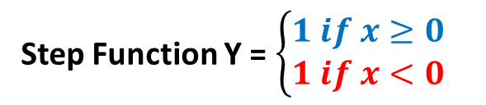

Predictions & Activation Functions
Yes
85% likely
x₂
x₂
70% likely
Yes
No
1
0.85
60% likely
1
0.7
0
Yes
0.6
40% likely
No
No
30% likely
1
0.4
0
0.3
20% likely
0
0.2
x₁
x₁
Discrete
Continuous
Step Function Y = $\left\{\begin{matrix}1 if x≥0 \\ 1 if x<0\end{matrix}\right.$
Sigmoid Function Y =$\frac{1}{(1+ e^{−x})}$
y
y
1
1
0.5
x
0
x

Slide 17
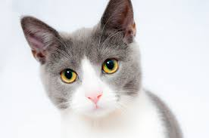
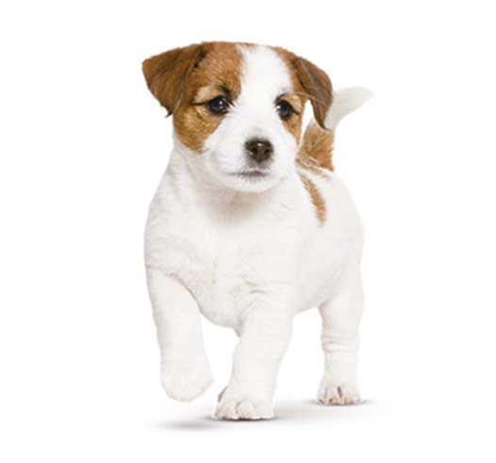
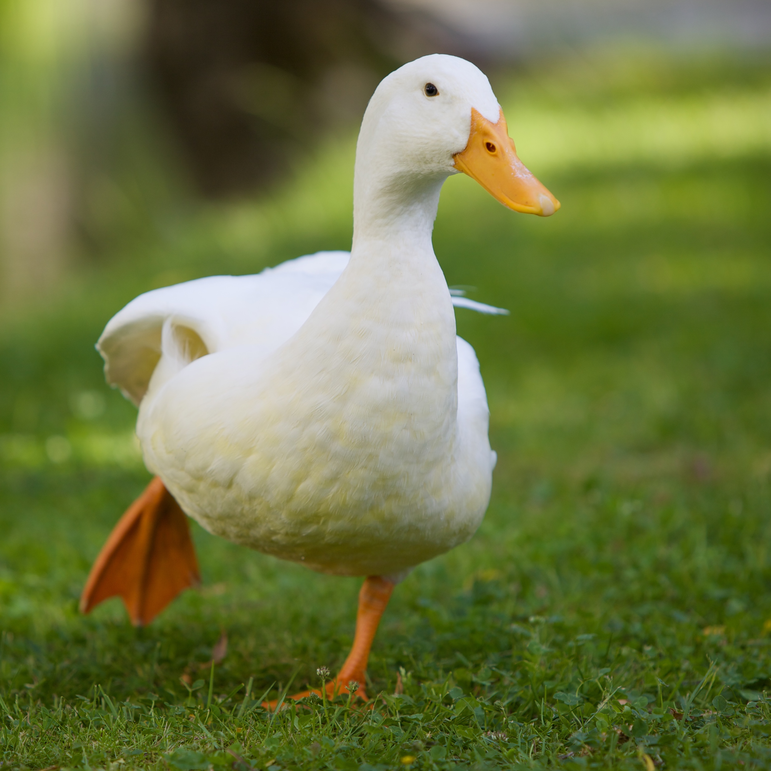

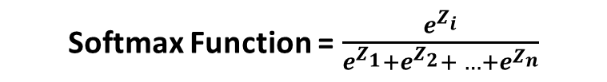
Predictions & Activation Functions
Binary Classification
Multi-Class Classification
Sigmoid Function Y =$\frac{1}{(1+ e^{−x})}$
Softmax Function = $\frac{e^{Z_{i}}}{e^{Z_{1}}+e^{Z_{2}}+ …+e^{Z_{n}}}$
One-Hot Encoding
Animal | Value
 | 1
 | 0
Animal | Dog | Cat | Duck
 | 1 | 0 | 0
 | 0 | 1 | 0
 | 0 | 0 | 1

Slide 18
Maximum Likelihood
Which model is better?

Slide 19
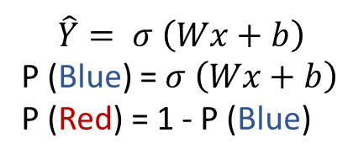
Maximum Likelihood
P(Blue)=0.2
P(Red)=0.8
P(Blue)=0.6
P(Red)=0.4
P(Blue)=0.3
P(Red)=0.7
P(Blue)=0.9
P(Red)=0.1
$$\hat{Y}= σ \left(Wx+b\right)$$
P (Blue) = $σ \left(Wx+b\right)$
P (Red) = 1 - P (Blue)

Slide 20
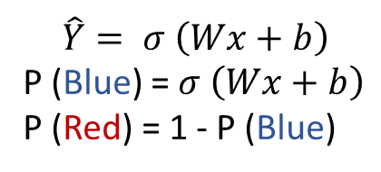
Maximum Likelihood
P(Blue)=0.2
P(Blue)=0.2
P(Blue)=0.6
P(Blue)=0.6
x
P(Red)=0.7
P(Red)=0.7
P(Red)=0.1
P(Red)=0.1
P(all)=0.0084
$$\hat{Y}= σ \left(Wx+b\right)$$
P (Blue) = $σ \left(Wx+b\right)$
P (Red) = 1 - P (Blue)

Slide 21
Maximum Likelihood
Goal: Maximize the Probability
P(Blue)=0.2
P(Blue)=0.7
P(Blue)=0.6
P(Blue)=0.9
P(Red)=0.7
P(Red)=0.8
P(Red)=0.1
P(Red)=0.6
0.6 x 0.2 x 0.1 x 0.7 = 0.0084
0.7 x 0.9 x 0.8 x 0.6 = 0.3024
ln(0.6) + ln(0.2) + ln(0.1) + ln(0.7)
ln(0.7) + ln(0.9) + ln(0.8) + ln(0.6)
(-0.51) + (-1.61) + (-2.3) + (-0.36) = -4.78
(-0.36) + (-0.1) + (-0.22) + (-0.51) = -1.19
- ln(0.6) - ln(0.2) - ln(0.1) - ln(0.7)
- ln(0.2) - ln(0.6) - ln(0.7) - ln(0.1)
0.51 + 1.61 x+ 2.3 + 0.36 = 4.78
0.36 + 0.1 x+ 0.22 + 0.51 = 1.19
Cross Entropy

Slide 22
Maximum Likelihood
Goal: Maximize the Probability by minimize the cross entropy
1.61
0.36
0.51
0.1
0.36
0.22
2.3
0.51
0.6 x 0.2 x 0.1 x 0.7 = 0.0084
0.7 x 0.9 x 0.8 x 0.6 = 0.3024
ln(0.6) + ln(0.2) + ln(0.1) + ln(0.7)
ln(0.7) + ln(0.9) + ln(0.8) + ln(0.6)
(-0.51) + (-1.61) + (-2.3) + (-0.36) = -4.78
(-0.36) + (-0.1) + (-0.22) + (-0.51) = -1.19
- ln(0.6) - ln(0.2) - ln(0.1) - ln(0.7)
- ln(0.2) - ln(0.6) - ln(0.7) - ln(0.1)
0.51 + 1.61 x+ 2.3 + 0.36 = 4.78
0.36 + 0.1 x+ 0.22 + 0.51 = 1.19

Slide 23
Gradient Decent
What are we optimizing?

Slide 24
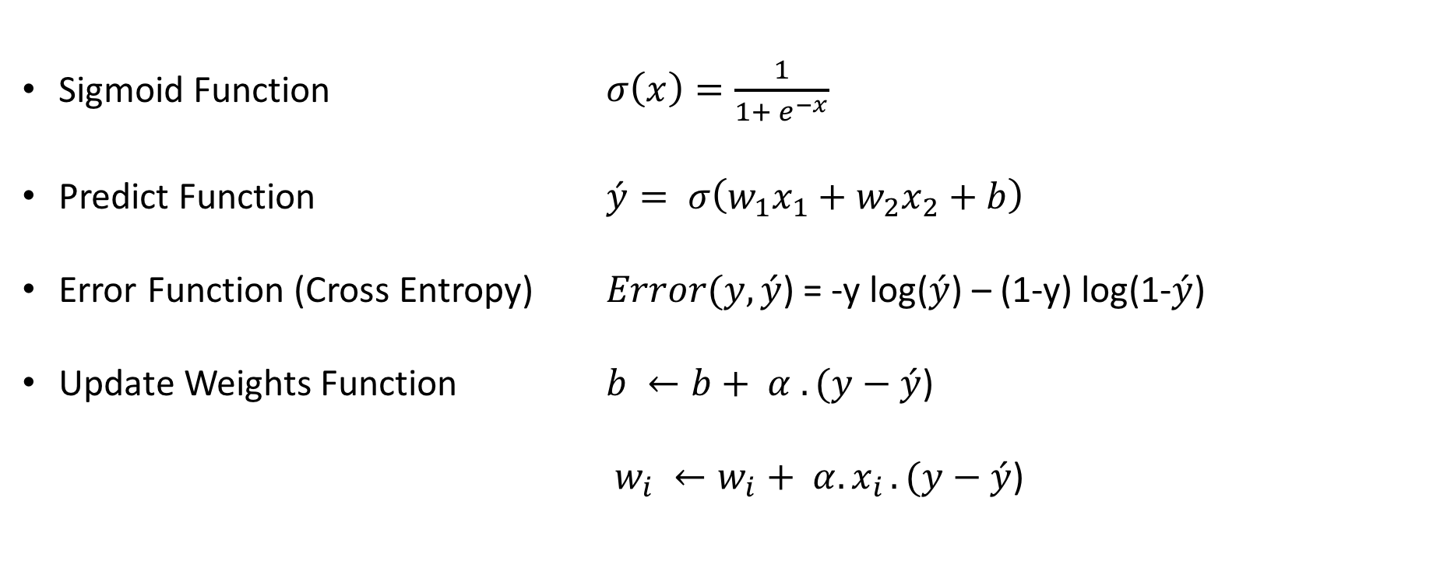
Gradient Descent – Basic Functions
Sigmoid Function $σ\left(x\right)=\frac{1}{1+ e^{−x}}$
Predict Function $\acute{y}= σ\left(w_{1}x_{1}+w_{2}x_{2}+b\right)$
Error Function (Cross Entropy) $Error(y,\acute{y}$) = -y log($\acute{y}$) – (1-y) log(1-$\acute{y}$)
Update Weights Function $b ←b+ α . (y−\acute{y}$)
$w_{i} ←w_{i}+ α{. x}_{i}.(y−\acute{y}\text{)}$

Slide 25
Run Code
gradient_descent.py
How gradient descent different from perceptron?

Slide 26
Run Code
perceptron_keras_scikit_learn.py
How can we evaluate the model with cross validation?

Slide 27
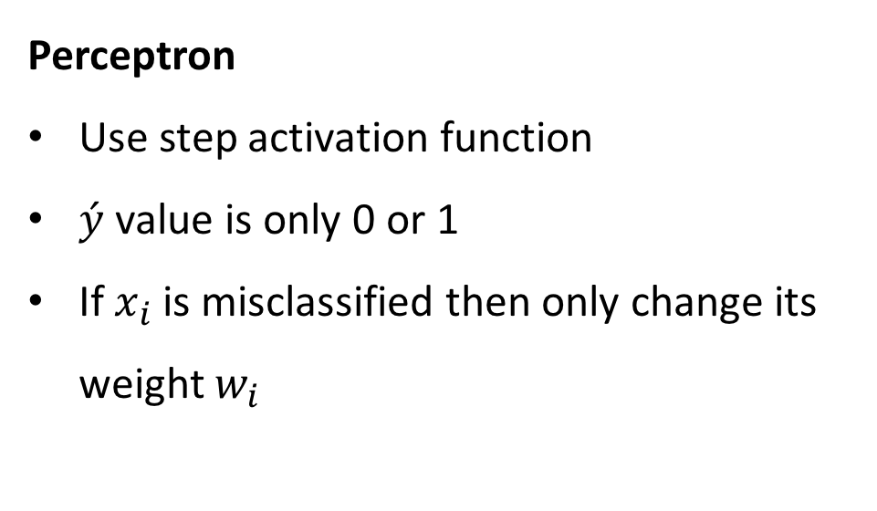
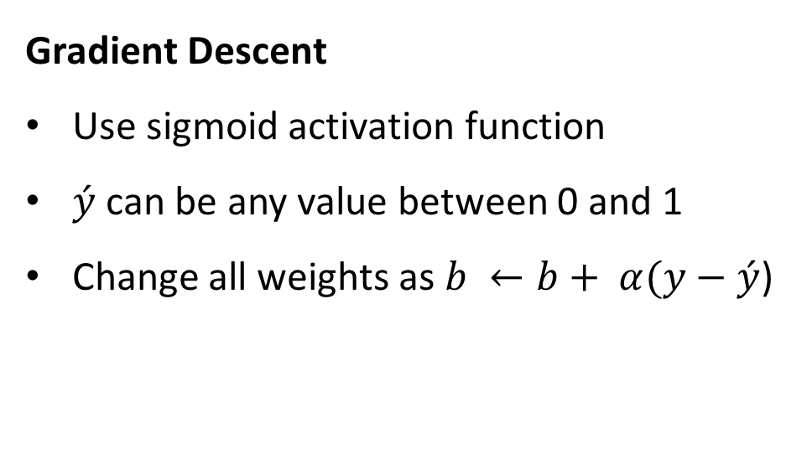
Perceptron vs Gradient Descent
Perceptron
Use step activation function
$\acute{y}$ value is only 0 or 1
If $x_{i}$ is misclassified then only change its weight $w_{i}$
Gradient Descent
Use sigmoid activation function
$\acute{y}$ can be any value between 0 and 1
Change all weights as $b ←b+ α(y−\acute{y}$)
come closer!
Go farther away!
come closer!
Incorrectly classified
Correctly classified

Slide 28
Two Layers of Perceptron

Slide 29
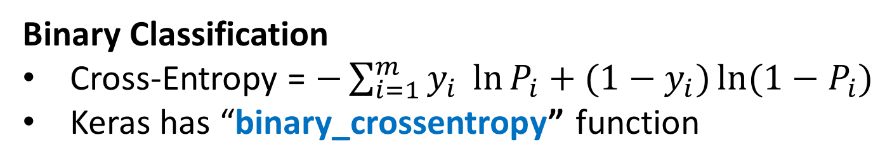
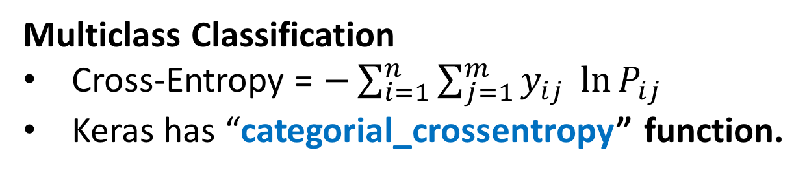
Cross Entropy
Binary Classification
Cross-Entropy = $−\sum_{i=1}^{m}{y_{i} \ln{P_{i}+(1−y_{i})\ln{(1−P_{i})}}}$
Keras has “binary_crossentropy” function
Multiclass Classification
Cross-Entropy = $−\sum_{i=1}^{n}{\sum_{j=1}^{m}{y_{ij} \ln{P_{ij}}}}$
Keras has “categorial_crossentropy” function.

Slide 30
Run Code
gradient_descent_2.py
What is the data type of X_train?
What does Flatten do?
What does activation=“softmax” do?
Why use a loss function=“category_crossentropy” at all?
What does optimizer=“adam” do?
How can we get model performance (metrics)?
How can we save best model (ModelCheckPoint)?

Slide 31
Run Code
model_saving.py
How to save a model as json file?
How to save a model as yaml file?

Slide 32
Run Code
gradient_descent_predict.py
How can we make inference on unseen data?

Slide 33
Multi Layers Networks

Slide 34
Activation Functions
Tanh
Sigmoid
ReLU
Leaky ReLU
Linear

Slide 35
Loss Functions
Binary Cross Entropy
Categorical Cross Entropy
Sparse Categorical Cross Entropy
Mean Squared Error – MSE
Mean Absolute Error – MAE
Mean Absolute Percentage Error – MAPE
Mean Squared Logarithmic Error – MSLE

Slide 36
Optimization Functions
SGD – Stochastic Gradient Descent optimizer
Learning rate
Momentum
Decay
Nesterov momentum
RMSProp
Adagrad
Adadelta
Adam
Adamax
Nadam
TFOptimize

Slide 37
Metrics
Accuracy
MAE – Mean Absolute Error

Slide 38
Run Code
gradient_descent_multilayers.py
How did this change run-time and accuracy?
Why do we use activation=“relu” in one layer?
How could we make a deeper model?

Slide 39
Dropout

Slide 40
Run Code
gradient_descent_dropout.py
How does this change training accuracy and validation accuracy?
When would we consider using dropout

Slide 41
Convolutional Neural Net CNN

Slide 42
Convolution

Slide 43
Convolutions

Slide 44
Run Code
convolution-demo.py
What happens if all the numbers are zeros?
What happens if the numbers are large?
What convolution would leave the image unaffected?

Slide 45
Convolutions
Horizontal edge
Vertical edge

Slide 46
Convolutions
https://ujwlkarn.files.wordpress.com/2016/08/giphy.gif?w=748

Slide 47
Activation Function
ReLU Activation

Slide 48
Max Pooling

Slide 49
Run Code
maxpool_demo.py
What is happening here?

Slide 50
Max Pooling
5 x 5
3 x 3

Slide 51
Max Pooling

Slide 52
CNN Architecture

Slide 53
Run Code
cnn.py
What is happening here?
Why am I reshaping the input data?
How could I add more convolutional and pooling layers?

Slide 54
LeNet Architecture 1994

Slide 55
CNN

Slide 56
Run Code
LeNet.py

Slide 58
Takeaways
What is the difference between MLPs and CNNs?
When might one or the other be more useful?

Slide 59
VGG Architecture 2014

Slide 60
Run Code
vgg_inspect.py
How many parameters does this model have?
Why doesn’t it overfit the training data?

Slide 61
Run Code
resnet50_inspect.py

Slide 62
Run Code
inception_inspect.py

Slide 63
Overview of Neural Networks

Slide 64
Project- Dog Breed Classification
Given an image of a dog, the algorithm will identify an estimate of the canine’s breed. If supplied an image of a human, the code will identify the resembling dog breed.

Slide 65
Project- Dog Breed Classification
Step 0: Import Datasets
Step 1: Detect Humans
Step 2: Detect Dogs
Step 3: Create a CNN to Classify Dog Breeds (from Scratch)
Step 4: Use a CNN to Classify Dog Breeds (using Transfer Learning)
Step 5: Create a CNN to Classify Dog Breeds (using Transfer Learning)
Step 6: Write your Algorithm
Step 7: Test Your Algorithm

Slide 66
Project- Dog Breed Classification
Git clone https://github.com/humayun/udacity_nanodegree/tree/master/p2_dog_project
https://github.com/humayun/udacity_nanodegree/blob/master/p2_dog_project/dog_app.ipynb

