Slide 1
Intro to AI, Machine learning and Deep Learning (using scikit-learn, tensorflow and keras)
Humayun Irshad and Qazaleh Mirsharif

Slide 2
What we want to achieve
Prepare and install required software on EC2 for machine learning
Learn most important concepts of Machine Learning and Deep Learning
Preparation of Dataset and splitting into training, validation and test set
Develop a line fitting (Regression) method in Tensorflow+Keras on EC2 Machine
Develop Logistic Classifier in Tensorflow+Keras to classify MNIST Dataset
Develop Multi-layer Perceptron in Tensorflow+Keras to classify MNIST Dataset
Use VGG and Inception deep models to classify MNIST Dataset
Fine tuning pre-trained deep models on custom dataset and play with different hyper parameters of deep models

Slide 3
Agenda
Setup AWS EC2 machine - 30 minutes
Review of machine learning methods (Regression, classification, clustering and etc) - 30 minutes
Application of machine learning for digit recognition - intro to MNIST - 30 minutes
Build and evaluate machine learning models for digit classification
Single perceptron and multi layer perceptron
Neural network and backpropagation
Deep learning Architecture
Build, train and evaluate a fully connected deep learning model
Transfer learning and fine tuning famous available deep learning models for classification

Slide 4
Prerequisites: what we need before we start!
Slides available at:
Create AWS account
Setup EC2 linux instance
Connect to your instance
Download the materials: git clone ....
Install the libraries: pillow, pandas, opencv-python, scikit-learn, tensorflow, keras
conda install pillow
conda install pandas
pip install opencv-python
conda install scikit-image
conda install scikit-learn
conda install h5py
conda install tensorflow
conda install keras
Notes:
This includes elite replacement and numerous other enhancements that are being considered

Slide 5
Introduction
Notes:
Michael

Slide 6
Instructors
Humayun Irshad
Lead Scientist
Machine Learning & Computer Vision
CrowdFlower
Postdoc, Harvard University
Qazaleh Mirsharif
Machine Learning Scientist, CrowdFlower
PhD, University of Houston

Slide 7
What do we mean by “machine learning”?
Notes:
Michael

Slide 8
Machine learning is often referred to an application of AI that provides machines, the ability to automatically learn from data and make decision!
The primary goal is to give machines access to data (text, images and etc) and let them learn the patterns in the examples we provide and make future decisions with minimal human intervention while be able to improve through experience
Notes:
This includes elite replacement and numerous other enhancements that are being considered

Slide 9
ML Algorithms
Supervised learning
Unsupervised learning
Reinforcement learning
Some use another category called “semi-supervised learning” which falls in between supervised and unsupervised categories

Slide 10
Supervised learning
Consists of a target/ outcome variables
Maps input to desired outputs
Training continues until a desired level of accuracy is achieved
Examples: SVM, Regression, Random forest

Slide 11
Supervised learning
Regression: How much/many?
Predict a quantity
Forecasting prices of houses, rash driving and number of accident
Classification: What category?
Predict a label
Is this a dog or cat?
Starts with datasets that contains training examples with associated correct labels!

Slide 12
What does regression do?
Approximate a mapping F (line or curve) from input X to a continuous value Y
Linear regression : aX + b =Y

Slide 13
Classification
Handwritten digit recognition: Depositing a check by taking picture through your phone!
Teach machine to map images to numbers!
Give it the training examples : images of numbers
Give it the labels (supervised learning)
Pick your Machine learning algorithm : Extract pattern and learn the mappings!

Slide 15
What are the patterns?
Similar features in each category coded as numbers
Feature #1 : height to width ratio
Feature #2 : Pixels confined in the number
Feature #1
Feature #2

Slide 16
Example: Parking sign detection (Q)
Training data
Train Classifier
Hog features
Sliding window object detector
Proprietary and Confidential - Do Not Distribute

Slide 17
ML Algorithms
Supervised learning
Unsupervised learning
Reinforcement learning

Slide 18
Unsupervised learning
There is no target to be predicted
Used for clustering population or data points into groups : within similarity/between similarity is maximum
Examples: K-Means clustering, EM clustering

Slide 19
Unsupervised learning
Is this weird? Anomaly detection
Does this credit card transaction appear fraudulent?
Is this sensor reading unusually high?

Slide 20
Reinforcement learning
Machine is exposed to an environment where it continuously learns the best action and decision using trial and error
What is the best action?
Should I stop or speed up at this yellow light?
Do I continue vacuuming or do I return to my charging station?

Slide 21
Time to practice!
What is the difference between regression and classification?
What is the difference between supervised and unsupervised clustering?
How do we measure performance in regression?
How do we measure performance in classification?

Slide 22
Load-mnist.py
Python load_mnist.py
What is the image size?
How many images?

Slide 23
Splitting Data
Data is split into two parts:
Training data : 80%
Test data: 20%
It is essential to separate the data we don’t learn from to make sure what we’ve learned generalizes!
Test Data
Data
Training data
Build Model

Slide 24
classifire_svm.py
Python classifire_svm.py
Let’s split data! Train = 50% and test = 50%
Let’s change the value of C to C=1
Let’s use more data for training!

Slide 25
regression.py
Type:
python regression.py
What we learn:
There is no label!
Output is continuous values!
Performance is measured using error functions!

Slide 26
Logistic regression
Regression_digits.py
Let’s use regression for classification!

Slide 27
Model Evaluation
Type:
Python shuffle.py

Slide 28
Model evaluation
Type:
Python shuffle_and_split.py
Let’s shuffle data and split it for model evaluation!
Data for building model :
Training data: 70%
Evaluation data 30%
Never use the same data for training the model and evaluating it!

Slide 29
Cross_validation
Python cross_validation.py

Slide 30
Feature_extraction.py
Python feature_extraction

Slide 31
Load_twits.py
Python load_twits.py
How many twits?
How many categories?
How many columns?

Slide 32
Perceptron

Slide 33
Linear Boundary / Classification
20
18
16
14
12
10
8
6
4
2
BOUNDARY: A LINE (WX + B)
2X₁ + X₂ -18 = 0
X₁ = Test
X₂ = Grade
2*Test + Grade – 18 = Score
PREDICTION:
Score >= 0 Accept
Score < 0 Reject
GRADES
2 4 6 8 10
TEST
Example: What is prediction of a student who got 4 on the test and 8 on the grades?
Answer: 2 x 4 + 8 – 18 = 16 - 18 = -2

Slide 34
Perceptron
Test = 4
2
Accepted or Rejected
Grades = 8
1
18
Bias

Slide 35
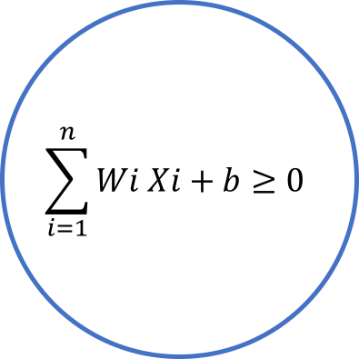
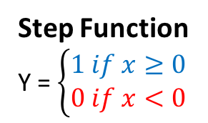
Perceptron
Step Function
Y = $\left\{\begin{matrix}1 if x≥0 \\ 0 if x<0\end{matrix}\right.$
y
x
X₁
W₁
$$\sum_{i=1}^{n}{Wi Xi+b≥0}$$
X₂
W₂
y
Accepted
or
Rejected
W₃
x
X₃
.
.
W_{n}
X_{n}
b
Bias

Slide 36
How to select the weights and bias – called TRAINING the Perceptron
3X₁ + 4X₂ – 10 = 0
Misclassified Point: (8,3)
3 4 -10
8 3 1
-5 1 -11
x₂
Positive Area
-
3X₁ + 4X₂ – 10 = 0
3X₁ + 4X₂ – 10 = 0
Misclassified Point: (8,3)
Learning Rate = 0.1
3 4 -10
8x0.1 3x0.1 1x0.1
2.2 3.7 -10.1
New Line: 2.2X₁ + 3.7X₂ – 10.1 = 0
Negative Area
x₁
-

Slide 37
How to select the weights and bias – called TRAINING the Perceptron
3X₁ + 4X₂ – 10 = 0
Misclassified Point: (8,3)
3 4 -10
8 3 1
-5 1 -11
x₂
Positive Area
-
2.2X₁ + 3.7X₂ – 10.1 = 0
3X₁ + 4X₂ – 10 = 0
Misclassified Point: (8,3)
Learning Rate = 0.1
3 4 -10
8x0.1 3x0.1 1x0.1
2.2 3.7 -10.1
New Line: 2.2X₁ + 3.7X₂ – 10.1 = 0
Negative Area
x₁
-

Slide 38
How to select the weights and bias – called TRAINING the Perceptron
2.2X₁ + 3.7X₂ – 10.1 = 0
Misclassified Point: (2,6)
Learning Rate = 0.1
2.2 3.7 -10.1
2x0.1 6x0.1 1x0.1
2.4 4.3 -10
New Line:
2.4X₁ + 4.3X₂ – 10 = 0
x₂
Positive Area
+
2.2X₁ + 3.7X₂ – 10.1 = 0
Negative Area
x₁

Slide 39
How to select the weights and bias – called TRAINING the Perceptron
2.2X₁ + 3.7X₂ – 10.1 = 0
Misclassified Point: (2,6)
Learning Rate = 0.1
2.2 3.7 -10.1
2x0.1 6x0.1 1x0.1
2.4 4.3 -10
New Line:
2.4X₁ + 4.3X₂ – 10 = 0
x₂
Positive Area
+
2.4X₁ + 4.3X₂ – 10 = 0
Negative Area
x₁

Slide 40
Pseudocode for Training – Adjusting the Weights & Bias
Positive Area
Start with random weights: (W₁, … , W_{n}, b)
For every misclassified point (X₁, … ,X_{n}):
If Prediction = 0
For I = 1 … n
W_{i} = W_{i}+ α X_{i}
b = b + α
If Prediction = 1
For I = 1 … n
W_{i} = W_{i} - α X_{i}
b = b - α
x₂
2.4X₁ + 4.3X₂ – 10 = 0
Negative Area
x₁

Slide 41

Perceptron – Basic Functions
Step Function Y’ $=\left\{\begin{matrix}1 if x≥0 \\ 0 if x<0\end{matrix}\right.$
Predict Function $\acute{y}$ $= σ\left(w_{1}x_{1}+w_{2}x_{2}+b\right)$
Error Function $Error$ $=y−\acute{y}$
Update Weights Function $b ←b+ α . x. Error$
$w_{i} ←w_{i}+ α{. x}_{i}. Error$

Slide 42
Run Code
perceptron_1.py
How can we initialize weights and bias?
How learning rate effects on model training?

Slide 43
Run Code
perceptron_2.py
What is epoch?
What does epochs=100 do?
Is our model better when we have high epoch?

Slide 44
Error Function & Log-Loss Function
x₂
Positive Area
Error = + + + + +
Negative Area
x₁
What happened if error function is discrete?
Error function should be continues and differentiable

Slide 45
Error Function & Log-Loss Function
x₂
Positive Area
Error = + + + + +
Negative Area
x₁
Negative Area
x₁

Slide 46
Predictions
Yes
85% likely
x₂
x₂
70% likely
Yes
No
1
0.85
60% likely
1
0.7
0
Yes
0.6
40% likely
No
No
30% likely
1
0.4
0
0.3
20% likely
0
0.2
x₁
x₁
Discrete
Continuous

Slide 47
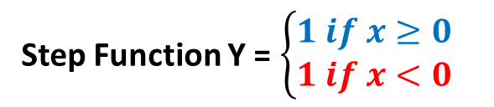

Predictions & Activation Functions
Yes
85% likely
x₂
x₂
70% likely
Yes
No
1
0.85
60% likely
1
0.7
0
Yes
0.6
40% likely
No
No
30% likely
1
0.4
0
0.3
20% likely
0
0.2
x₁
x₁
Discrete
Continuous
Step Function Y = $\left\{\begin{matrix}1 if x≥0 \\ 1 if x<0\end{matrix}\right.$
Sigmoid Function Y =$\frac{1}{(1+ e^{−x})}$
y
y
1
1
0.5
x
0
x

Slide 48

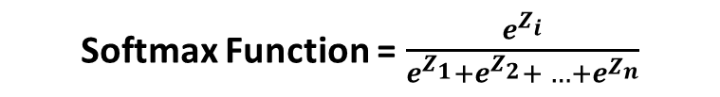
Predictions & Activation Functions
Binary Classification
Multi-Class Classification
Sigmoid Function Y =$\frac{1}{(1+ e^{−x})}$
Softmax Function = $\frac{e^{Z_{i}}}{e^{Z_{1}}+e^{Z_{2}}+ …+e^{Z_{n}}}$
One-Hot Encoding
Animal | Value
 | 1
 | 0
Animal | Dog | Cat | Duck
 | 1 | 0 | 0
 | 0 | 1 | 0
 | 0 | 0 | 1

Slide 49
Maximum Likelihood
Which model is better?

Slide 50
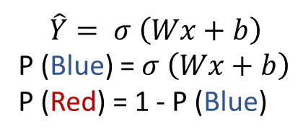
Maximum Likelihood
P(Blue)=0.2
P(Red)=0.8
P(Blue)=0.6
P(Red)=0.4
P(Blue)=0.3
P(Red)=0.7
P(Blue)=0.9
P(Red)=0.1
$$\hat{Y}= σ \left(Wx+b\right)$$
P (Blue) = $σ \left(Wx+b\right)$
P (Red) = 1 - P (Blue)

Slide 51
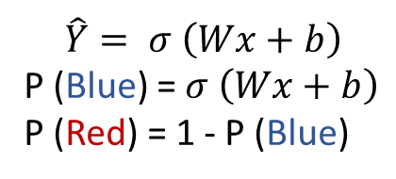
Maximum Likelihood
P(Blue)=0.2
P(Blue)=0.2
P(Blue)=0.6
P(Blue)=0.6
x
P(Red)=0.7
P(Red)=0.7
P(Red)=0.1
P(Red)=0.1
P(all)=0.0084
$$\hat{Y}= σ \left(Wx+b\right)$$
P (Blue) = $σ \left(Wx+b\right)$
P (Red) = 1 - P (Blue)

Slide 52
Maximum Likelihood
Goal: Maximize the Probability
P(Blue)=0.2
P(Blue)=0.7
P(Blue)=0.6
P(Blue)=0.9
P(Red)=0.7
P(Red)=0.8
P(Red)=0.1
P(Red)=0.6
0.6 x 0.2 x 0.1 x 0.7 = 0.0084
0.7 x 0.9 x 0.8 x 0.6 = 0.3024
ln(0.6) + ln(0.2) + ln(0.1) + ln(0.7)
ln(0.7) + ln(0.9) + ln(0.8) + ln(0.6)
(-0.51) + (-1.61) + (-2.3) + (-0.36) = -4.78
(-0.36) + (-0.1) + (-0.22) + (-0.51) = -1.19
- ln(0.6) - ln(0.2) - ln(0.1) - ln(0.7)
- ln(0.2) - ln(0.6) - ln(0.7) - ln(0.1)
0.51 + 1.61 x+ 2.3 + 0.36 = 4.78
0.36 + 0.1 x+ 0.22 + 0.51 = 1.19
Cross Entropy

Slide 53
Maximum Likelihood
Goal: Maximize the Probability by minimize the cross entropy
1.61
0.36
0.51
0.1
0.36
0.22
2.3
0.51
0.6 x 0.2 x 0.1 x 0.7 = 0.0084
0.7 x 0.9 x 0.8 x 0.6 = 0.3024
ln(0.6) + ln(0.2) + ln(0.1) + ln(0.7)
ln(0.7) + ln(0.9) + ln(0.8) + ln(0.6)
(-0.51) + (-1.61) + (-2.3) + (-0.36) = -4.78
(-0.36) + (-0.1) + (-0.22) + (-0.51) = -1.19
- ln(0.6) - ln(0.2) - ln(0.1) - ln(0.7)
- ln(0.2) - ln(0.6) - ln(0.7) - ln(0.1)
0.51 + 1.61 x+ 2.3 + 0.36 = 4.78
0.36 + 0.1 x+ 0.22 + 0.51 = 1.19

Slide 54
Gradient Decent
What are we optimizing?

Slide 55
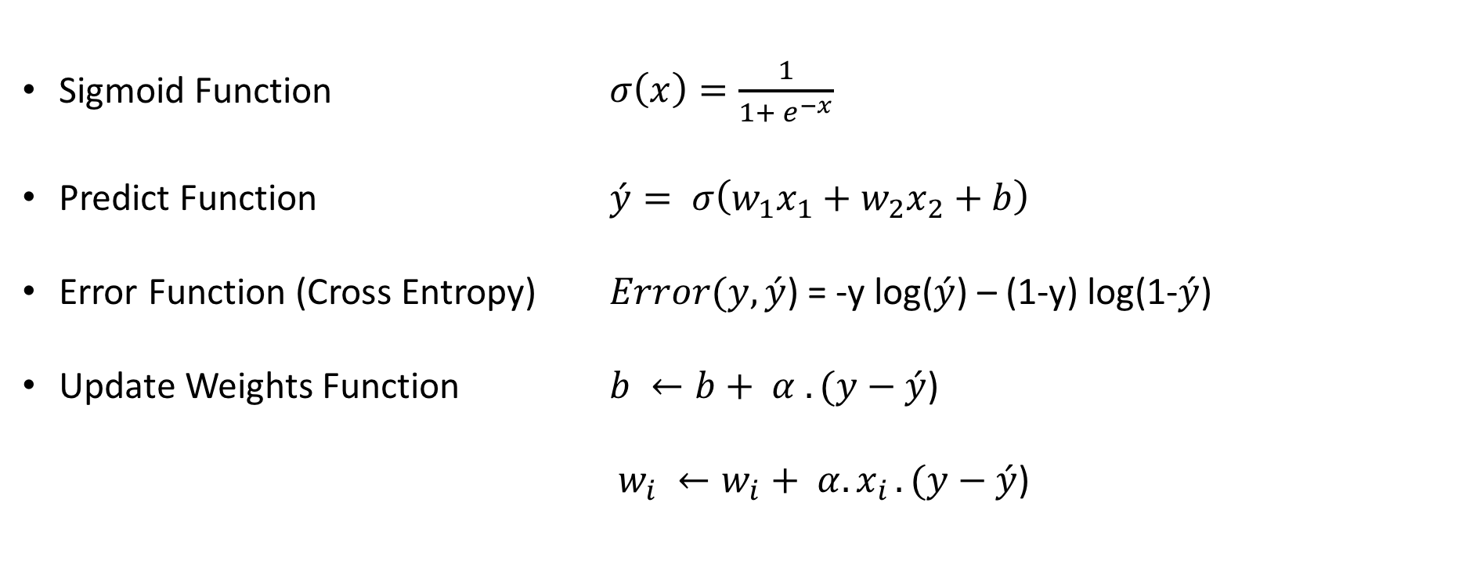
Gradient Descent – Basic Functions
Sigmoid Function $σ\left(x\right)=\frac{1}{1+ e^{−x}}$
Predict Function $\acute{y}= σ\left(w_{1}x_{1}+w_{2}x_{2}+b\right)$
Error Function (Cross Entropy) $Error(y,\acute{y}$) = -y log($\acute{y}$) – (1-y) log(1-$\acute{y}$)
Update Weights Function $b ←b+ α . (y−\acute{y}$)
$w_{i} ←w_{i}+ α{. x}_{i}.(y−\acute{y}\text{)}$

Slide 56
Run Code
gradient_descent.py
How gradient descent different from perceptron?

Slide 57
Run Code
perceptron_keras_scikit_learn.py
How can we evaluate the model with cross validation?

Slide 58
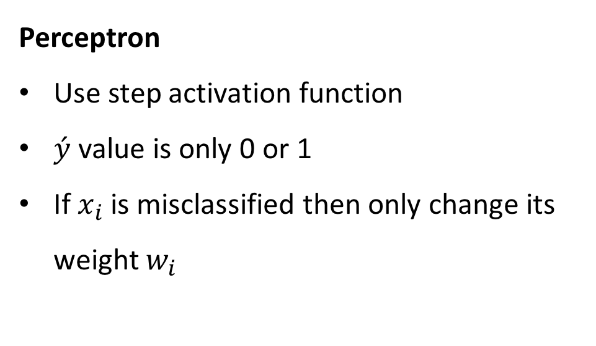
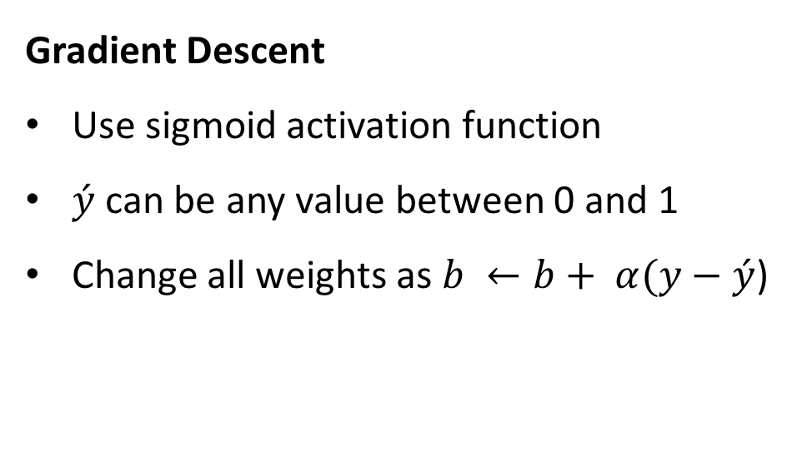
Perceptron vs Gradient Descent
Perceptron
Use step activation function
$\acute{y}$ value is only 0 or 1
If $x_{i}$ is misclassified then only change its weight $w_{i}$
Gradient Descent
Use sigmoid activation function
$\acute{y}$ can be any value between 0 and 1
Change all weights as $b ←b+ α(y−\acute{y}$)
come closer!
Go farther away!
come closer!
Incorrectly classified
Correctly classified

Slide 59
Two Layers of Perceptron

Slide 60
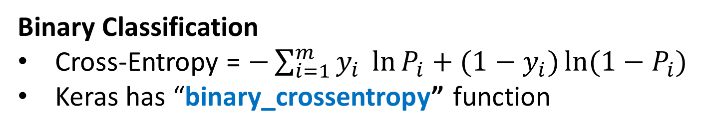
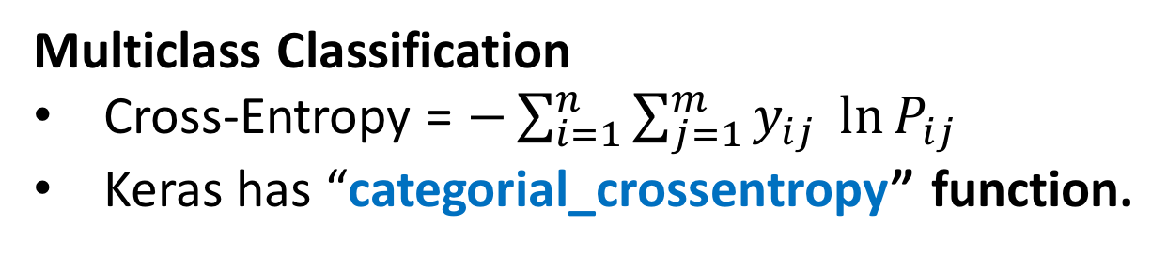
Cross Entropy
Binary Classification
Cross-Entropy = $−\sum_{i=1}^{m}{y_{i} \ln{P_{i}+(1−y_{i})\ln{(1−P_{i})}}}$
Keras has “binary_crossentropy” function
Multiclass Classification
Cross-Entropy = $−\sum_{i=1}^{n}{\sum_{j=1}^{m}{y_{ij} \ln{P_{ij}}}}$
Keras has “categorial_crossentropy” function.

Slide 61
Run Code
gradient_descent_2.py
What is the data type of X_train?
What does Flatten do?
What does activation=“softmax” do?
Why use a loss function=“category_crossentropy” at all?
What does optimizer=“adam” do?
How can we get model performance (metrics)?
How can we save best model (ModelCheckPoint)?

Slide 62
Run Code
gradient_descent_load.py
How can we load saved model?

Slide 63
Run Code
model_saving.py
How to save a model as json file?
How to save a model as yaml file?

Slide 64
Run Code
gradient_descent_predict.py
How can we make inference on unseen data?

Slide 65
Multi Layers Networks

Slide 66
Activation Functions
Tanh
Sigmoid
ReLU
Leaky ReLU
Linear

Slide 67
Loss Functions
Binary Cross Entropy
Categorical Cross Entropy
Sparse Categorical Cross Entropy
Mean Squared Error – MSE
Mean Absolute Error – MAE
Mean Absolute Percentage Error – MAPE
Mean Squared Logarithmic Error – MSLE

Slide 68
Optimization Functions
SGD – Stochastic Gradient Descent optimizer
Learning rate
Momentum
Decay
Nesterov momentum
RMSProp
Adagrad
Adadelta
Adam
Adamax
Nadam
TFOptimize

Slide 69
Metrics
Accuracy
MAE – Mean Absolute Error

Slide 70
Run Code
gradient_descent_multilayers.py
How did this change run-time and accuracy?
Why do we use activation=“relu” in one layer?
How could we make a deeper model?

Slide 71
Dropout

Slide 72
Run Code
gradient_descent_dropout.py
How does this change training accuracy and validation accuracy?
When would we consider using dropout

Slide 73
Convolutional Neural Net CNN

Slide 74
Convolution

Slide 75
Convolutions

Slide 76
Run Code
convolution-demo.py
What happens if all the numbers are zeros?
What happens if the numbers are large?
What convolution would leave the image unaffected?

Slide 77
Convolutions
Horizontal edge
Vertical edge

Slide 78
Convolutions
https://ujwlkarn.files.wordpress.com/2016/08/giphy.gif?w=748

Slide 79
Activation Function
ReLU Activation

Slide 80
Max Pooling

Slide 81
Run Code
maxpool_demo.py
What is happening here?

Slide 82
Max Pooling
5 x 5
3 x 3

Slide 83
Max Pooling

Slide 84
CNN Architecture

Slide 85
Run Code
cnn.py
What is happening here?
Why am I reshaping the input data?
How could I add more convolutional and pooling layers?

Slide 86
LeNet Architecture 1994

Slide 87
CNN

Slide 88
Run Code
LeNet.py

Slide 90
Takeaways
What is the difference between MLPs and CNNs?
When might one or the other be more useful?

Slide 91
VGG Architecture 2014

Slide 92
Run Code
vgg_inspect.py
How many parameters does this model have?
Why doesn’t it overfit the training data?

Slide 93
Run Code
resnet50_inspect.py

Slide 94
Run Code
inception_inspect.py

Slide 95
Overview of Neural Networks

Slide 96
Project- Dog Breed Classification
Given an image of a dog, the algorithm will identify an estimate of the canine’s breed. If supplied an image of a human, the code will identify the resembling dog breed.

Slide 97
Project- Dog Breed Classification
Step 0: Import Datasets
Step 1: Detect Humans
Step 2: Detect Dogs
Step 3: Create a CNN to Classify Dog Breeds (from Scratch)
Step 4: Use a CNN to Classify Dog Breeds (using Transfer Learning)
Step 5: Create a CNN to Classify Dog Breeds (using Transfer Learning)
Step 6: Write your Algorithm
Step 7: Test Your Algorithm

Slide 98
Project- Dog Breed Classification
Git clone https://github.com/humayun/udacity_nanodegree/tree/master/p2_dog_project
https://github.com/humayun/udacity_nanodegree/blob/master/p2_dog_project/dog_app.ipynb

