Slide 1
Intro to AI, Machine learning and Deep Learning (using scikit-learn, tensorflow and keras)
Humayun Irshad and Qazaleh Mirsharif

Slide 2
What we want to achieve:
Preparing and installing required libraries on EC2 for machine learning
Learning main concepts of Machine Learning and Deep Learning
Data preparation and splitting into training, validation and test set
Training machine learning models and evaluation
Experimenting with machine learning models for computer vision and sentiment analysis
Developing Multi-layer Perceptron in Tensorflow+Keras to classify MNIST Dataset
Using VGG and Inception deep learning models for classification of MNIST Dataset
Fine tuning pre-trained deep models on custom dataset and experimenting with different hyper parameters of deep models

Slide 3
Agenda
Setup AWS EC2 machine - 30 minutes
Review of machine learning methods (Regression, classification, clustering and etc) - 30 minutes
Application of machine learning for digit recognition - 30 minutes
Build and evaluate machine learning models for digit classification - 30 minutes
Single perceptron and multi layer perceptron - 30 minutes
Neural network and backpropagation - 30 minutes
Deep learning Architecture - 30 minutes
Build, train and evaluate a fully connected deep learning model - 30 minutes
Transfer learning and fine tuning famous available deep learning models for classification

Slide 4
Prerequisites: what we need before we start!
Slides & codes available at: https://github.com/humayun/dl-dataday-workshop
Create AWS account
Setup EC2 linux instance
Connect to your instance
Download the materials: git clone ....
Install the libraries: pillow, pandas, opencv-python, scikit-learn, tensorflow, keras
conda install pillow
conda install pandas
pip install opencv-python
conda install scikit-image
conda install scikit-learn
conda install h5py
conda install tensorflow
conda install keras
pip install seaborn
Notes:
This includes elite replacement and numerous other enhancements that are being considered

Slide 5
Introduction
Notes:
Michael

Slide 6
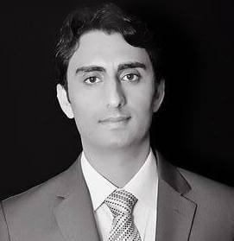

Instructors
Humayun Irshad
Lead Scientist
Machine Learning & Computer Vision
CrowdFlower
Postdoc, Harvard University
Qazaleh Mirsharif
Machine Learning Scientist, CrowdFlower
PhD, University of Houston

Slide 7
What do we mean by “machine learning”?
Notes:
Michael

Slide 8

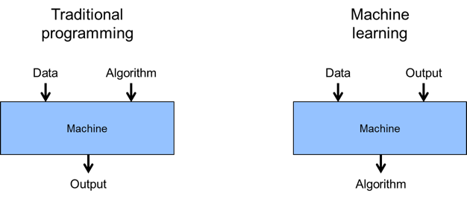
Machine learning is often referred to an application of AI that provides machines, the ability to automatically learn from data and make decision!
The primary goal is to give machines access to data (text, images and etc) and let them learn the patterns in the examples we provide and make future decisions with minimal human intervention and be able to improve through experience
Notes:
This includes elite replacement and numerous other enhancements that are being considered

Slide 9
Machine Learning
Supervised learning
Unsupervised learning
Reinforcement learning
Task driven
(Regression/Classification)
Data driven
(Clustering)
Machines learn to react to environment
Some use another category called “semi-supervised learning” which falls in between supervised and unsupervised categories

Slide 10
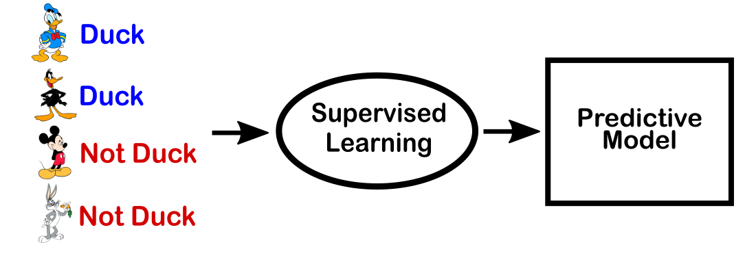
Supervised learning
Consists of a target/ outcome variables
Maps input to desired outputs
Training continues until a desired level of accuracy is achieved
Examples: SVM, Regression, Random forest

Slide 11
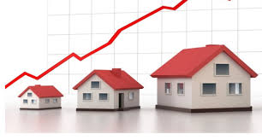
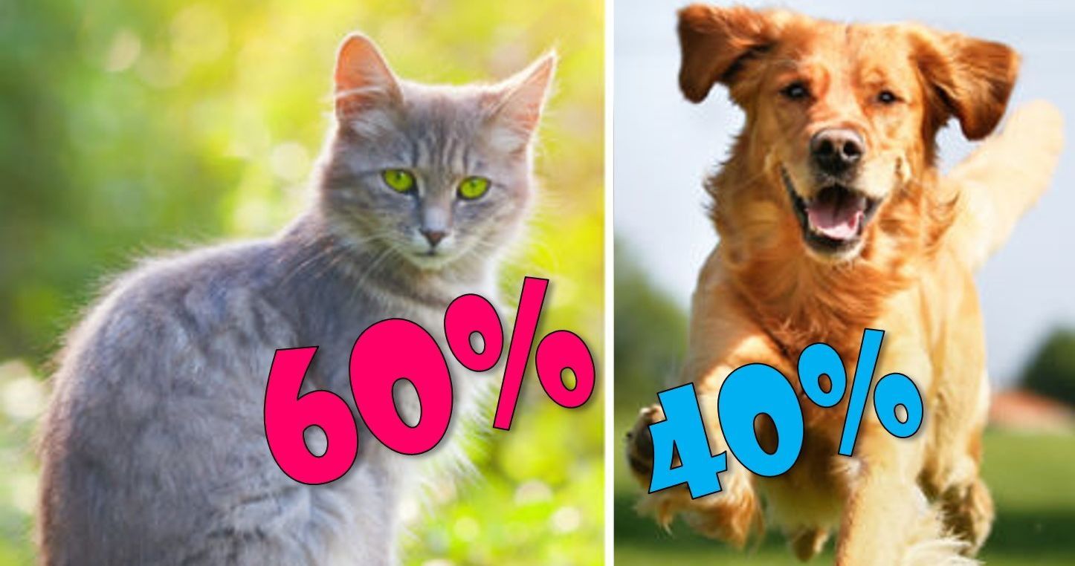
Supervised learning
Regression: How much/many?
Predict a quantity
Forecasting prices of houses, rash driving and number of accident
Classification: What category?
Predict a label
Is this a dog or cat?
Starts with datasets that contain training examples with associated correct labels!

Slide 12
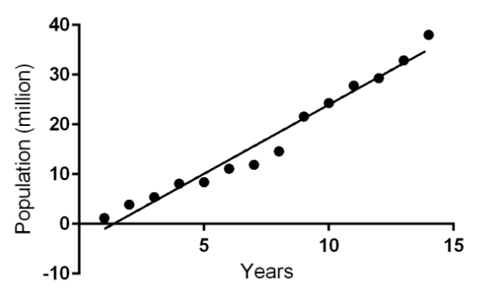
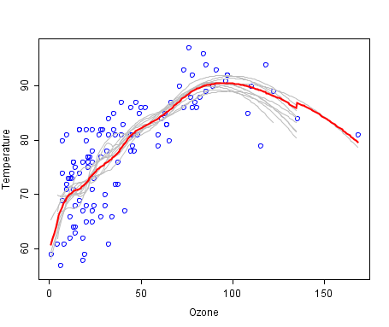
What does regression do?
Approximate a mapping function f (line or curve) from input X to a continuous value Y
Linear regression : aX + b =Y

Slide 13
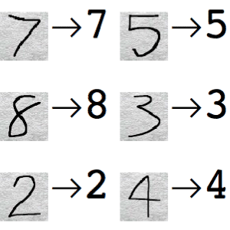
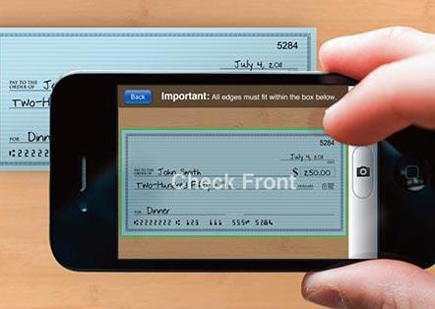
Classification
Handwritten digit recognition: Depositing a check by taking picture through your phone!
Teach machine to map images to numbers!
Give it the training examples : images of numbers
Give it the labels (supervised learning)
Pick your machine learning algorithm : Extract pattern and learn the mappings!

Slide 14
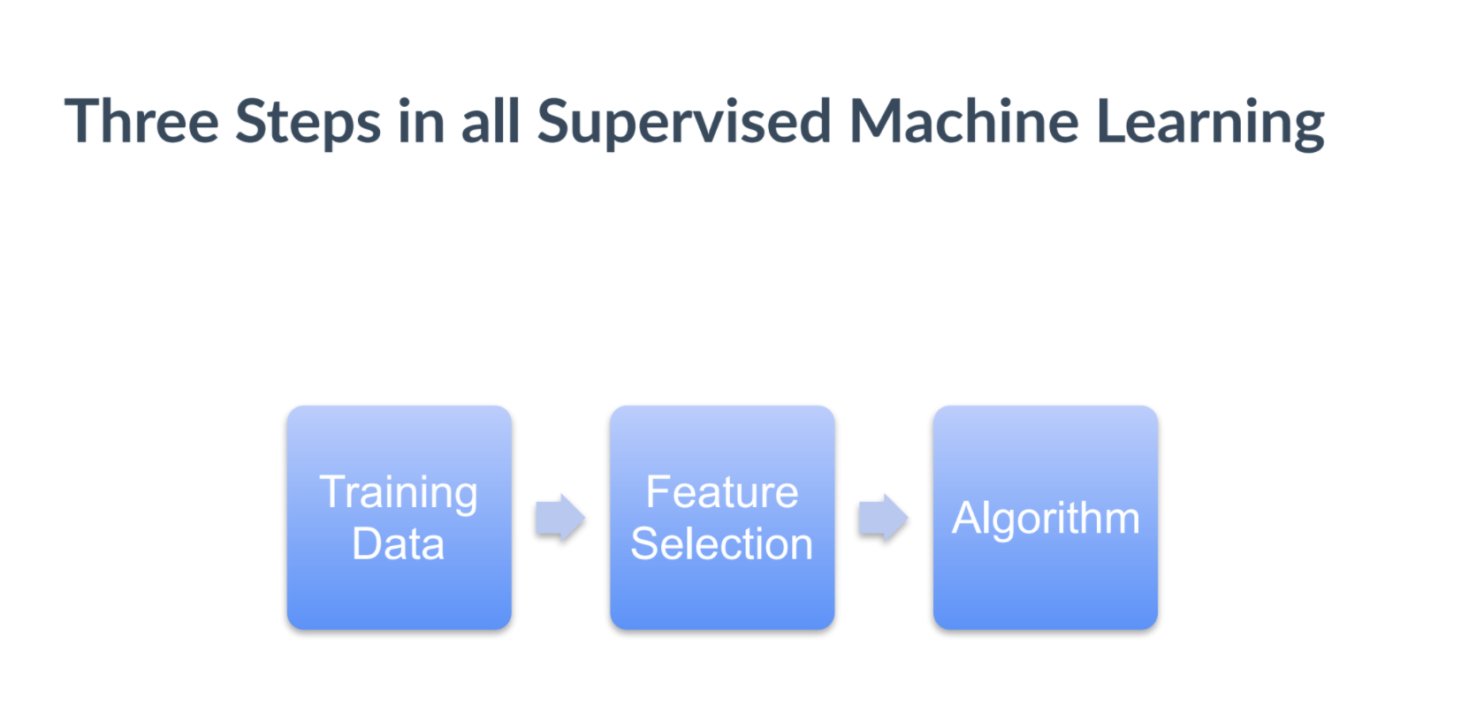

Slide 15
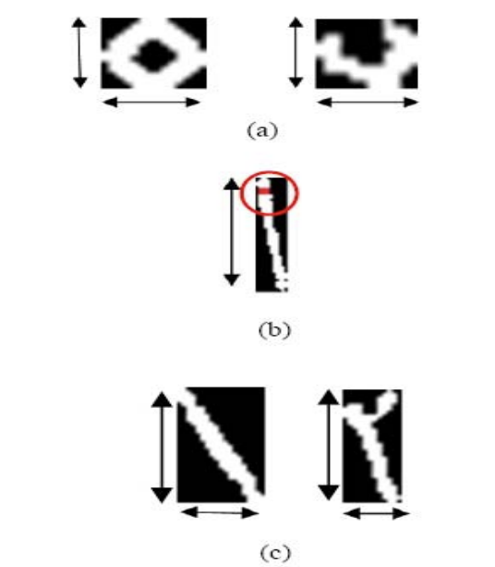
What are the patterns?
Similar features in each category coded as numbers
Feature #1 : height to width ratio
Feature #2 : Pixels confined in the number
Feature #1
Model B
Model A
Feature #2

Slide 16
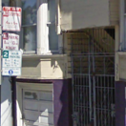
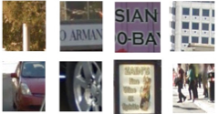

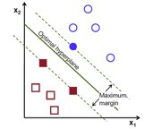
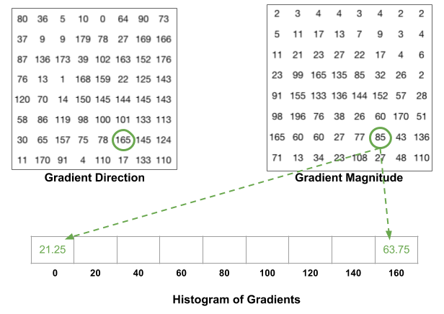
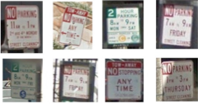
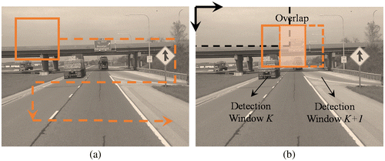
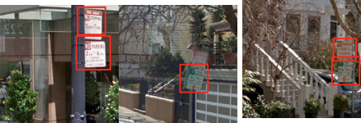
Example: Parking sign detection (Q)
Training data
Train Classifier
Hog features
Sliding window object detector
Proprietary and Confidential - Do Not Distribute

Slide 17
ML Algorithms
Supervised learning
Unsupervised learning
Reinforcement learning

Slide 18
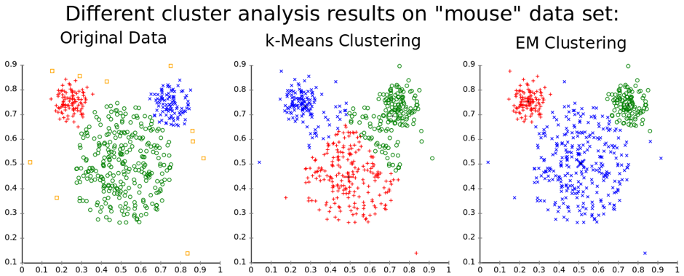
Unsupervised learning
There is no target to be predicted
Used for clustering population or data points into groups : within similarity/between similarity is maximum
Examples: K-Means clustering and EM clustering

Slide 19
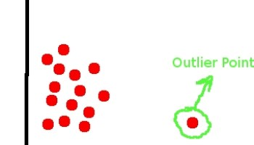
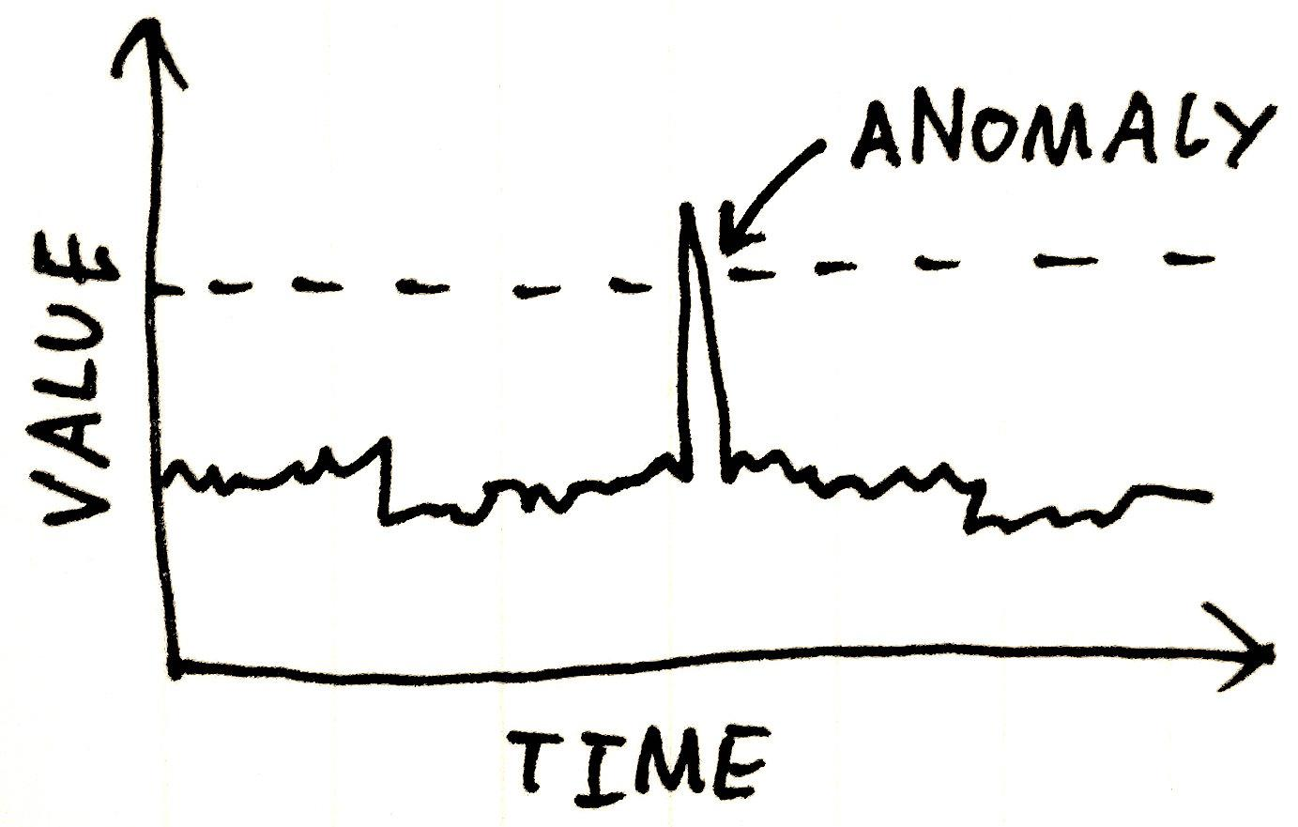
Unsupervised learning
Is this weird? Anomaly detection
Does this credit card transaction appear fraudulent?
Is this sensor reading unusually high?

Slide 20
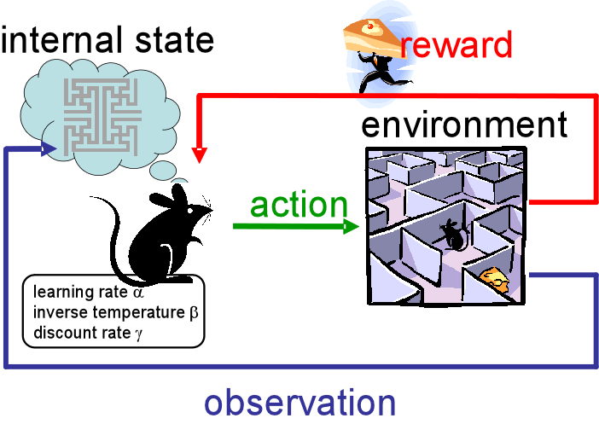
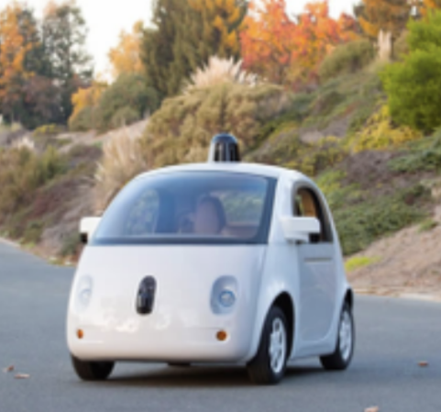
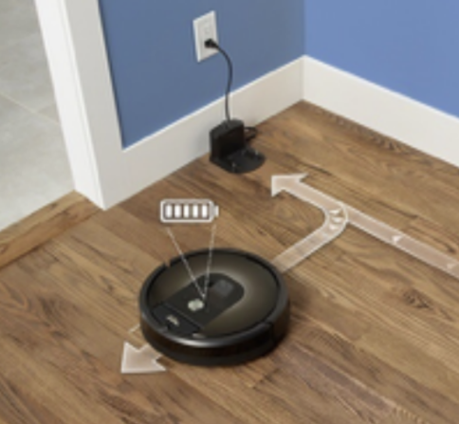
Reinforcement learning
Machine is exposed to an environment where it continuously learns the best action and decision using trial and error
What is the best action?
Should I stop or speed up at this yellow light?
Do I continue vacuuming or do I return to my charging station?

Slide 21
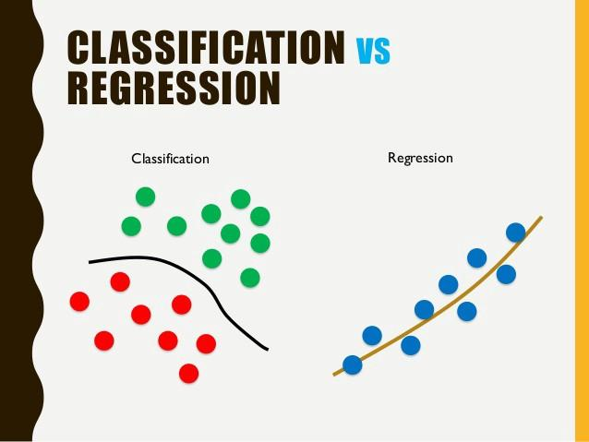
Time to practice!
What is the difference between regression and classification?

Slide 22
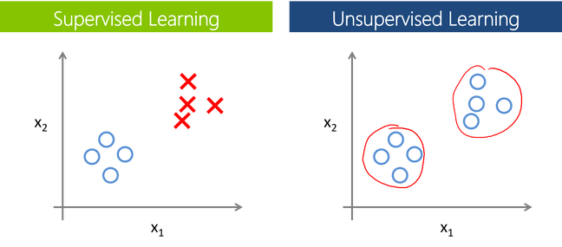
Time to practice!
What is the difference between supervised and unsupervised clustering?

Slide 23
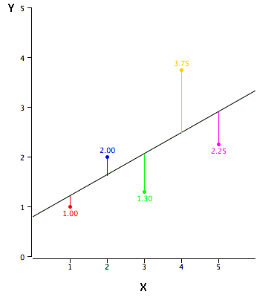
Time to practice!
How do we measure performance in regression?

Slide 24
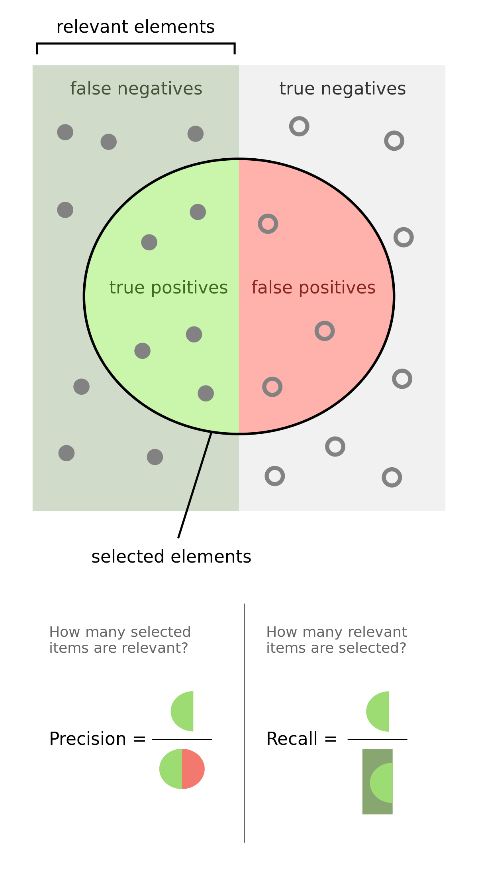
Time to practice!
How do we measure performance in classification?

Slide 25
Load-mnist.py
Python load_mnist.py
What is the image size?
How many images?

Slide 26
Splitting Data
Data is split into two parts:
Training data : 80%
Test data: 20%
It is essential to separate the data we don’t learn from to make sure what we’ve learned generalizes!
Test Data
Data
Training data
Build Model

Slide 27
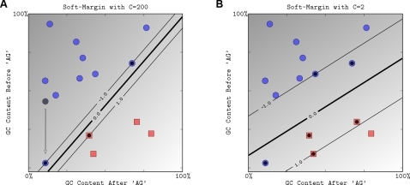
classifire_svm.py
Python classifire_svm.py
Let’s split data! Train = 50% and test = 50%
Let’s change the value of C to C=1
Let’s use more data for training!

Slide 28
Model Evaluation
Type:
Python shuffle.py

Slide 29
Model evaluation
Type:
Python shuffle_and_split.py
Let’s shuffle data and split it for model evaluation!
Data for building model :
Training data: 70%
Evaluation data 30%
Never use the same data for training the model and evaluating it!

Slide 30
Model evaluation
Python evaluate_svm.py
Experiment with svm parameter and training data size!

Slide 31
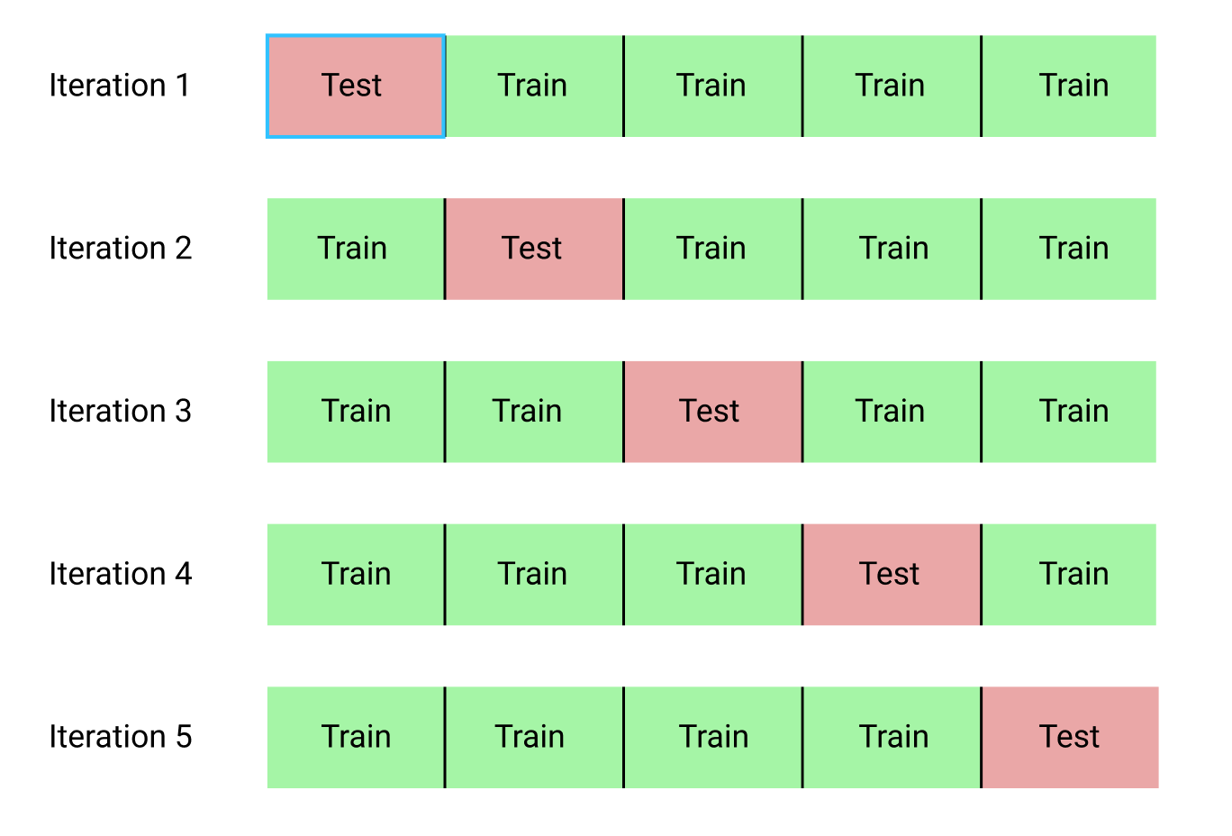
Cross_validation
Python cross_validation.py

Slide 32
Regression
Type:
python linear_regression.py
What we learn:
There is no label!
Output is continuous values!
Performance is measured using error functions!

Slide 33
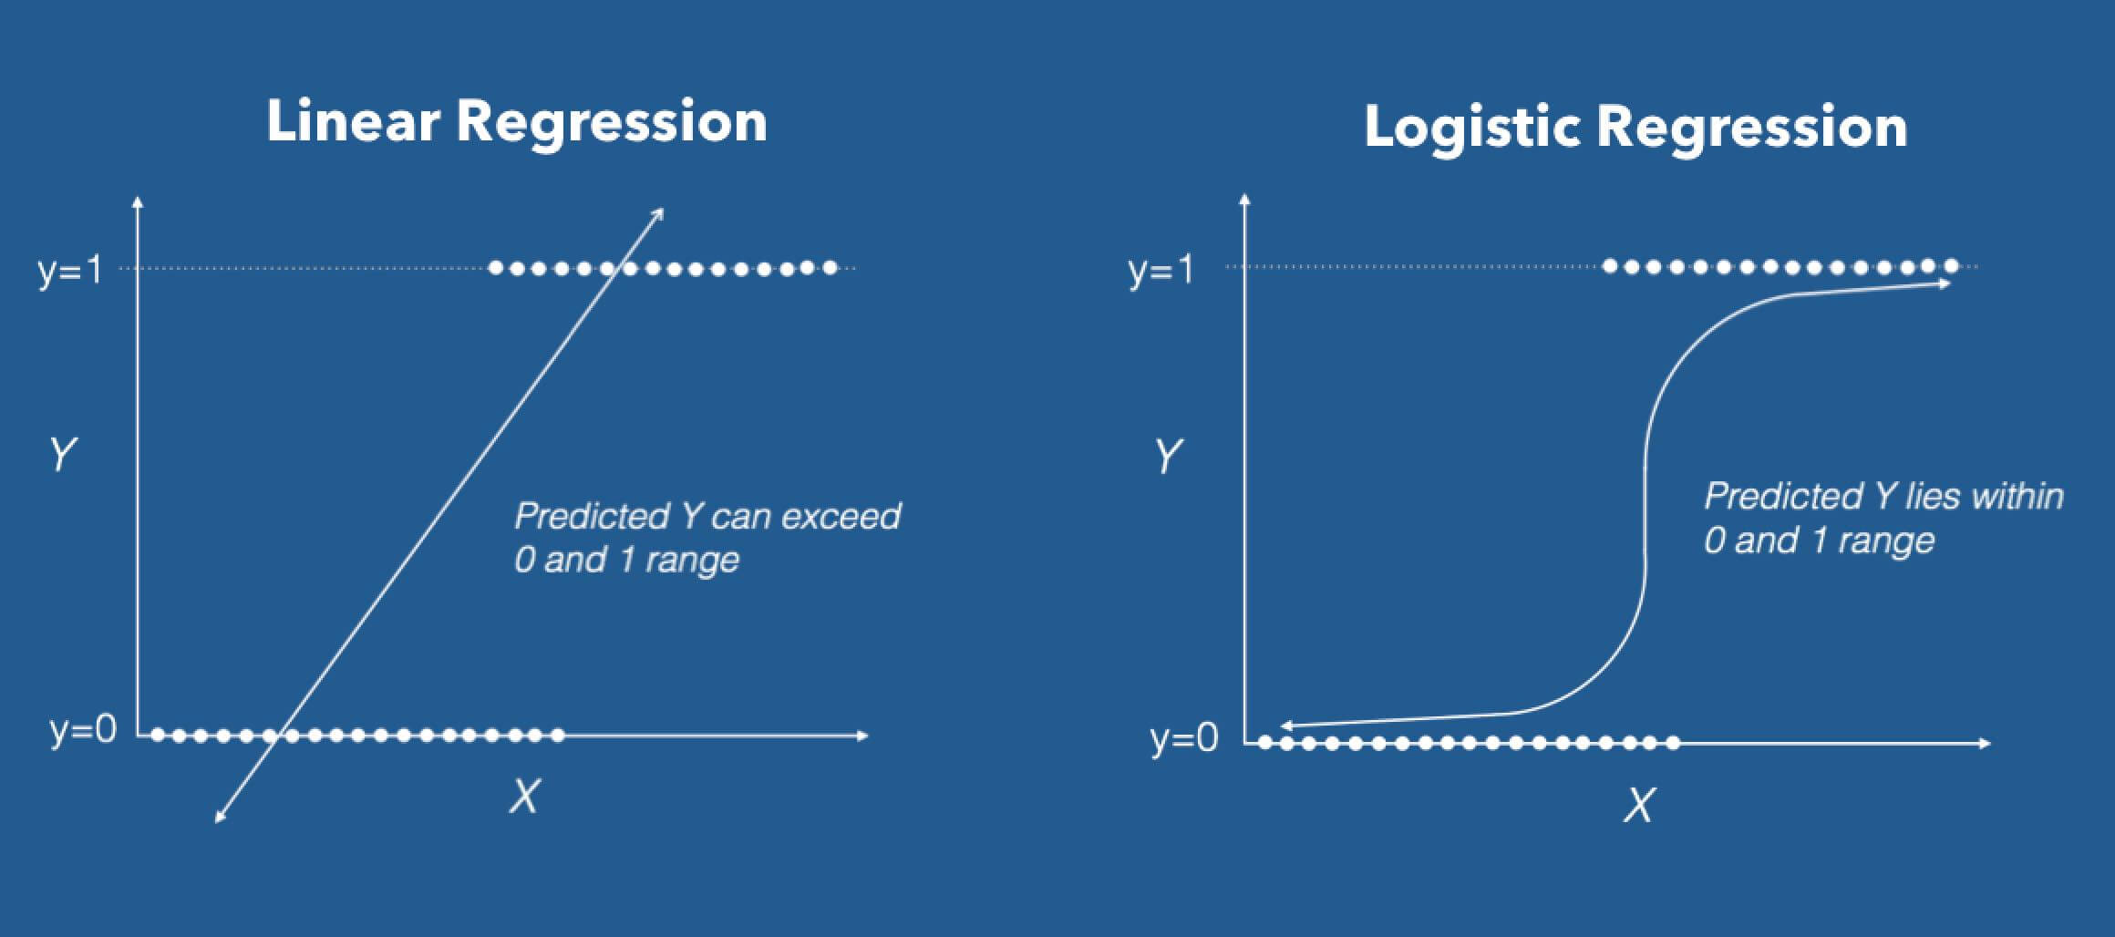
Logistic regression
Python regression_digits.py
Let’s use regression for classification!

