Slide 1

Spotify Wrapped with AI Insights
Unlocking Your Listening Universe

Slide 2
Presentation Overview
This presentation details an interactive web application that merges Spotify's rich music data with advanced AI-powered insights. We'll explore its purpose, core features, underlying technology, and visual design.
1
2
3
Seamless Experience
Elegant Design
Privacy-Focused
Interactive elements and responsive design for all devices.
Spotify-themed aesthetics with professional typography and smooth transitions.
Local processing ensures your data remains yours.

Slide 3
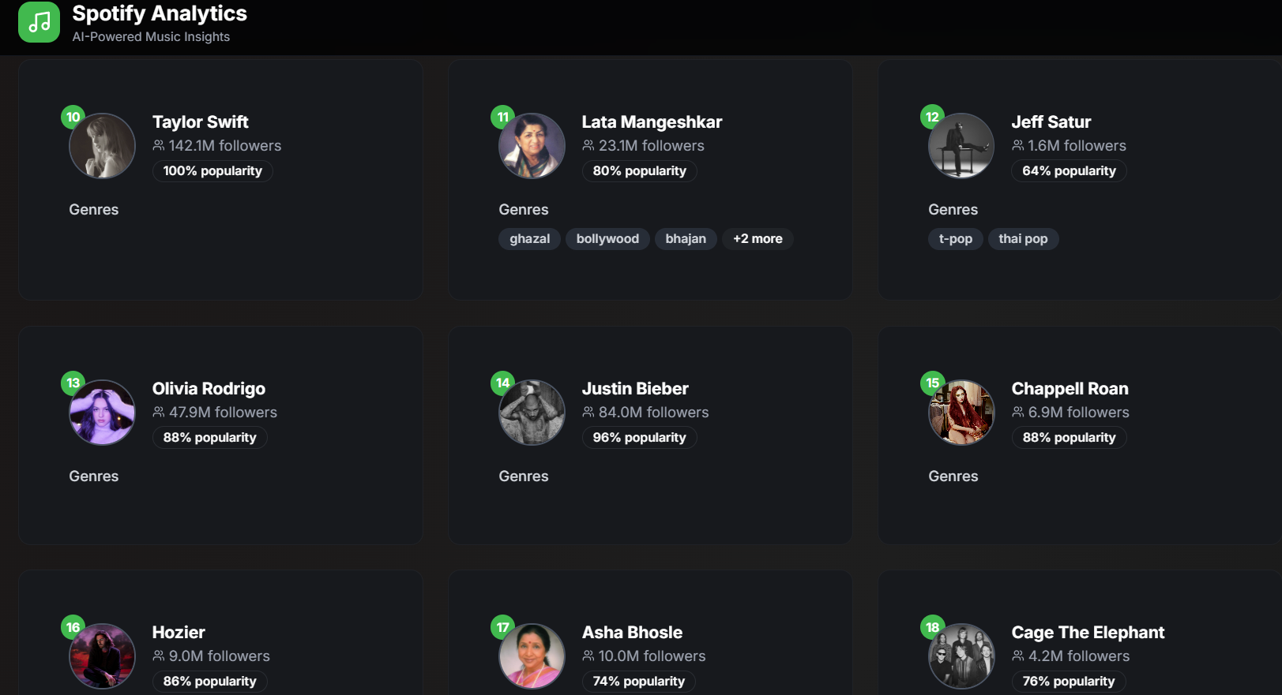
Project: Spotify Wrapped with AI Insights
An interactive web app that connects Spotify with AI-powered insights to analyze your listening patterns, offering a deeper understanding of your musical journey.
GitHub Repository:
https://github.com/amydosomething/India-Accelerator-OpenXAI-2025/tree/main/Spotify_Wrapped
Live Demo:
https://youtu.be/j0KCqKimt3o

Slide 4
Project Overview
Purpose
AI Integration
Privacy Assurance
Personalized Analytics
Explore the evolution of your music taste and uncover unique listening patterns, providing insights beyond standard Spotify Wrapped reports.
Leverages Ollama Llama3 for on-device AI processing, generating intelligent, personalized analysis of your music data.
All data processing is performed locally, ensuring no personal listening data ever leaves your device. Your privacy is paramount.
Delivers highly personalized recommendations and detailed genre tracking, adapting to your unique musical fingerprint.

Slide 5
Key Features
🤖 AI-Powered Insights
🔗 Spotify Integration
Taste Evolution
Secure OAuth2 authentication
See how your musical preferences have shifted over time.
Display of user profile
Pattern Recognition
Identify recurring listening habits and trends.
Top tracks, artists, genres
(last 4 weeks, 6 months, 1 year)
Smart Recommendations
Discover new music tailored to your unique profile.
Recently played songs with timestamps
Genre Insights
In-depth analysis of your preferred genres and sub-genres.

Slide 6

System Architecture
The application's architecture is designed for efficiency, security, and local AI processing, ensuring a smooth and private user experience.
User → Next.js Frontend → Spotify OAuth2 Auth → Spotify Web API → AI Engine (Ollama Llama3) → Processed Insights → User Dashboard

Slide 7
Technology Stack
Built with modern, robust technologies to deliver a fast, responsive, and secure application.
Frontend
Authentication
API Integration
Next.js, React, Tailwind CSS
NextAuth.js (Spotify OAuth2)
Spotify Web API
AI Processing
Utilities
Ollama Llama3
TypeScript, ESLint, PostCSS

Slide 8
Project Structure
A well-organized codebase ensures maintainability and scalability, following best practices for modern web development.
app/ → Pages, Layout, API routes
hooks/ → Custom hooks (toast)
components/ → Dashboard, Profile, AIInsights, SpotifyAuth, UI components
types/ → TypeScript models (Spotify data)
screenshots/ → UI previews (artists, genres, tracks, AI insights, recents)
lib/ → Spotify API handling, Ollama integration

Slide 9
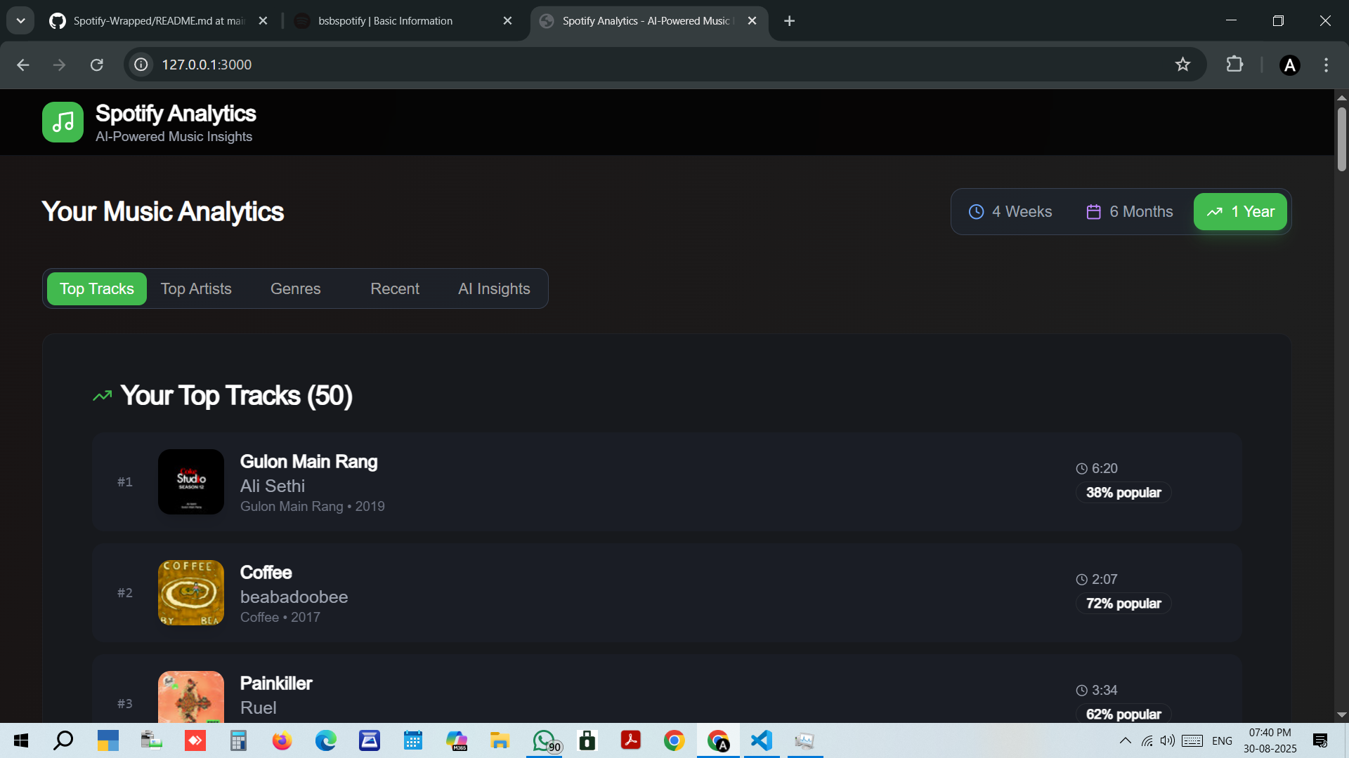
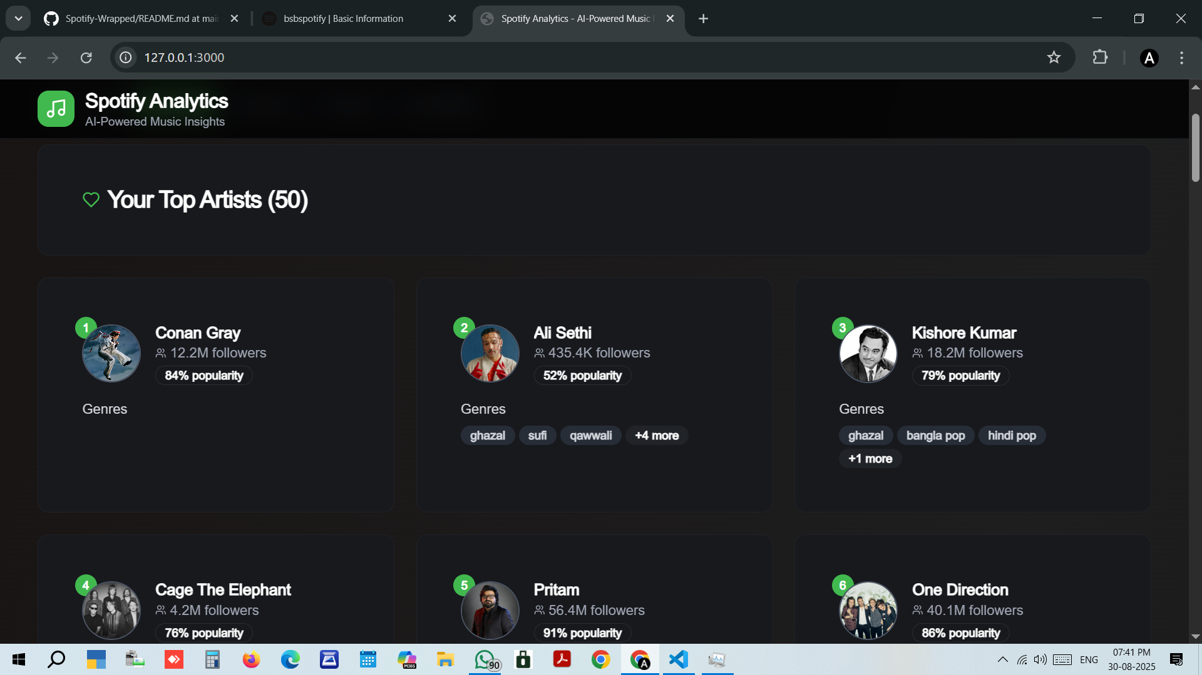
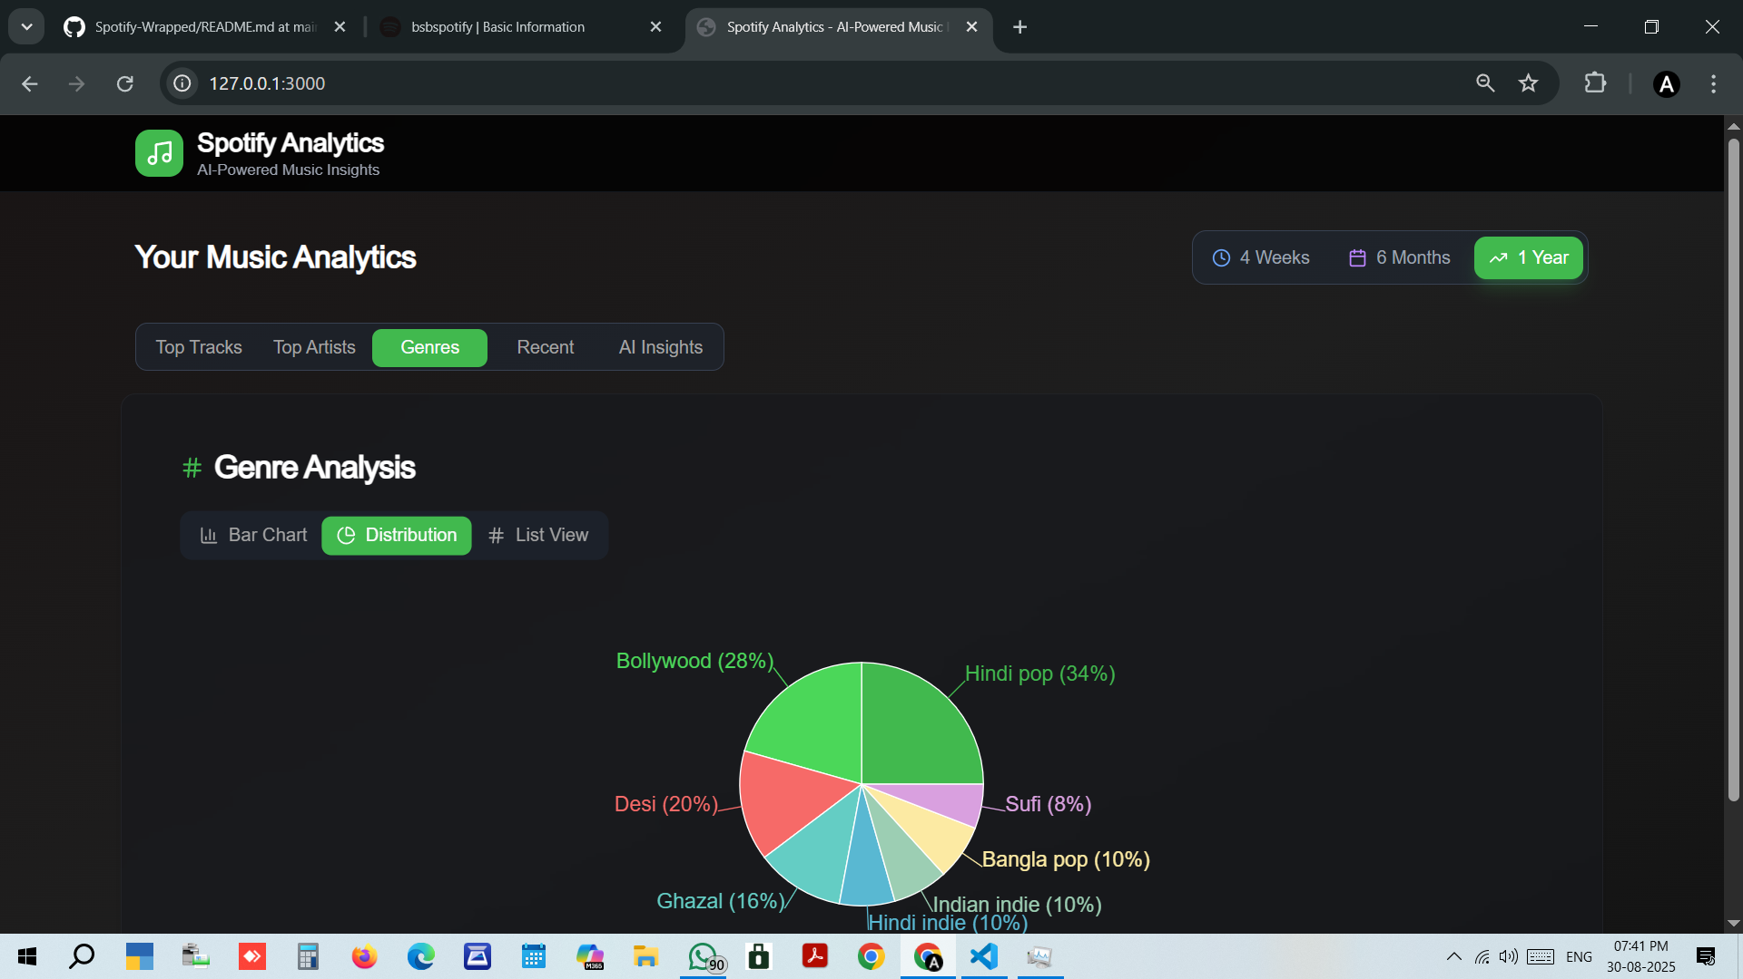
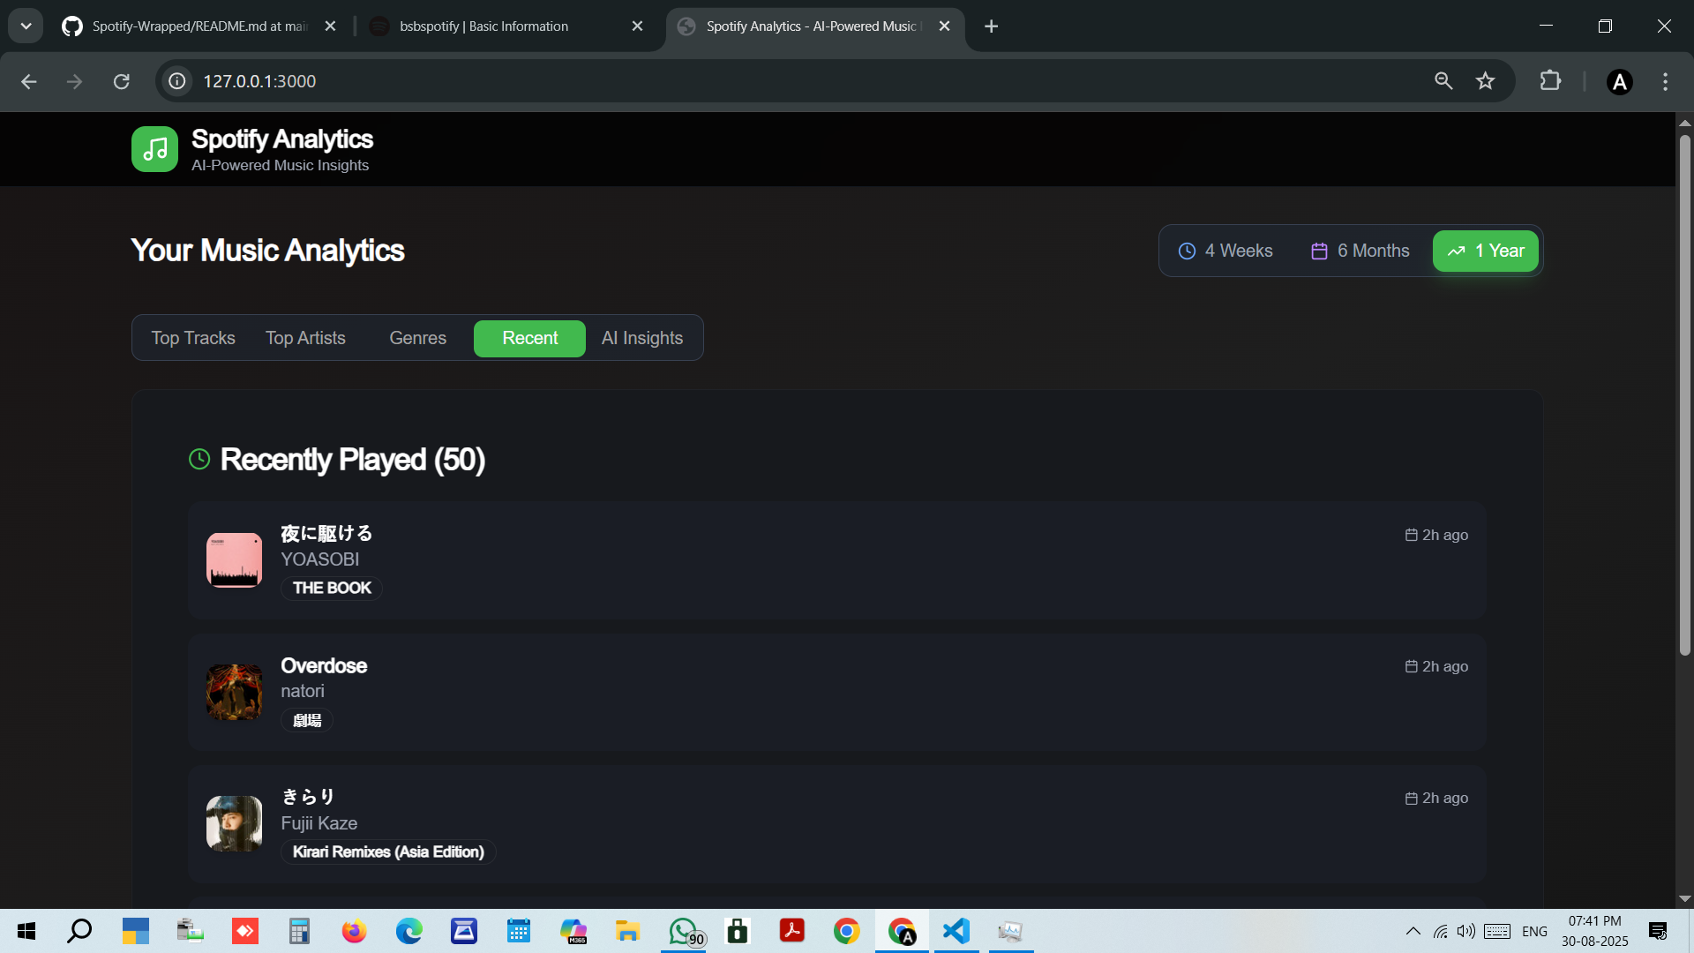
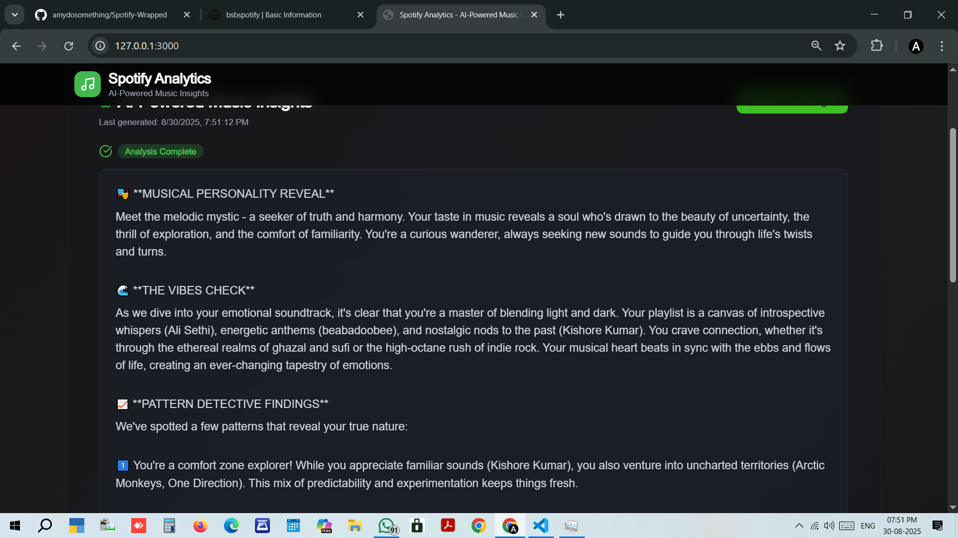
Application Screenshots

Slide 10



Design Highlights
The application's design is crafted to be visually appealing, intuitive, and consistent with the Spotify brand identity.
Spotify Aesthetic
Interactive Elements
Fluid Transitions
Utilizes Spotify's iconic green gradient and a sleek dark mode theme for a familiar and immersive experience.
Subtle hover effects for buttons and cards provide satisfying user feedback and enhance usability.
Smooth animations and transitions create a seamless flow between different sections, improving overall user experience.

