Slide 1
Data PURLs @ Stanford
Amy Hodge, Science Data Librarian
Engineering Executive Committee Meeting
May 22, 2013

Slide 2
What is a Data PURL?
What can a Data PURL do for you?
Data PURL examples
How to get a Data PURL

Slide 3
What is a Data PURL?
What can a Data PURL do for you?
Data PURL examples
How to get a Data PURL

Slide 4
Persistent
Uniform
Resource
Locator
....for DATA
Describe your data
Click to download files
Link to papers & resources
Say how you would like your data cited
Assign a license
Decide who can see it
Choose an embargo
Stanford Digital Repository

Slide 5
What is a Data PURL?
What can a Data PURL do for you?
Data PURL examples
How to get a Data PURL

Slide 6

Light-weight approach to NSF requirements for data sharing and preservation

Slide 7
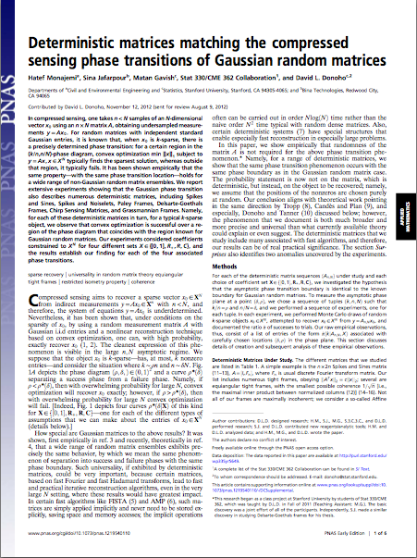
Add value to your article with a persistent link to your data

Slide 8
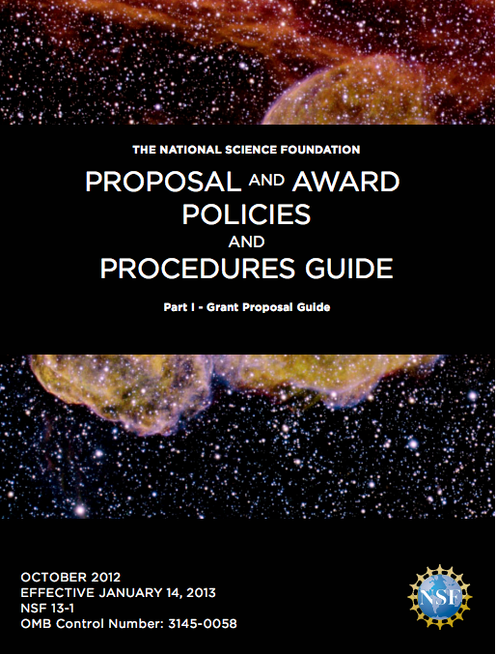
“Products” for NSF Proposals
“Chapter II.C.2.f(i)(c), Biographical Sketch(es), has been revised to rename the “Publications” section to “Products” and amend terminology and instructions accordingly. This change makes clear that products may include, but are not limited to, publications, data sets, software, patents, and copyrights.”

Slide 9
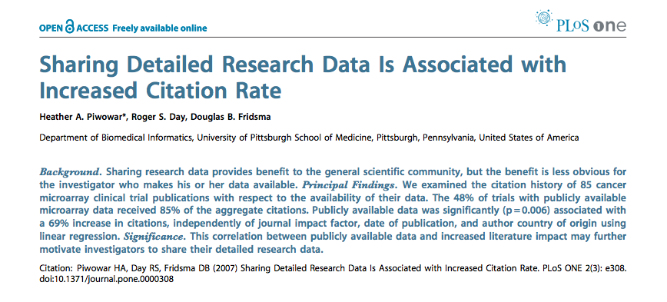
Increase Your Citation Rate

Slide 10
What is a Data PURL?
What can a Data PURL do for you?
Data PURL examples
How to get a Data PURL

Slide 11
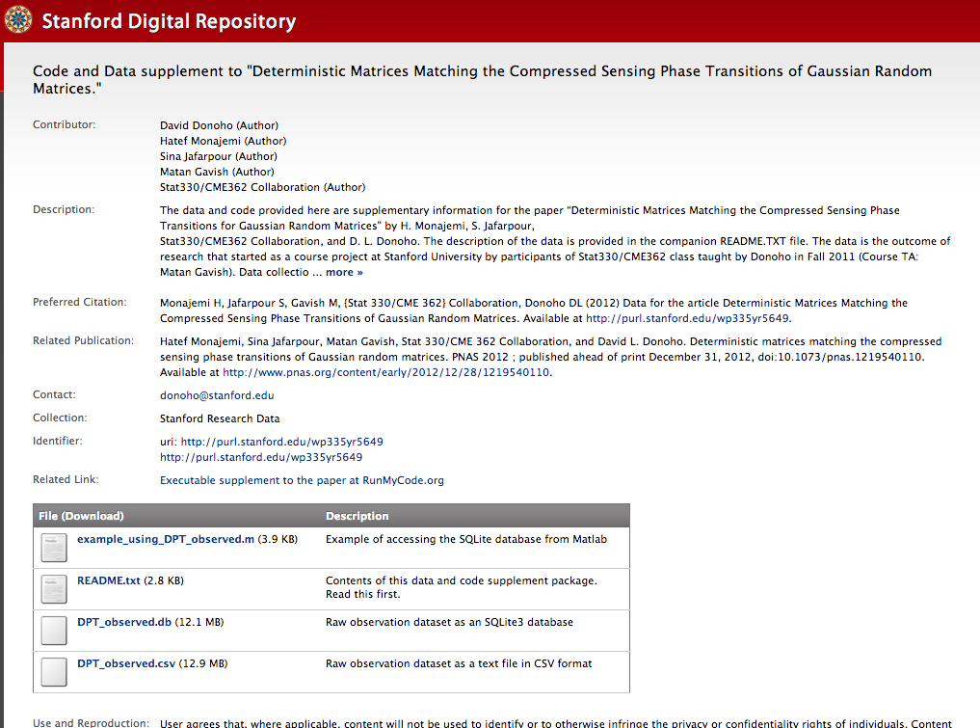
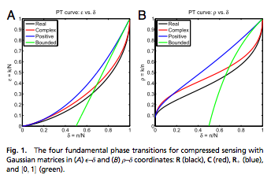
PURL for Publication Support
PNAS paper was in press
Required to publish data, but journal did not provide a place for this
PURL required prior to data publication for the galley proof

Slide 12
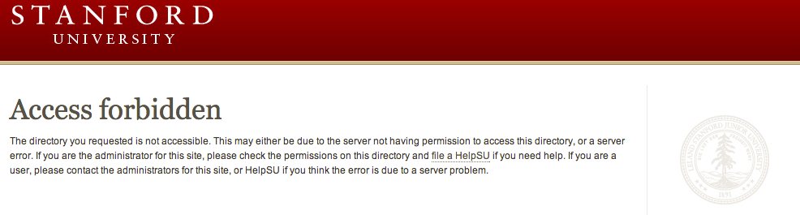
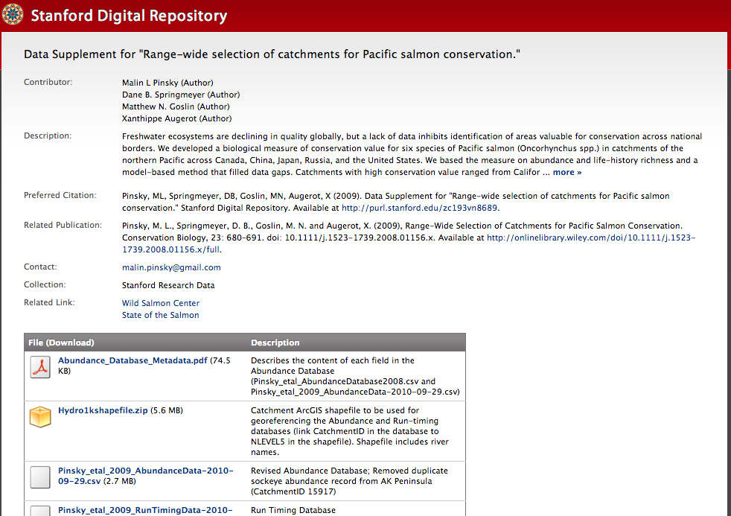
PURL for Restoring Data Access
www.stanford.edu/~mpinsky/salmon/
purl.stanford.edu/zc193vn8689

Slide 13
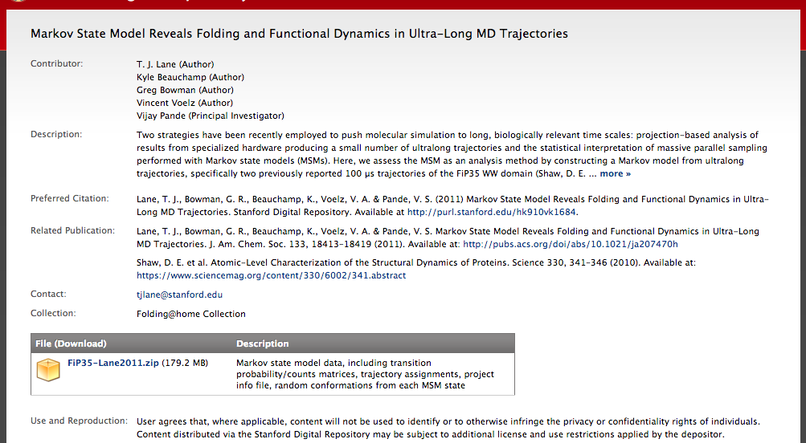
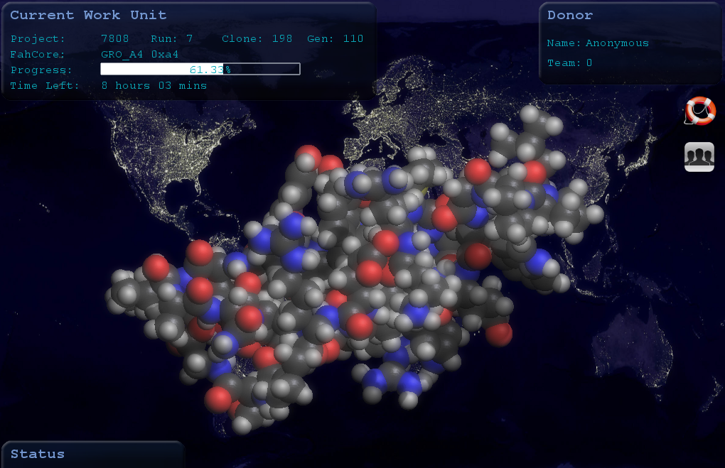
PURL for Discoverability
Folding@home

Slide 14
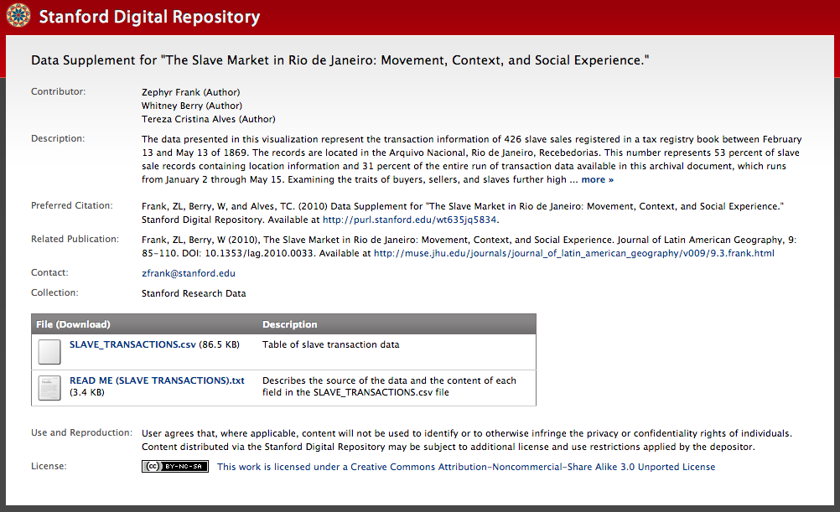
PURL for Original Publication
Spatial History Project online visualizations
Slave Markets in Rio de Janeiro
Notes:
Typically includes compilation of historical data from a variety of different sources along with geospatial information

Slide 15
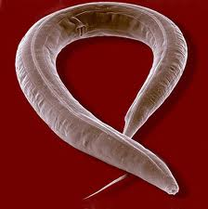
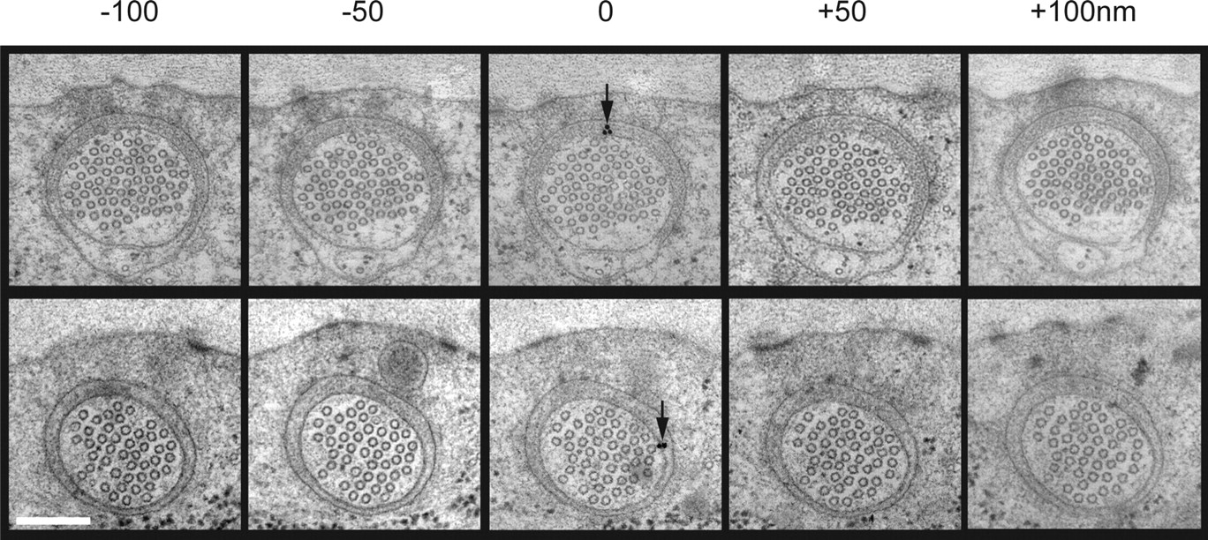
PURL for Data Sharing
Micrographs are information-rich, storage-intensive, and hard for people to access
They are done publishing > more questions could be asked of these images by others
Colleagues in India are interested in access
Jürgen Berger & Ralph Sommer,
Max Planck Institute for Developmental Biology
©2007 by Society for Neuroscience
Cueva J G et al. J. Neurosci. 2007;27:14089-14098

Slide 16
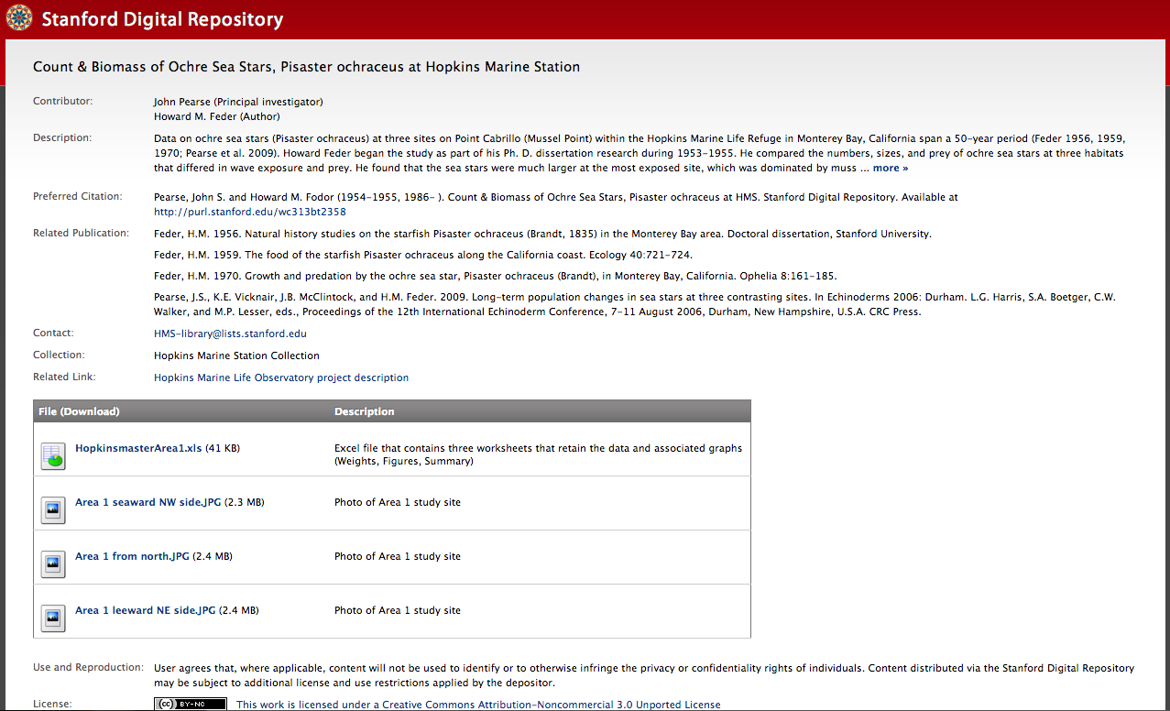
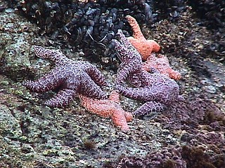
PURL for Preservation
Notes:
Much of the data involves long-term, on-going monitoring of sea otters, harbor seals, elephant seals, abalone, algae, sea stars, barnacles and weather data at the refuge

Slide 17
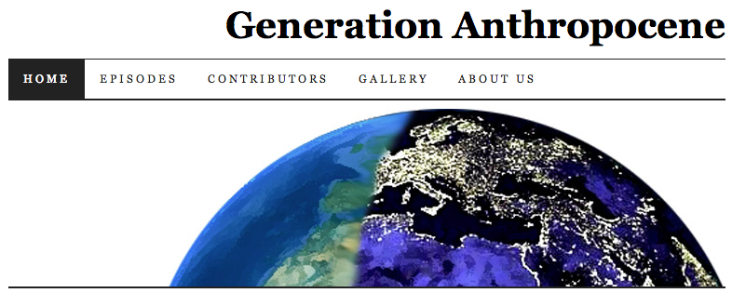
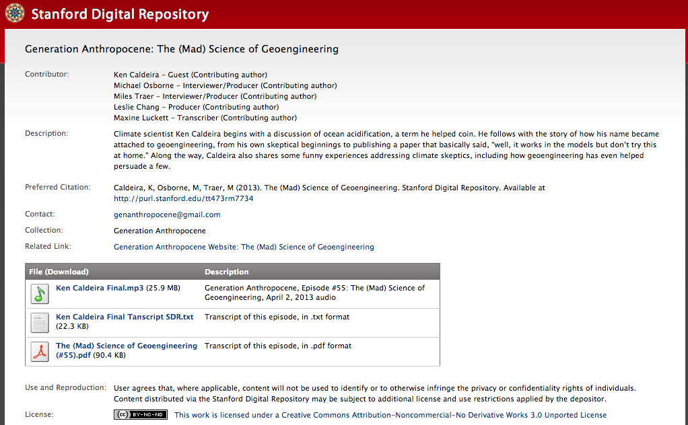
PURL for Student Science
Notes:
Podcast started by Mike Osborne, a grad student in Earth Sciences, consisting of interviews about planetary change

Slide 18
What is a Data PURL?
What can a Data PURL do for you?
Data PURL examples
How to get a Data PURL

Slide 19
How to Get a Data PURL
Email amyhodge@stanford.edu
Go to sdr.stanford.edu
Upload files & describe
PUBLISH
Notes:
For access to web interface for making deposits
For consultation on best approaches for your data
For instruction on using the deposit interface

Slide 20
amyhodge@stanford.edu

Slide 21
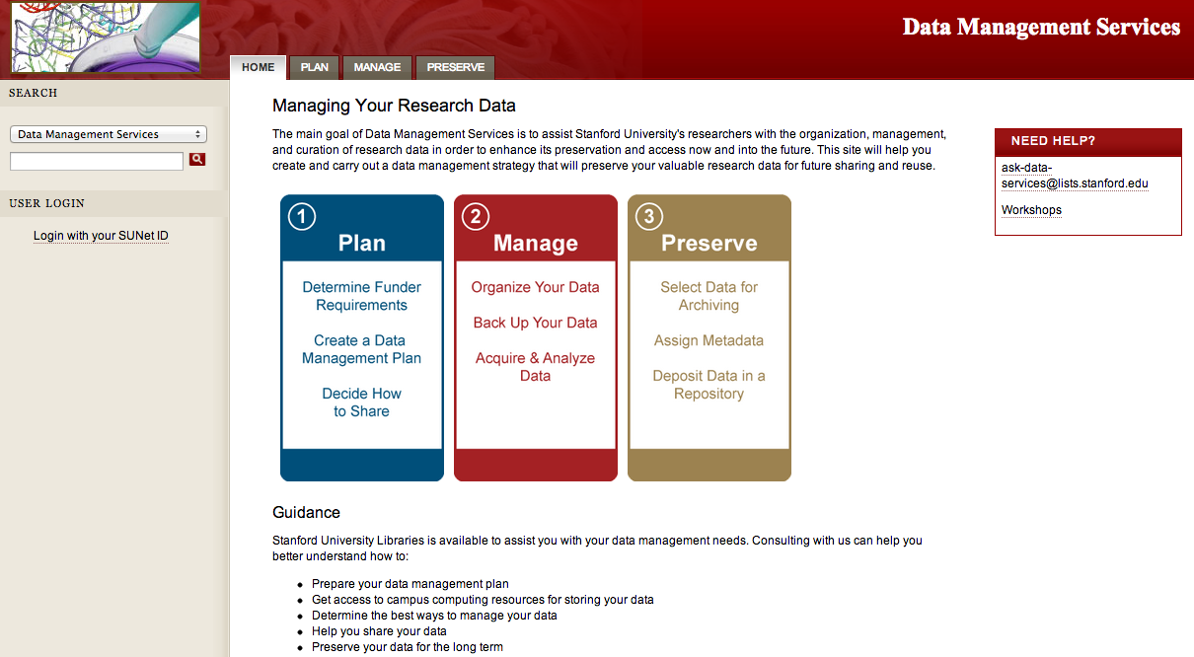
Data Services Web Site
Notes:
Two of the most popular pages on this site are the DMPTool page and the page that lists subject specific repositories. Screen shots of those follow.
Most visited: home page
Second: DMP Tool
Third: Subject-Specific Data Repositories

Slide 22
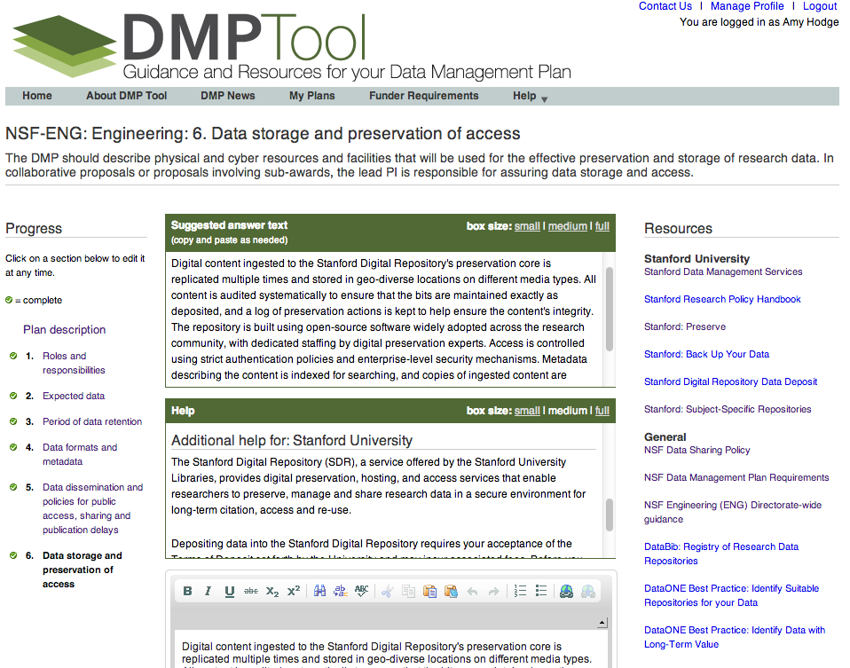
Notes:
85 institutions with single sign-on
As of February 11, Stanford usage stats:
119 users
47 have created plans
Most users added when we were giving workshops in the fall and in response to an email about it that went out from the Dean of Research’s office.
This screen shot shows an example where we have contextualized Help text, Suggested Answer text, and links to Stanford sites with additional information.

