Slide 1
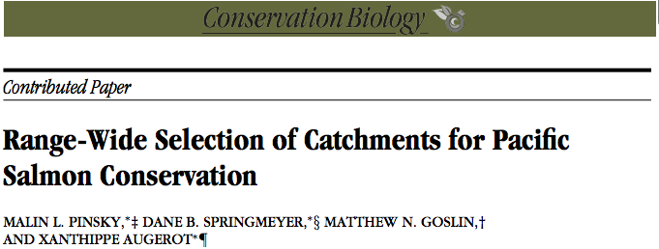
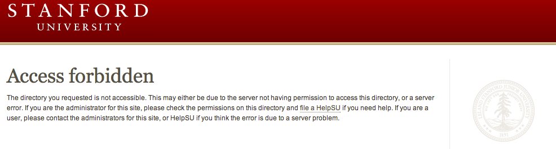
Notes:
This is a story of forbidden access....and Malin Pinsky, a former Stanford researcher who is now at Princeton. Once upon a time (in 2009) he published an article in Conservation Biology. In that article he made reference to some additional data sets that he made available online. The problem came when he left Stanford a couple of years later, and the data suddenly became inaccessible because where he had published it was in his AFS space. And everyone who tried to reach that data saw only this. He began a search for a way to make the data accessible again. And he discovered that the SDR can do that.

