Slide 1

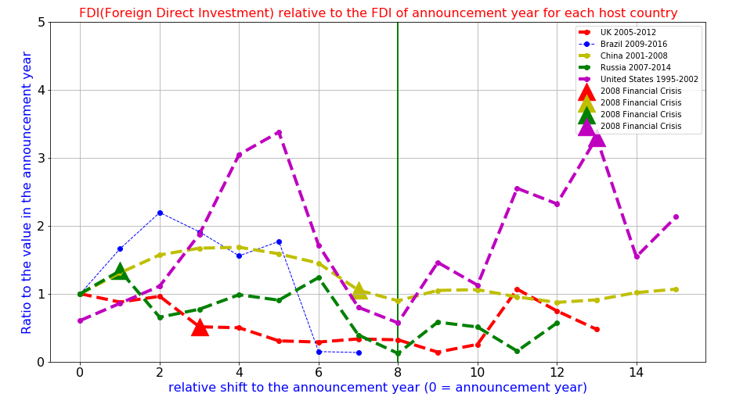


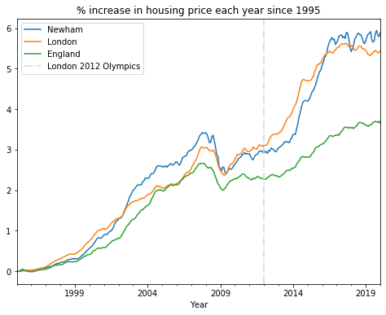




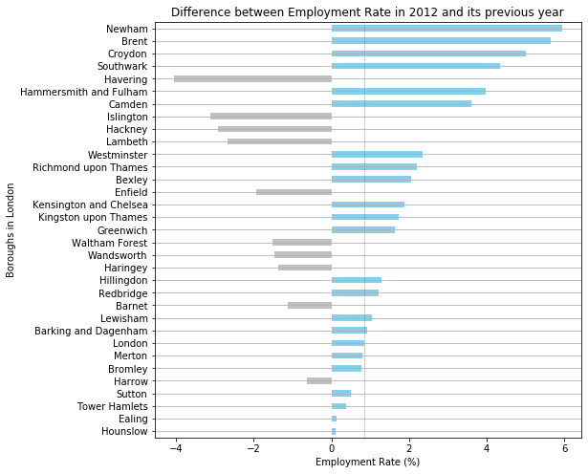
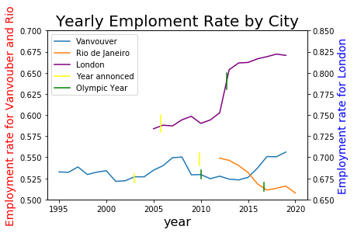
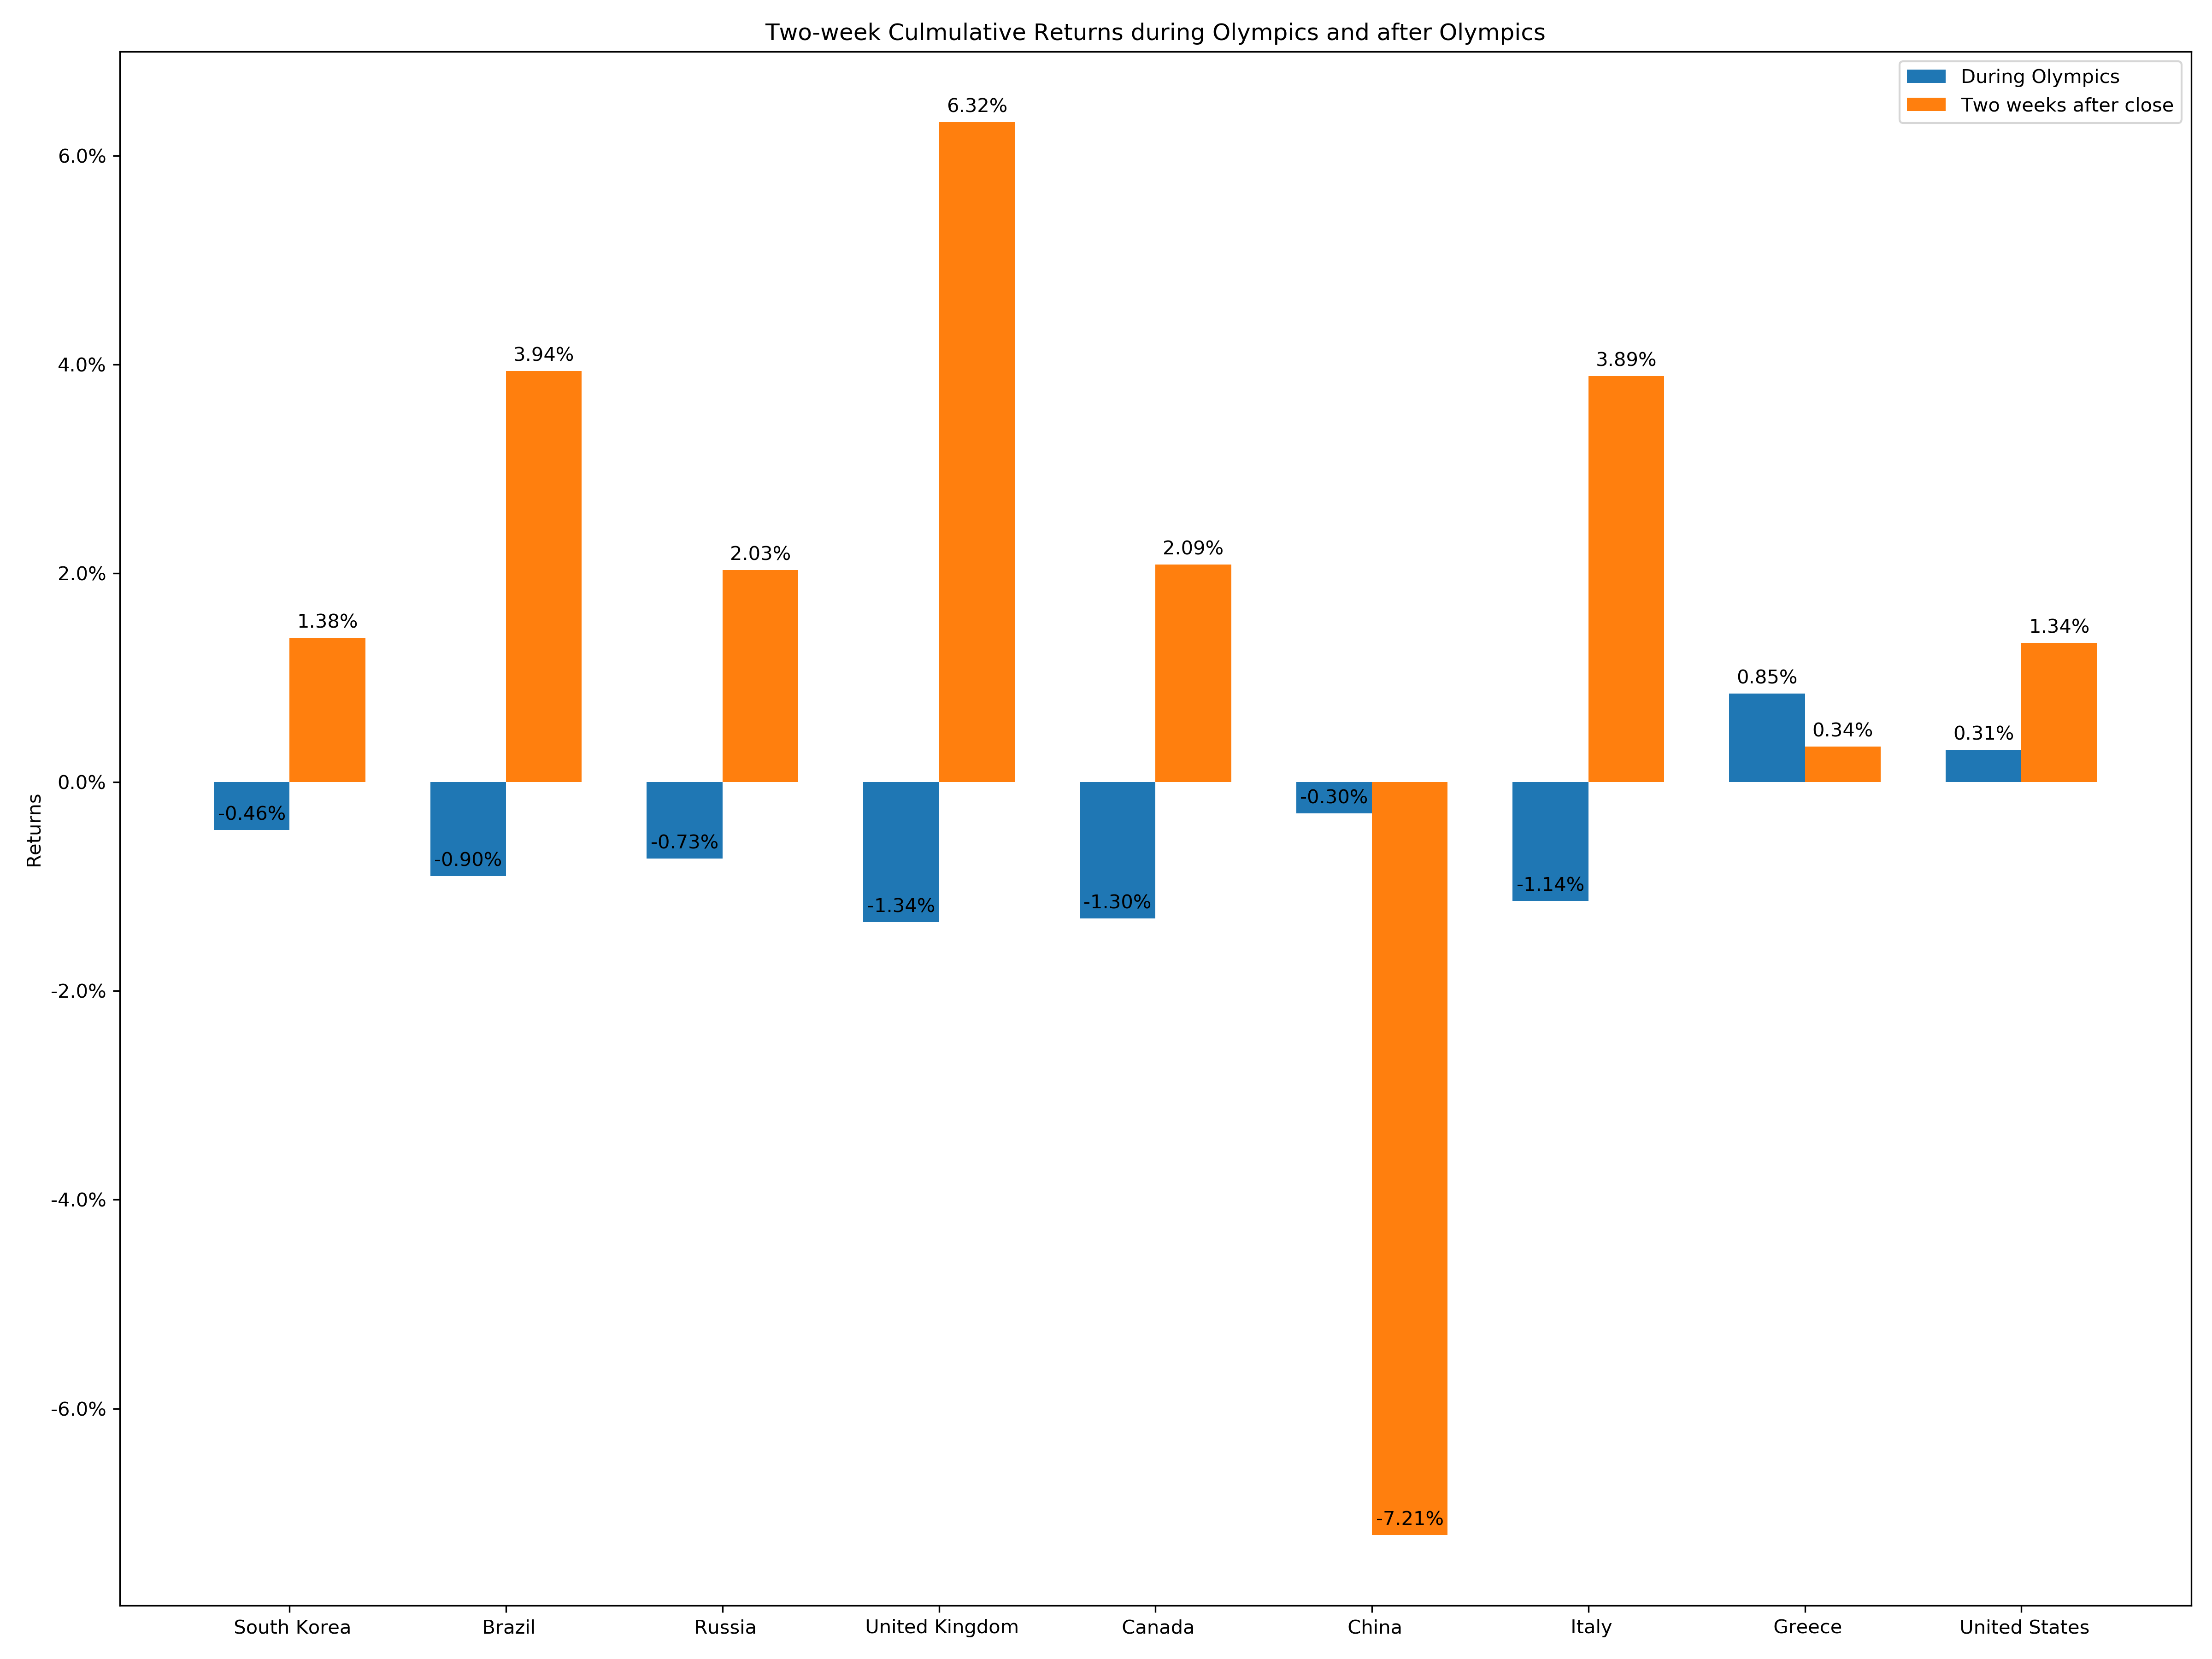
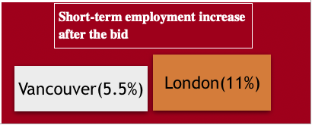
Macro through the lens of Olympics
Team 10
Introduction
Our Datathon project focuses on the systematic macro impact of the Olympics Games by visualizing the economic structural impact and aims to answer to question of how a well-organized Olympics Games improves host countries’ fundamentals, which includes income, employment and foreign investment, and infiltrates the benefits to the host city into a longer term.
Impact on Foreign Direct Investment
Case Study: London 2012
Post-Game planning is essential to our success of hosting an Olympic game.
Why do countries bid for hosting Olympics.? It’s so costly.
Short-Run Benefits:
Employment: Positive effect after the bid-year
Investment: Positive effect in the short-term but evades in the long-run.
Stock: Investors are usually optimistic over the host country after the Olympic Game is closed.
Long-Run Benefits:
The London 2012 Olympics revitalized the Newham borough well-organized post-game planning.
Why there is a reverse U-shape pattern for FDI between bid-year and Olympic-year?
Boosting exists in short-term rather in long-term. Investors generally leave even if they profit from investing this country.
Main Findings Breakdown
Impact on Employment
Insight: Hosts should focus more on the synergy effect brought by the mega-event rather the short-term FDI boosting. E.g. London does a great job! See the case study.
Impact on Stock Market
Insight: Olympics seem to create a significant number of construction jobs in Vancouver, which is maintained even after the Olympics finished. Similarly, London also shows sustainable employment growth.
Insight: Olympics have a positive impact on the local host market after adjusted by the benchmark MSCI World Index.
Insight: Positive two-week returns show the optimistic assessment of local investors over the long-term benefits of the host country.
Insight: Both the increases of income and housing prices in Newham swell compared with England-wide average increases and London average increases.
Insight: The employment rate in Newham increased about 6% in 2012 compared to 2011, creating many job opportunities to people in Newham and promoting the community economy.

