Slide 1
Capstone
By: Shawn Mathew, Anthony Tan, Amy Wong

Slide 2
Huffman Encoding

Slide 3
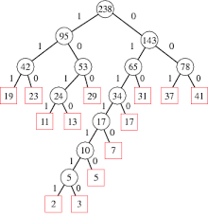
Correctness Proof of Huffman Encoding Algorithm
To justify the correctness, we will be doing a proof by contradiction
We will be assuming that for two symbols A and B with probabilities p(A) >= p(B), then it is possible for the length of symbol A to be longer than that of symbol B.

Slide 4
Huffman Encoding Cont.
Under our assumption, then in our tree representation of the symbols, the node for symbol A would have a larger depth than that of symbol B
Since the node for symbol B has a smaller depth then its frequency or probability would have to be higher than that of symbol A or equal to symbol A, which contradicts the statement that p(A) >= p(B).

Slide 5
Ordered Matrix Search

Slide 6
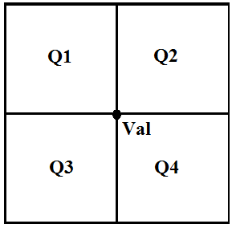
Finding Element in n x n Matrix
Find middle element value in matrix A[i][j] = val and split matrix into 4 parts
Q1: minimum values
Q4: maximum values
Compare val to x:
Val == x: return location
Val != x && size == 1: return not found
Val < x: repeat steps 1 and 2 for Q2, Q3, and Q4
Val > x: repeat steps 1 and 2 for Q1, Q2, and Q3

Slide 7
Pseudo Code
def findX(int[][] A, int r, int rlen, int c, int clen, int x):
int rmed = r+rlen/2
int cmed = c+clen/2
if A[rmed][cmed] == x:
return [rmed, cmed]
if rlen and clen are both 1 return [-1,-1]
if A[rmed][cmed] < x:
res = findX(A, r, rmed, cmed+1, clen-cmed-1, x)
return res if not equal -1
res = findX(A, rmed, rlen-rmed, c, cmed, x)
return res if not equal -1
res = findX(A, rmed, rlen-rmed, cmed+1, clen-cmed-1, x)
return res if not equal -1

Slide 8
Pseudo Code Cont.
if A[rmed][cmed] > x:
res = findX(A, r, rmed, c, cmed, x)
return res if not equal -1
res = findX(A, r, rmed, cmed+1, clen-cmed-1, x)
return res if not equal -1
res = findX(A, rmed, rlen-rmed, c, cmed, x)
return res if not equal -1

Slide 9
Time Complexity
T(N) = 3 T(N / 4) + 7
Master Theorem:
AT(N/B) +f(N) A=3, B =4, f(N) = O(1)
Since f(N) < O(n^log_{B}A) O(1) < O(n^log₄3)
Time Complexity = O(n^log_{B}A)
Time Complexity: O(n^log₄3)

Slide 10
Search Engine Evaluation

Slide 11
Procedure
Pick out a group of words
Create a phrase to search
One person puts in the search and passes top result to evaluator
Evaluator compares respective search result ranking sites
Evaluator awards points on certain categories
Add points and whichever has most points is the best

Slide 12
Categories
Using similarweb.com statistics about each site was obtained to test Google, DuckDuckGo, and Dogpile
Categories Tested:
Total Visits (10 pts)
Traffic from Search (10 pts)
String Matches (10 pts)
Full points for finding all words, partial points for single words

Slide 13
Results
Our results show that Google is the best search engine. It is important to note that a lot of search results from DogPile and DuckDuckGo had similar results
Search Engine | Total Points
Google | 1083
DogPile | 1051
DuckDuckGo | 1076

