Slide 1
QTUNES
By: Shawn Mathew, Varan Sharma, and Amy Wong

Slide 2
Purpose
To create a music player application using:
Qt (cross-platform development software developed by Trolltech )
OpenGL (graphics development library)
TagLib (retrieve tag info from mp3 files)

Slide 3

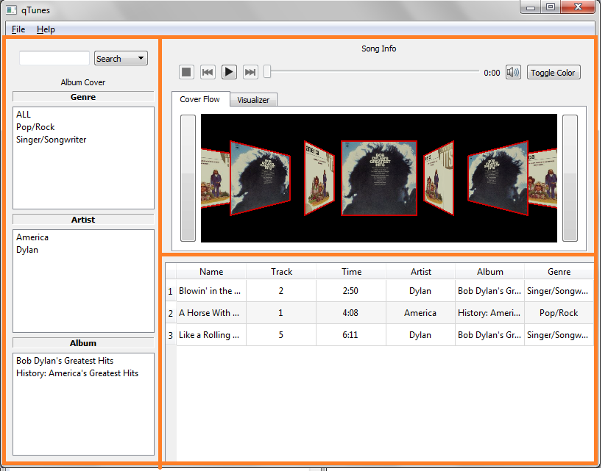
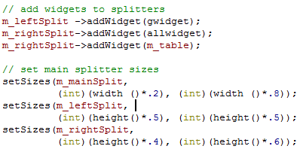
Layout (Splitters)

Slide 4
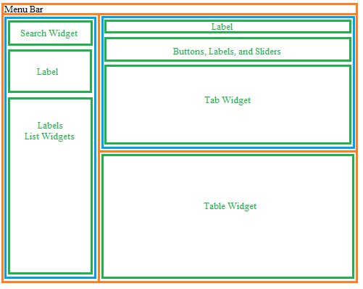
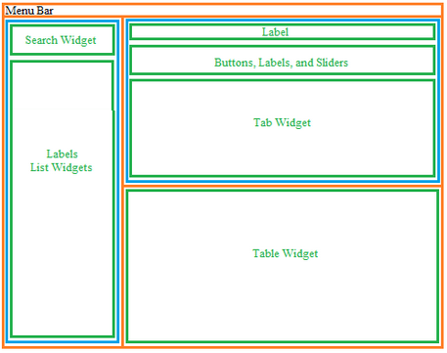
Layout (Diagram)

Slide 5
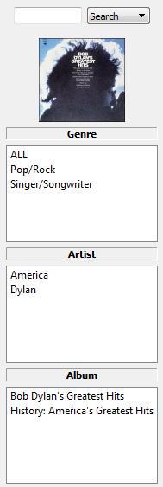
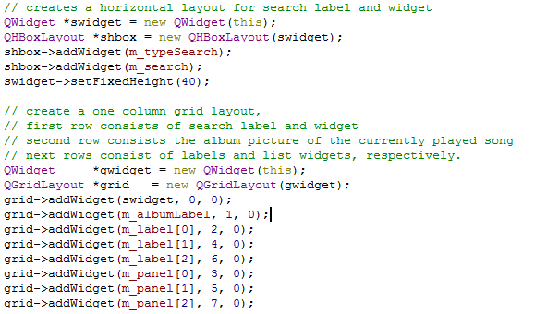
Layout (Left split)

Slide 6
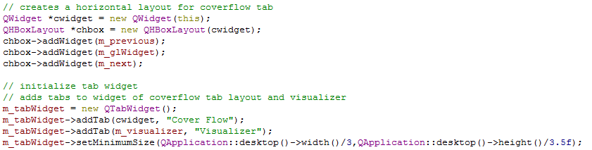
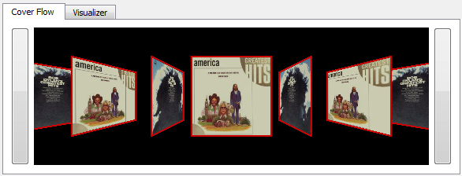
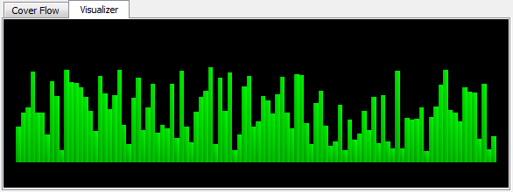
Layout (Tab Widget)

Slide 7
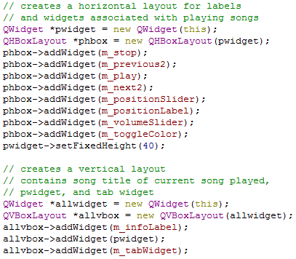
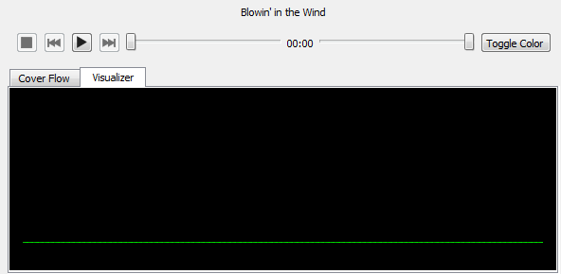
Layout (Upper Right Split)

Slide 8
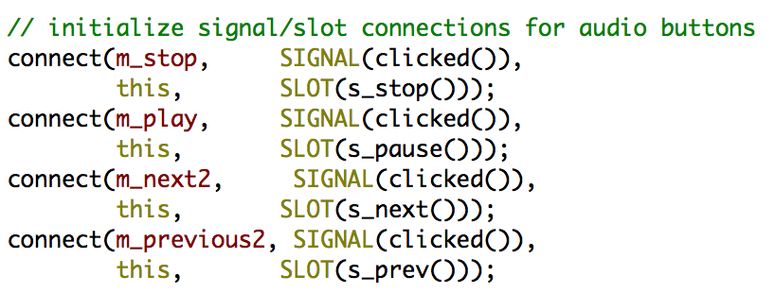
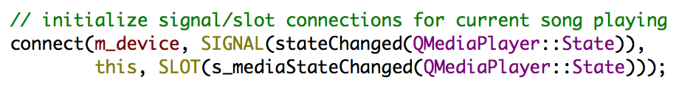
Audio Buttons

Slide 9
s_mediaStateChanged(state)
Checks the current media state
Determines how to display buttons
Ex: If media is stopped, all buttons besides the Play button are disabled
Ex++: If media is playing, Play button shows a Pause icon instead

Slide 10
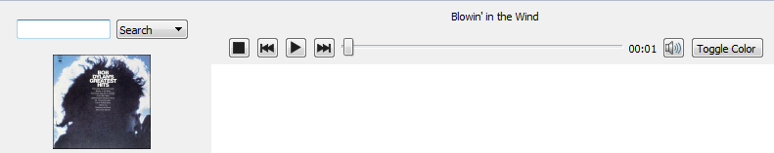
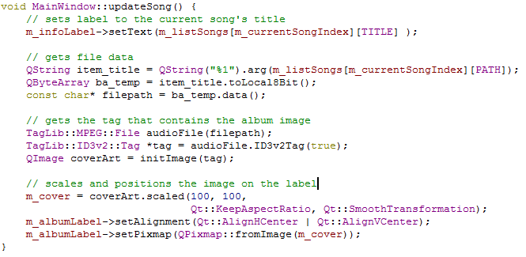
Update Song Information

Slide 11
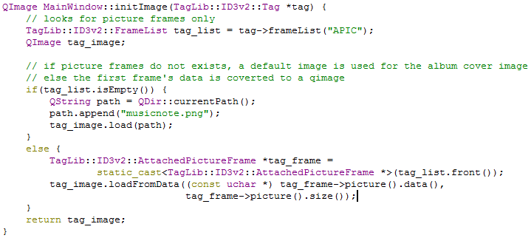
Create the Image

Slide 12
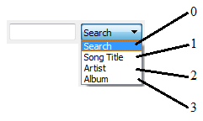

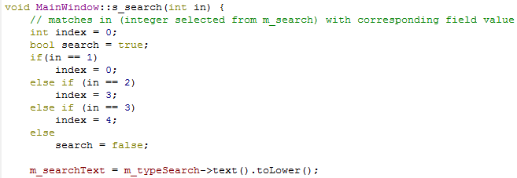
Search Option

Slide 13
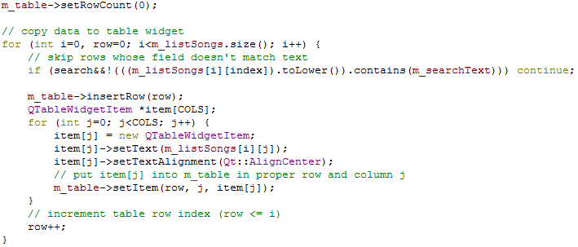
Search Option

Slide 14
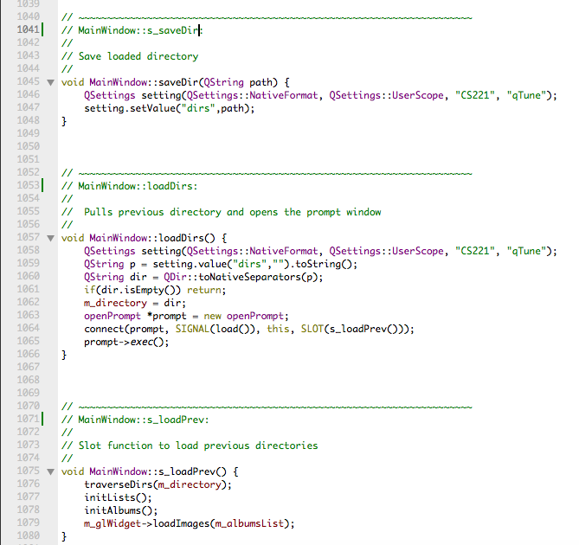
Loading Saved Directory
Use QSettings to
save previously loaded
directory

Slide 15
Coverflow
Features:
Loops around
Rotates about an edge

Slide 16


Coverflow

Slide 17
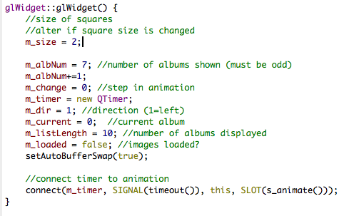
Coverflow

Slide 18
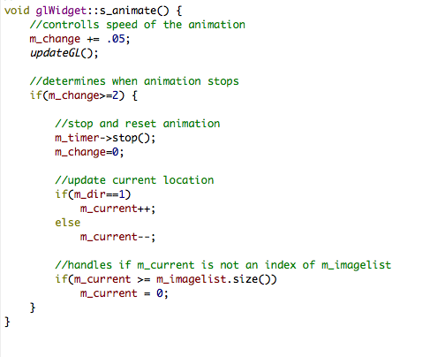
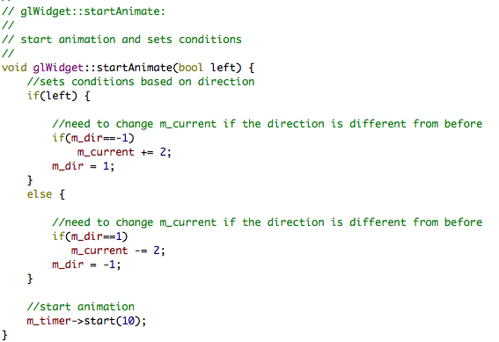
Coverflow

Slide 19

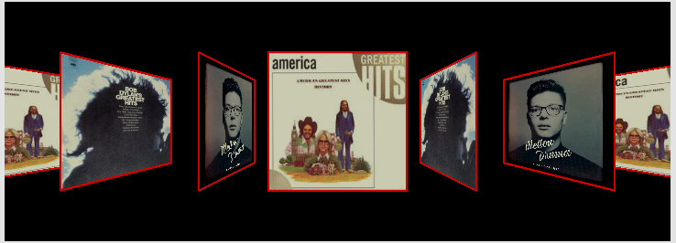
Coverflow
draw:
animate:

Slide 20
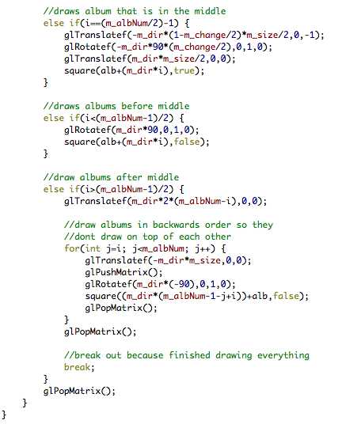
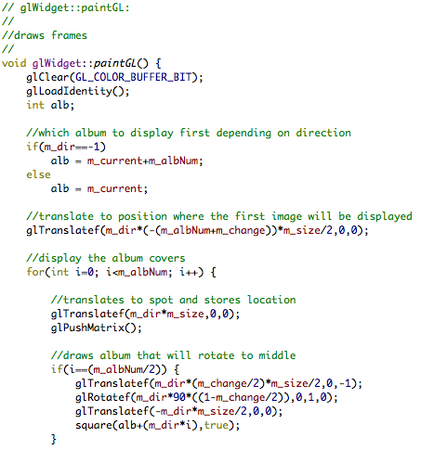
Coverflow

Slide 21
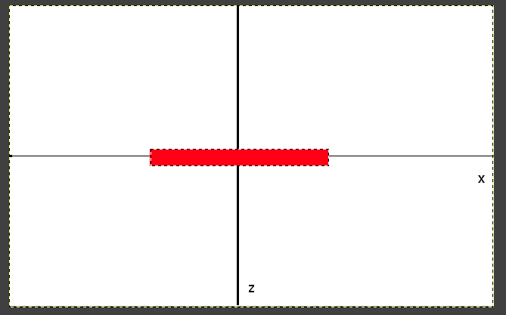
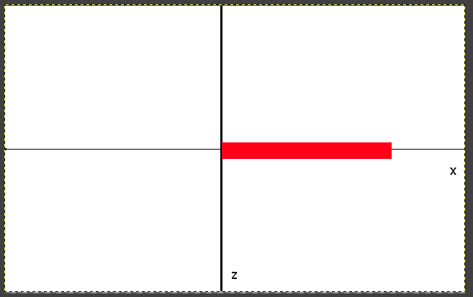
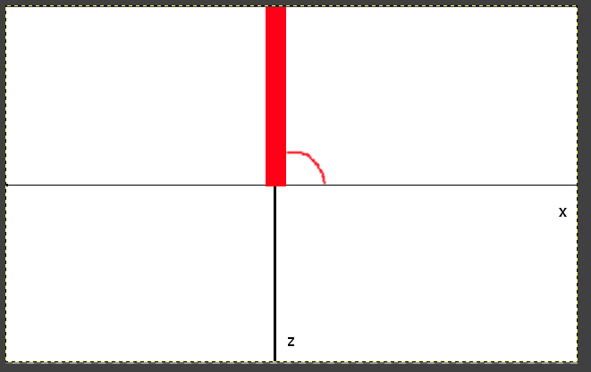
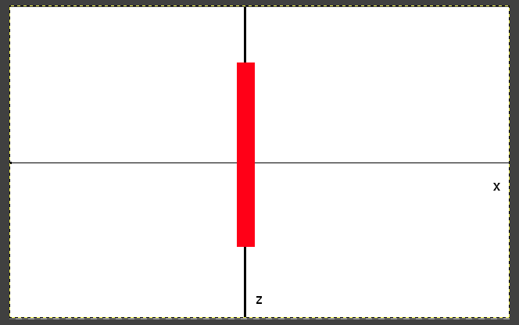
Coverflow
initial
translate
1)
2)
rotate
translate
3)
4)

Slide 22
Coverflow

Slide 23
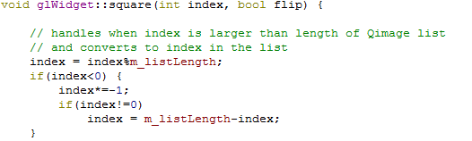
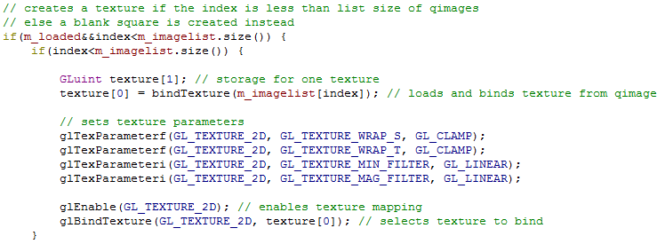
Coverflow (Texture Mapping)
Notes:
GL_clamp stops wrapping so that parts of the texture will not be duplicated
GL_Linear filter texture when scaling

Slide 24
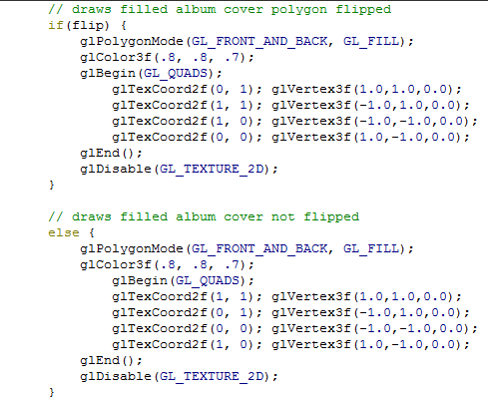

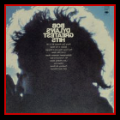
Coverflow (Orientation)

Slide 25
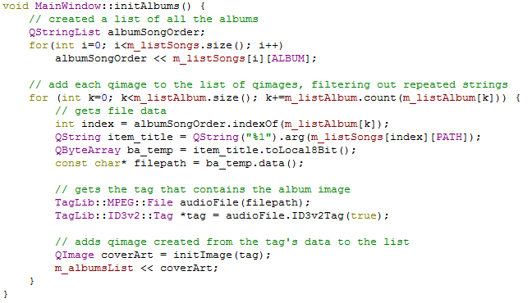
Texture Mapping Images

Slide 26
Visualizer
Bar visualizer
Drop animation and randomized jump animation
Colors

Slide 27
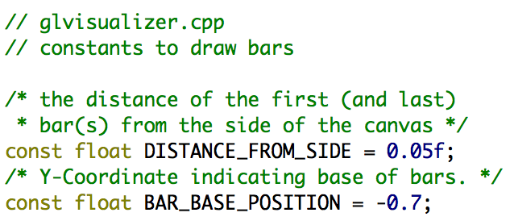
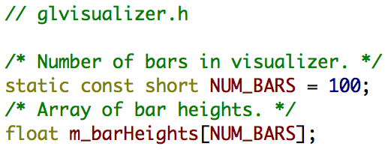
Drawing The Visualizer

Slide 28
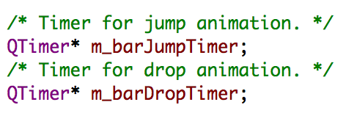
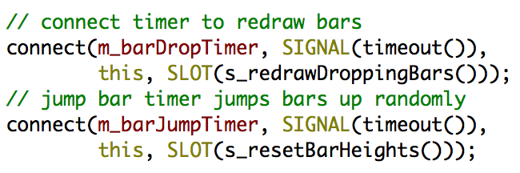
Animation Variables

Slide 29
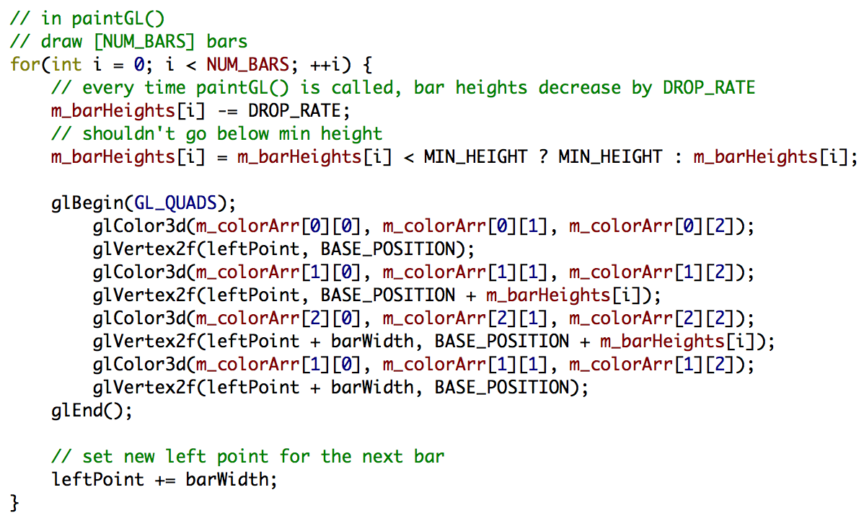
Drop animation
`paintGL()` called by slot connected to `m_barDropTimer`:

Slide 30
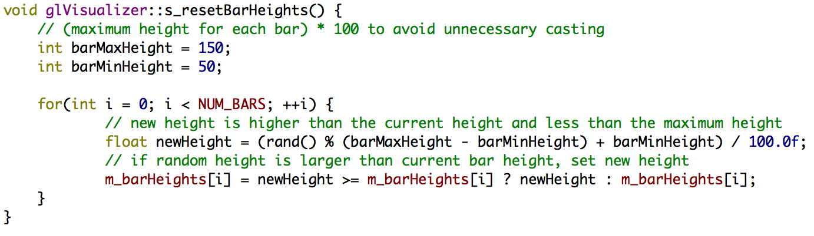
Jump Animation
Slot connected to `m_barJumpTimer` called every 500 ms:

Slide 31
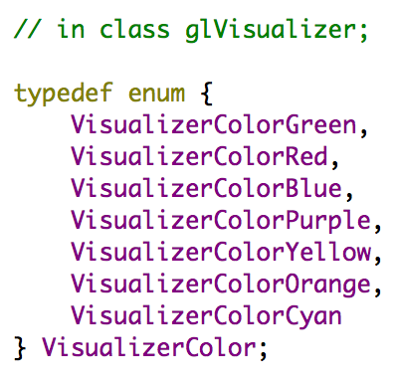
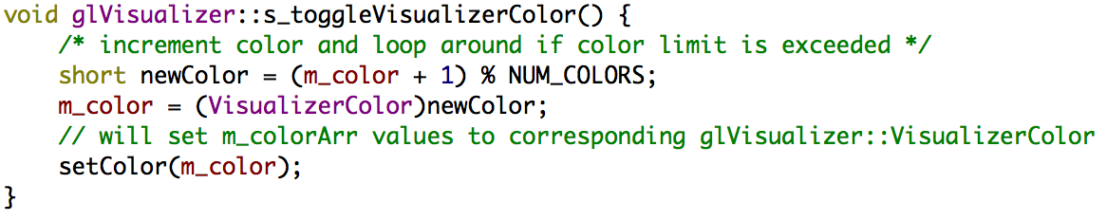
Colors

Slide 32
Obstacles
Using TagLib
Coverflow Gap

Slide 33
What We Learned
How to use Qt to design a GUI
The basics of using OpenGL for graphics
Managing a larger project with multiple group members

