Slide 1
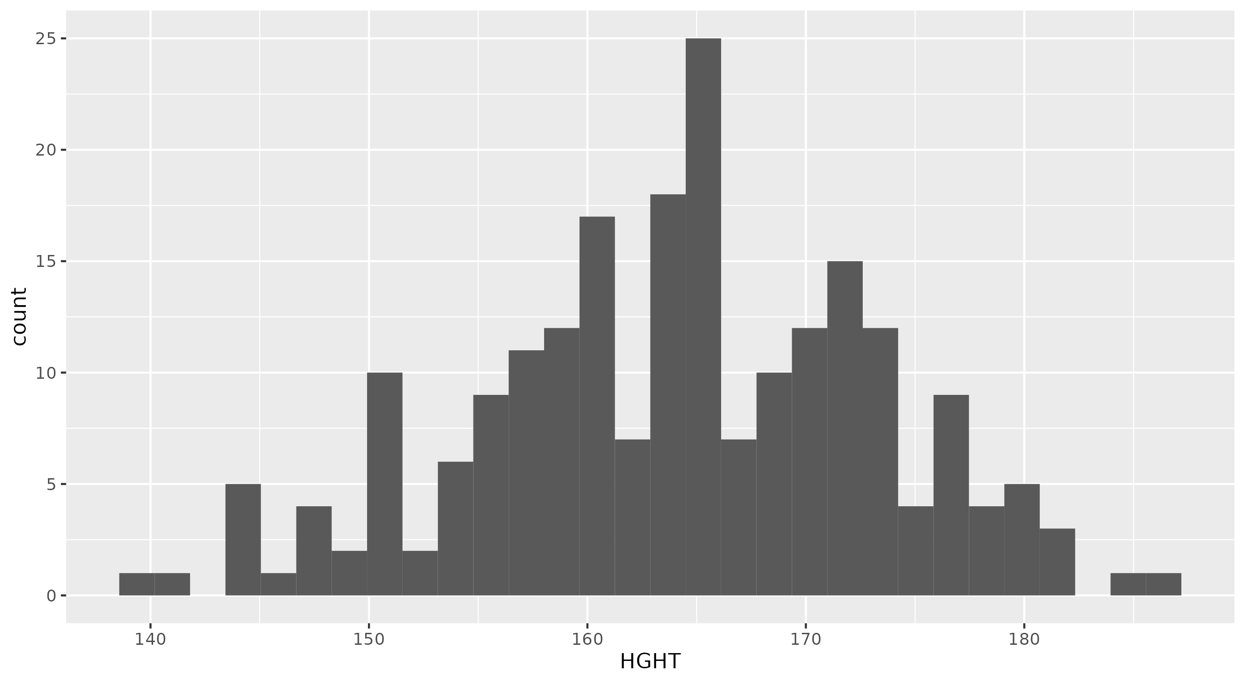

Slide 2
1.00
0.75
smk
1
count
0.50
2
3
NA
0.25
0.00
2009
2010
2011
2012
2013
2014
2015
Year

Slide 3
1 | 2 | 3 | p | test
125 | 34 | 53
119.96 (15.50) | 126.56 (14.52) | 122.77 (16.28) | 0.079
74.39 (10.05) | 79.76 (10.01) | 78.09 (10.84) | 0.008

