Slide 1
Final Project
Calcium Curve Analysis

Slide 2
Introduction of the Final Project
Introduction:
T cell activation is critical in immune response.
T cells activate upon encounter antigens.
The intracellular Calcium concentration increase when T cells is activated.
Objective:
Study T cell activation by monitoring their intracellular calcium level.
Experiment and data collection:
Put antigens on coverglass to induce T cell activation.
Load T cells with fluorescent calcium indicator. When intracellular calcium level raises, their fluorescent intensity increases.
Take movies during T cells interaction with the coverglass to record their fluorescent intensity over time.

Slide 3
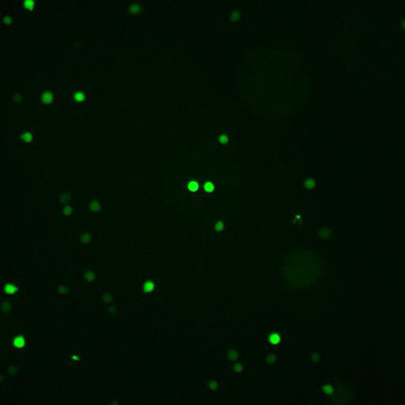
Final project: Calcium Curve Analysis
Data Analysis
Image Analysis
Background subtraction
Segmentation
Track T cells
Measure the fluorescent intensity of each T cell at each time points.
Calcium Curve Analysis
Activated
Fluorescent Intensity
Not activated
Time

Slide 4
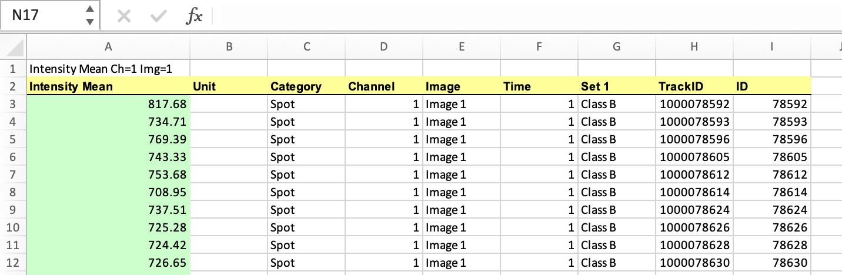
Final project: Calcium Curve Analysis
Measurements
TrackID
We follow the movement of cells, and give each cell a unique ID
Time
For each cell (with a unique TrackID), the time it is being detected.
Note:
There maybe “gaps” in time for some cells
The length of time for some TrackID are very short
Intensity Mean
The corresponding fluorescent intensity measured within the cell.

Slide 5
Final project: Calcium Curve Analysis
Tasks
Find all activated cells and save the corresponding ‘Intensity Mean’, ‘Time’ and ‘TrackID’ to a new DataFrame.
Find all unactivated cells and save the corresponding ‘Intensity Mean’, ‘Time’ and ‘TrackID’ to a new DataFrame.
What is the percentage of activated cells?
Plot the average calcium curve for all activated cells with error bars.

Slide 6
Final project
Requirements
Use data: calcium_curves.xlsx
Include comments, outputs, inline plots.
Cite GenAI if you used it for completing the final project
You are expected to complete this final project on your own. If we find evidences of similar answers in two reports, BOTH will get ZERO.
Submit the Python notebook .ipynb

Slide 7
Final project: Calcium Curve Analysis
Step-by-step instructions:
HW4
HW5 (to get derivative use np.gradient( ))
Now you should have the derivatives of the ‘Intensity Mean’ for each TrackID. If there is a rapid increase in ‘Intensity Mean’, you will find a peak in the corresponding derivatives. (use function find_peaks( ) from the scipy.signal module)
Define a threshold for the peak. If the height of the peak is greater than this threshold, the cell is considered activated.
Find the time of activation (at what time the peak happens).
Randomly select 50 activated cells. Plot their “Intensity Mean” as y-axis, and “Time” as x-axis together with the time of activation point in subplots of 10 rows and 5 columns (example function for plotting provided)
Randomly select 50 unactivated cells. Plot their “Intensity Mean” as y-axis, and “Time” as in subplots of 10 rows and 5 columns.
Visually check if your threshold works well in separating activated vs unactivated curves. If not, adjust the threshold.

Slide 8
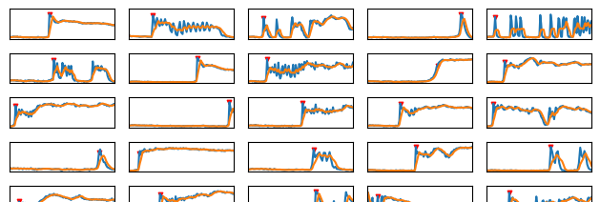
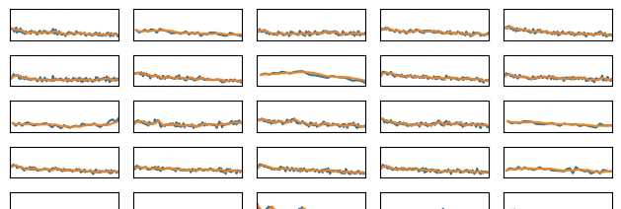
Subplot look like this
Activated
Not activated

Slide 9
Final project: Calcium Curve Analysis
Step-by-step instructions:
Find all activated cells and save the corresponding ‘Intensity Mean’, ‘Time’ and ‘TrackID’ to a new DataFrame.
Find all unactivated cells and save the corresponding ‘Intensity Mean’, ‘Time’ and ‘TrackID’ to a new DataFrame.
What is the percentage of activated cells?
For all activated cells, align the activation time 0. For example: ‘TrackID’: 100001, ‘Time’: [11, 12, 13, …..,19, 20], if the activation happens at ’Time’=12, → ‘Time’: [-1, 0, 1, …..,7, 8]
Calculate the average and SEM for all activated curves at each time point. (SEM: np.std(data)/np.sqrt(data.size))
Plot the average calcium curve for all activated cells with SEM as error bars.

Slide 10
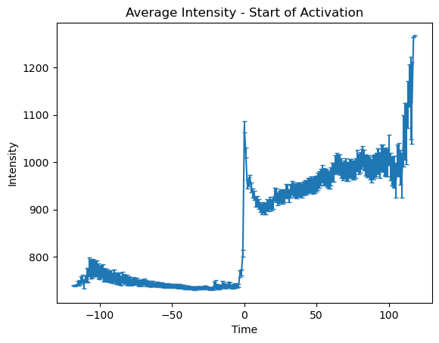
Final project: Calcium Curve Analysis
Align the activation time for all curves to 0
Fluorescent Intensity
Fluorescent Intensity
Time
-1
0
1
Time
The average calcium curve look like this

