Slide 1

Vehicle crashes in Texas 2013

Slide 2
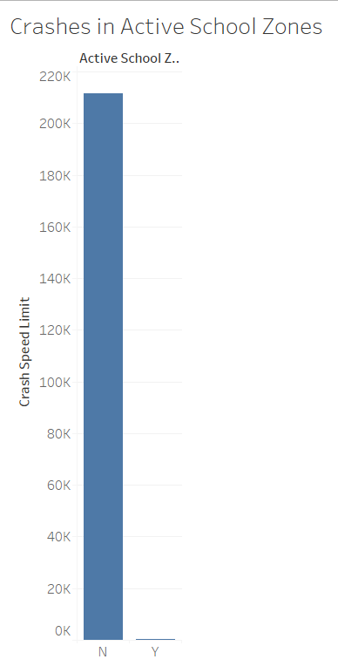
the Data we have shows there were very few crashes that happened in active school zones. Although it is hard to verify this is likely due to the fact that people driving in these zones are dropping off or picking up their children so they are being more diligent about their surroundings.

Slide 3
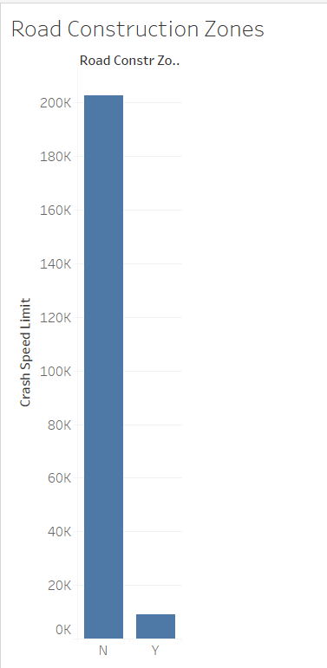
Like School Zones the Construction Zones are not as high as areas without construction going on. Shockingly, the data shows that the speeds of drivers that had crashes in construction zones fall anywhere between 0 mph and 75mph! Unlike school zones people are more likely to speed and in their rush not be as diligent about driving defensively.

Slide 4
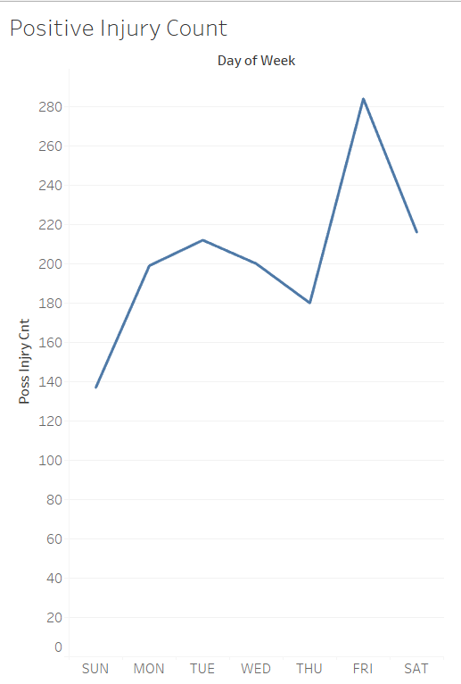
Here is a representation broken down by day of the week. As you can see crashes with injury spike on Fridays. There are a number of reasons for this that can include; more people on the road traveling for vacations, more people going out after work to celebrate the weekend, and the possibility of more drunk drivers on the road.

Slide 5
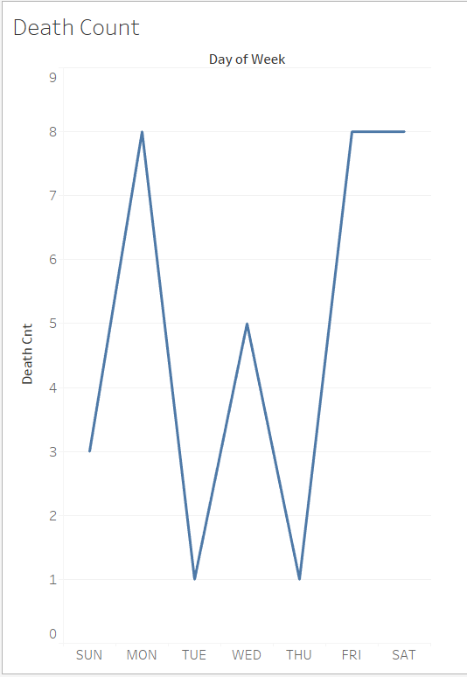
Unlike the injury data the data surrounding accidents that have fatalities do not point in one certain direction as far as day of the week.

Slide 6
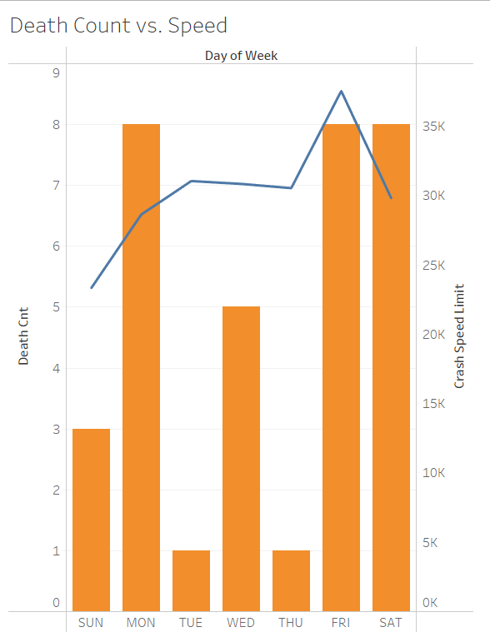
Here we have broken down the speed of the crash vs. whether there was a fatality in the crash or not. While it stands to reason that the faster the car is going the more likely there is to be a death in the event of an accident we can see here that is not always the case. There are many factors at play, not just speed. The safety of your vehicle, how many vehicles are involved in the crash, weather conditions and other factors can all account for injury up to and including death.

Slide 7
So in conclusion the safest way to drive is defensively. You can greatly reduce your risk of a crash as long as you are paying attention to your surroundings and making sure you are doing everything you can do to keep you and your family safe!

