Slide 1

Video Games
Sales trends over the years

Slide 2
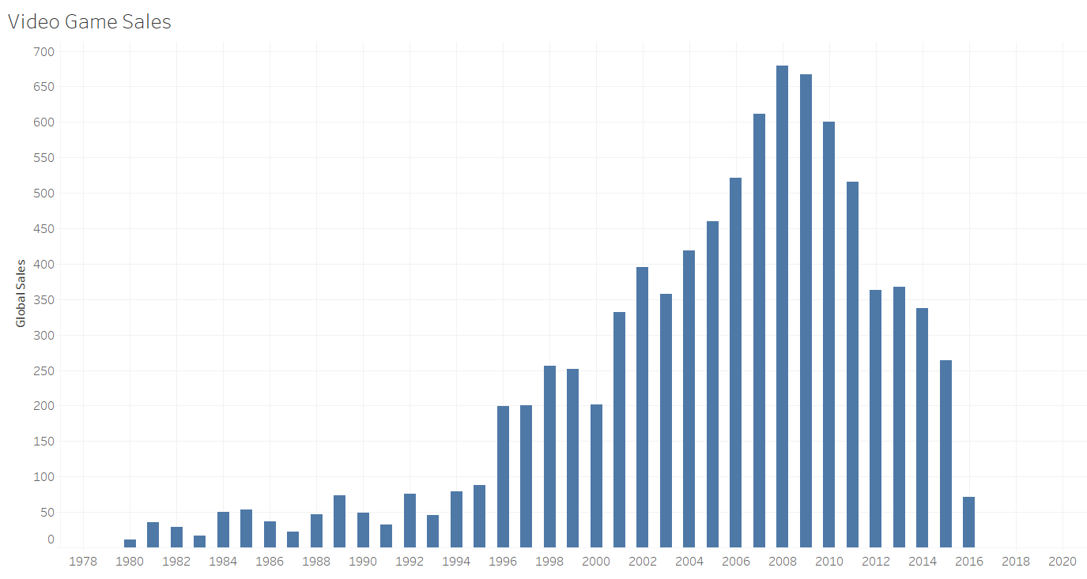
Here is a general overview of the video game sale trends from 1980-2020.

Slide 3
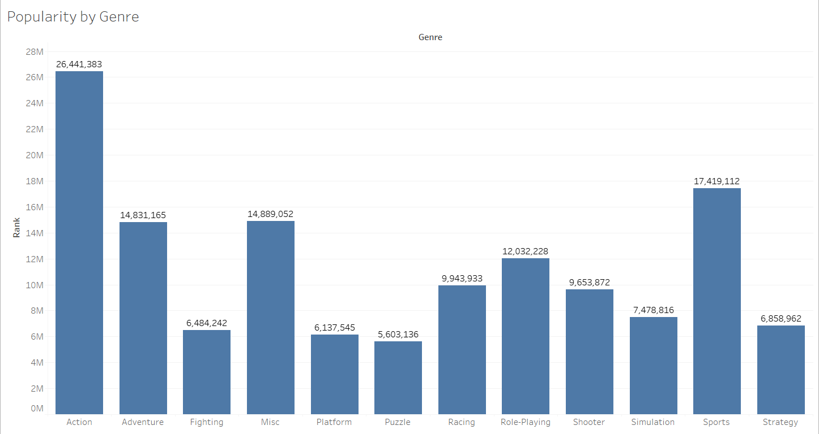
Here I have provided each Genre by popularity with Action being a strong number 1 followed by Sports in the number 2 spot.

Slide 4
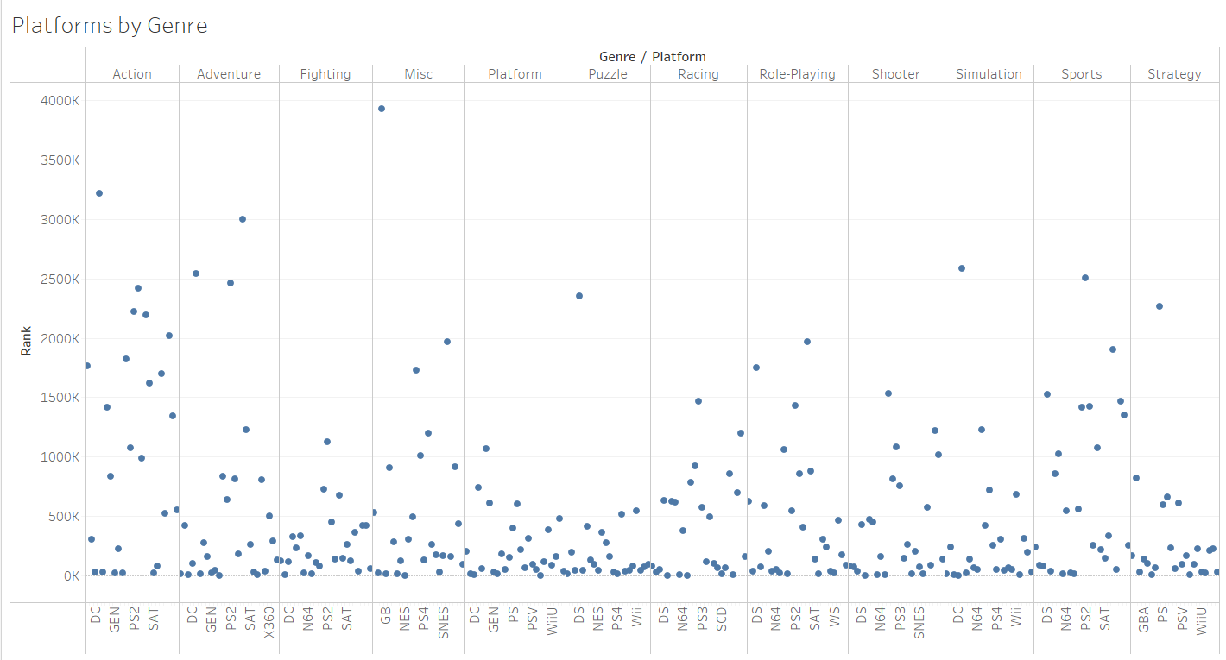
Here we have a representation of the sales by platforms and genre.

Slide 5
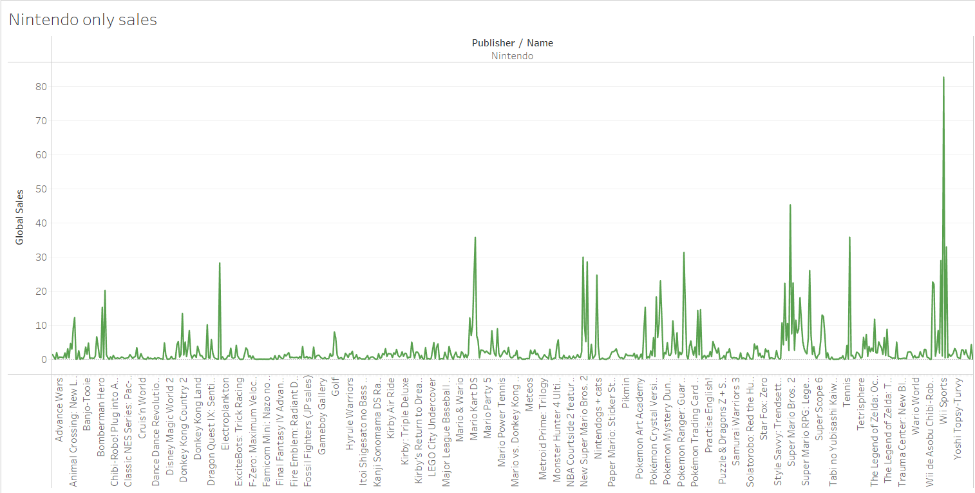

Slide 6
In conclusion, we need to focus on the Action genre in order to create an engaging game that will have the most likelihood of generating the most sales since that is overall our most popular genre of video games!
PLAY ON!

