Slide 1

Comparing the differences of 5 countries between 1952 and 2007
Lesson 9 hands-on

Slide 2
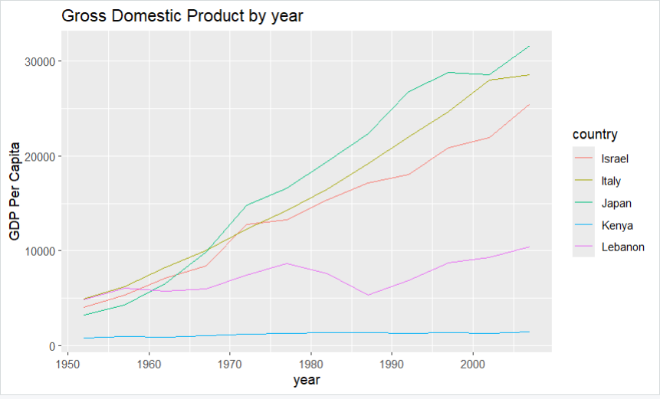
Here is a chart showing the Gross Domestic Product (GDP) as a graph for each country. The lowest GPD for 1952 is Kenya at 853.5, and it remained the lowest into 2007 at 1463.2.
The highest GPD in 1952 was held by Italy at 4931.4, but by 2007 Japan was highest of all at 31,656!

Slide 3
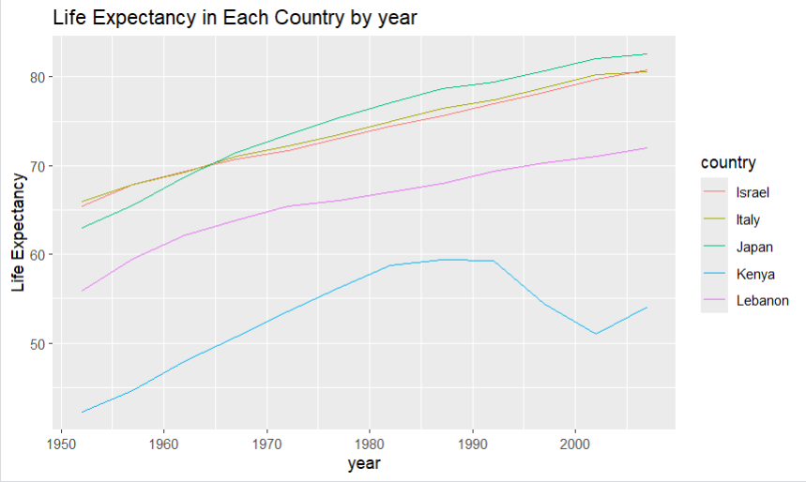
Here is the graph for the life expectancy in our 5 countries. Kenya, just like in our other slide remains the lowest. This is likely due to several famines that epidemics by which they were effected.

Slide 4
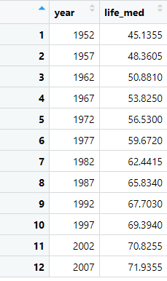
Attached is the median Life Expectancy for the Gapminder data frame. All of our countries, except Kenya, had median life expectancies higher than the listed median from the Gapminder data frame. Kenya’s median fell below the Gapminder median every year.

