Slide 1
So you think you know <html>?

Slide 2
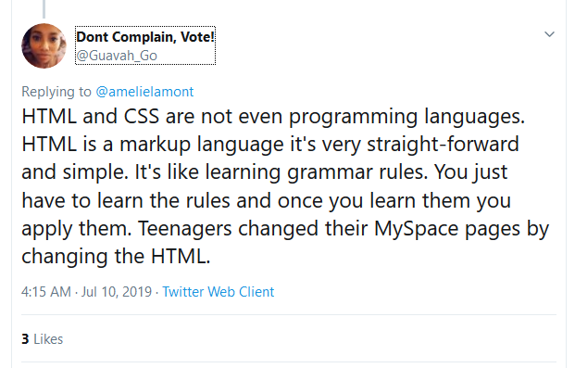







Slide 3
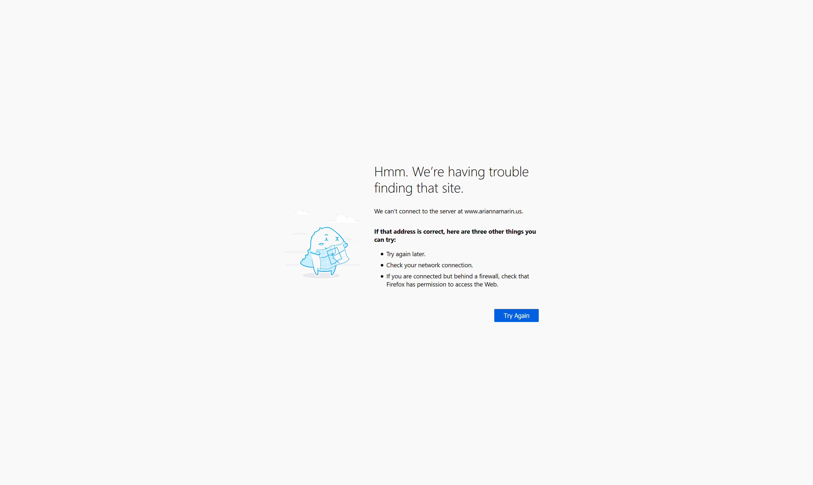


Slide 4
<html> is relatively simple

Slide 5
Did you learn it?

Slide 6
Properly?

Slide 7
<button href"/link">Click here</button>

Slide 8
const Link = styled('a')`
color: navajoWhite;
`
const LinkB = Link.withComponent('button’)
<LinkB href="/link">Click here</LinkB>

Slide 9
h1 {
color: navajoWhite;
}

Slide 10
<div class="title" role="heading" aria-level="1">
Page Title
</div>

Slide 11
<h1>Page Title</h1>

Slide 12
<div class="link" onclick="location.href='/link’”>
Click here
</div>
.link {
color: navajoWhite;
cursor: pointer;
text-decoration: underline;
}

Slide 13
<a href="/link">Click here</a>

Slide 14
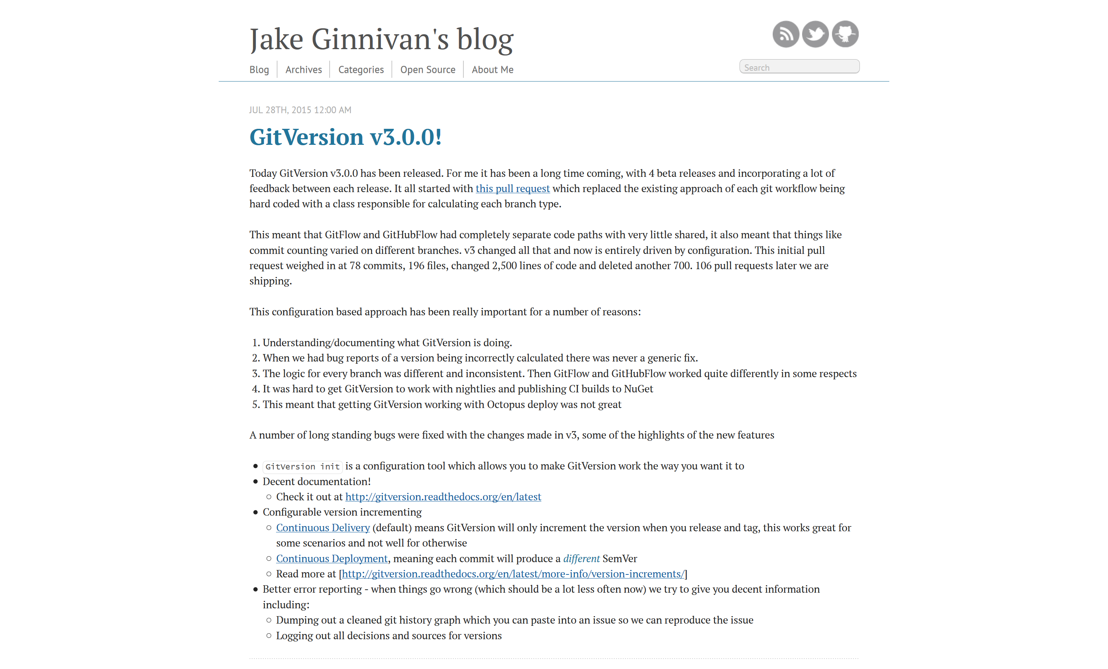

Slide 15
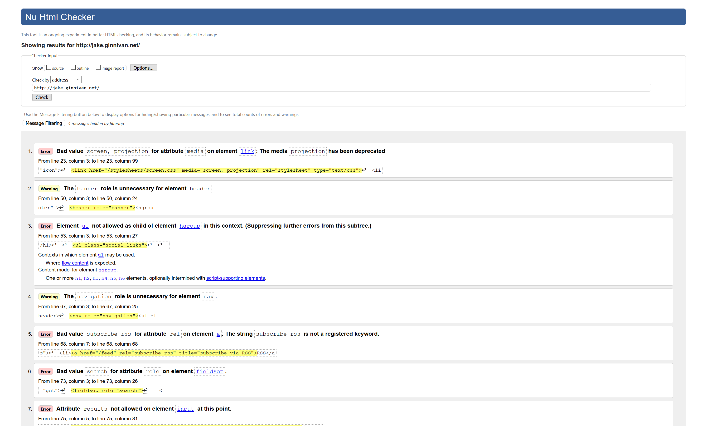
17 Errors

Slide 16
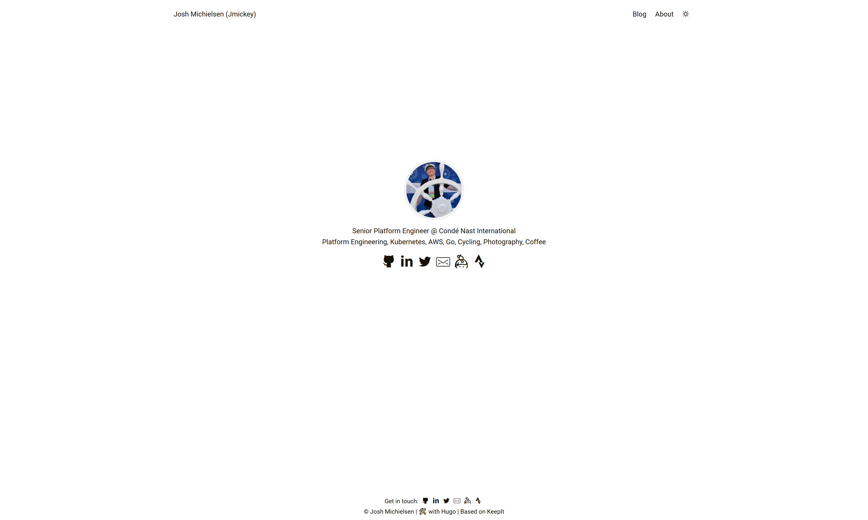

Slide 17
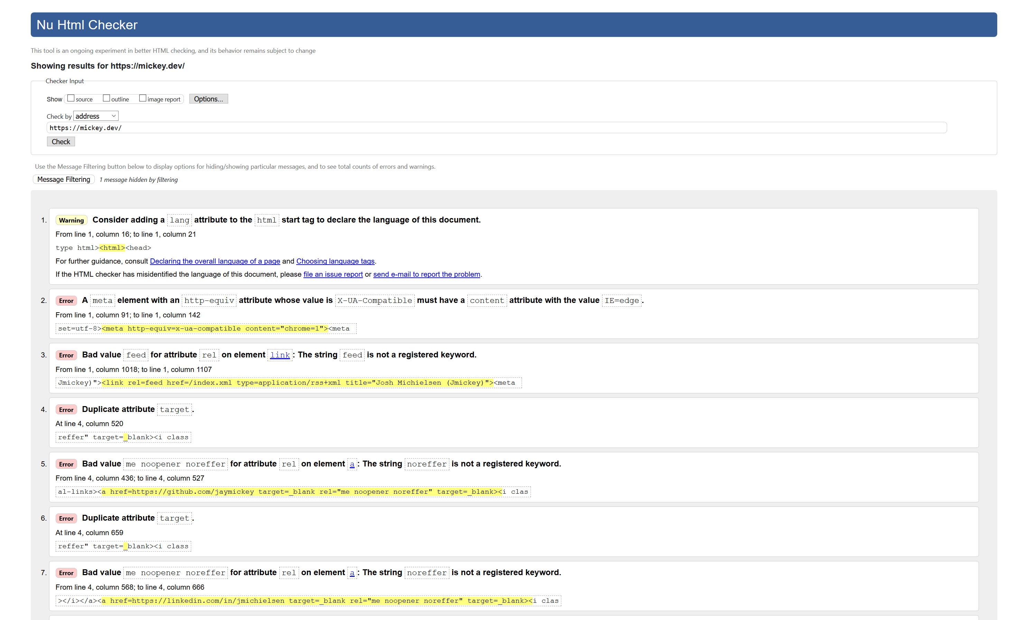
25 Errors

Slide 18


Slide 19
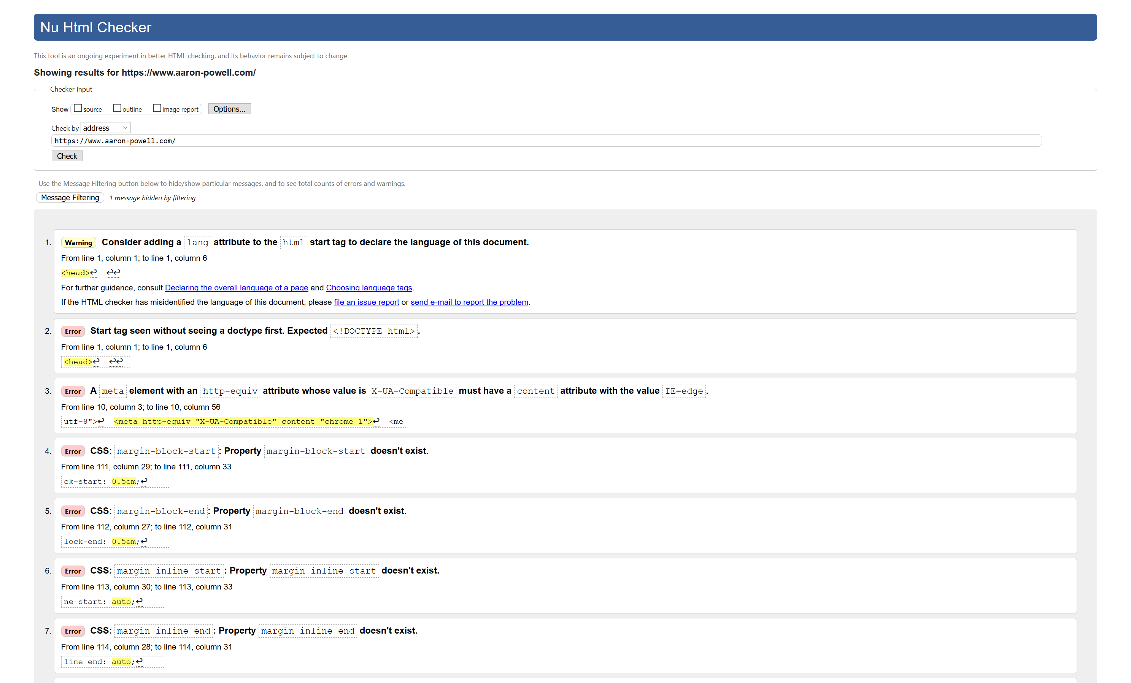
6 Errors

Slide 20


