Slide 1
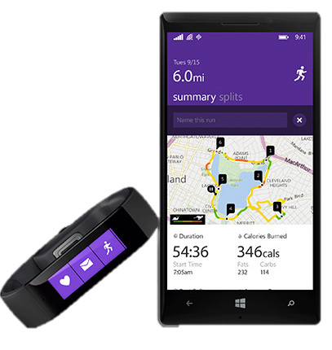
Demo: Band on the Run
@AmyKateNicho

Slide 2
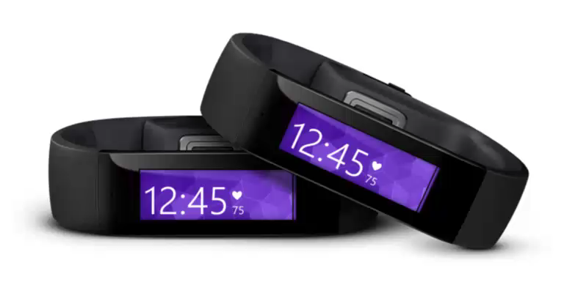
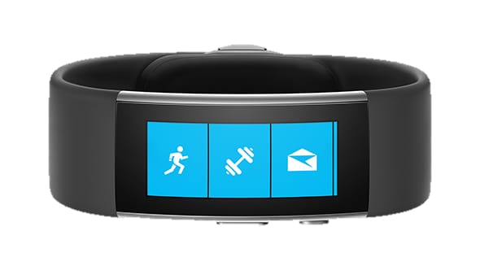
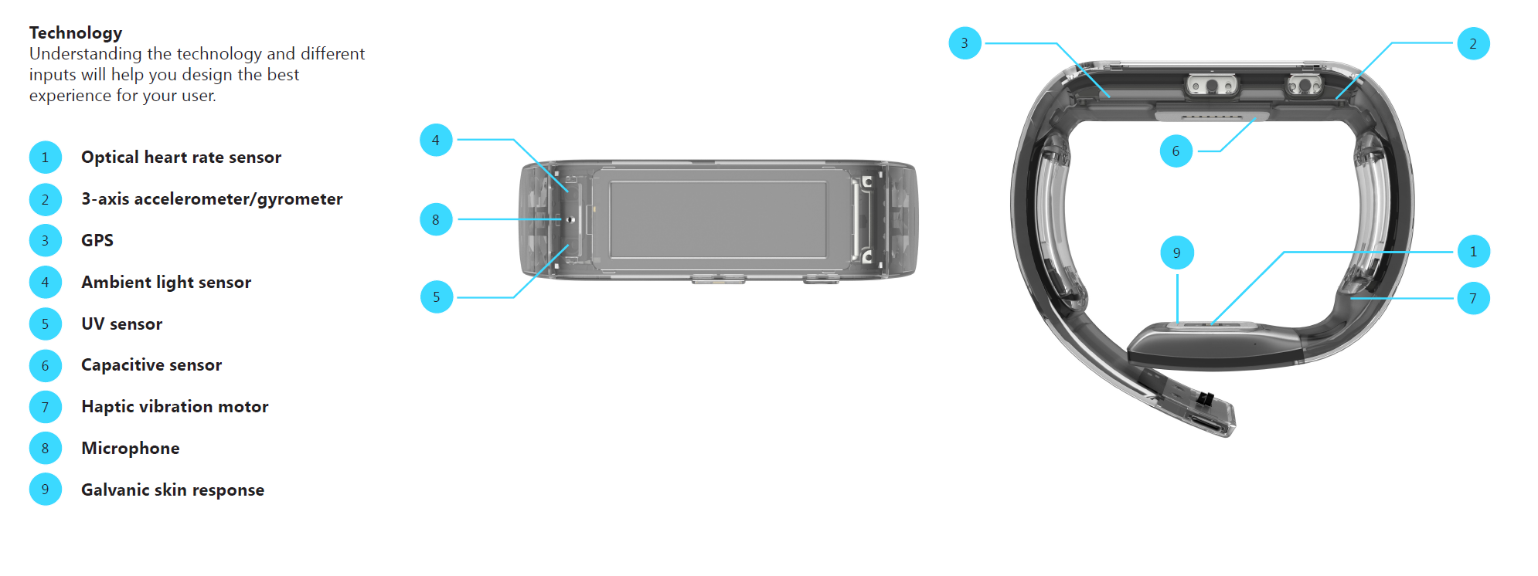

What is the Band?
All day wearable device
Live healthier
Be more productive
Stay connected at a glance
Technology
10 sensors
Touch display
2 days+ battery
10
10
Gyroscope
Notes:
Talking Points:
With the Microsoft Azure IoT Suite we give you a very comprehensive solution that’s designed to help you connect your devices, whether a few hundred or millions across the world, analyze all the data coming from these devices and take action from the insights by integrating with your back end systems. The Azure IoT Suite brings together and offer the following capabilities:
Device connectivity and management: Connect to millions of devices simultaneously. Enhance security of your IoT solutions by taking advantage of per-device authentication to communicate with devices that have the appropriate credentials. Revoke access rights to specific devices to maintain the integrity of your system.
Data Ingestion & Command & Control: Establish reliable, bi-directional communication with these assets, even if they are intermittently connected, and analyze—and act on—incoming telemetry data.
Workflow automation: Integrates with your company’s existing back-end systems to enable you to make the best use of the data and processes you already have. Whether it’s as simple as sending a text or integrating with your CRM or ERP system
Dashboards & Visualization: Create powerful and rich visualization experience and finally
Preconfigured solutions: One of the biggest value we can provide is helping you develop IoT solutions faster. This will not only allow you to do more PoCs and pilots, it will also help accelerate the long project cycles we spoke about earlier. We do this by offering preconfigured solutions for the more common IoT scenarios.

Slide 3





Demo – Band on the Run Architecture
Notes:
Talking Points:
With the Microsoft Azure IoT Suite we give you a very comprehensive solution that’s designed to help you connect your devices, whether a few hundred or millions across the world, analyze all the data coming from these devices and take action from the insights by integrating with your back end systems. The Azure IoT Suite brings together and offer the following capabilities:
Device connectivity and management: Connect to millions of devices simultaneously. Enhance security of your IoT solutions by taking advantage of per-device authentication to communicate with devices that have the appropriate credentials. Revoke access rights to specific devices to maintain the integrity of your system.
Data Ingestion & Command & Control: Establish reliable, bi-directional communication with these assets, even if they are intermittently connected, and analyze—and act on—incoming telemetry data.
Workflow automation: Integrates with your company’s existing back-end systems to enable you to make the best use of the data and processes you already have. Whether it’s as simple as sending a text or integrating with your CRM or ERP system
Dashboards & Visualization: Create powerful and rich visualization experience and finally
Preconfigured solutions: One of the biggest value we can provide is helping you develop IoT solutions faster. This will not only allow you to do more PoCs and pilots, it will also help accelerate the long project cycles we spoke about earlier. We do this by offering preconfigured solutions for the more common IoT scenarios.

