Slide 1

Microsoft Power BI
REST APIs

Slide 2
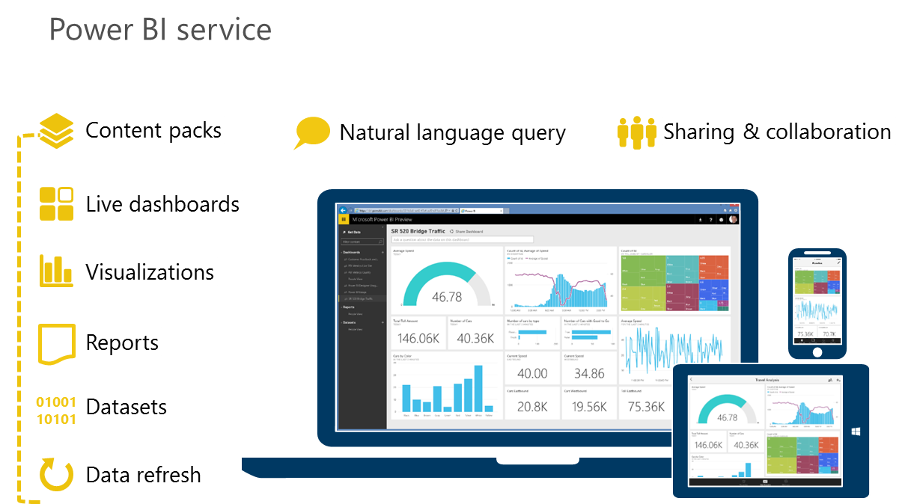

Power BI for Developers
Develop exactly what your organization needs
011001010
0001010
Visuals
Create your own custom visuals for Power BI
“name”:[string], “columns”:[String] “daType”:[String]
Integration
Push data
Add Power BI to existing application workflows
{
"name":{String},
"tables":[
...
]
}
Push data directly from an application into Power BI
{
"name":{String},
"columns":[
{
"name":{String},
"dataType":{String}
},
Real-time
Enable real-time content management and monitoring so users can uncover the latest insights from device, sensor and application data
Notes:
Key message:
Power BI REST APIs allow developers to extend Power BI to deliver exactly what an organization needs
Talking points:
Here are some of the important uses of APIs:
Push data directly from another application into Power BI
Push not only static data, but also real-time data, into Power BI
Just as Azure Stream Analytics can push data directly into Power BI, you can enable other applications to do the same thing for real time visibility
This enables users to manage and monitor real-time content
You can add Power BI to existing application workflows
As discussed earlier, you can create custom connectors and content packs for unique data sources that Power BI doesn’t support as a default
Manage authentication using Azure Active Directory integration

Slide 3
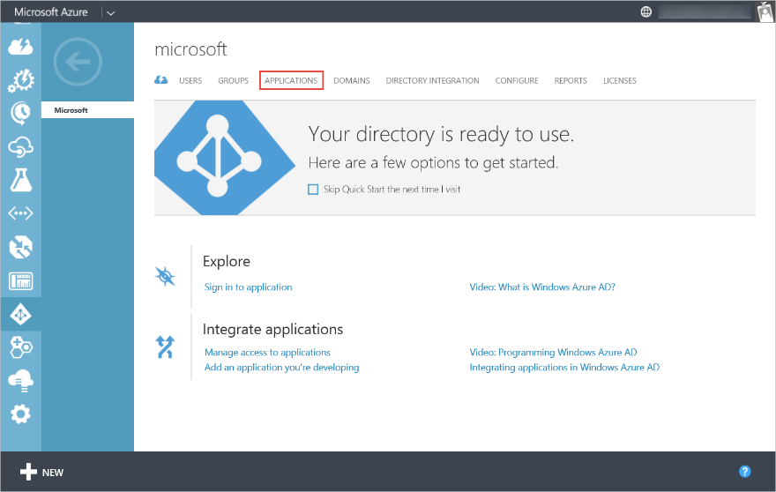
Client app development
Power BI for Developers
Using console app, cloud app, mobile app, cloud app we can push real time data to Power BI
Register a client app
Get client app id
Power BI REST API calls are made on behalf of an authenticated user by passing a token in the “Authorization” header that is acquired through Azure Active Directory
http://dev.powerbi.com
Client app
Web
REST API
Extensibility
Samples
Notes:
Key message:
Talking points:

Slide 4
Web development
Power BI for Developers
Using web application, web app role you can push real time data to Power BI
Register your web app
Configure Power BI settings to authenticate with Azure AD
Create a query string to get authorization code from Azure AD
Acquire an Azure AD access token using authorization code
Use Azure AD access token to call a Power BI operation
http://dev.powerbi.com
Client app
Web
REST API
Extensibility
Samples
Notes:
Key message:
Talking points:

Slide 5
Open API for integration
Power BI for Developers
Programmatically access Power BI resources (datasets, tables)
Use the REST API to push data directly from your application into Power BI
Azure Active Directory and OAuth 2.0 for user authentication
Max rows per single push 10,000
Used JSON to describe objects
5 million row max per table
Max of 5 pending request at one time
http://dev.powerbi.com
Client app
Power BI SaaS Service
Web
Power BI User Account
REST API
Datasets
Reports
Dashboards
Extensibility
Samples
Your Service or Application
Push Data Component
Push Content Component
Notes:
Key message:
Talking points:

Slide 6
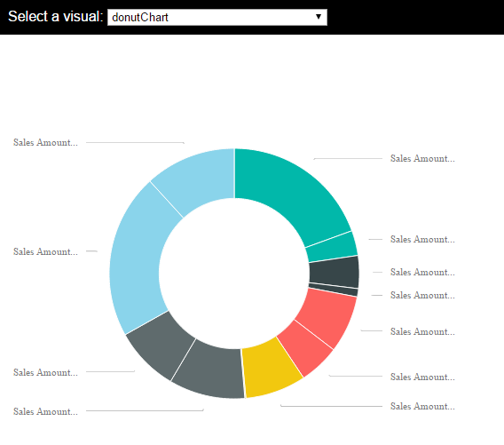
Extend Power BI
Power BI for Developers
Extend Power BI with custom visuals
Enabling developers to easily add custom visuals into Power BI for use in dashboard, reports and content packs
https://github.com/Microsoft/PowerBI-Visuals
http://dev.powerbi.com
Client app
Web
REST API
Extensibility
Samples
Notes:
Key message:
Talking points:

Slide 7
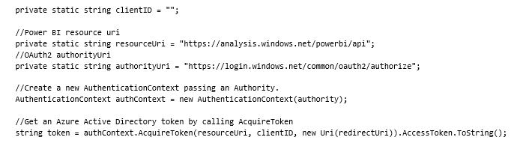
Client app sample: Get Azure AD access token
Power BI for Developers
Add the "Active Directory Authentication Library" NuGet package to your project
Add a reference to Microsoft.IdentityModel.Clients.ActiveDirectory
Create a new AuthenticationContext passing an Authority
Get an Azure Active Directory token by calling AcquireToken
Client app
Web
REST API
Extensibility
Samples
Notes:
Key message:
Power BI REST APIs allow developers to extend Power BI to deliver exactly what an organization needs
Talking points:
Here are some of the important uses of APIs:
Push data directly from another application into Power BI
Push not only static data, but also real-time data, into Power BI
Just as Azure Stream Analytics can push data directly into Power BI, you can enable other applications to do the same thing for real time visibility
This enables users to manage and monitor real-time content
You can add Power BI to existing application workflows
As discussed earlier, you can create custom connectors and content packs for unique data sources that Power BI doesn’t support as a default
Manage authentication using Azure Active Directory integration

Slide 8
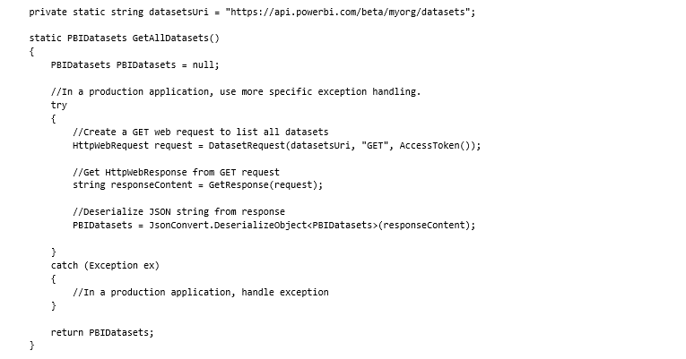
Client app sample: Get all datasets from Power BI
Power BI for Developers
Create an HttpWebRequest using a GET method
Get a response from the Power BI service
Client app
Web
REST API
Extensibility
Samples
Notes:
Key message:
Power BI REST APIs allow developers to extend Power BI to deliver exactly what an organization needs
Talking points:
Here are some of the important uses of APIs:
Push data directly from another application into Power BI
Push not only static data, but also real-time data, into Power BI
Just as Azure Stream Analytics can push data directly into Power BI, you can enable other applications to do the same thing for real time visibility
This enables users to manage and monitor real-time content
You can add Power BI to existing application workflows
As discussed earlier, you can create custom connectors and content packs for unique data sources that Power BI doesn’t support as a default
Manage authentication using Azure Active Directory integration

Slide 9
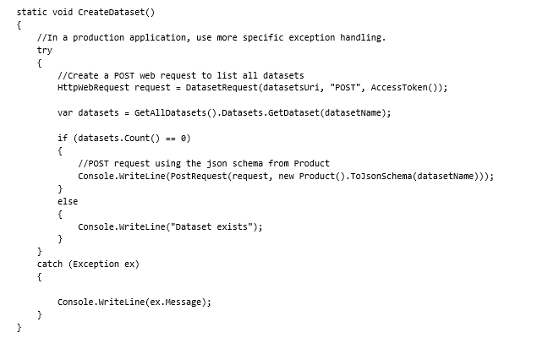
Client app sample: Create a dataset in Power BI
Power BI for Developers
Create an HttpWebRequest using a POST method
Get a response from the Power BI service
Client app
Web
REST API
Extensibility
Samples
Notes:
Key message:
Power BI REST APIs allow developers to extend Power BI to deliver exactly what an organization needs
Talking points:
Here are some of the important uses of APIs:
Push data directly from another application into Power BI
Push not only static data, but also real-time data, into Power BI
Just as Azure Stream Analytics can push data directly into Power BI, you can enable other applications to do the same thing for real time visibility
This enables users to manage and monitor real-time content
You can add Power BI to existing application workflows
As discussed earlier, you can create custom connectors and content packs for unique data sources that Power BI doesn’t support as a default
Manage authentication using Azure Active Directory integration

Slide 10
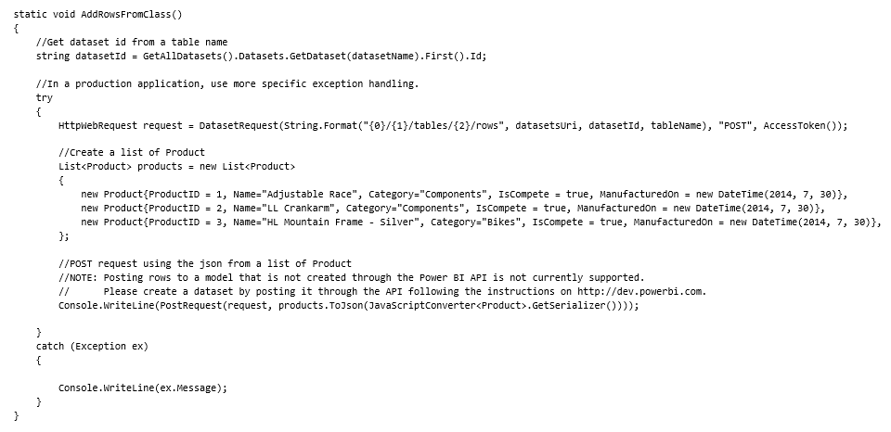
Client app sample: Create a dataset in Power BI
Power BI for Developers
Create an HttpWebRequest using a POST method
To identify the dataset to add rows to, the resource uri for a POST method has a dataset id
Get a response from the Power BI service
Client app
Web
REST API
Extensibility
Samples
Notes:
Key message:
Power BI REST APIs allow developers to extend Power BI to deliver exactly what an organization needs
Talking points:
Here are some of the important uses of APIs:
Push data directly from another application into Power BI
Push not only static data, but also real-time data, into Power BI
Just as Azure Stream Analytics can push data directly into Power BI, you can enable other applications to do the same thing for real time visibility
This enables users to manage and monitor real-time content
You can add Power BI to existing application workflows
As discussed earlier, you can create custom connectors and content packs for unique data sources that Power BI doesn’t support as a default
Manage authentication using Azure Active Directory integration

Slide 11
Web app sample: Create a dataset in Power BI
Power BI for Developers
Create an HttpWebRequest using a POST method
Get a response from the Power BI service
For additional details please see:
https://msdn.microsoft.com/en-us/library/mt143610.aspx
Client app
Web
REST API
Extensibility
Samples
Notes:
Key message:
Power BI REST APIs allow developers to extend Power BI to deliver exactly what an organization needs
Talking points:
Here are some of the important uses of APIs:
Push data directly from another application into Power BI
Push not only static data, but also real-time data, into Power BI
Just as Azure Stream Analytics can push data directly into Power BI, you can enable other applications to do the same thing for real time visibility
This enables users to manage and monitor real-time content
You can add Power BI to existing application workflows
As discussed earlier, you can create custom connectors and content packs for unique data sources that Power BI doesn’t support as a default
Manage authentication using Azure Active Directory integration

Slide 12
REST API Samples
Experience your data … anyway, anywhere, anytime

Slide 13

Object model hierarchy
A Power BI tenant can have multiple datasets which are identified with GUID
A dataset can have multiple tables which are referenced by name
A table has multiple rows
Power BI
Datasets
Tables
Rows
Notes:
Source: https://msdn.microsoft.com/en-US/library/dn889825.aspx
Data types
Supported EDM date types and restrictions:
Data type Restrictions
Int64 Int64.MaxValue and Int64.MinValue not allowed.
Double Double.MaxValue and Double.MinValue values not allowed.
NaN not supported.+Infinity and -Infinity not supported
in some functions (e.g. Min, Max).
Boolean
Datetime During data loading we quantize values with day fractions
to whole multiples of 1/300 seconds (3.33ms).
String Currently allows up to 128K characters.
Table Rows [/datasets/{id}/tables/{TableName}/rows]
A collection of rows for a specific Table.
Parameters
id (required, string, some guid) ... Unique guid of the Dataset to use.
TableName (required, string, friendly table name) ... Name of the Dataset table.
Supported limits
POST Rows
Max rows per single push 10,000
Single push is non-continuous. It does not mean that the table is empty to start and it does not need to complete in under a second
Continuous push: Once per second at a max size of 500 rows with a max table size of 2 million rows
5 million row max per table
Max of 5 pending request at one time

Slide 14
GET Datasets example
Use GET against your organization path using datasets
Returns JSON with id and name
GET https://api.powerbi.com/beta/myorg/datasets HTTP/1.1
Authorization: Bearer {AAD Token}.
Content-Type: application/json; charset=utf-8
{
"datasets": [
{
"id": "2C0CCF12-A369-4985-A643-0995C249D5B9",
"name": "Music"
},
{
"id": "C446840B-94AD-4B23-8896-C276E69B8FAA",
"name": "SalesMarketing"
}
]
}
Notes:
Ap-uri… Link for these

Slide 15
POST a Table to a Dataset
Create table using POST to datasets collection
Specify the name of the dataset
Specify the table name
Specify the columns in the table
POST https://api.powerbi.com/beta/myorg/datasets HTTP/1.1
Authorization: Bearer {AAD Token}
Content-Type: application/json
{
"name": "SalesMarketing",
"tables":
[
{
"name": "Product", "columns":
[
{ "name": "ProductID", "dataType": "Int64"},
{ "name": "Name", "dataType": "string"},
{ "name": "Category", "dataType": "string"},
{ "name": "IsCompete", "dataType": "bool"},
{ "name": "ManufacturedOn", "dataType": "DateTime"}
]
}
]
}
1
2
3

Slide 16
POST rows to a table
Use POST with rows JSON payload to add rows to a table
Use the ID for the Dataset along with the table name
Specify the payload with the column name and value
POST https://api.powerbi.com/beta/myorg/datasets/2C0CCF12-A369-4985-A643-0995C249D5B9/Tables/Product/Rows HTTP/1.1
Authorization: Bearer {AAD Token}
Content-Type: application/json
{
"rows":
[
{
"ProductID":1,
"Name":"Adjustable Race",
"Category":"Components",
"IsCompete":true,
"ManufacturedOn":"07/30/2014"
}
]
}
1
2

Slide 17
DELETE all rows in the table
Use DELETE verb and the path to the table rows to truncate the table
Include the Dataset ID and the Table name in the path
DELETE https://api.powerbi.com/beta/myorg/datasets/2C0CCF12-A369-4985-A643-0995C249D5B9/Tables/Product/Rows HTTP/1.1
Authorization: Bearer {AAD Token}
Content-Type: application/json
1

Slide 18
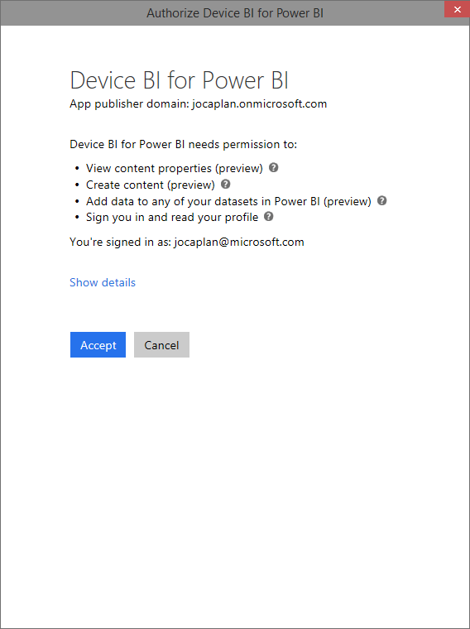
User authorization of app on first run
User launches application
Power BI displays the Authorize Device dialog for the app token

Slide 19
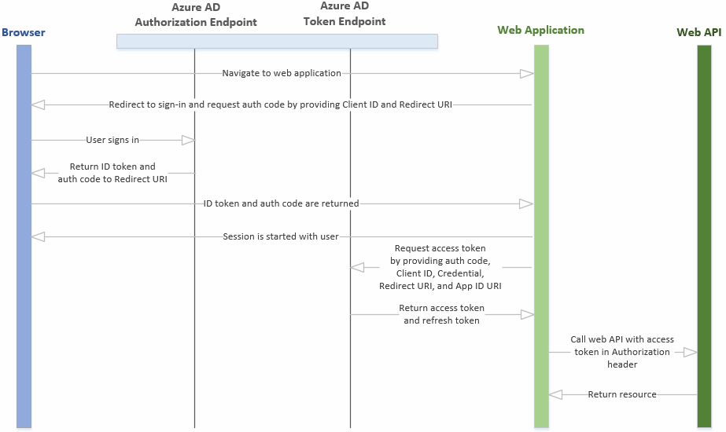
How Web Applications are authorized
From top to bottom, this is how Power BI authenticates application requests

Slide 20
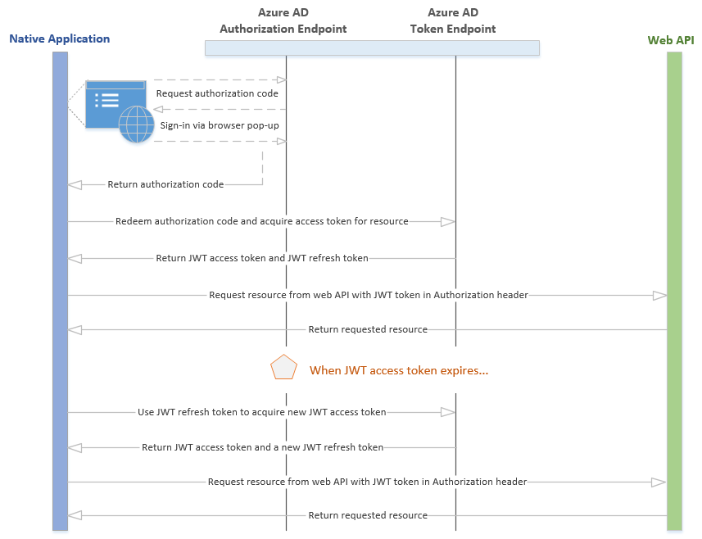
How native client applications are authorized
From top to bottom, this is how Power BI authenticates application requests

Slide 21
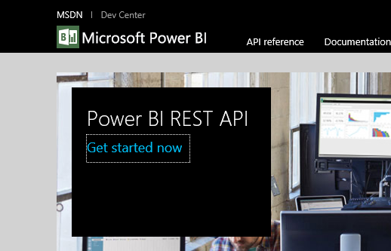
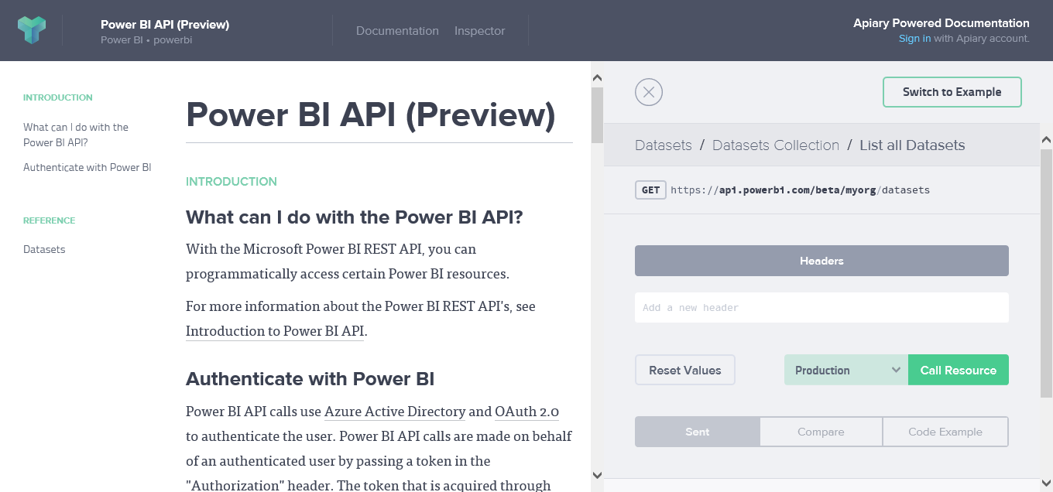
Working with the API console
To better understand how the API works, click on Get started now to launch the API console
Test out each of the API verbs using the console interface

