Slide 1
All-Time Fantasy Baseball
Bridging eras with machine learning
Babe Ruth vs. Shohei Ohtani — for real.
Tim · Axiom Trading
Notes:
• Open with the hook: imagine drafting Ruth, Mays, and Ohtani onto the same fantasy team and simulating a 162-game season. • That's what we're building — a fantasy league where every era plays on the same field. • Nobody has done it credibly before because it requires solving one specific technical problem — which is what the rest of this talk is about.

Slide 2
THE IDEA
An all-time league that plays like real baseball
1
2
3
Every era, one league
Era-adjusted stats
Real game outcomes
Draft pool spans 1871 → 2024.
Ruth, Wagner, Mays, Judge, Ohtani —
all eligible, all on the same roster.
Full House Modeling (Eck et al., 2025)
puts every player on a comparable
rate scale — 1921 next to 2024.
Same matchup, different result
each game. Deterministic projection
would just be a spreadsheet.
All three need a real simulation engine — that's where OOTP comes in. →
2 / 12
Notes:
• We want a fantasy league that spans every era of MLB history — Ruth, Wagner, Mays, Judge, Ohtani all eligible to be on the same roster. • The cross-era comparison problem is already solved by other research — Full House Modeling (Eck et al., 2025) gives us era-adjusted career stats, putting Ruth's 1921 and Judge's 2024 on a comparable rate scale. • But we don't just want a deterministic projection where the better stats always win — that would be boring. We want real game-by-game variance like actual baseball, where the underdog can win on any given day. • All three of those — every era, era-adjusted, and real game outcomes — need a real simulation engine. That's where OOTP comes in, on the next slide.

Slide 3
THE GAME ENGINE
Out of the Park Baseball
[ Your OOTP slide goes here ]
Cover the engine briefly — what OOTP simulates, why we use it, ~30 seconds
3 / 12
Notes:
• Keep this tight (~30 seconds) so the rest of the talk has time.

Slide 4
THE PROBLEM
OOTP doesn't simulate from raw stats.
Real career stats
?
OOTP ratings (20–80)
???
HR, BA, OBP, SLG
K%, BB%, ISO
wOBA, sprint speed
POW · CON · EYE
SPE · FLD · ARM
STU · MOV · CTL · STA
supervised learning problem
Modern players have BOTH real stats AND OOTP ratings — that's our training signal.
4 / 12
Notes:
• OOTP is a powerful simulator but it doesn't take raw stats as input — it uses internal 20–80 ratings for power, contact, eye, speed, etc. • To put any historical player into the game, we have to convert their career stats into one of those rating vectors. • That's a supervised-learning problem, and we have a clean training signal: modern players have both real stats and OOTP ratings.

Slide 5
APPROACH
Train. Validate. Apply.
1
2
3
4
Modern overlap
Train + validate
Apply to history
Import to OOTP
667 OOTP players
with real-stat lookups
Linear / polynomial
MAE & R² on holdout
Era-adjusted stats
→ rating per player
Roster CSV → draft
→ simulate seasons
Experiment 1 covers the full chain — on one rating (POW)
5 / 12
Notes:
• The strategy is: train the stat-to-rating mapping on modern players where we have both, validate it on a holdout, then apply to era-adjusted historical stats. • Each rating in OOTP gets its own model trained the same way. • Experiment 1 is the smallest version of this — one rating (power), one feature family (HR rate) — but it goes end-to-end through all four steps.

Slide 6
EXPERIMENT 1 · METHOD
Predicting OOTP POW from career HR rate
DATA
FEATURES
MODELS
667 OOTP players
HR rate + handedness
Linear + polynomial
MLB Stats API · 2024
Career HR + PA per player
Filter PA ≥ 500 → 441 hitters
hr_per_600 = (HR / PA) × 600
one-hot bats (R reference)
kept simple on purpose
OLS regression
Polynomial deg-2 (sanity)
80 / 20 split · seed 42
TARGETS: MAE < 6 rating points · R² > 0.6
6 / 12
Notes:
• One feature on purpose — if HR rate doesn't work, more features won't save it. • Why HR per 600: normalizes for playing time. 30 HR in 350 PA is very different from 30 HR in 700 PA. • Why PA ≥ 500: below that, OOTP ratings rely on scouting projections rather than MLB stats — adds noise. • Why only linear and polynomial: with one feature, complex models overfit and we lose the coefficient interpretation.

Slide 7
DEEP DIVE · NOTEBOOK 1
Build the training set
1
Load OOTP ratings — 667 active MLB hitters
with POW, B_1 (handedness), HistID
CODE SNIPPET
2
Map bbref IDs → MLBAM IDs
via pybaseball.playerid_reverse_lookup
[ Drop a screenshot here ]
3
Pull career HR + PA from MLB Stats API
in 50-ID batches; cache to JSON for instant reruns
Capture from 01_load_and_join.ipynb:
the MLB Stats API batch-fetch loop
(inside load_career_via_mlb_api)
showing the requests.get call and
the homeRuns / plateAppearances
extraction from the JSON response
4
Inner-join OOTP labels to stats; filter PA ≥ 500
→ 441 hitters survive
5
Engineer features: hr_per_600, bats_L, bats_S
→ write data/training_data.csv
7 / 12
Notes:
• Notebook 1 builds a clean training set from the modern OOTP cohort. • Step 1: load the OOTP CSV — 667 active MLB hitters with their POW rating and handedness. • Step 2: map bbref IDs to MLBAM IDs via pybaseball's reverse lookup — that part of pybaseball still works reliably. • Step 3: pull career HR and PA from the official MLB Stats API in batches of 50; responses are cached locally so reruns are instant. • Step 4: filter to PA ≥ 500 — below that, OOTP ratings lean on scouting projections rather than MLB stats and add noise. • Step 5: feature-engineer and write training_data.csv — that's what notebook 2 picks up.

Slide 8
DEEP DIVE · NOTEBOOK 2
Train and validate the POW model
1
Read training_data.csv (441 rows)
CODE SNIPPET
2
80 / 20 random split with random_state = 42
→ 352 train · 89 test
[ Drop a screenshot here ]
3
Fit linear regression on hr_per_600 + bats_L + bats_S
Capture from 02_train_pow_model.ipynb:
the train + evaluate block —
LinearRegression().fit(X_train, y_train)
+ mean_absolute_error / r2_score on the
holdout split.
Bonus: include the polynomial pipeline
(make_pipeline + PolynomialFeatures)
if there's room.
4
Fit polynomial degree-2 (sanity check for ceiling effects)
5
Evaluate on the 89-player holdout: MAE, R², max error
6
Save scatter, residuals, predicted-vs-actual + metrics.json
8 / 12
Notes:
• Notebook 2 trains the POW model on the training set notebook 1 built and validates it on a holdout. • Step 1+2: load and 80/20 split with a fixed seed for reproducibility. • Step 3+4: fit linear regression, then a degree-2 polynomial as a sanity check for boundary curvature. • Step 5: evaluate on the held-out 89 players — MAE 5.14, R² 0.704 for the polynomial, both targets passed. • Step 6: save plots and metrics.json — those are what we'll see on the next slide.

Slide 9
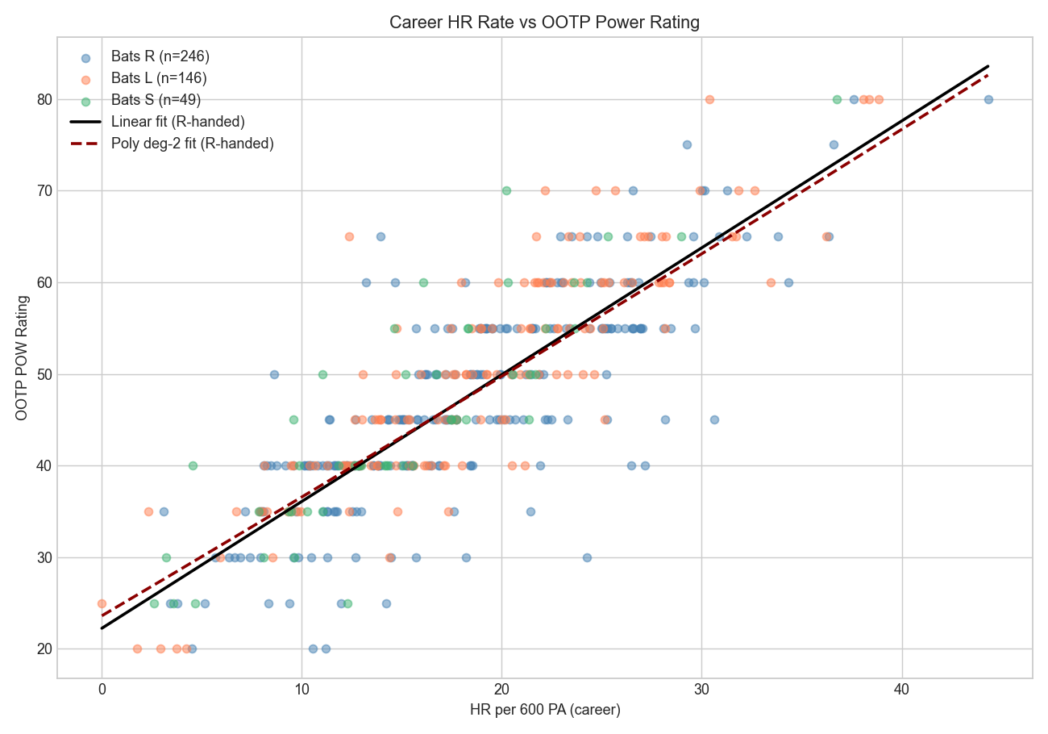
EXPERIMENT 1 · VALIDATION
Both targets met — single feature, ~70% R²
Test set (n = 89)
Model
MAE
R²
Linear
5.22
0.697
Polynomial deg-2
5.14
0.704
PASS · MAE < 6
PASS · R² > 0.6
Judge: actual 80, predicted 83.6
+1 HR/600 → +1.4 POW points
9 / 12
Notes:
• Both targets met: MAE 5.14 and R² 0.704 — about 70% of POW variance from a single rate stat. • Linear coefficient: each additional HR per 600 PA adds about 1.4 POW points — matches intuition. • Quick sanity: Aaron Judge actual 80, predicted 83.6 — model gets the top of the scale right. • One iteration story worth a sentence: first run on Lahman-2021 missed both targets; switching to MLB Stats API 2024 fixed it with no model changes — data recency mattered more than model complexity.

Slide 10
DEEP DIVE · NOTEBOOK 3
Apply the model to era-adjusted history
1
Run extract_era_adjusted_data.R
fullhouse + Lahman → era_adjusted_batters.csv
CODE SNIPPET
2
Read the CSV (9,637 batters, era-adjusted career stats)
[ Drop a screenshot here ]
3
Normalize handedness: Lahman "B" → "S"; missing → "R"
Capture from 03_predict_historical.ipynb:
the predict-and-clamp block —
linear.predict(X_hist) followed by
.clip(20, 80).round().astype(int)
Bonus: include the re-fit step
(LinearRegression().fit(X_train, y_train)
on the full training set) so it's clear
this is fit-then-apply.
4
Same feature engineering (hr_per_600, bats_L, bats_S)
filter PA ≥ 500
5
Re-fit POW on the full training set
(no holdout — every drop of signal helps)
6
Predict for every historical batter; clamp to [20, 80]
7
Save data/historical_pow_predictions.csv
10 / 12
Notes:
• Notebook 3 takes the validated model and applies it to era-adjusted career stats for every batter in MLB history. • Step 1: a tiny R script does the heavy lifting — fullhouse and Lahman are both R packages, so we let R join them and emit a single CSV. • Step 2-4: read the CSV, normalize handedness, run the same feature engineering as notebook 1. • Step 5: re-fit the model on the FULL training set (no holdout — we already validated; now we want every drop of signal). • Step 6+7: predict POW for every player, clamp to the OOTP 20-80 range, and write the predictions CSV. • Output: an OOTP-ready POW rating for 9,637 historical batters — Ruth at the top, just as expected.

Slide 11
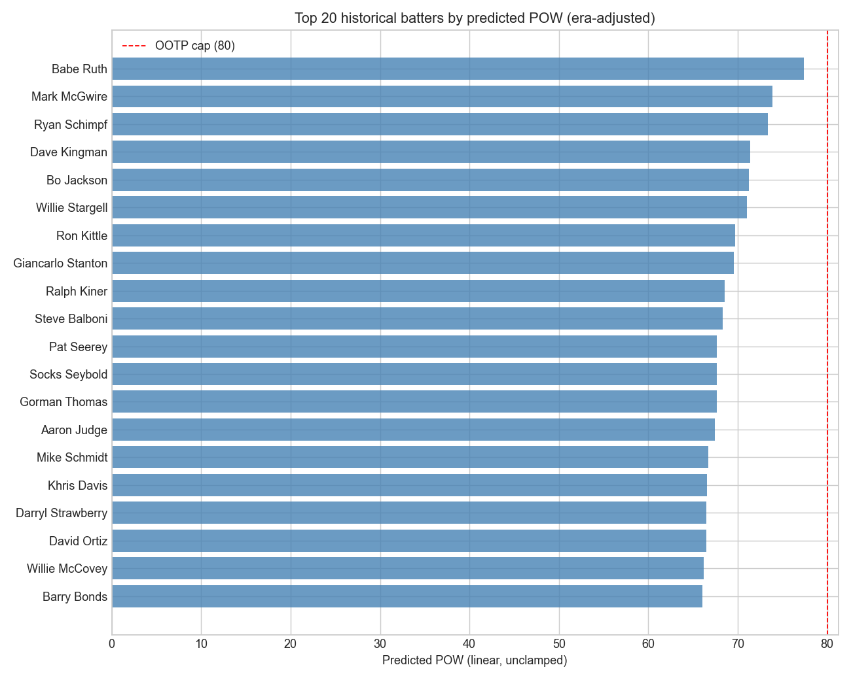
APPLY · ERA-ADJUSTED
Every batter in MLB history — one rating each
9,637
batters → 9,637
OOTP-ready POW ratings
PIPELINE
fullhouse R package
→ R script joins handedness
→ notebook re-fits POW
→ predictions CSV
Era adjustment puts 1921 and 2024
on the same scale.
11 / 12
Notes:
• This is where the era-adjusted research package by Eck et al. (2025) comes in — career stats with era effects already removed, so a 1921 home run rate is comparable to a 2024 one. • Pipeline: an R script joins fullhouse + Lahman handedness, the notebook re-fits POW on the full training set, then predicts for every historical batter. • Output: one CSV with an OOTP-ready POW for every batter who's ever played — drop into a roster import and we're done. • Sanity check: Babe Ruth lands at the top, Stanton/Stargell/Schmidt/Bonds/McCovey/Ortiz all near 70, contact specialists in the 40s–50s.

Slide 12
NEXT
What's next.
Sharpen POW
1
Add ISO (slugging − batting avg) — fixes bottom-of-scale errors
Predict POW vs. L and POW vs. R separately
Replicate the template for every other rating
2
CON ← BA, K% · EYE ← BB%, chase rate · SPE ← SB%, sprint speed
FLD, ARM ← DRS, OAA, throw velocity
Pitcher ratings (STU, MOV, CTL, STA) ← K/9, velocity, BB/9, IP/start
Build the league
3
Stitch all rating predictions → OOTP roster CSV
Import into a custom league → draft → simulate
Proof of concept works end-to-end. The rest is repetition.
Notes:
• Same template — train on modern overlap, validate, apply to era-adjusted history — gets repeated for every other rating. • For pitchers we use pitchers_career_adjusted from the same fullhouse package. • Once every rating is predicted, stitch them into a roster CSV, import into OOTP, simulate seasons. • Bottom line: the proof of concept works end-to-end, on POW, for every batter in MLB history. Everything else is the same pattern. Thanks — happy to take questions.

