Slide 1

The Happiness Project
Group Seven
Notes:
ID=d924773e-9a16-4d6d-9803-8cb819e99682 Recipe=text_billboard Type=TextOnly Variant=0 FamilyID=AccentBoxWalbaum_Zero

Slide 2

Industry: Public Policy
Dataset:
The World Happiness Report is a publication of the Sustainable Development Solutions Network, powered by the Gallup World Poll data. The World Happiness Report reflects a worldwide demand for more attention to happiness and well-being as criteria for government policy. It reviews the state of happiness in the world today and shows how the science of happiness explains personal and national variations in happiness.
Life evaluations from the Gallup World Poll provide the basis for the annual happiness rankings. They are based on answers to the main life evaluation question. The Cantril ladder (aka. Life Ladder) asks respondents to think of a ladder, with the best possible life for them being a 10 and the worst possible life being a 0. They are then asked to rate their own current lives on a 0 to 10 scale.

Slide 3

Metrics
1. Log GDP per capita is in terms of Purchasing Power Parity (PPP). The equation uses the natural log of GDP per capita, as this form fits the data significantly better than GDP per capita.
2. The Healthy life expectancy at birth is constructed based on data from the WHO, with data available for 2005, 2010, 2015, 2016, and 2019. To match this report’s sample period (2005-2022), interpolation and extrapolation are used.
3. Social support (0-1) is the national average of the question “If you were in trouble, do you have relatives or friends you can count on to help you whenever you need them, or not?”
4. Freedom to make life choices (0-1) is the national average of the question “Are you satisfied or dissatisfied with your freedom to choose what you do with your life?”
5. Positive affect is defined as the average of previous-day effects measures for laughter, enjoyment, and interest. The general form for the affect questions is: Did you experience the following feelings during a lot of the day yesterday?
6. Negative affect is defined as the average of previous-day effects measures for worry, sadness, and anger.

Slide 4
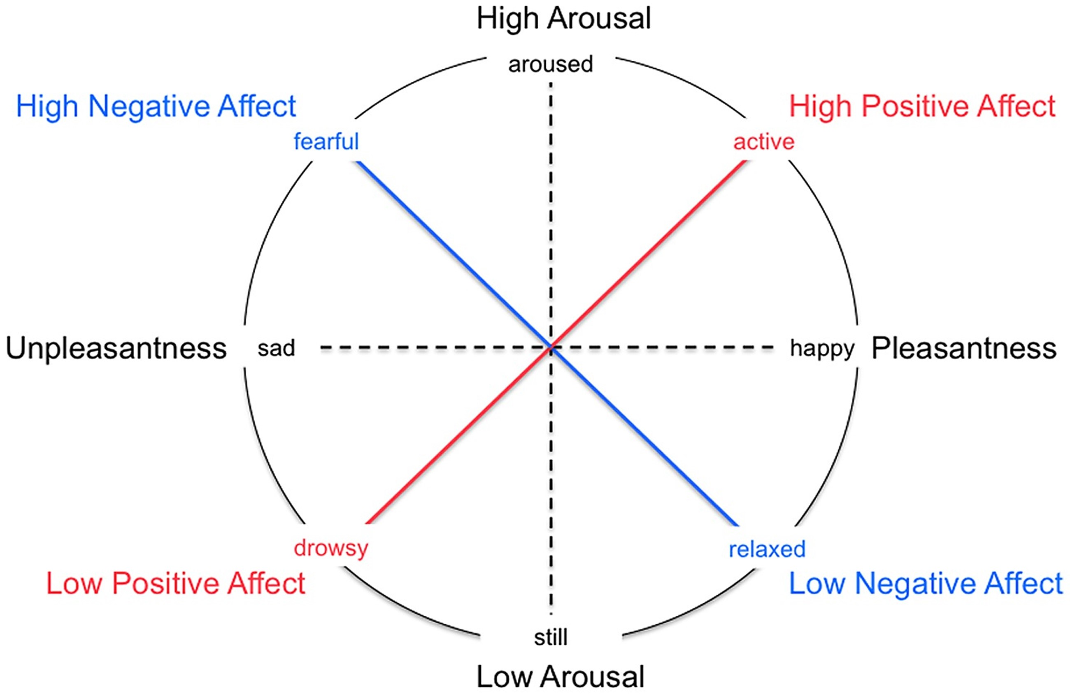
How Do Positive and Negative Affect Interplay with Happiness?

Slide 5
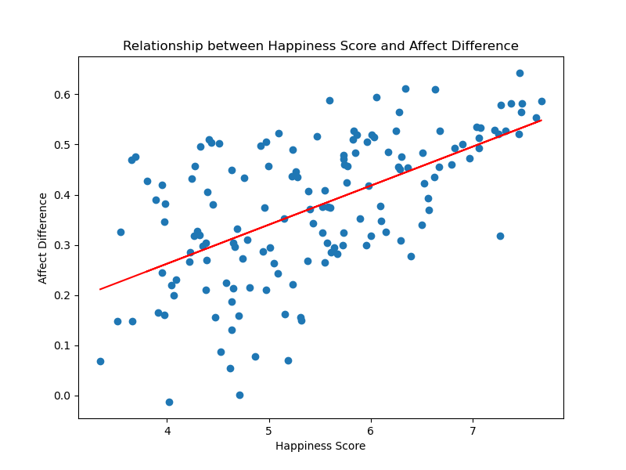
Relationship between Happiness Score and Affect Difference:
Pearson Correlation Coefficient is .58: a strong positive correlation
With a p-value of 0.00, it appears that Happiness Score and Affect Difference are related.

Slide 6
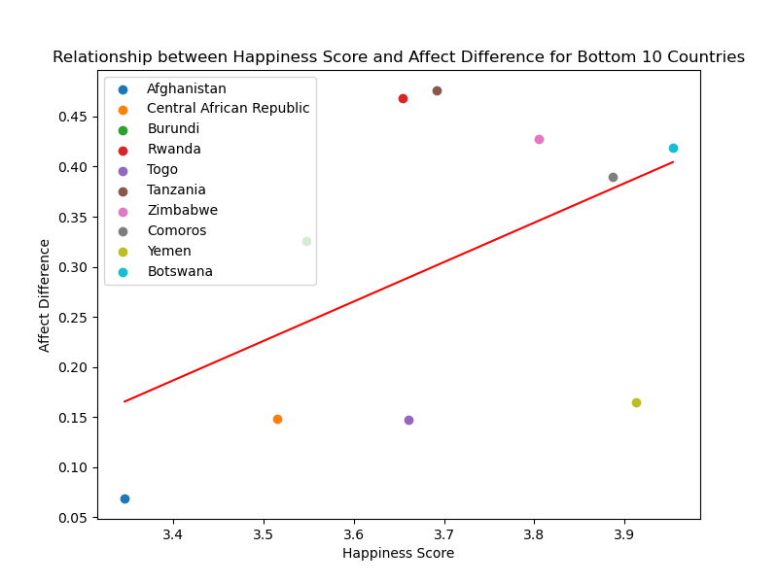
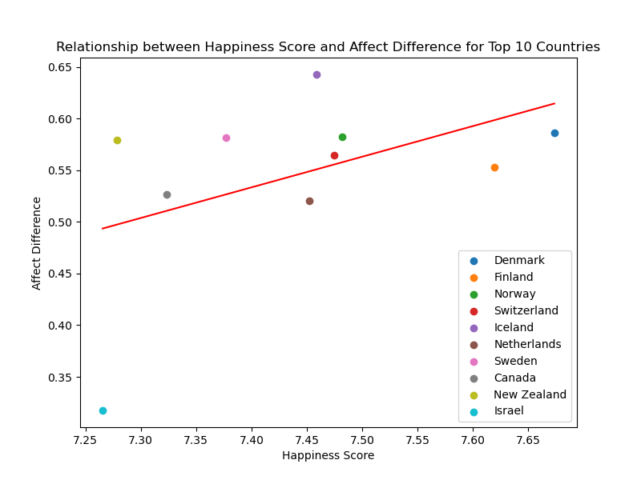
Happiness Score and Affect Difference:
Bottom 10 and Top 10 Countries

Slide 7
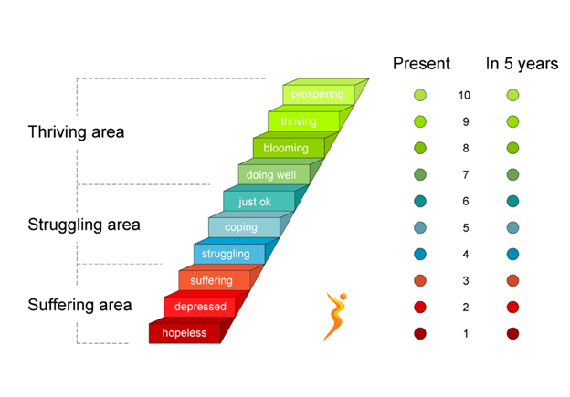
How Does the Life Ladder and Life Expectancy interplay for Happiness?

Slide 8
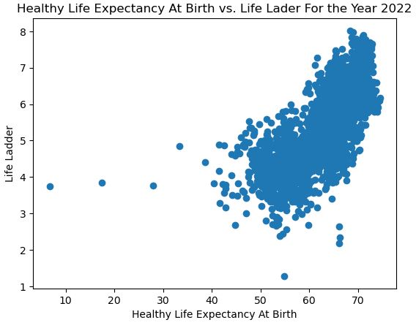
LifeLadder vs Life Expectancy:
The higher the life expectancy, the higher the Life Ladder

Slide 9
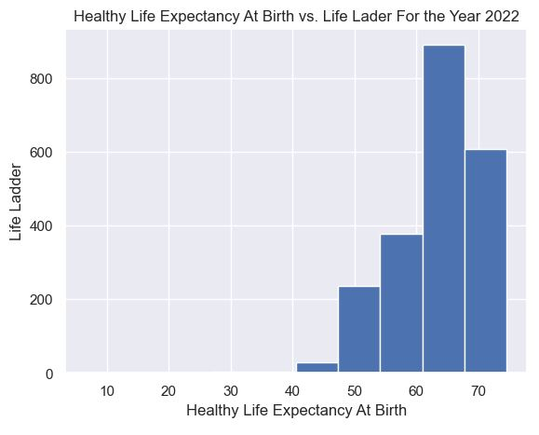
LifeLadder vs Life Expectancy:
The higher the life expectancy, the higher the Life Ladder

Slide 10
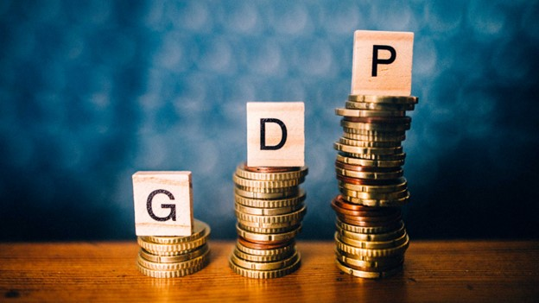
How does GDP interplay with Confidence in Government?

Slide 11
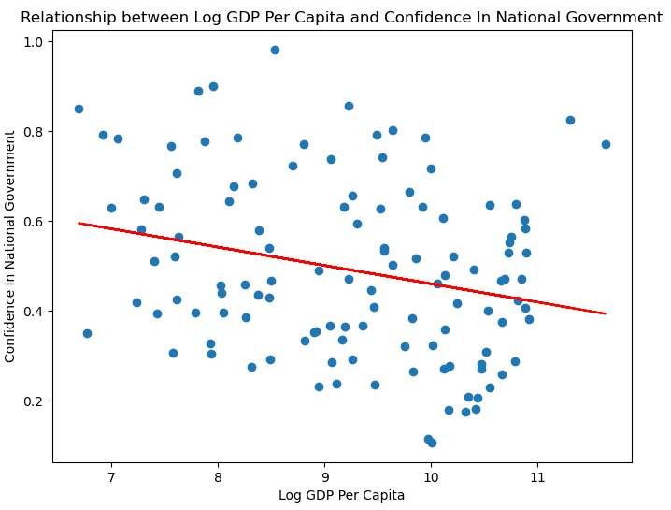
2011
GDP vs Confidence in Gov:
Pearson Correlation Coefficient is -0.25 : a very weak, negative correlation
With a p-value of 0.01, it appears that there is little to no reason to infer that the GDP is related to confidence in government

Slide 12
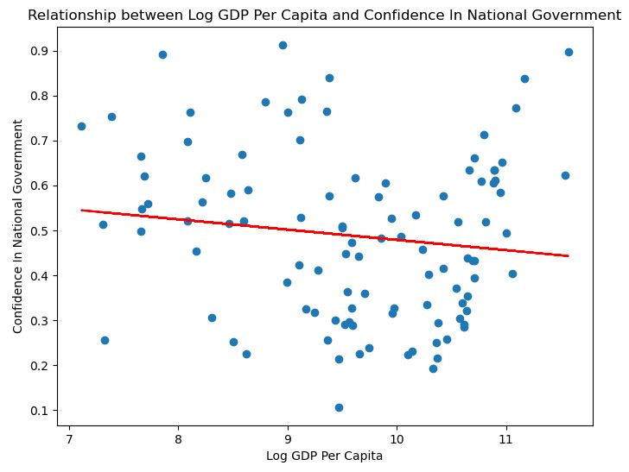
2021
GDP vs Confidence in Gov:
Pearson Correlation Coefficient is -0.13 : a very weak, negative correlation
With a p-value of 0.17, it appears that there is little to no reason to infer that the GDP is related to confidence in government

Slide 13

How does the Freedom to Make Life choices interplay with Happiness?

Slide 14
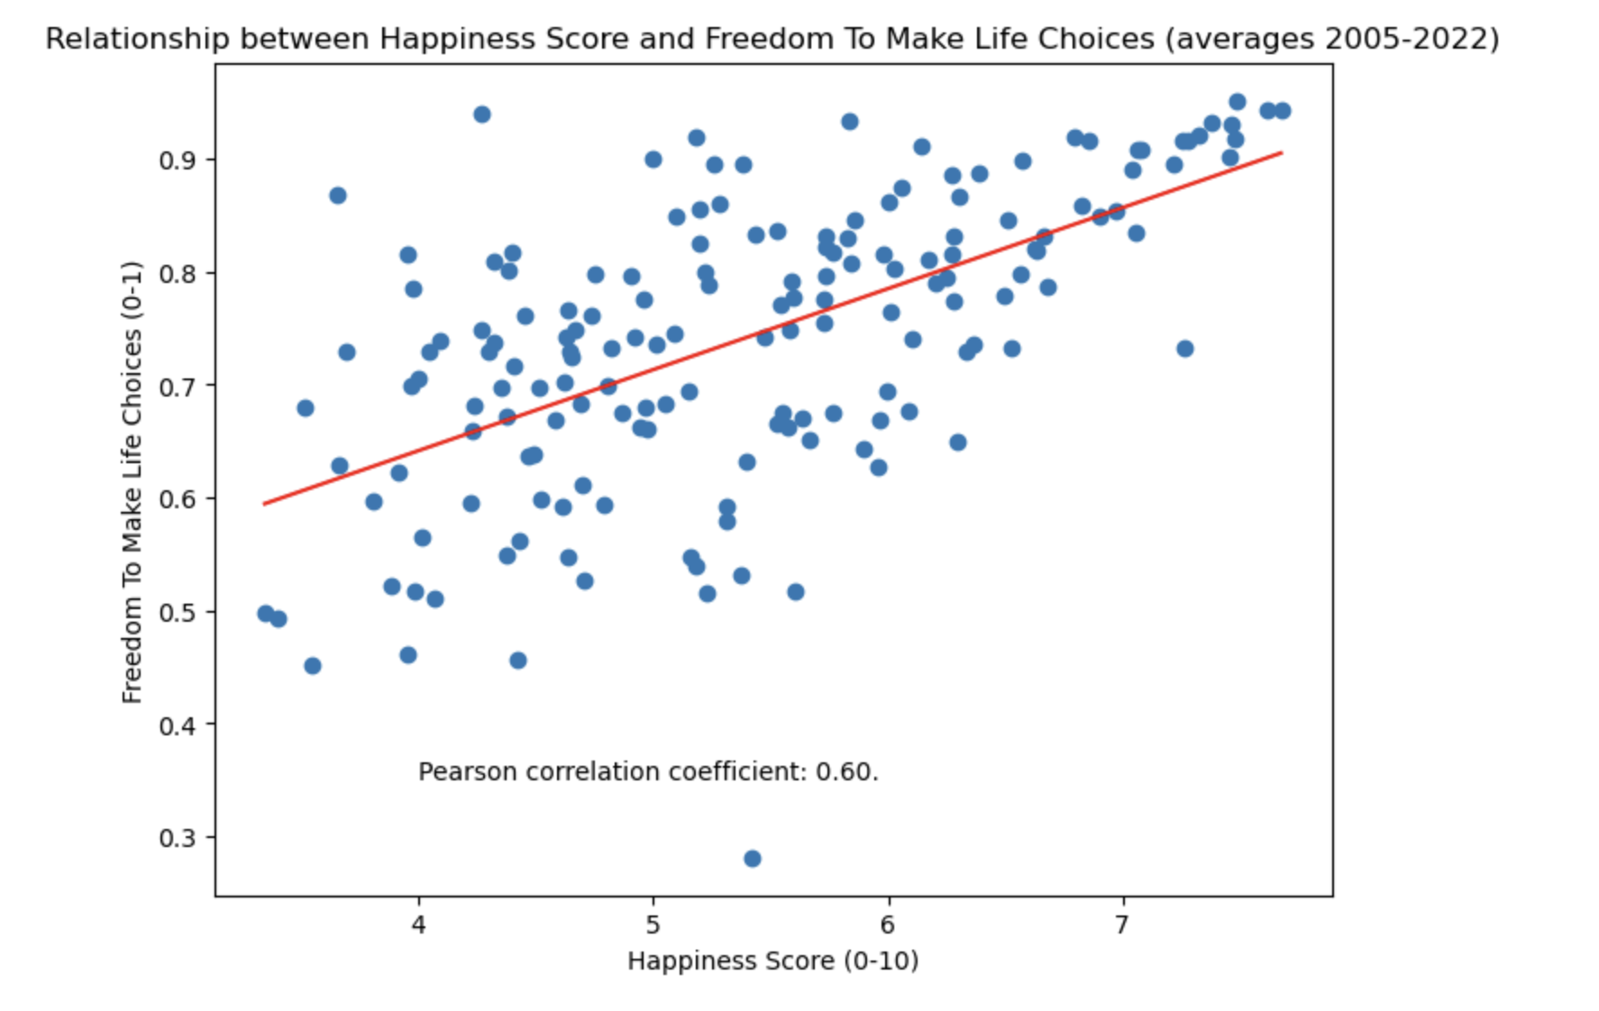
Freedom to Make Life Choices
Pearson Correlation Coefficient is 0.60 – a strong correlation
For the Top 10: the r = 0.56 and p-value = 0.09
For the Top 10: the r = 0.25 and p-value = 0.48

Slide 15
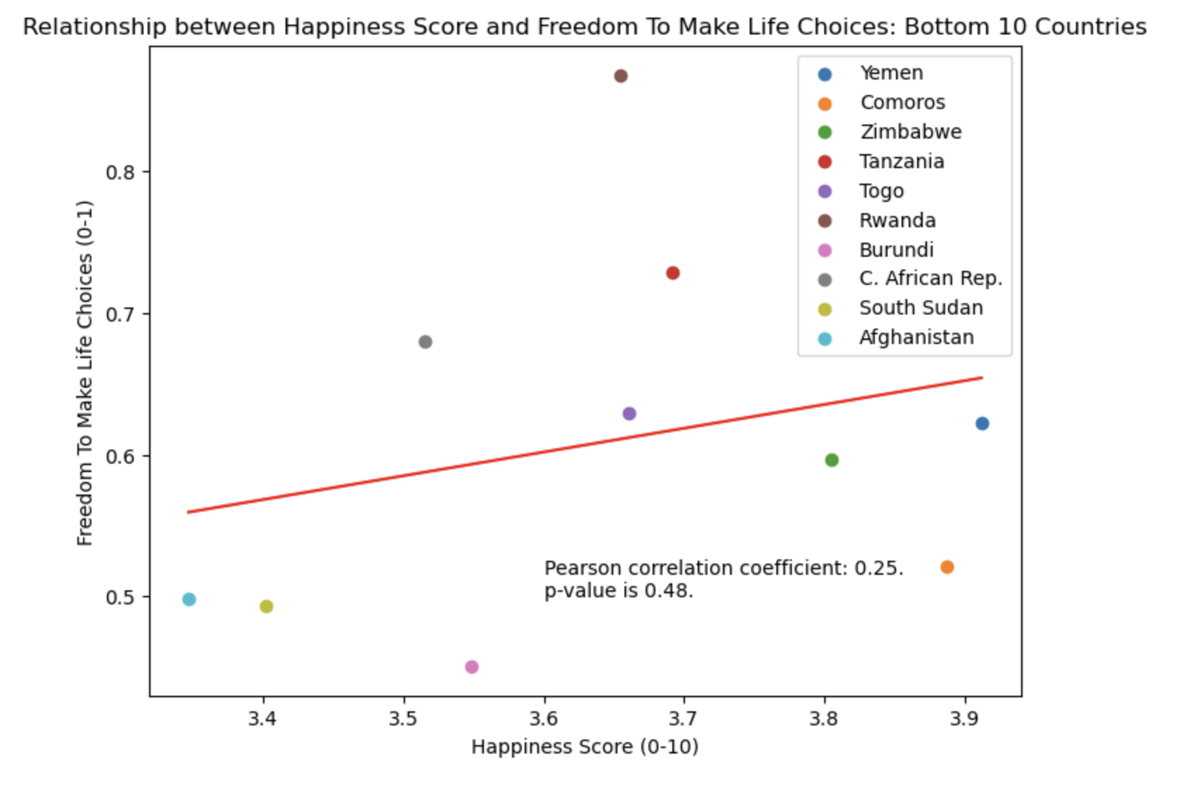
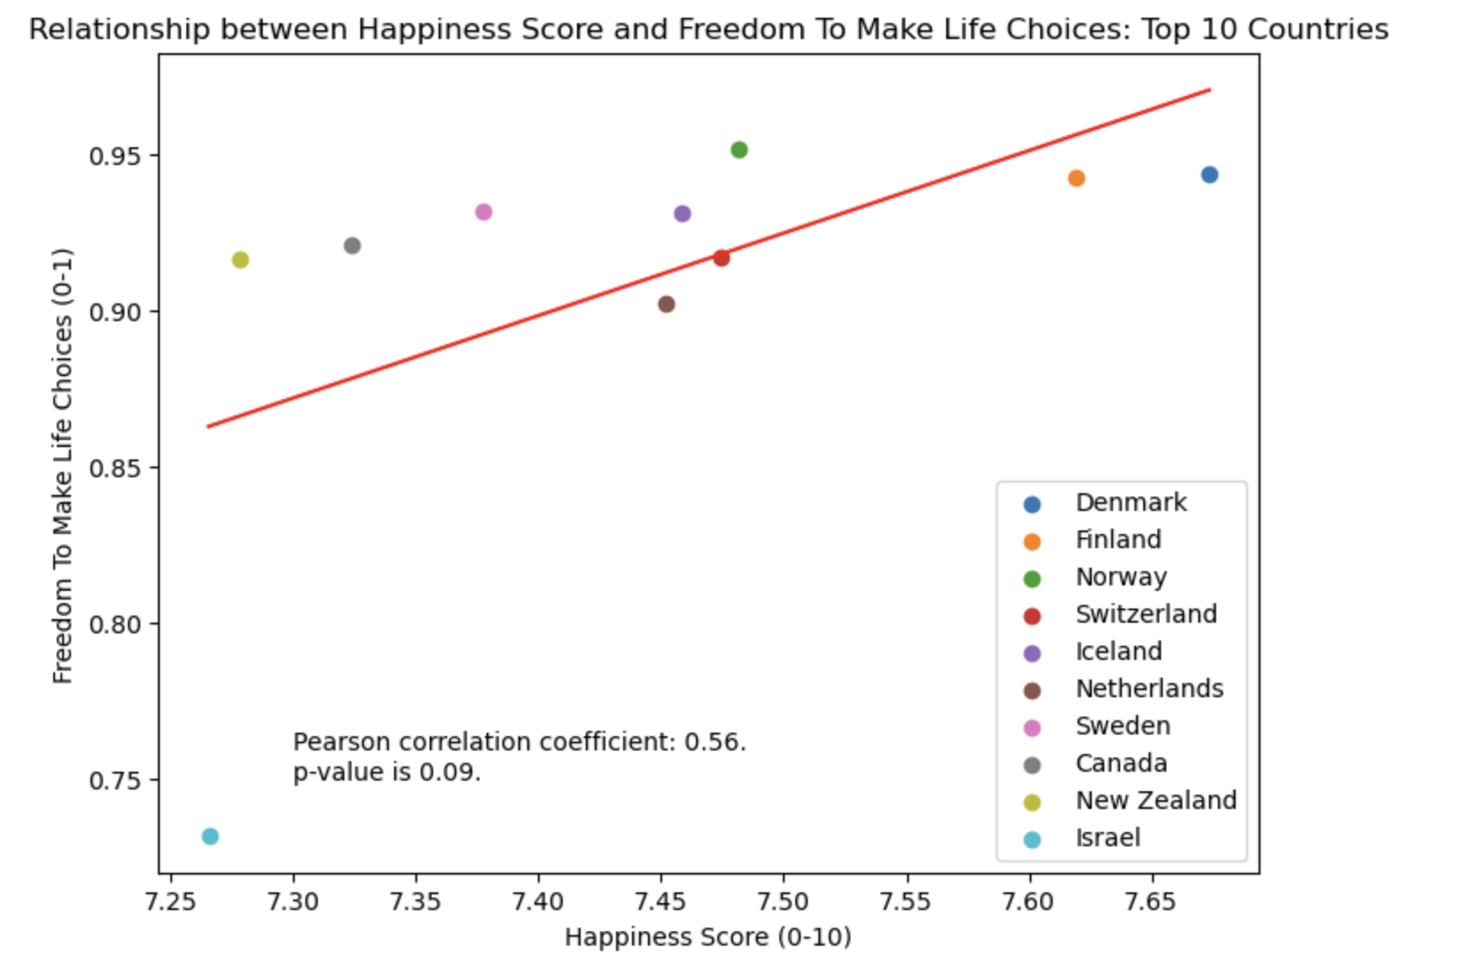
Happiness Score and Freedom to Make Life Choices:
Bottom 10 and Top 10 Countries

Slide 16
Trends from 2005 – 2022: the Top 5 and Bottom 5

Slide 17
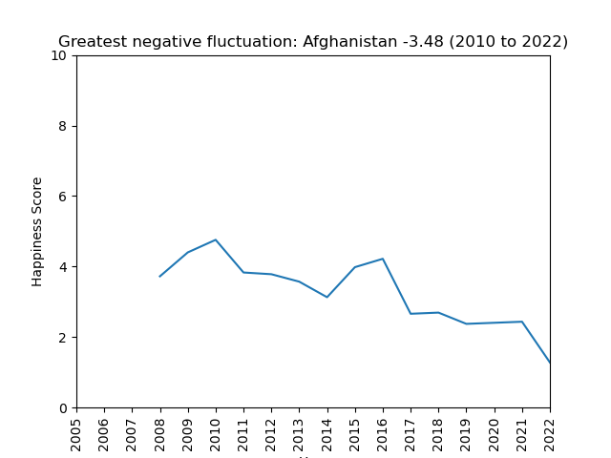
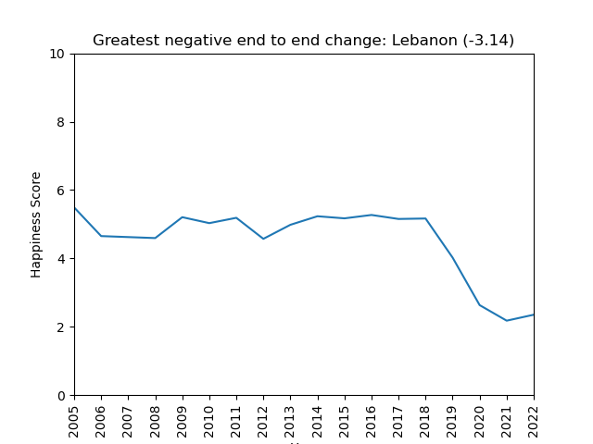
The negative

Slide 18
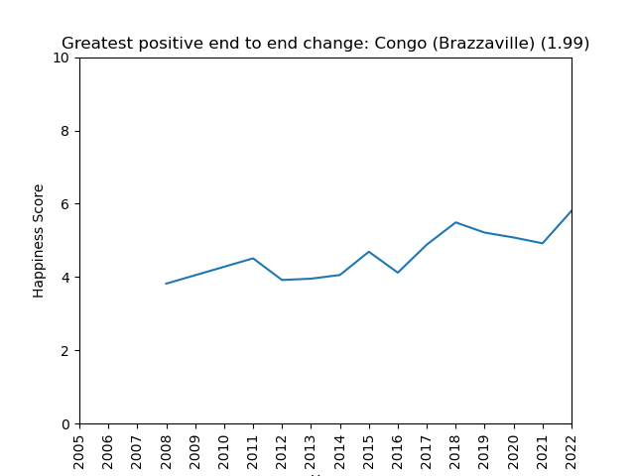
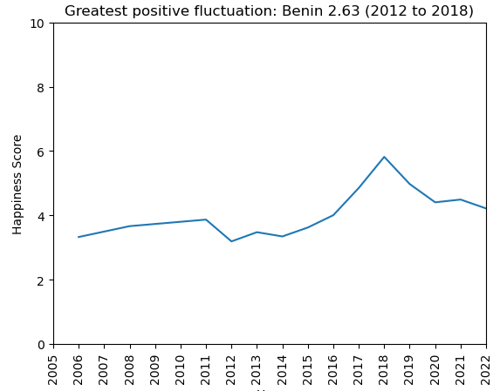
The positive

Slide 19

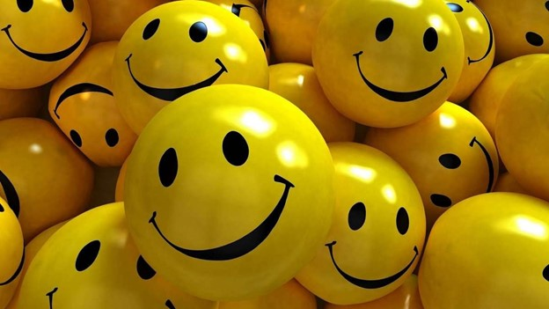
Analysis
1. There is a strong correlation between Affect Difference and Happiness
2. Higher Life Expectancy leads to higher reported Life Ladder/Happiness scores.
3. There is a weak and negative correlation between GDP and Confidence in Gov
4. Trends 1: Happiest tend to be in Scandinavia
5. Trends 2: Least happy tend to be in Africa
6. Trends 3: Outliers from the above trends are likely due to political/social security or lack thereof.
Next Steps: Continue monitoring the dataset

Slide 20

Group Seven
Anisa Braun
Amy Paschal
Nels Jacobson II
Tony Coast

