Slide 1
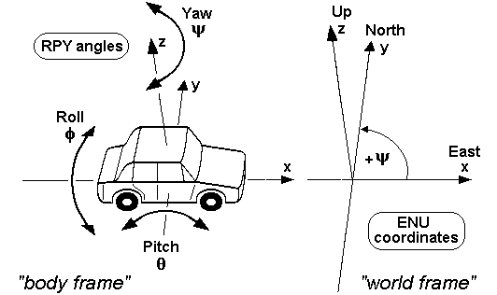
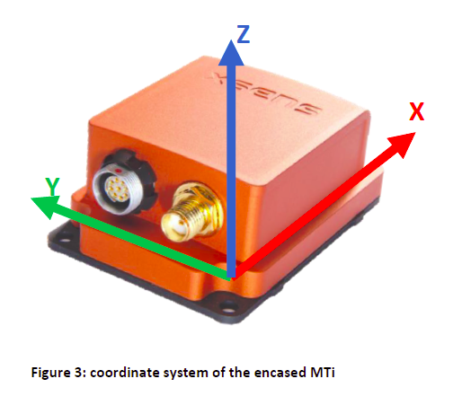
sensor-fixed output coordinate system (S)
object coordinate system (O)
local Earth-fixed coordinate system (L)
4.2.3 Orientation data
The MTi calculates the orientation (DataID 0x2010, 0x2020, 0x2030) between the calibrated inertial data and magnetic field, represented in (S) or (O), and the local Earth-fixed coordinate system (L).
By default the local earth-fixed reference co-ordinate system used is defined as a right handed Cartesian co-ordinate system with:
X positive to the East (E).
Y positive to the North (N).
Z positive when pointing up (U).
This coordinate system is known as ENU and is the standard in inertial navigation for aviation and geodetic applications. Note that it is possible to change the coordinate system using an alignment matrix or orientation reset.
The 3D orientation output is defined as the orientation between the body-fixed co-ordinate system, (S), and the earth-fixed co-ordinate system, (L), using the earth-fixed co-ordinate system, (L), as the reference co-ordinate system.
Interpretation of yaw as heading3
Heading is defined as the angle between north and horizontal projection of the vehicle roll axis. Yaw is defined for a particular local-level navigation frame as the angle from a horizontal navigation axis to the projection of the longitudinal axis in the horizontal plane following the right-hand rule. Based on the definition of heading and yaw, consider the use of the MTi in an aircraft which is stationary and pointing north. Below, a table is displayed that shows the heading and yaw outputs for the three reference coordinate system (available with MTi)
Similarly if you would like to use the ENU as your local frame, mount the MTi such that the y-axis is pointing to the direction of motion of the vehicle. In section 4.11 the various alignment resets are described.

Slide 2
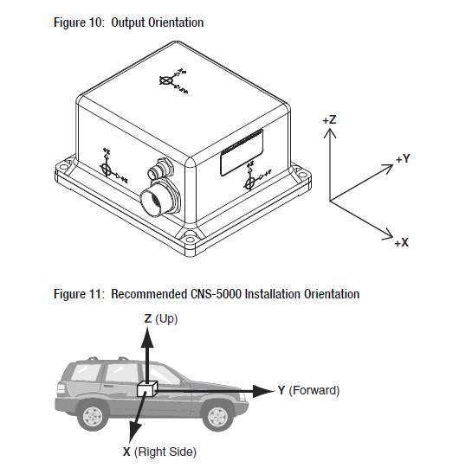
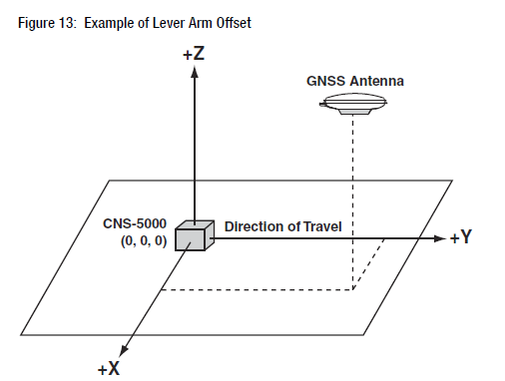
If the CNS-5000 is not mounted precisely with the Z-axis pointing
up and the Y-axis pointing forward along the direction of travel,
you will need to enter additional configuration commands prior
to use.
To configure the CNS-5000 for proper operation, you will need to
enter the offset distances between the phase center of the GNSS
antenna and each axis of the CNS-5000 (also called the “lever arm
offset”).

