Slide 1
Master’s Project: HIIT
Amy Woods
3/4/2022

Slide 2
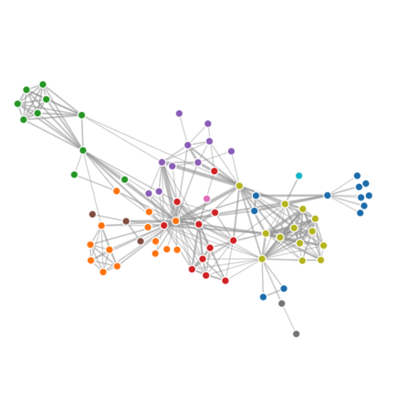
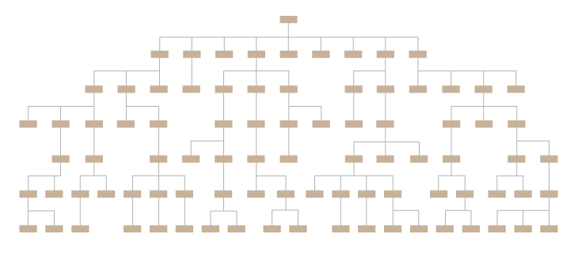
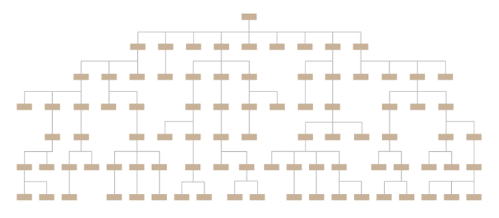
Problem/Motivation
Scurge the 3rd
Tree Datatset
Each Tree = NCF
Network Dataset
Inter = tree1 → tree2
Intra = tree1Node9 → tree1Node6
User Goals
Verify and Validate Dataset
Analysis Questions
Problem/Goal
Design a data visualization application that not only visualizes both the hierarchical and network components of the unique dataset but also allows developers to verify and validate the dataset by detecting network and tree related anomalies or patterns.

Slide 3
Demo

Slide 4
Future Work
Improve HIIT by user testing
Determine what other analysis questions can be applied ot HIIT
Create Database for all NCFS
Standardize NCF tree and inter/intra edges creation

