Slide 1
Linear Regression
Presented by: Katey Yoast and Stephen Roecker

Slide 2
Objectives
Compute and interpret coefficients in a linear regression analysis in R.
Interpolate regression model in R to produce a raster layer.

Slide 3
Linear Regression
Regression attempts to explain the variation in a dependent variable using the variation in one or more independent variable(s).
Used in soil science since the early 1900s
Commonly used to develop pedotransfer functions
y = β₀ + β₁x + ε
error
dependent
(or response)
variable
y-intercept
slope
independent
(or predictor)
variable

Slide 4
Simple vs. Multiple Linear Regression
Simple linear regression (SLR):
Y is predicted from one independent variable (X).
Multiple linear regression (MLR):
Y is predicted from two or more independent variables (X₁, X₂, X_{k}).
Notes:
Can anyone provide an example of how regression has been used in the natural resources field?

Slide 5




Linear Regression
ε
ε
Bulk Density
$$∆y$$
Β₁=
$$∆y$$
$$∆x$$
$$∆x$$
}
β₀
Sand Content
y = β₀ + β₁x + ε
Bulk Density = β₀ + β₁ (sand)
Notes:
Line of best fit = mean of y given x

Slide 6
Ordinary Least Squares
Goal: minimize
sum of squared
error
Bulk Density
Sand Content
y = β₀ + β₁x + ε
Bulk Density = β₀ + β₁ (sand)
Notes:
OLS produces a line that minimizes the sum of the squared vertical distances from the line to the observed data points.

Slide 7
Wills et al., 2013
Carbon equivalent correction regression factor:
OC_{dc} = 0.25 + 0.86(OC_{wc})
where
OC_{dc} = organic carbon by dry combustion (%)
OC_{wc} = organic carbon by wet combustion (%)
r² = 0.93, root mean square error [RMSE] = 1.8

Slide 8
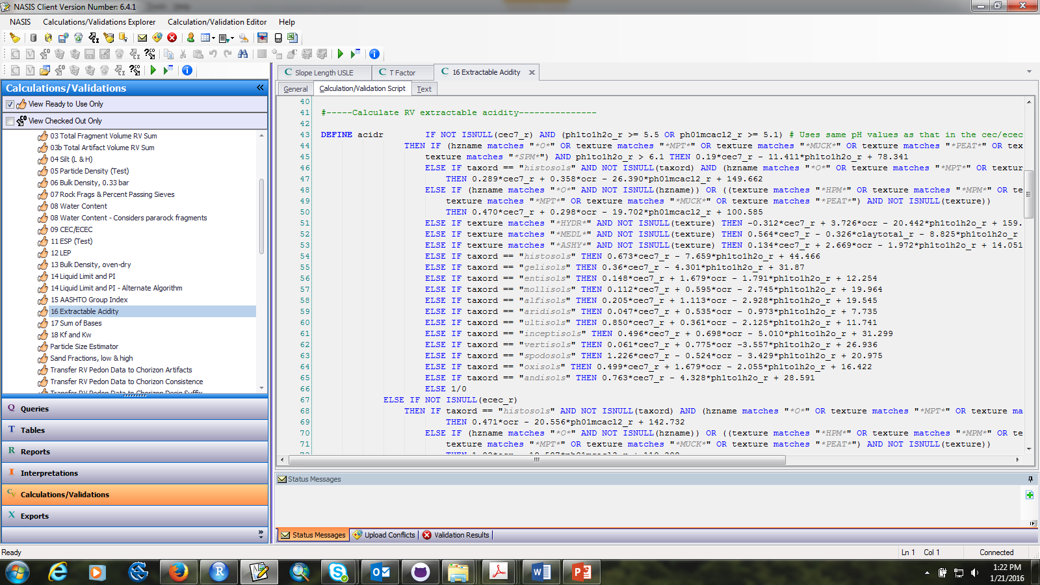
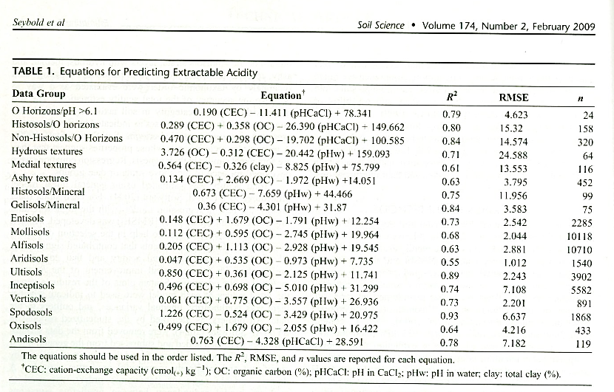
Seybold et al., 2009

Slide 9
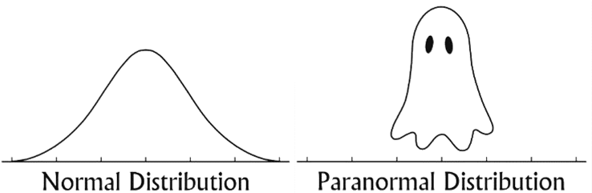
Model Assumptions
Linearity - Y is linearly related to X.
Independence of Error - the error (residual) is independent for each value of X.
Homoscedasticity - the variation around the regression line is constant for all values of X.
Normality - the values of Y are normally distributed at each value of X.
GOOD
BAD
https://mathcoachblog.files.wordpress.com/2014/10/paranormal.jpg
www.csus.edu/indiv/h/hopfem/multiple.ppt

Slide 10
Testing Model Assumptions
Normality
Outliers
Multicollinearity
Homoscedasticity
Normality
Histograms
QQ plots
Residual plots
Shapiro-Wilk
Outliers
QQ plots
Multicollinearity
Correlation
Variance inflation factors
Homoscedasticity
Residual plots

Slide 11
Methodology
Run a full linear regression model.
Interpret model results.
Test model assumptions (normality, outliers, multicollinearity, homoscedasticity).
Modify and rerun the model (if necessary).
Interpret model results.

Slide 12
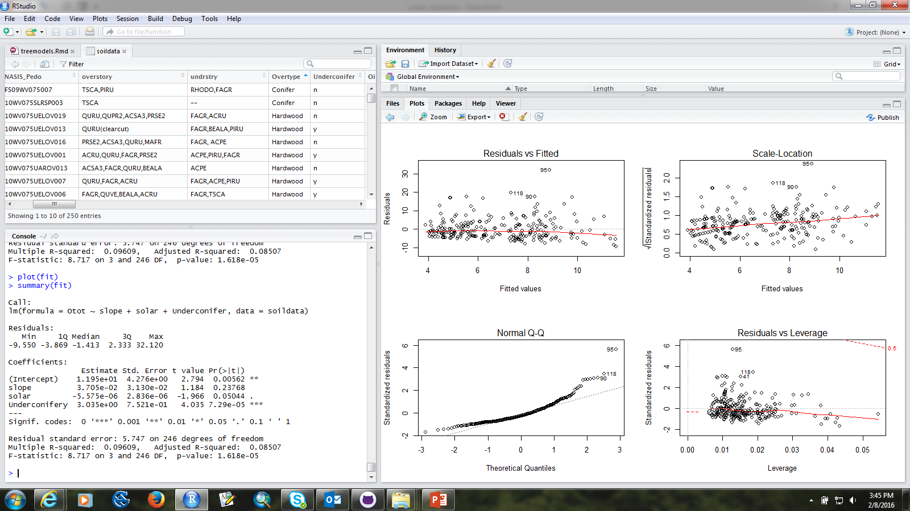
Interpreting Model Results
Y = 11.95 + 0.037(slope) – 0.000006(solar) + 3.035(understory conifer yes)
Notes:
Model formula
Quartiles, or 5 number summary of residuals
Estimate of the y-intercept (estimated mean of Y when all X’s are zero) and slope of x
Standard error of the y-intercept and slope
The t-values test the hypothesis that the coefficient is different from 0. You can get the t-values by dividing the coefficient by its standard error. The t-values also show the importance of a variable in the model.
Two-tail p-values test the hypothesis that each coefficient is different from 0.
RMSE; Relative model error; degrees of freedom = n-2
R2 shows the amount of variance of Y explained by X. Adjusted R2 shows the same as R2 but adjusted by the # of cases and # of variables. When the # of variables is small and the # of cases is very large then Adj R2is closer to R2. This provides a more honest association between X and Y.
F-statistic = tests the null hypothesis that all the model coefficients are 0; p-value of the model--tests whether R2is different from 0.

Slide 13
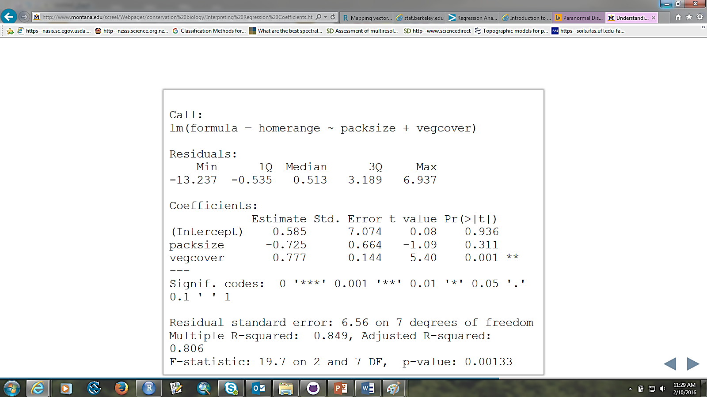
EXERCISE: Interpreting Model Results
http://www.montana.edu/screel/Webpages/conservation%20biology/Interpreting%20Regression%20Coefficients.html#/24
Notes:
What can you conclude from this regression summary?

Slide 14
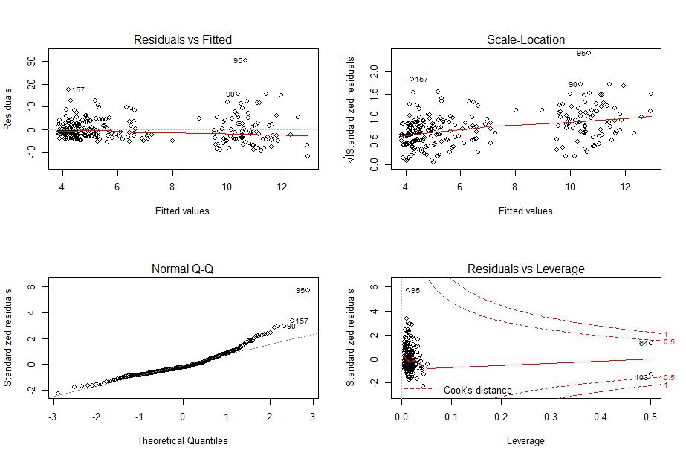
Diagnostic Plots

Slide 15
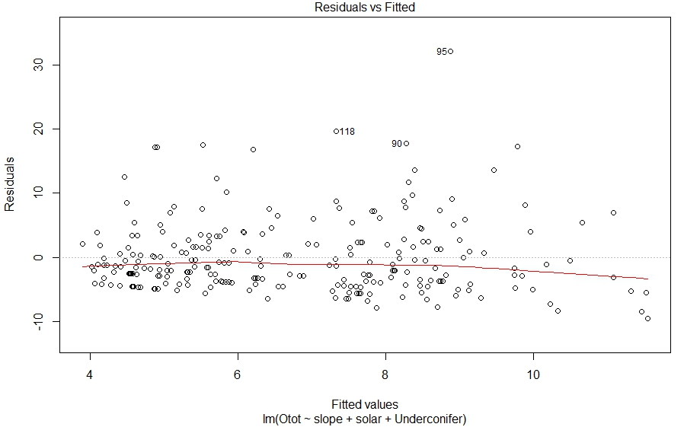
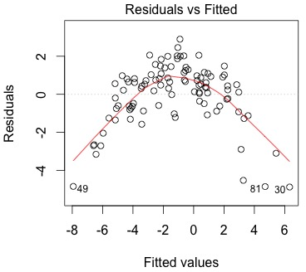
Residuals vs Fitted
Notes:
This plot is used to detect non-linearity, unequal error variances, and outliers. In a perfect world, the observations would be equally spread around a horizontal line without any distinct patterns. Do you see a linear trend? What about their variances? Are there any outliers? –click- what about this model?

Slide 16
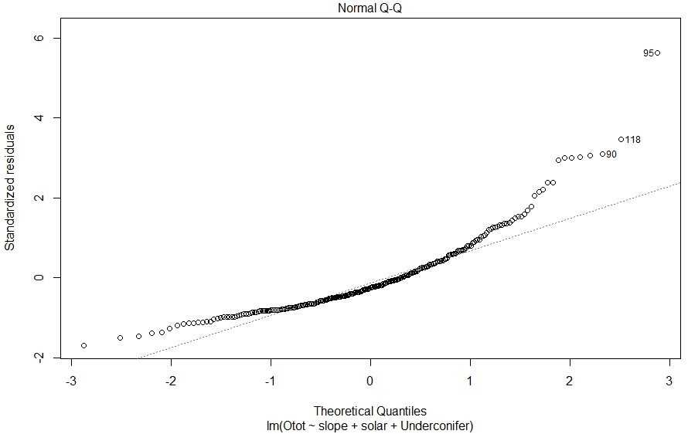
QQ Plot
Notes:
Quantile plot is a probability plot that can be used to compare the shapes of the data vs theoretical distribution, ie: location, scale, and skewness . If the quantiles of the theoretical and data distributions agree, observations will plot on the line shown in the figure above. What do you notice about the tails of this distribution? The tails are positively skewed and there are a few outliers denoted by the observations labels--same outliers in this plot as the last.

Slide 17
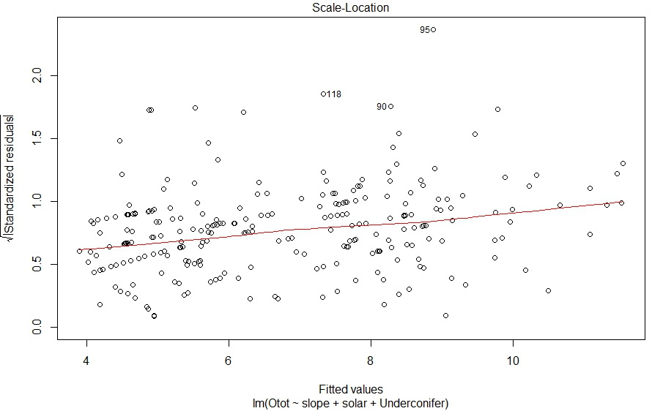
Spread-Location
Notes:
This plot shows if residuals are spread equally along the ranges of predictors. This is how you can check the assumption of equal variance (homoscedasticity). It’s good if you see a horizontal line with equally (randomly) spread points. What does this plot tell you?

Slide 18
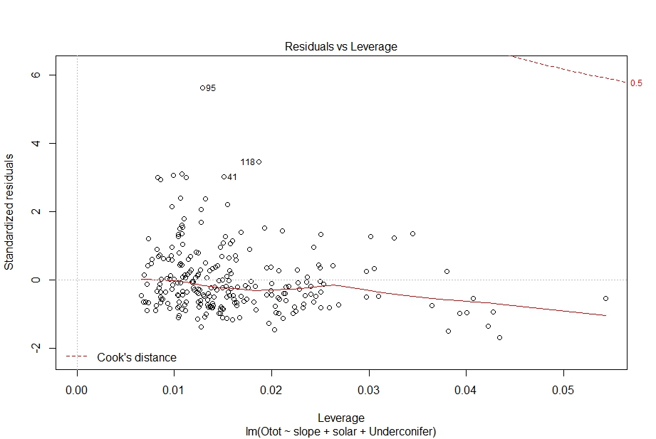
Leverage Plot
Notes:
Unlike the other plots, this time patterns are irrelevant. Leverage is a measure of how much each data point influences the regression. Because the regression must pass through the centroid, points that lie far from the centroid have greater leverage, and their leverage increases if there are fewer points nearby. As a result, leverage reflects both the distance from the centroid and the isolation of a point. The plot also shows values of Cook’s distance, which measures how much the regression would change if a point was deleted. Cook’s distance is increased by leverage and by large residuals: a point far from the centroid with a large residual can severely alter the regression. On this plot, you want to see that the red smoothed line stays close to the horizontal gray dashed line and that no points have a large Cook’s distance (i.e, >0.5). What do you notice about this plot?

Slide 19
EXERCISE: Linear Regression
https://github.com/ncss-tech/stats_for_soil_survey/tree/master/chapters/6_linear_models

Slide 20
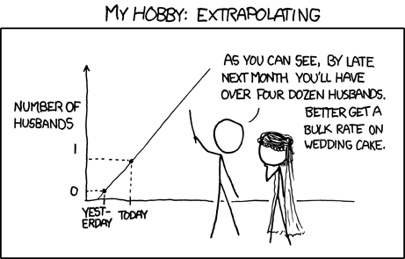
Summary
Correlation does NOT imply Causation!
http://xkcd.com/833/
Notes:
As with all models, it is important to remember that correlation does not imply causation. Always remember to look at the variables you have – do they make sense that they would be good predictors of the response variable? Are the model assumptions met?

Slide 21
Scull et al., 2005
Notes:
Scull et al., 2005 in The Professional Geographer. This study compared nonspatial statistical models with geospatial statistical models to predict A horizon gravel and surface fragments for a portion of the Pinto Basin in Joshua Tree National Park, CA. They concluded that MLR performed the best with a mean jackknife RMSE of 12.7% for A horizon gravel and 20.7% for rock fragments. Looking at the fitted vs actual values, what do you notice about their MLR model?
-PCA of landsat was used in MLR models
“the high standard deviations for the regression tree and geostatistical models show that they are more sensitive to outliers and data anomalies than other methods”
“the discontinuous data pattern.”

Slide 22
Summary
Linear regression models are intuitive, quick to execute, and easy to interpret, making them useful for NASIS calculations and pedotransfer functions.
Due to the non-linear nature of environmental data, data transformations or deletions are often needed to meet model assumptions.
Tacit knowledge is needed throughout model development.

Slide 23
Linear Regression in R
lm(formula, data)
formula response~predictor1+predictor2+predictorx
data= specifies the dataset
summary ( ) | detailed statistical summary
plot ( ) | a series of diagnostic plots, including leverage, residual, and QQ plots

Slide 24
Linear Regression in R – Diagnostic Tests
cor ( ) | correlation matrix
hist ( ) | histogram
vif ( ) | variance-inflation and generalized variance inflation factors for linear and generalized linear models (in car package)

Slide 25
Other Types of Regression
Step-wise regression – typically used for exploratory data analysis or datasets with large sets of predictors; not recommended for modeling due to its unreliability (Whittingham et al., 2006) .
Weighted least squares regression – potentially useful when the homoskedasticity assumption is violated in OLS; gives more weight to observations with small error variance. WLS is not recommended unless the variance structure is known.
Logistic regression - useful when predicting a binary outcome from a set of continuous predictor variables.
Notes:
Regression can also be used in geospatial models, such as regression kriging, geographically weighted regression, etc. It is common in the soil science field to krige the residuals of a model such as OLS and add them to the OLS model to better capture spatial variability in the model.

Slide 26
Review Questions
What are the components of simple linear regression equation?
What is the main limitation of using linear regression?
Can you think of other names for regression?
Are more variables better?
What are the components of simple linear regression equation?
What is the main limitation of using linear regression?
Can you think of other names for regression?
Are more variables better?
What are the components of simple linear regression equation?
What is the main limitation of using linear regression?
Can you think of other names for regression?
Are more variables better?
What are the components of simple linear regression equation?
What is the main limitation of using linear regression?
Can you think of other names for regression?
Are more variables better?

Slide 27
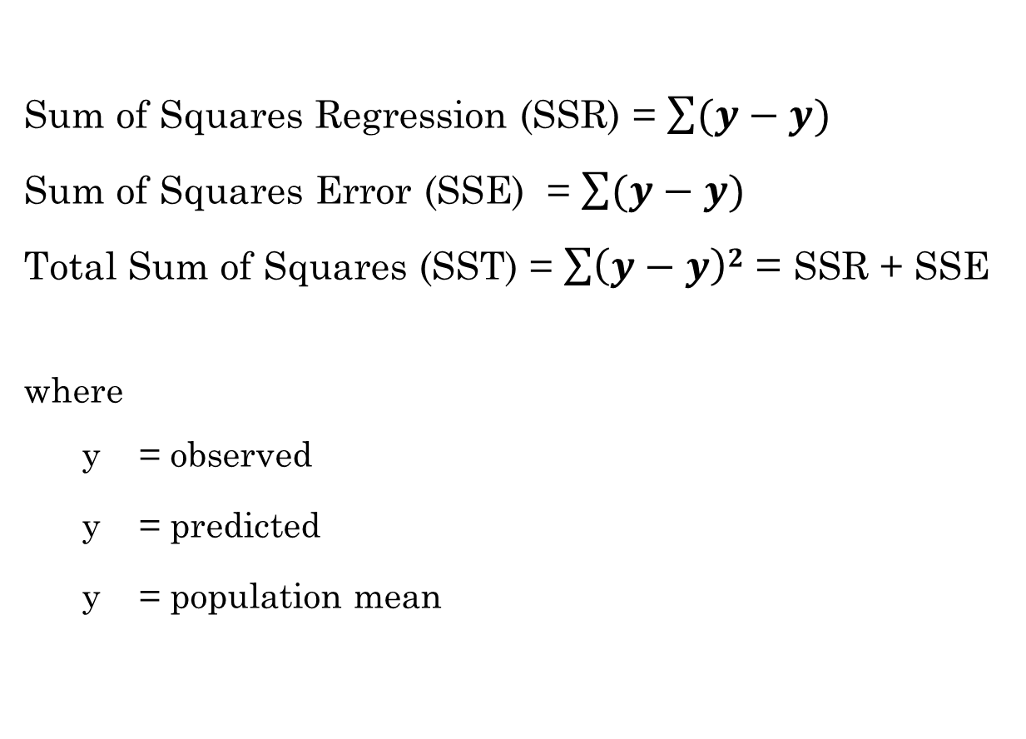
Additional Resources
^
Sum of Squares Regression (SSR) = $\sum{(y−y)}$
Sum of Squares Error (SSE) = $\sum{(y−y)}$
Total Sum of Squares (SST) = $\sum{\left(y−y\right)2}$ = SSR + SSE
where
y = observed
y = predicted
y = population mean
^
^
Notes:
The Sum of Squares Regression (SSR) is the sum of the squared differences between the prediction for each observation and the population mean. (explained variation)
A least squares regression selects the line with the lowest total sum of squared prediction errors or SSE (unexplained variation)
SST (total variation in y)

Slide 28
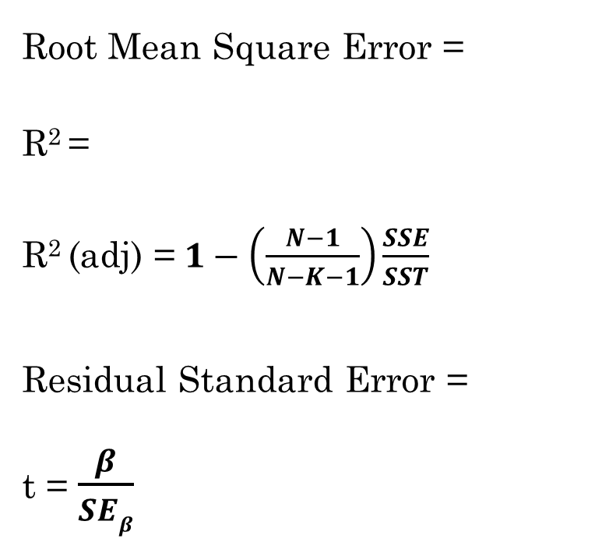
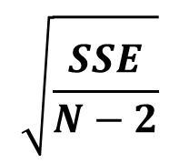
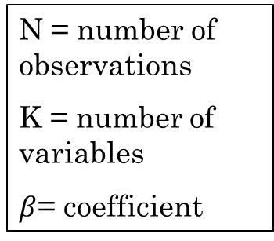


Additional Resources
Root Mean Square Error =
R² =
R² (adj) =$1−\left(\frac{N−1}{N−K−1}\right)\frac{SSE}{SST}$
Residual Standard Error =
t = $\frac{β}{SEβ}$
$$\sqrt{MSE}$$
$$\frac{SSR}{SST}$$
N = number of observations
K = number of variables
$β$= coefficient
$$\sqrt{\frac{SSE}{N−2}}$$

Slide 29
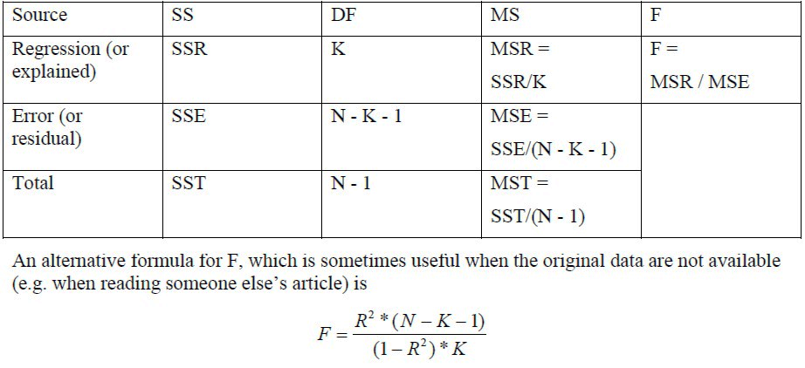
Additional Resources - ANOVA
where
N = number of observations K = number of variables
https://www3.nd.edu/~rwilliam/stats2/l02.pdf

Slide 30
References
Bishop, T.F.A, A.B. McBratney. 2001. A comparison of prediction methods for the creation of field-extent soil property maps. Geoderma. 103: 1-2, 149-160.
Faraway, J. J. 2002. Practical regression and anova using R. <https://cran.r-project.org/doc/contrib/Faraway-PRA.pdf>.
Holland, S. 2011. Data analysis in geosciences. <http://strata.uga.edu/6370/rtips/regressionPlots.html>
Seybold, C.A., P.R. Finnell, M.A. Elrashidi. 2009. Estimating total acidity from soil properties using linear models. Soil Science. 174:2, 88-93.
Whittingham, M.J., P.A. Stephens, R.B. Bradbury, and R.P. Freckleton. 2006. Why do we still use stepwise modelling in ecology and behavior? Journal of Animal Ecology. 75: 1182-1189.
Wills, S., C. Seybold, J. Chiaretti, C. Sequeira, and L. West. 2013. Quantifying tacit knowledge about soil SOC stocks using soil taxa and official soil series descriptions. Soil Science Society of America Journal. 77: 1711-1723.

