Slide 1
Logistic Regression
Part of the family of regression models named “Generalized linear models”

Slide 2
Logistic Regression
Technique used to analyze a dependent variable with a discrete response
The independent variables are used to estimate the probability of occurrence for the dependent variable
Output values range from 0 – 1.0 (indicating 0 – 100% probability)
A threshold value, often 0.5, is used to determine if the prediction is part of the modeled class

Slide 3
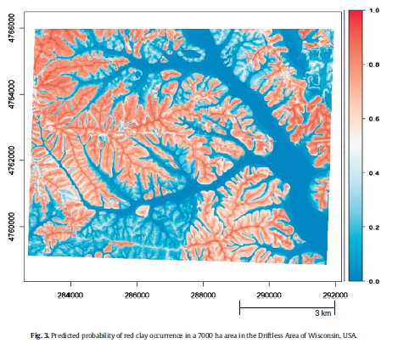
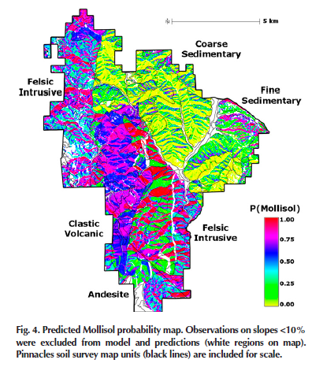
Logistic Regression
Evans & Hartemink, 2014
Beaudette & O'Geen, 2009

Slide 4
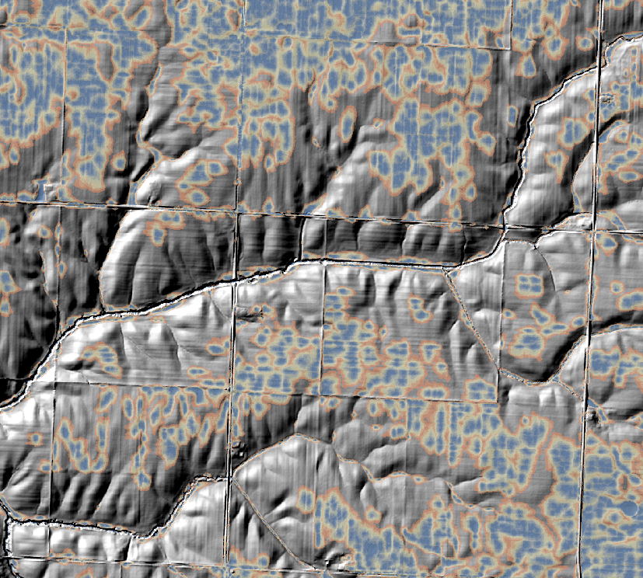
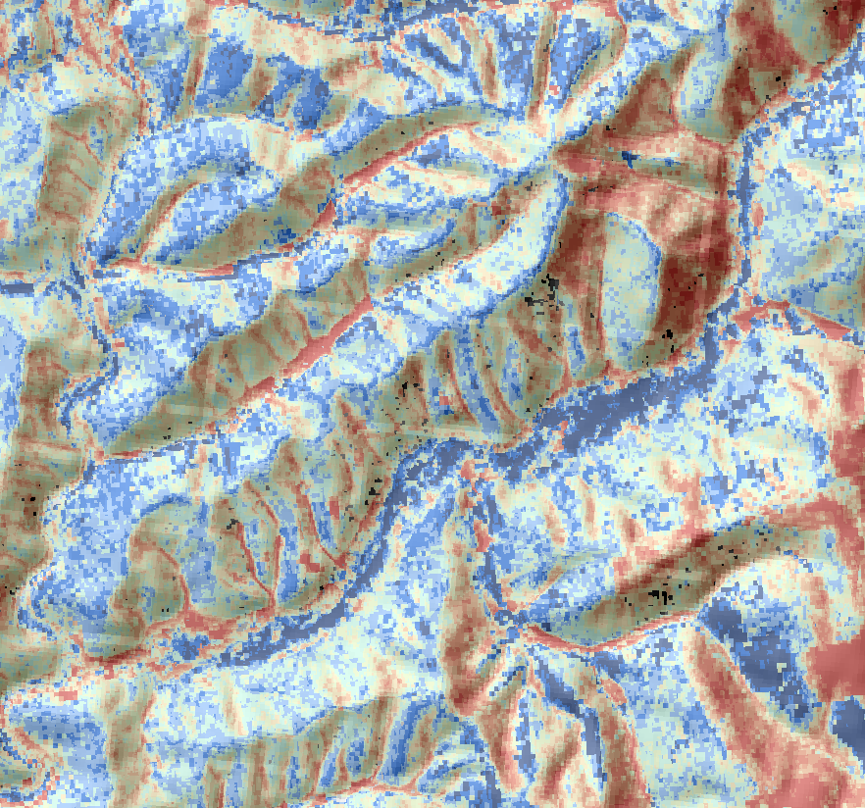


Logistic Regression
Ponded probability, NRCS, unpub.
Spodic probability, NRCS, unpub.

Slide 5
Logistic Regression
The response variable is discrete, i.e. binomial. For example:
spodic present/absent = 1/0
fragipan present/absent = 1/0
plant community or species present/absent = 1/0
gopher turtle present/absent = 1/0
The independent variables can be numeric or categorical
No assumptions for normality among independent variables
Do check for highly correlated variables and select accordingly

Slide 6
Logistic Regression
The minimum number of cases per independent variable is 10:1
The preferred number of cases per independent variable is 20:1
The preferred number of cases per independent variable is 50:1 when using stepwise logistic regression

Slide 7
Logistic Regression
The measure of model fit is the likelihood value
A well fit model will have a small likelihood value
Testing the strength of relationship among independent variables is done by testing the model against another model without any independent variables (i.e. pure chance)

Slide 8
Logistic Regression
Sometimes a model will report a “fail to converge” error
this seems to be a problem with small sample #s, or very few cases of one outcome compared to another
Best to reject results if the Standard Error of any predictor is > 2
A pseudo R squared provides an idea of the strength of a relationship, but should only be used as a rough guide
The ultimate test of the model is an accuracy assessment comparing the predicted to observed

Slide 9
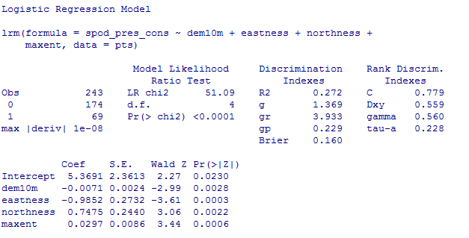
Logistic Regression Example
Evaluation of results
Is the ratio of cases to independent variables ok?
Notes:
Ratios of observations per independent variable
10:1 minimum
20:1 ideal for simultaneaous
50:1 for stepwise

Slide 10
Logistic Regression Example
Evaluation of results
The relationship between the dependent (DV) and independent variables (IV)
The low P value indicates there is a relationship between the DV and IV
A high value (e.g. > 0.05) indicates the model performs no better with the IVs than with a constant

Slide 11
Logistic Regression Example
Evaluation of results
Is multicollinearity present?
The Standard Errors should be less than 2. This does not pertain to the intercept/constant.
What if Standard Error is > 2?
Notes:
If SE is greater than 2:
Reject entire model
Drop the offending variables from the model

Slide 12
Logistic Regression Example
Evaluation of results
Relationship of individual IVs to DV
Small “P” values indicate the IV is a meaningful predictor
What to do with IVs that have a large “P”?
Notes:
Ratios of observations per independent variable
10:1 minimum
20:1 ideal for simultaneaous
50:1 for stepwise

Slide 13
Logistic Regression Example
Evaluation of results
Does the model perform better than random chance?
“C” refers to the concordance aka c-index or AUC, with the following suggested scale (Hosmer & Lemeshow, 2013)
0.5 = no discrimination
0.7 – 0.8 acceptable discrimination
0.8 – 0.9 excellent discrimination
>0.9 outstanding discrimination
Notes:
Ratios of observations per independent variable
10:1 minimum
20:1 ideal for simultaneaous
50:1 for stepwise

Slide 14
Logistic Regression Example
Evaluation of results
What is the “Goodness of fit” for the model?
The R² of linear regression does not exist for Logistic regression. A measure called the pseudo R squared is only roughly analogous. There are several methods for calculating the pseudo R squared. In general, the higher the value the greater the variability that is explained by the IVs.
Notes:
pseudo R-squareds cannot be interpreted independently or compared across datasets, they are valid and useful in evaluating multiple models predicting the same outcome on the same dataset.
A pseudo R-squared statistic without context has little meaning.
A pseudo R-squared only has meaning when compared to another pseudo R-squared of the same type, on the same data, predicting the same outcome.
In this situation, the higher pseudo R-squared indicates which model better predicts the outcome.

Slide 15
References
Beaudette, D. E., & O'Geen, A. T. (2009). Quantifying the aspect effect: an application of solar radiation modeling for soil survey. Soil Science Society of America Journal, 73(4), 1345-1352.
Gessler, P. E., Moore, I. D., McKenzie, N. J., & Ryan, P. J. (1995). Soil-landscape modelling and spatial prediction of soil attributes. International Journal of Geographical Information Systems, 9(4), 421-432.
Gorsevski, P. V., Gessler, P. E., Foltz, R. B., & Elliot, W. J. (2006). Spatial prediction of landslide hazard using logistic regression and ROC analysis. Transactions in GIS, 10(3), 395-415.
Evans, D.M. and Hartemink, A.E., 2014. Digital soil mapping of a red clay subsoil covered by loess. Geoderma, 230, pp.296-304.
Hosmer Jr, D.W., Lemeshow, S. and Sturdivant, R.X., 2013. Applied logistic regression (Vol. 398). John Wiley & Sons.
Kempen, B., Brus, D. J., Heuvelink, G., & Stoorvogel, J. J. (2009). Updating the 1: 50,000 Dutch soil map using legacy soil data: A multinomial logistic regression approach. Geoderma, 151(3), 311-326.

Slide 16
Logistic Regression Exercise:
Spodic Presence
Open R and enter the following:
require(sp)
require(raster)
require(rgdal)
require(rms)
setwd("C:/workspace")
file <-'https://raw.githubusercontent.com/ncss-tech/stats_for_soil_survey/master/data/logistic/wv_transect_editedforR.csv'
download.file(file, destfile = "pts.csv")
pts <- read.csv("pts.csv", header=TRUE, sep=",")
head(pts, 1)

Slide 17
Logistic Regression Exercise:
Spodic Presence
Add a column called spod_pres_cons to the pts object that converts spodint to a binary variable:
spodint > 1 will be reclassified as spodic (1)
spodint <=1 will be reclassified as nonspodic (0)
pts$spod_pres_cons <- ifelse(pts$spodint <= 1, 0, 1)
Create a GLM using dem10m, eastness, northness, and maxent to predict spod_pres_con:
GLM.1 <- lrm(spod_pres_cons ~ dem10m + eastness + northness + maxent, data=pts)

Slide 18
Logistic Regression Exercise:
Spodic Presence
GLM.1 <- lrm(spod_pres_cons ~ dem10m + eastness + northness + maxent, data=pts)
print(GLM.1)

Slide 19
Logistic Regression Exercise:
Spodic Presence
Use the following R code to spatially interpolate the GLM using environmental covariate rasters:
Note: the following code only works if all rasters are co-registered, .img files, have the same projection and spatial extent, and are stored in your working directory.
rasters = stack(list.files(getwd(), pattern="img$", full.names = FALSE))
predict(rasters, GLM.1, type= "fitted", progress = "window", overwrite = TRUE, filename = "spodic_pres_GLM1.img")
Add the raster "spodic_con_GLM1.img“ to ArcGIS
Does it look reasonable?

Slide 20
Logistic Regression Exercise:
Spodic Presence
Explore spodic presence using a new field with a different classification of presence as the dependent variable.
Reclassify other potential variables for presence (0 = absent, 1 = present), such as:
Folistic Epipedon
“Off” drainage
Stoniness
Fragipan

Slide 21
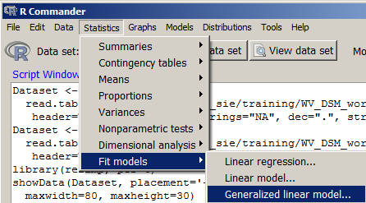
Logistic Regression (Appendix) Rcmdr Example
Rcmdr has a logistic regression option

Slide 22
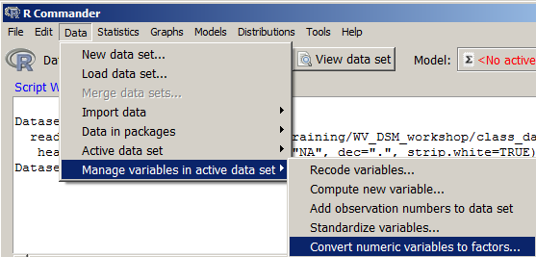
Logistic Regression (Appendix) Rcmdr Example
Convert the 0/1 values in “spod_pres_cons” to a factor

Slide 23
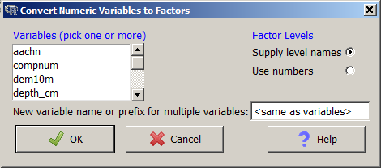
Logistic Regression (Appendix) Rcmdr Example
Select the “spod_pres_cons”
Hit OK
When prompted to overwrite, hit Yes

Slide 24
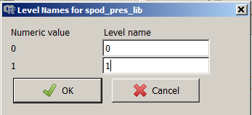
Logistic Regression (Appendix) Rcmdr Example
Recode and hit OK

Slide 25
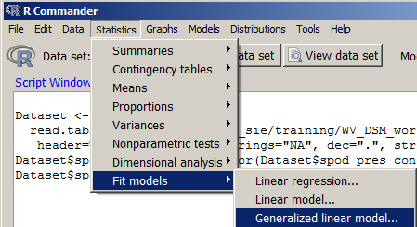
Logistic Regression (Appendix) Rcmdr Example
Open Generalized linear models

Slide 26
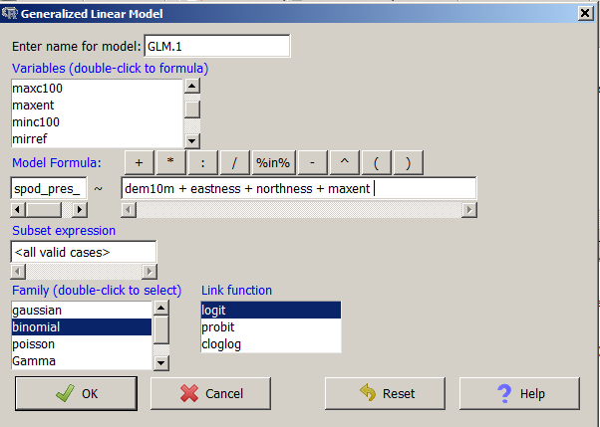
Logistic Regression (Appendix) Rcmdr Example
Create model formula

Slide 27
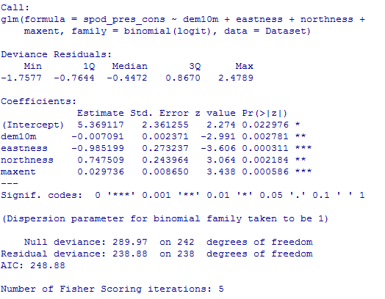
Logistic Regression (Appendix) Rcmdr Example
View output summary in Rcmdr Output Window

