Slide 1
Validation and Uncertainty

Slide 2
Validation and Uncertainty
Outline
Sources of error
Error and uncertainty
Accuracy and precision
Validation methods

Slide 3
Common Sources of Error
Measurement errors
Interpretation errors
Digitization errors
Classification errors
Generalization errors
Interpolation errors
Heuvelink (2012)

Slide 4
Error
Difference between reality and our representation of reality

Slide 5
Error
Example
Map says soil organic C = 30 g/kg at some location
True value = 45 g/kg
Error = 45 – 30 = 15 g/kg

Slide 6
Error
Problem
We usually do not know the error (because if we did, we would eliminate it)
But in many cases we do know something
We may know that the error has equal chance of being positive or negative
We may know that it is unlikely that the absolute value of the error is greater than a given threshold
In other words, we are uncertain about the true value but not completely ignorant
Heuvelink (2012)

Slide 7
Accuracy and Precision
Accuracy
Degree to which a representation of reality is close to reality (∼ inverse of error)
Precision
Degree to which repeated measurements under unchanged conditions show the same results

Slide 8
Accuracy
Accurate
Inaccurate
(systematic error)
Precise
Precision
Imprecise
(reproducibility error)

Slide 9
Uncertainty
Uncertainty arises when we are not sure about the ‘true’ state of the environment; it is an expression of confidence based on limited knowledge
Uncertainty is an acknowledgement of error: we are aware that our representation of reality may differ from reality and express this by being uncertain
Uncertainty is subjective; one person can be more uncertain than another
In the presence of uncertainty, we cannot identify a true ‘reality’. But perhaps we can identify all possible realities and a probability for each one
Heuvelink (2012)

Slide 10
Validation
Three types of validation
Apparent
Performance on sample used to develop model
Internal
Performance on population underlying the sample
External
Performance on related but slightly different population
Notes:
The previous graph showed the apparent validity of a regression model. It is of more interest to study the internal validity, that is the performance on an underlying population (also labelled ‘reproducibility’), or external validity, that is the performance on a different population (also labelled ‘generalizability’ or ‘transportability’).

Slide 11
Apparent Validation
Goodness of fit
Correlation (r², R², adjusted R²)
P-values (model, individual variables)
Residuals
Heteroscedasticity (plot residuals vs. predicted)
Non-normality (histogram, QQ plot)
Spatial autocorrelation (Moran’s I)

Slide 12
Heteroscedasticity
Standardized Residuals
Standardized Residuals
Predicted y
Predicted y
Standardized Residuals
Standardized Residuals
Predicted y
Predicted y

Slide 13
Apparent Validation
Analysis of residuals
Heteroscedasticity, non-normality, or spatial autocorrelation indicates
One or more important variables were omitted from the model
Incorrect functional form used for the model (e.g., linear when the function is actually nonlinear)

Slide 14
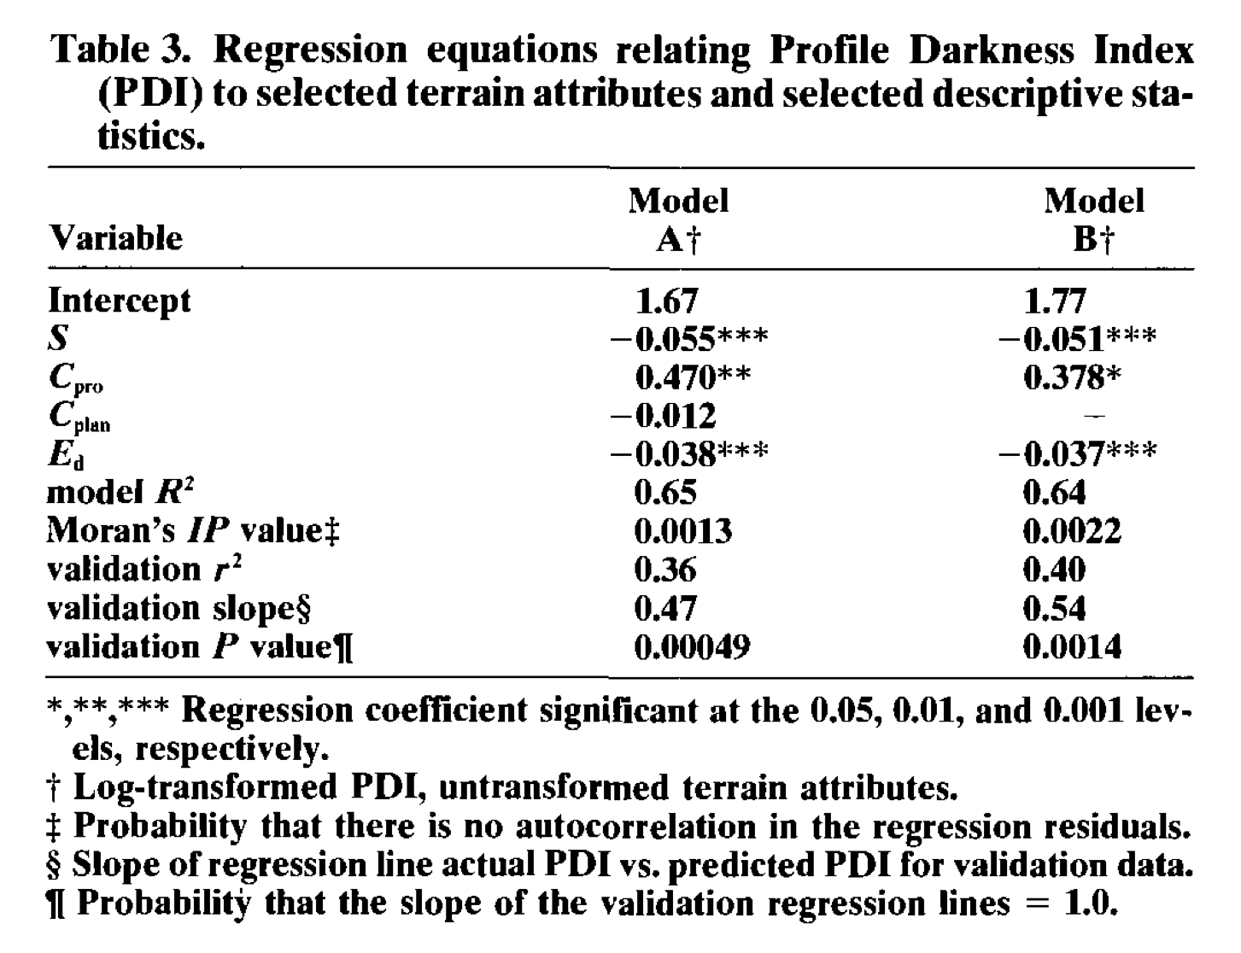
Apparent Validation
Thompson et al. (1997)

Slide 15
Internal Validation
Split-sample
Training data
Validation data
Cross-validation
Alternating development and validation
Jack-knife
n-1 for training, 1 validate
Bootstrap
Random subsample
Notes:
Three internal validation techniques are shown. Split-sample means that a random split is made, resulting in e.g. a 50% development and a 50% validation sample. Cross-validation uses the same principle, but alternates the development and validation samples (e.g. 50:50 split means 2 development and test rounds; a 90:10 split 10 rounds). The most extreme variant of cross-validation is the ‘jack-knife’, where n-1 patients are used for model development, with validation on the patient who was left out. The bootstrap is however the preferred technique (see next slide).

Slide 16
Internal Validation
Methods to assess error
Numerical data
Correlation (r²)
Scatter plots
Mean error (ME)
Root mean square error (RMSE)
Categorical data
Confusion matrix (error matrix)

Slide 17
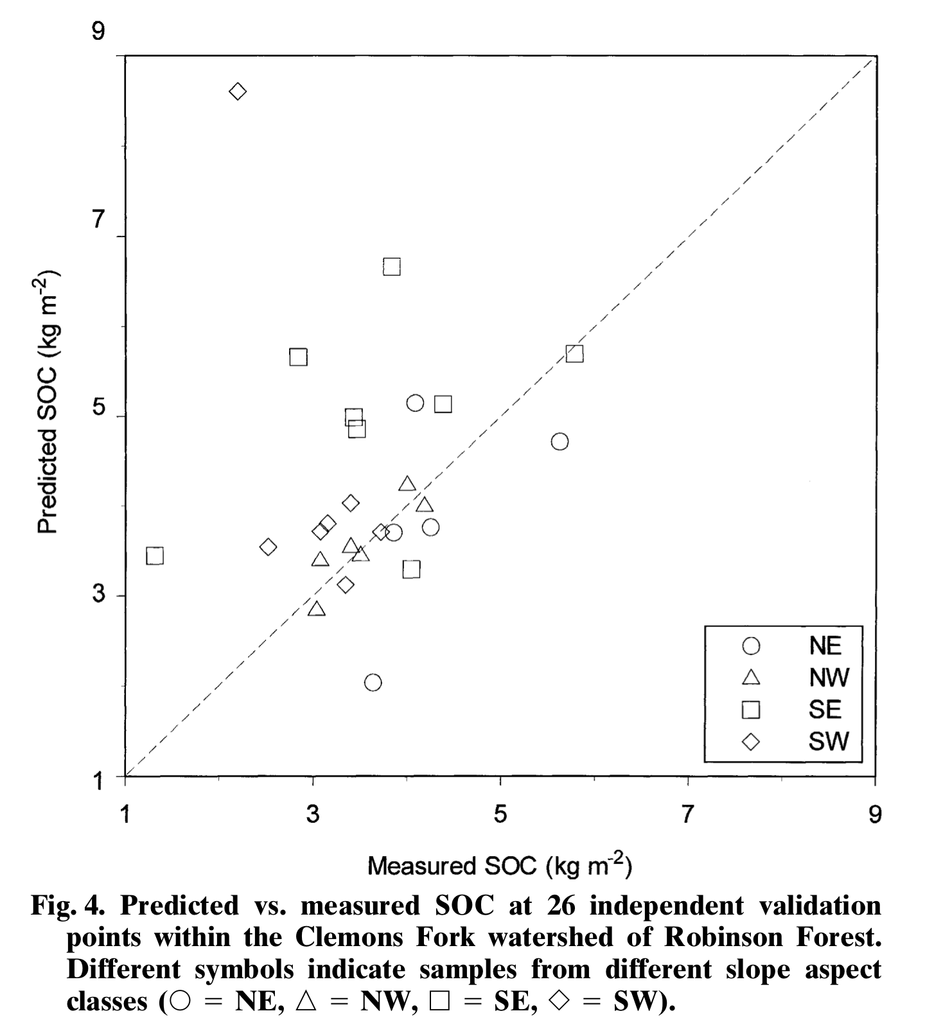
Internal Validation
Thompson and Kolka (2005)

Slide 18
Internal Validation
Thompson et al. (1997)

Slide 19
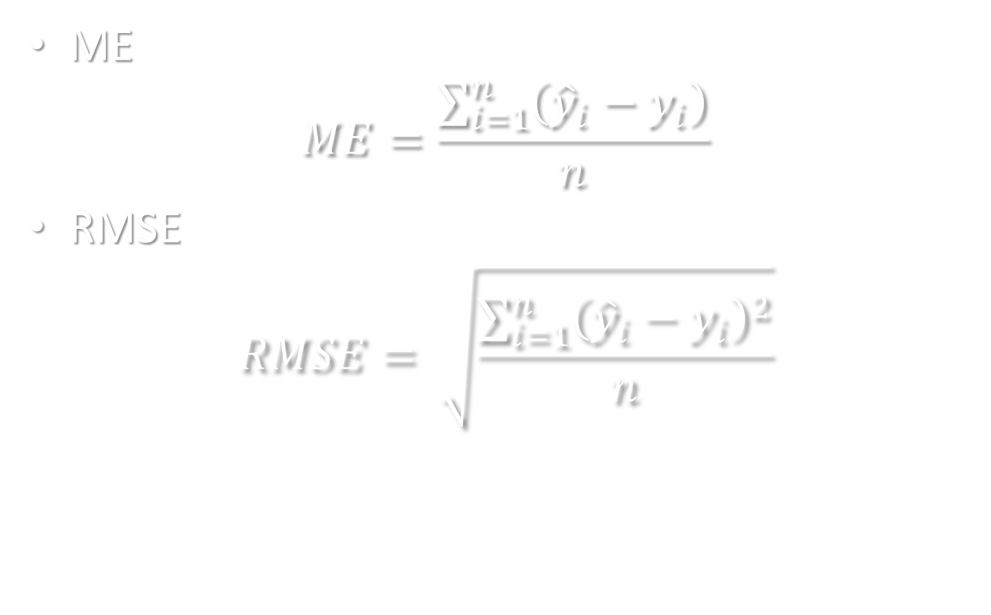
Internal Validation
ME
$$ME=\frac{\sum_{i=1}^{n}{\left({\hat{y}}_{i}−y_{i}\right)}}{n}$$
RMSE
$$RMSE= \sqrt{\frac{\sum_{i=1}^{n}{{\left({\hat{y}}_{i}−y_{i}\right)}^{2}}}{n}}$$

Slide 20
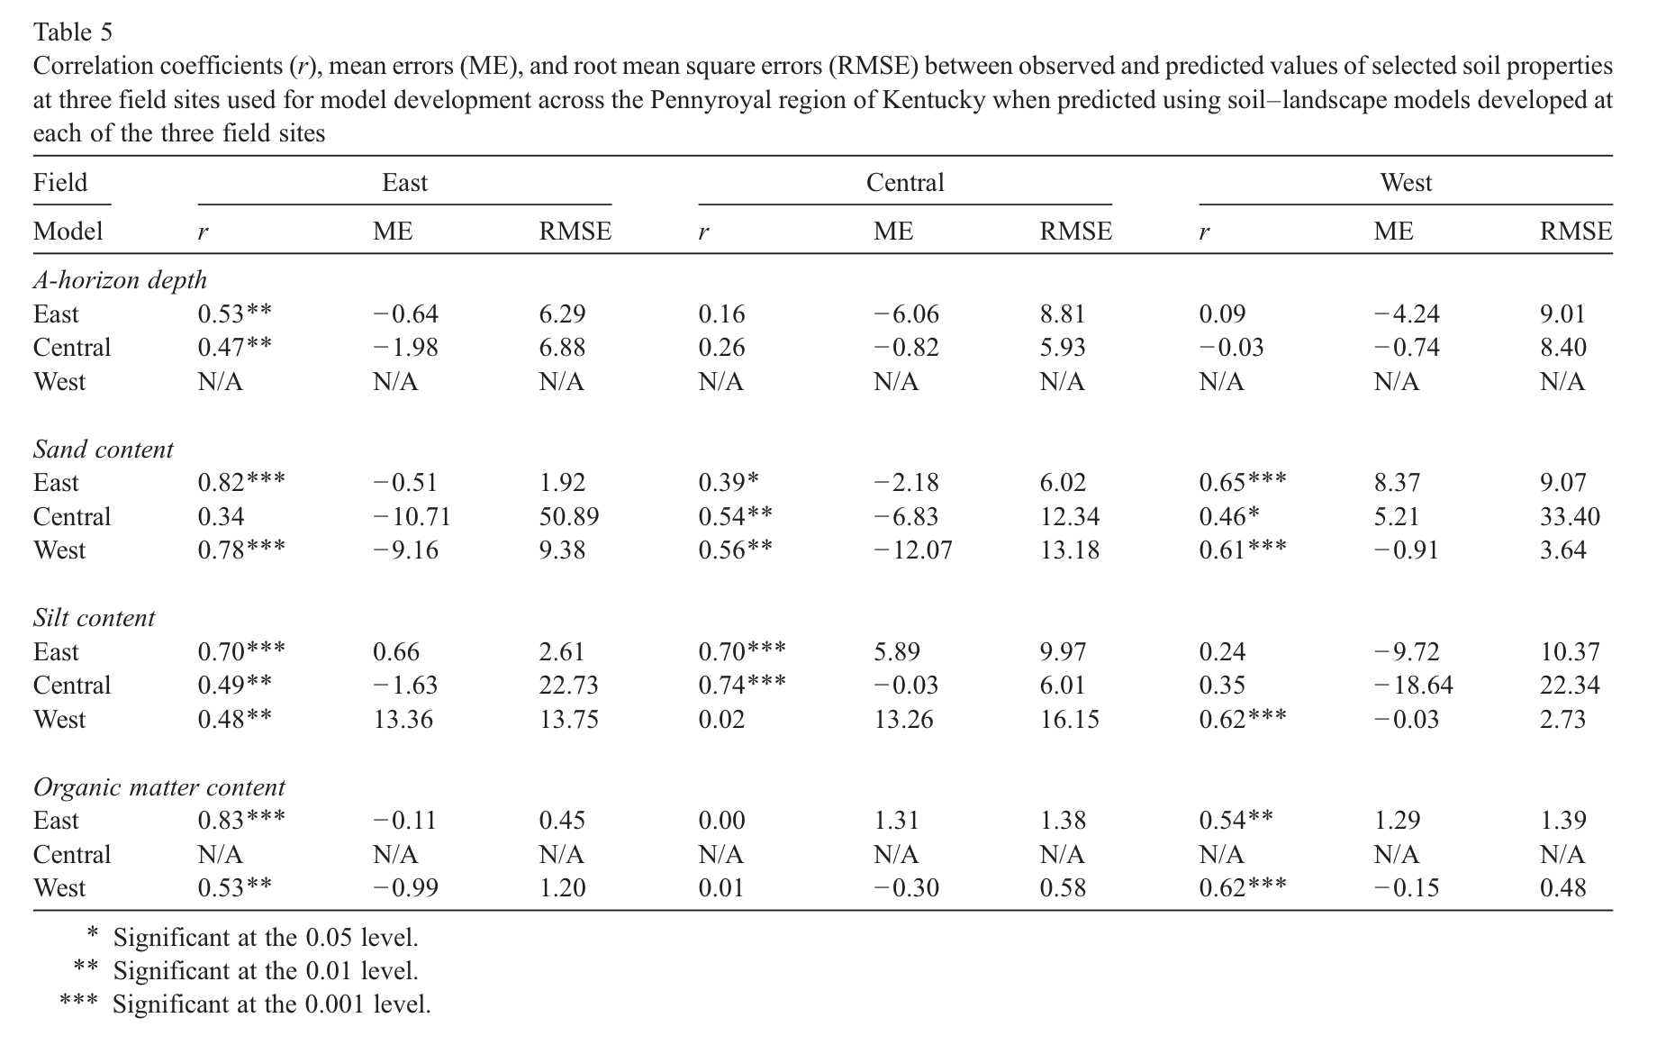
Internal Validation
Thompson et al. (2006)

Slide 21
Internal Validation
 |  | Reference Data
 | Class | Gypsic | Natric | Neither | Row Total | User’s Accuracy
Class Data | Gypsic | 21 | 0 | 0 | 21 | 21/21 = 100%
 | Natric | 0 | 14 | 3 | 17 | 14/17 = 82.4%
 | Neither | 3 | 13 | 39 | 55 | 39/55 = 70.9%
 | Column Total | 24 | 27 | 42 | 93
 | Producer’s Accuracy | 21/24 = 87.5% | 14/27 = 51.9% | 39/42 = 92.9% |  | Overall Accuracy 74/93=79.6%
Notes:
Let’s populate an error matrix with the accuracy assessment data from the San Rafael Swell (Nield et al., 2007).

Slide 22
Confusion Matrix
Types of Accuracy
Overall Accuracy
Number of correct observations divided by total number of observations
User’s Accuracy
Probability that a class on the map actually represents that category on the ground
Producer’s Accuracy
Probability that a ground reference observation was assigned to the correct class in the map
Notes:
Overview of the kinds of accuracy that will be introduced in the next three slides.

Slide 23
Internal Validation
 |  | Reference Data
 | Class | Gypsic | Natric | Neither | Row Total | User’s Accuracy
Class Data | Gypsic | 21 | 0 | 0 | 21 | 21/21 = 100%
 | Natric | 0 | 14 | 3 | 17 | 14/17 = 82.4%
 | Neither | 3 | 13 | 39 | 55 | 39/55 = 70.9%
 | Column Total | 24 | 27 | 42 | 93
 | Producer’s Accuracy | 21/24 = 87.5% | 14/27 = 51.9% | 39/42 = 92.9% |  | Overall Accuracy 74/93=79.6%
Notes:
Let’s populate an error matrix with the accuracy assessment data from the San Rafael Swell (Nield et al., 2007).

Slide 24
External Validation
Thompson et al. (2006)

Slide 25
Regression Tree Model
Random Forest probability model of spodic expression (i.e., SI = 0 vs. SI > 0)
Topographic spatial layers from 30-m National Elevation Dataset digital elevation model
Remote sensing layers from Landsat Geocover 2000
Nauman et al. (2014)
Notes:
- Developed a GIS database of raster layers to try and model where spodic morphology is found.

Slide 26
Validation
Apparent Validation
Full model (n=322)
Out Of Bag error = 29.5%
Internal Validation
Split-sample
Training set (n=208)
Test set (n=114)
0.57 probability threshold
Error = 30%
External Validation
Independent plot data (n=24)
88.1% accuracy
Nauman et al. (2014)
Notes:
To get a more continuous model, a random forest probability model was produced.
Combines many trees built using random sample subsets and random variable-subset selection to create more robust model.
Determined threshold by holding back 33% of data from a model run and adjusting prob thresh to get best confustion matrix.

Slide 27
Validation
Confusion matrix
User’s
Accuracy
0.57 threshold |  | observed
 |  | no spod | spod
predicted | no spod | 19 | 22 | 46.3%
 | spod | 12 | 61 | 83.6%
 |  | 61.3% | 73.5% | 70.2%
Producer’s
Accuracy
Overall
Accuracy
Nauman et al. (2014)

