Slide 1
TEUI Geospatial Toolkit
Terrestrial Ecological Unit Inventory
an ArcGIS Add-in by USFS

Slide 2
What is TEUI?
Zonal Statistics on steroids
You can install without Admin (my experience)
Great tool for comparing data composition between map units or polygons within map units

Slide 3
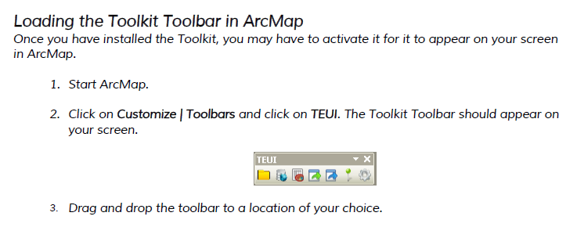
Load the Toolbar

Slide 4
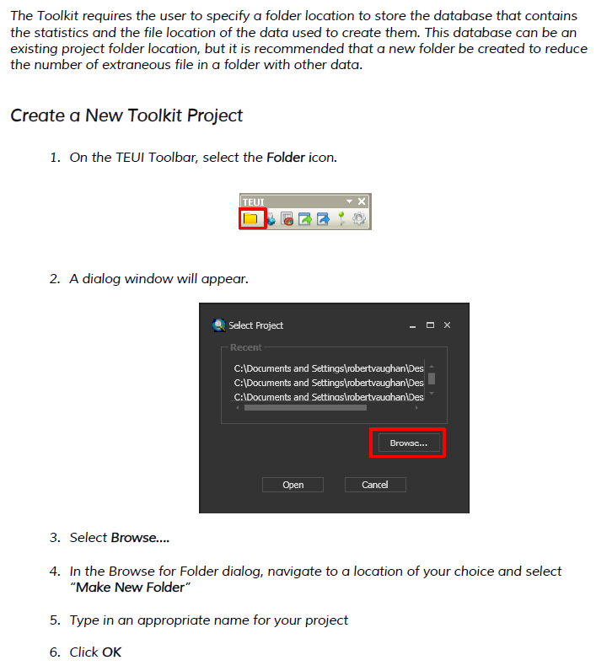
Create a project folder

Slide 5
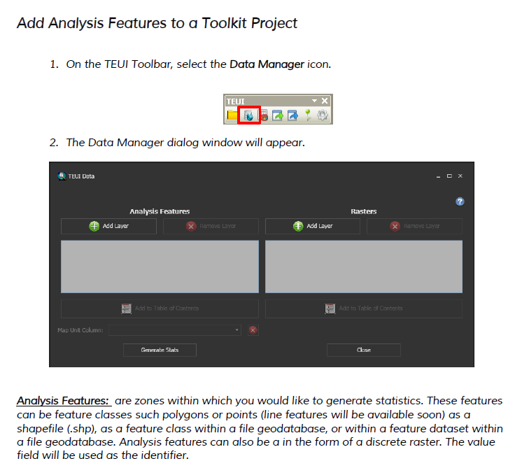
Add analysis features

Slide 6
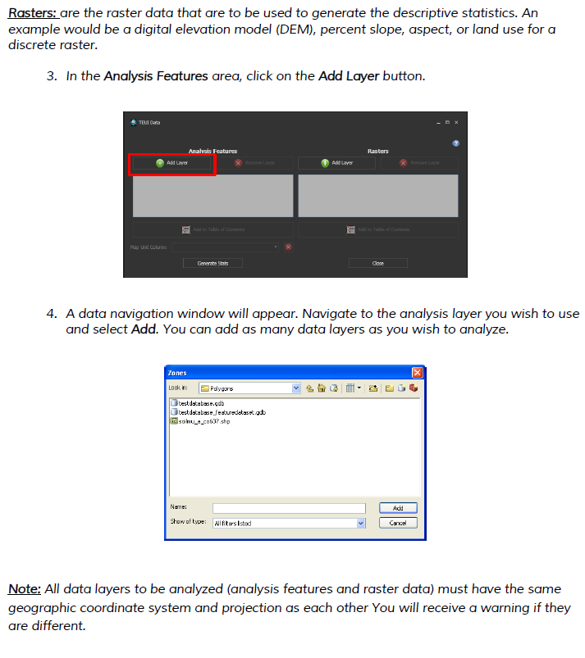
Add analysis features

Slide 7
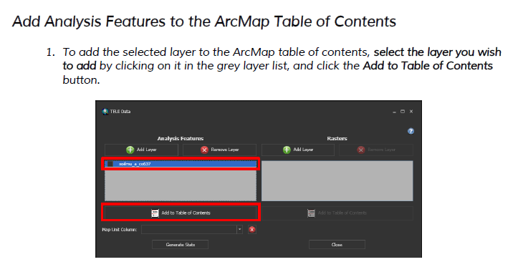
Add features to table of contents

Slide 8
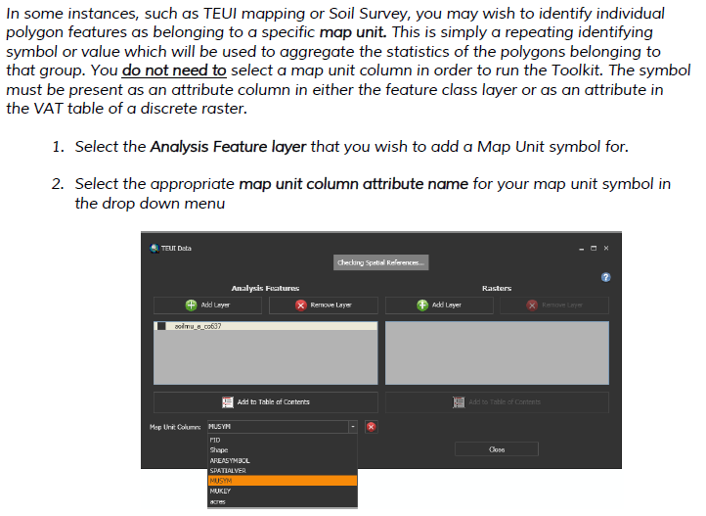
Choose a map unit

Slide 9
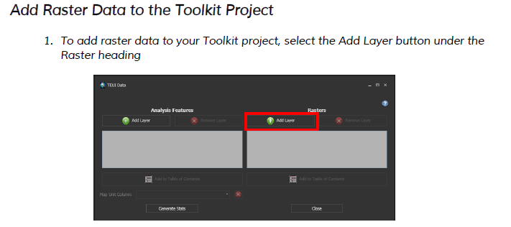
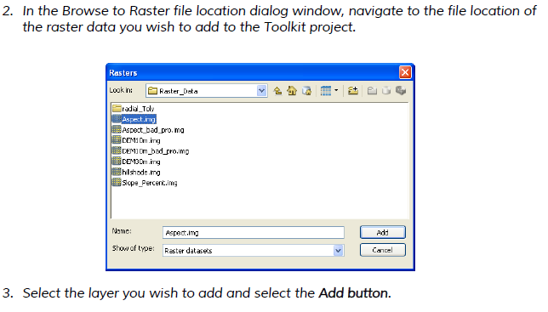
Add raster features

Slide 10
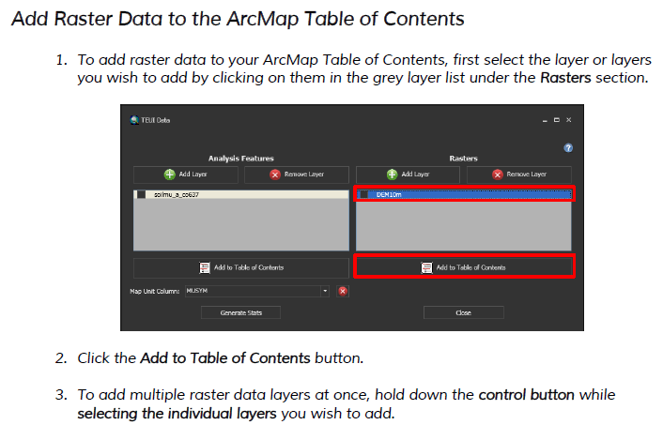
Add raster(s) to table of contents

Slide 11
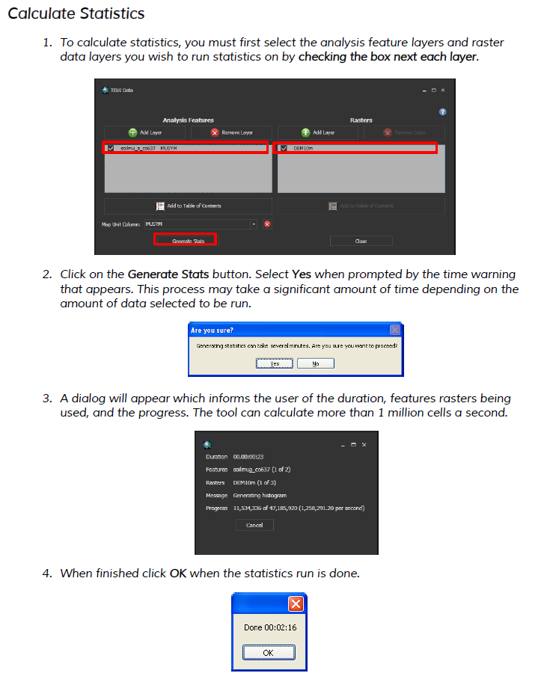
Calculate statistics

Slide 12
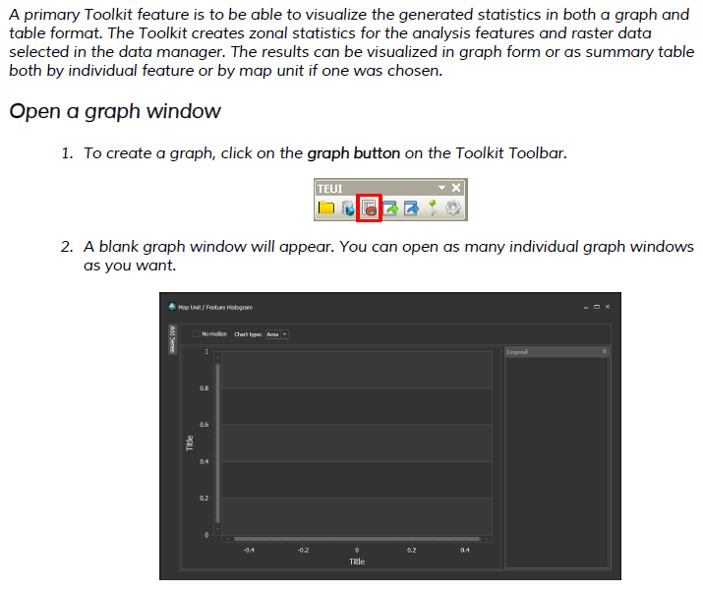
Create and visualize graphs

Slide 13
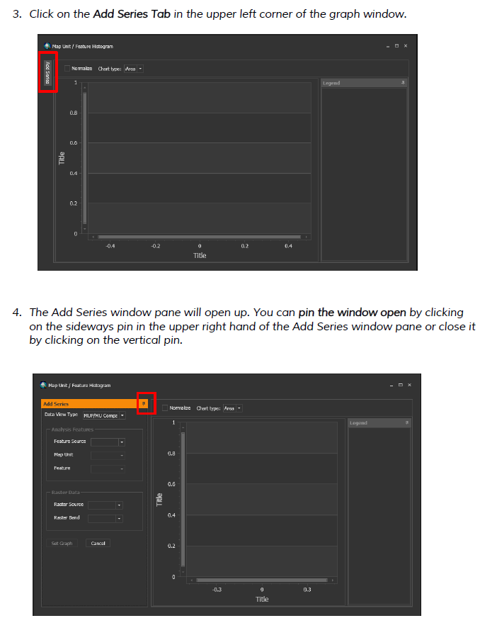
Create and visualize graphs

Slide 14
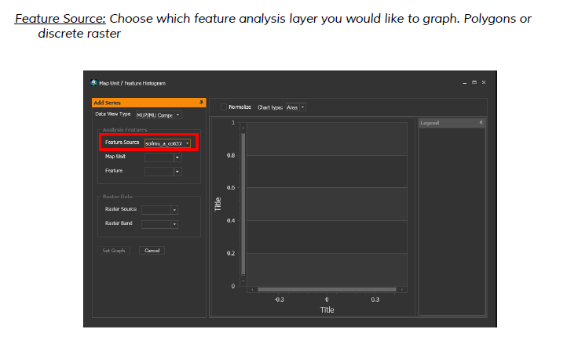
Choose feature analysis layer

Slide 15
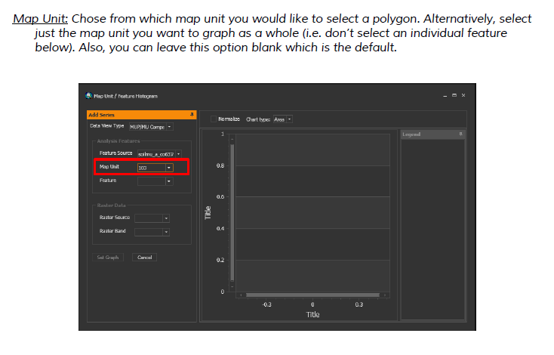
Select map unit

Slide 16
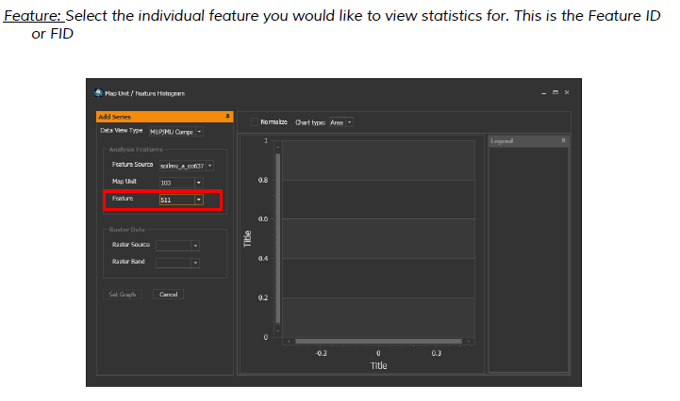
Select polygon if desired

Slide 17
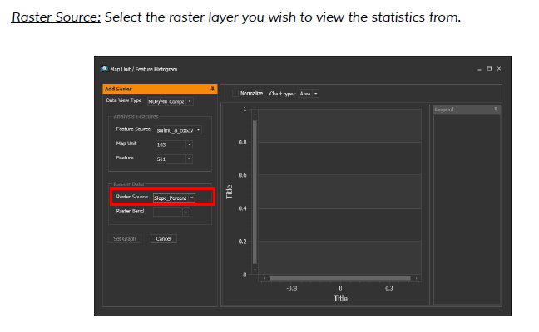
Select raster source

Slide 18
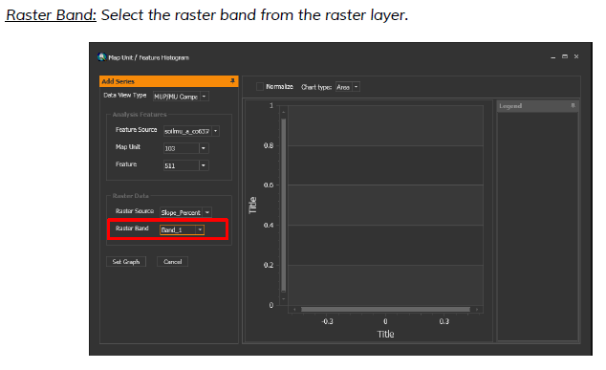
Select the raster band

Slide 19
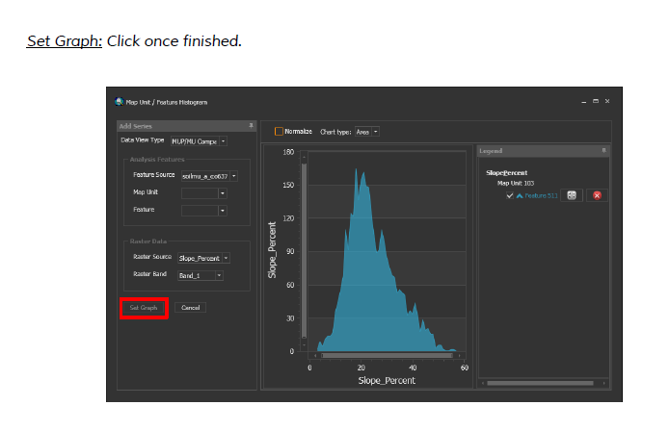
Set graph

Slide 20
Set graph

Slide 21
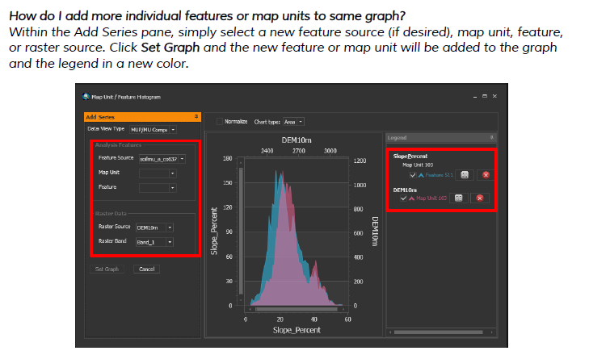
Adding more features e.g. compare CoC and CoC2

Slide 22
Downloads and User Guide
The software and more details are provided in the TEUI User Guide from the URL below
http://www.fs.fed.us/eng/rsac/programs/teui/downloads.html

