Slide 1
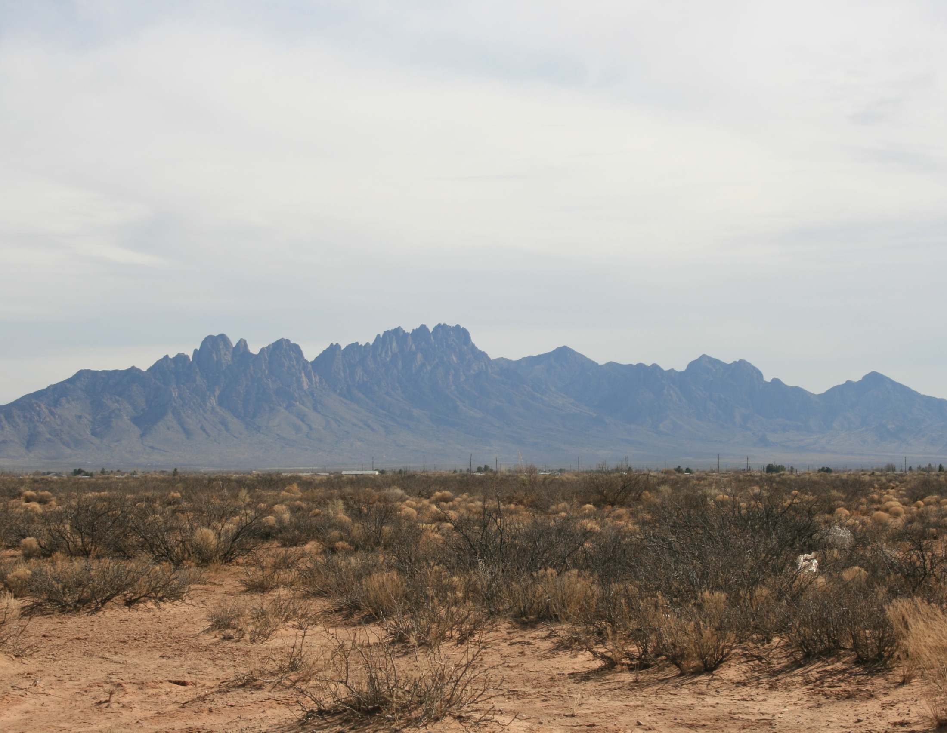
Statistics
the basics

Slide 2
Overview
Statistics without equations?
Kinds of Data
How to summarize
Distributions
Transformations?
Make a list of questions for the next session

Slide 3
Overview
Let’s think about how to use data:
Where did it come from?
What does it represent?
How can I use it (or not use it)?
Statistics without equations?
Kinds of Data
How to summarize
Inference Space and Sampling
How to determine what that summary represents

Slide 4
Think about what you do with data
Storytime…………AR forest interps

Slide 5
Problems?
LONG | LAT | ACRES | SEEDLINGSU | MLRA | MUSYM | MUKEY | SeedMortal | AWC_0_6
-93.69299 | 33.09362 | 60 | 60 | 133B | 1 | 564881 | High | 0.2
-93.87277 | 33.20831 | 70 | 70 | 133B | 82 | 564961 | High | 0.2
-93.92391 | 33.27395 | 27 | 27 | 133B | 2 | 564892 | High | 0.2
-93.94135 | 33.61500 | 40 | 40 | 135B | 82 | 564961 | High | 0.2
-94.08030 | 33.73043 | 35 | 35 | 135B | 29 | 564902 | High | 0.2
-94.15653 | 33.74911 | 50 | 50 | 135B | 29 | 564902 | High | 0.2
-94.34380 | 33.79173 | 20 | 20 | 135B | 2 | 564892 | High | 0.2
-93.17249 | 33.16598 | 24 | 24 | 133B | 28 | 565364 | High | 0.1
-93.45277 | 33.22083 | 40 | 40 | 133B | 1 | 565344 | High | 0.2
-93.28423 | 33.27211 | 37 | 37 | 133B | 16 | 565351 | High | 0.2
-93.28423 | 33.27211 | 10 | 10 | 133B | 16 | 565351 | High | 0.2
-93.43333 | 33.33333 | 28 | 28 | 133B | 29 | 564902 | High | 0.2
-93.34115 | 33.34302 | 92 | 92 | 133B | 2 | 565355 | High | 0.2
-93.43337 | 33.34658 | 40 | 40 | 133B | 29 | 564902 | High | 0.2
-93.50000 | 33.35000 | 14 | 14 | 133B | 82 | 564961 | High | 0.2

Slide 6
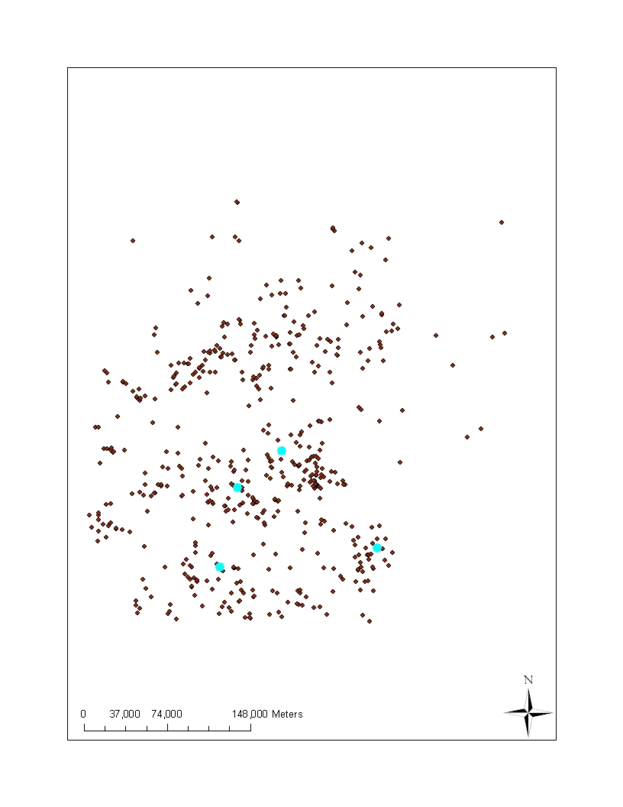
Problems?
LONG | LAT | ACRES | SEEDLINGSU | MLRA | MUSYM | MUKEY | SeedMortal | AWC_0_6
-93.69299 | 33.09362 | 60 | 60 | 133B | 1 | 564881 | High | 0.2
-93.87277 | 33.20831 | 70 | 70 | 133B | 82 | 564961 | High | 0.2
-93.92391 | 33.27395 | 27 | 27 | 133B | 2 | 564892 | High | 0.2
-93.94135 | 33.61500 | 40 | 40 | 135B | 82 | 564961 | High | 0.2
-94.08030 | 33.73043 | 35 | 35 | 135B | 29 | 564902 | High | 0.2
-94.15653 | 33.74911 | 50 | 50 | 135B | 29 | 564902 | High | 0.2
-94.34380 | 33.79173 | 20 | 20 | 135B | 2 | 564892 | High | 0.2
-93.17249 | 33.16598 | 24 | 24 | 133B | 28 | 565364 | High | 0.1
-93.45277 | 33.22083 | 40 | 40 | 133B | 1 | 565344 | High | 0.2
-93.28423 | 33.27211 | 37 | 37 | 133B | 16 | 565351 | High | 0.2
-93.28423 | 33.27211 | 10 | 10 | 133B | 16 | 565351 | High | 0.2
-93.43333 | 33.33333 | 28 | 28 | 133B | 29 | 564902 | High | 0.2
-93.34115 | 33.34302 | 92 | 92 | 133B | 2 | 565355 | High | 0.2
-93.43337 | 33.34658 | 40 | 40 | 133B | 29 | 564902 | High | 0.2
-93.50000 | 33.35000 | 14 | 14 | 133B | 82 | 564961 | High | 0.2

Slide 7
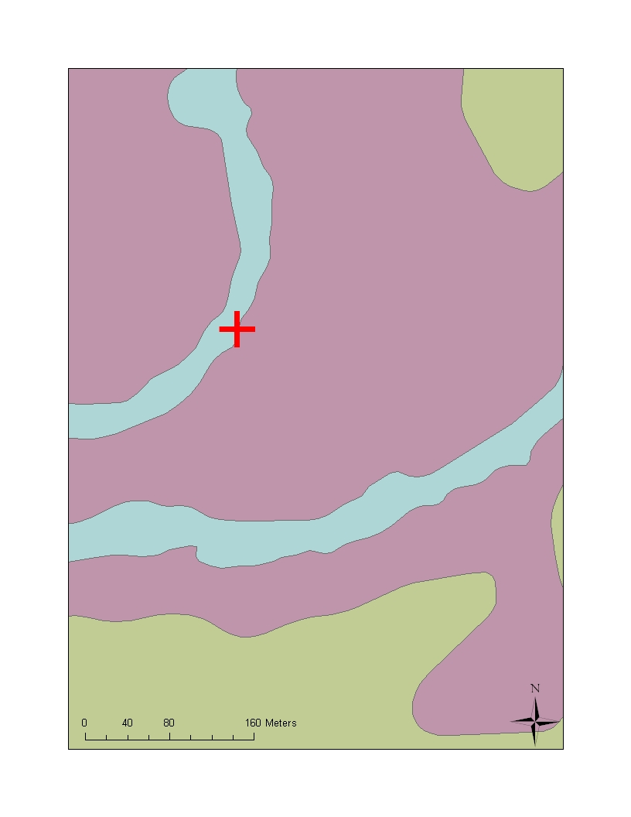
Problems
LONG | LAT | ACRES | Survival% | MUname
-93.69299 | 33.09362 | 60 | 100 | Acadia silt loam, 0 to 2 percent slopes
-93.87277 | 33.20831 | 70 | 84 | Wrightsville silt loam, 0 to 1 percent slopes
-93.92391 | 33.27395 | 27 | 95 | Adaton silt loam, 0 to 1 percent slopes
-93.94135 | 33.61500 | 40 | 55 | Wrightsville silt loam, 0 to 1 percent slopes
-94.08030 | 33.73043 | 35 | 70 | Guyton silt loam, frequently flooded
-94.15653 | 33.74911 | 50 | 44 | Guyton silt loam, frequently flooded
-94.34380 | 33.79173 | 20 | 70 | Adaton silt loam, 0 to 1 percent slopes
-93.17249 | 33.16598 | 24 | 98 | Smithton fine sandy loam, 0 to 2 percent slopes
-93.45277 | 33.22083 | 40 | 84 | Adaton-Felker association, 0 to 2 percent slopes
-93.28423 | 33.27211 | 37 | 55 | Guyton silt loam, frequently flooded
-93.28423 | 33.27211 | 10 | 86 | Guyton silt loam, frequently flooded
-93.43333 | 33.33333 | 28 | 28 | Guyton silt loam, frequently flooded
-93.34115 | 33.34302 | 92 | 60 | Amy silt loam, 0 to 1 percent slopes
-93.43337 | 33.34658 | 40 | 70 | Guyton silt loam, frequently flooded
-93.5 | 33.35 | 14 | 97 | Water

Slide 8
Statistics
2 parts
Philosophical and Common Sense
How do you conduct a study?
Framing hypotheses
What are your assumptions
Sampling and inference
Equations, algorithms etc.
Necessary to obtain measures and tests
Many programs that allow you to “push a button”
Notes:
You don’t have to remember everything in the this powerpoint, however, you do need to think about these issues when analyzing any dataset.

Slide 9
Statistics
2 parts
Philosophical and Common Sense
How do you conduct a study?
Framing hypotheses
What are your assumptions
Sampling and inference
Equations, algorithms etc.
Necessary to obtain measures and tests
Many programs that allow you to “push a button”
An expert (you) with the study subject must be involved in this part. We’ll come back to this .
The key is to know what “buttons” to push
Notes:
You don’t have to remember everything in the this powerpoint, however, you do need to think about these issues when analyzing any dataset.

Slide 10
Three kinds of data
We’ll talk about some examples
We’ll apply the ideas to soil information.
No
math
Most
math
NOMINAL
ORDINAL
CONTINUOUS
Notes:
Nominal – names or classes
Ordinal – numbers or letters that can be ranked
Continuous – numbers that are continuous from zero

Slide 11
Note cards
Answer questions on your note cards
We’ll use these as examples now and later
Basic Information
Gender: M or F
Native State
Current State
Hair Color: blonde, brunette, redhead
Eye color: blue, brown, hazel, green, grey
Rate you knowledge of statistics:
1 – almost none to 5 – extensive

Slide 12
How tall are you?
In inches
What kind of data is this?

Slide 13
Height
How do we summarize this?
Statistically
Average
Mean
Median
Mode
What type of data is it?
Use histograms to determine which is most appropriate
Student | Height (in) | Student | Height (in)
1 | 68 | 13 | 77
2 | 68 | 14 | 67
3 | 60 | 15 | 62
4 | 59 | 16 | 77
5 | 62 | 17 | 69
6 | 70 | 18 | 65
7 | 68 | 19 | 64
8 | 71 | 20 | 66
9 | 75 | 21 | 67
10 | 67 | 22 | 70
11 | 63 | 23 | 72
12 | 62 | 24 | 71

Slide 14
Histogram: a graphical display of frequencies
Count or frequency: the number of times
values fell within each bin.
Range of values called “bins”.

Slide 15
How would I summarize height?
Average –
Usually arithmetic mean (add all values and divide by the number of values)
Student | Height | Student | Height
1 | 68 | 13 | 77
2 | 68 | 14 | 67
3 | 60 | 15 | 62
4 | 59 | 16 | 77
5 | 62 | 17 | 69
6 | 70 | 18 | 65
7 | 68 | 19 | 64
8 | 71 | 20 | 66
9 | 75 | 21 | 67
10 | 67 | 22 | 70
11 | 63 | 23 | 72
12 | 62 | 24 | 71
Average = 67.6
Notes:
Average is a fuzzy term, google “average vs. mean” and you’ll see what I mean. Most people use average to mean arithmetic mean – but it can also mean any value that represents the central tendency of a dataset, sample or population.

Slide 16
Height
Height is an example of continuous data. They are numbers that can be mathematically combined and fractions or decimals make some sense.
Means are usually a good way to summarize this kind of data
Student | Height | Student | Height
1 | 68 | 13 | 77
2 | 68 | 14 | 67
3 | 60 | 15 | 62
4 | 59 | 16 | 77
5 | 62 | 17 | 69
6 | 70 | 18 | 65
7 | 68 | 19 | 64
8 | 71 | 20 | 66
9 | 75 | 21 | 67
10 | 67 | 22 | 70
11 | 63 | 23 | 72
12 | 62 | 24 | 71

Slide 17
When does an mean not work for continuous data?
When the distribution is skewed or has a “tail”
Median
The middle of the distribution
mean | 79.5
median | 81.0
mode | 83.0
Median: 81.0
Average: 79.5
Notes:
The median has the same number of values above and below it. To get the median, list all the values from lowest to highest, the one in the middle is the median.

Slide 18
When does an mean not work for continuous data?
When you are really looking at more than one condition or population.
Average Women
Average Men
Average: 67.4

Slide 19
Did you groan, grimace or curse when you saw the word “statistics” on the agenda?
Yes or No

Slide 20
Reaction to “statistics” on the agenda
How do we summarize this information?

Slide 21
Can’t take an arithmetic mean of the response:
This is called nominal data: text, words or labels not usually numbers
Mode
The value that has the largest number of observations
Mode: No

Slide 22
Add to your note card
In which month were you born?

Slide 23
What kind of data are months?

Slide 24
We can change months to numeric values
This is called ordinal data – numbers…with restrictions
mean | 7
median | 7
mode | 7
Notes:
Ordinal values have a rank but no true zero. January always come before February. Often the distance between values isn’t constant (January has 31 days, but February has 28). Therefore, 7.2 doesn’t have real meaning.

Slide 25
We can change months to numeric values
This is called ordinal data – numbers…with restrictions
mean | 7
median | 7
mode | 7
We can calculate an average but we must be careful. fractions and decimals don’t make sense with ordinal values
Mean = 7.24
7.24 = July 7, 5 am
Notes:
Ordinal values have a rank but no true zero. January always come before February. Often the distance between values isn’t constant (January has 31 days, but February has 28). Therefore, 7.2 doesn’t have real meaning.

Slide 26
What kind of data is the background information have we collected?
Nominal
Gender
Hair and eye color
Ordinal
Rate your knowledge

Slide 27
Three kinds of data
more
math
No
math
NOMINAL
ORDINAL
CONTINUOUS
Notes:
Nominal – names or classes
Ordinal – numbers or letters that can be ranked
Continuous – numbers that are continuous from zero

Slide 28
What kind of data are these? fill out your worksheet
Nominal | Ordinal | Continuous
Classification
Color –
value/chroma
Color - hue
Structure – grade,
Structure –
size measurement
Structure - type
size class
Diagnostic horizon
- type
Diagnostic horizon
- thickness
% clay content
texture
Most lab data

Slide 29
What are mean, median and mode used to populate?

Slide 30
More than RV
Range
Low and high
Standard Deviation
Statistical measure (calculates the measure of the variability or dispersion)
Confidence Interval
Statistical measure of the certainty of the estimation of the mean
Notes:
Standard deviation is a property of the population (you don’t expect it to change dramatically as you collect more samples)
Confidence intervals are a property of the sample (this means increasing the number of samples will increase your certainty or shrink the confidence interval).

Slide 31
Range
Usually simple: max and min
Student | Height (in) | Student | Height (in)
1 | 68 | 13 | 77
2 | 68 | 14 | 67
3 | 60 | 15 | 62
4 | 59 | 16 | 77
5 | 62 | 17 | 69
6 | 70 | 18 | 65
7 | 68 | 19 | 64
8 | 71 | 20 | 66
9 | 75 | 21 | 67
10 | 67 | 22 | 70
11 | 63 | 23 | 72
12 | 62 | 24 | 71
Low | 59
High | 77

Slide 32
Which properties on you list can you create a range for?
Nominal | Ordinal | Continuous
texture
Classification
Color –
value/chroma
Color - hue
Structure – grade,
Structure –
size measurement
Structure - type
size class
Diagnostic horizon
- type
Diagnostic horizon
- thickness
Most lab data
texture

Slide 33
Distributions
Probability Distribution
Describes the range of possible values
Describes the probability of finding any particular value
Underlies the science of statistics

Slide 34
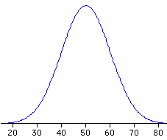
Distributions
Normal – most standard statistics are based on a normal distribution
Notes:
What does “normal” mean to you?

Slide 35
Normal Distribution
Symmetric (bell shaped) distribution with a single peak

Slide 36
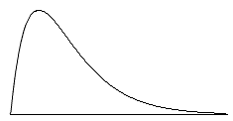
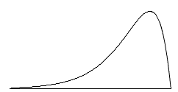
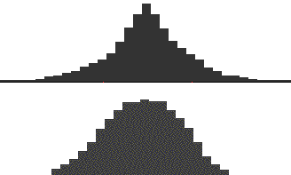
Shape of Distributions
Skew
Kurtosis
positive skew
negative skew
“tails” – long
short

Slide 37
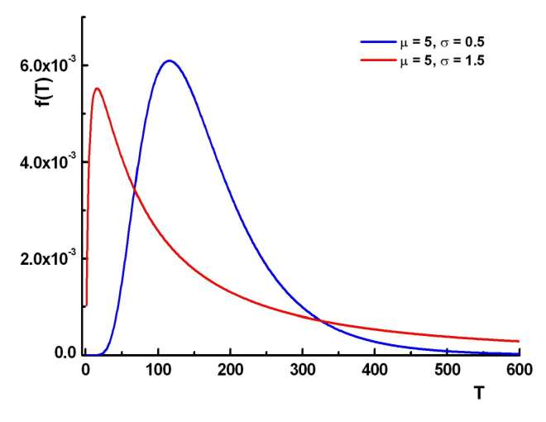
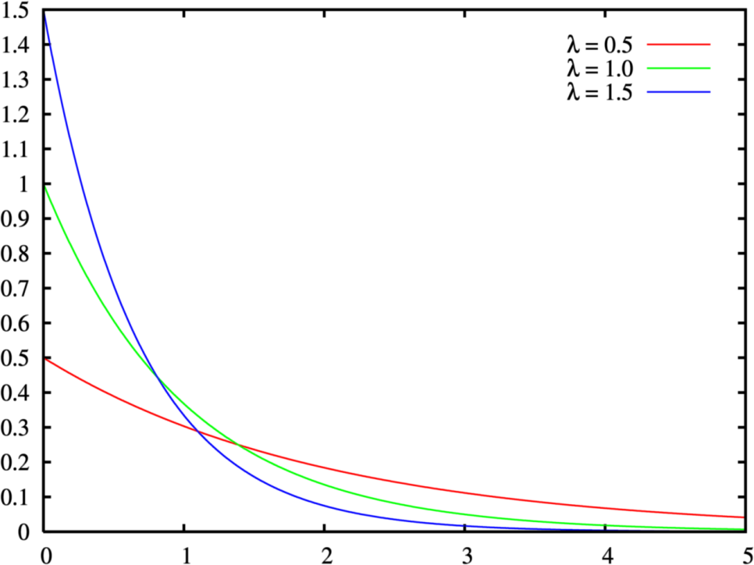
Other Distributions
Lognormal
Exponential

Slide 38
Summary or Descriptive Statistics
Description
Central tendency
Dispersion
Shape of distribution
For Normal Distribution
Mean
Range
Variance
Standard Deviation
Skewness
Kurtosis
Notes:
Summary statistics are used to summarize a set of observations – communicate a large amount of information as easilty as possible

Slide 39
Central Limit Theorem
Under common conditions a large number of random observations will approximate a normal distribution

Slide 40
Standard Deviation
Tells you how tightly observations are clustered around the mean

Slide 41
x – one observation
- mean of all observations
- the difference between that one observation and the mean
- square so that it doesn’t matter if obsv. Is less than or greater than mean

Slide 42
Sum all observations
Divide by n – 1
Take the
square root

Slide 43
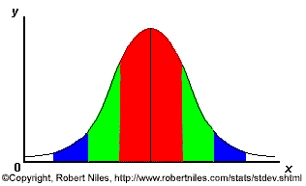
Red – 1 stdev (expect 68% within)
Green – 2 stdev (expect 95% within)
Blue – 3 stdev (expect 99% of samples)
Taken from RoberNiles.com
Notes:
Its expected that 68% of the samples will fall within one standard deviation (the red), 95 % within 2 standard deviations (red and greed) and 99% will fall within 3 std deviations (red, green and blue).

Slide 44
mean | 67.6
median | 67.5
mode | 68.0
Std. dev. | 4.84
Mean
2 stdev
1 stdev
60 65 67 70 75

Slide 45
mean | 78.3
median | 80.1
mode | 83.0
Std. dev. | 5.7
Mean
2 stdev
1 stdev

Slide 46
mean | 78.3
median | 80.1
mode | 83.0
Std. dev. | 5.7
Outlier: an observation that is numerically distant from the rest of the data
Mean
3 stdev
2 stdev
1 stdev
Notes:
A value that is far outside of the rest of the values is called an outlier.

Slide 47
Outliers can occur for many reasons.
That observation is outside of the population
Measurement error
median
not
mean
How do you deal with an outlier?
Remove it from the analysis
Use appropriate stats for a skewed distribution

Slide 48
Which properties on you list can you calculate a standard deviation for?
Nominal | Ordinal | Continuous
texture
Classification
Color –
value/chroma
Color - hue
Structure – grade,
Structure –
size measurement
Structure - type
size class
Diagnostic horizon
- type
Diagnostic horizon
- thickness
Most lab data

Slide 49
Confidence Interval
Indicates the reliability of an estimate
Gives a range of likely values
Depends of the confidence limit
Usually expressed as a %
For example – I am 80% certain that the class average was between 94 - 97 pts
The confidence interval changes based on the standard deviation, the number of samples and the confidence limit

Slide 50
* where t* is the upper (1-C)/2 critical value for the t distribution with n-1 degrees of freedom, t(n-1)

Slide 51

T value – students t
Degrees of freedom
N – 1
Determines shape of t values
Alpha – risk level
100 – CL = alpha
How far along the distribution you are
Can be reported as one tail or 2 (alpha/2)
Traditionally, looked t up in a table. You can use excel or other program

Slide 52
Mean | 67.6
Std. dev. | 4.84
CI (80%) | 66.3 – 68.8
CI (90%) | 66.0 – 69.1
CI (99%) | 65.1 – 70.1
Mean
99% CI
80% CI
60 65 67 70 75
Notes:
CI and CL can be confusing. The higher the CL, the wider the CI
Alpha = 1 – the confidence limit
CI = t* x std dev/sqrt(N-1)
Get t from a standard table
t* = students t with alpha/2 and N-1 degrees of table

Slide 53
CI and CL can be confusing. The higher the CL, the wider the CI
Alpha = 1 – the confidence limit
Get t from a standard table
t* = students t with alpha/2 and N-1 degrees of freedom

Slide 54
Mean | 70.9
Std. dev. | 10.5
CI (80%) | 67.5 - 74.4
CI (90%) | 66.5 - 75.4
CI (95%) | 65.6 - 76.3
CI (99%) | 64.0 - 77.9

Slide 55
Standard Error vs. Standard Deviation
Standard error of the mean
Represents the likely accuracy of the sample mean
Standard deviation of means with repeated sampling
Standard deviation of the sample or population
Represents the distribution of values
An estimate of the variability of the population (dispersion)
Notes:
Standard errors are a kind of standard deviation, If you took lots of samples from one population; how would the mean vary. As sample size increases, standard error decreases. This is not generally the case for standard deviation

Slide 57
Exercise
Use excel to characterize some data
Excel_example1.xlsx
Data
Summary statistics
Calculate standard deviation by hand

Slide 59
Notes
Double click function names in the formula bar to learn more about them
Don’t trust excel to do much more than you just asked it to do
To round numbers (not just alter the display) =CEILING(J18,1)

Slide 60
Excel
Summary statistics formulas
Mean =AVERAGE(D2:D26)
Square = power(E2,2)
N = count(D2:D26)

Slide 61
Data Analysis
See your graphing in Excel handout
Construct a histogram
Description/summary statistics

