Slide 1
A brief intro to Rcmdr

Slide 2
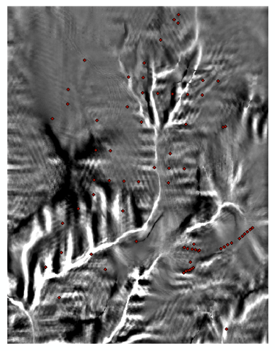
Have field acquired information and associated covariates
To expand existing knowledge/understanding
about processes that may be occurring on the
landscape
Extract to the observation
points (point features) landscape covariates or,
Extract to polygon features landscape covariates (Convert graphics to feature). Polygons can be drawn – see the example later, or can be from SSURGO soil polygons – if they are consistent.

Slide 3
Study area
Dependent Variables=
Soil Series
Independent Variables=
Landscape Attributes
Snowdog
Plan Curvature (PLN)
Mandy
Slope % (SLP)
Wildell
Wetness (WETM)
Things Get Complicated Real Fast

Slide 4
Rcmdr intro
Descriptive statistics
Graphical plots

Slide 5
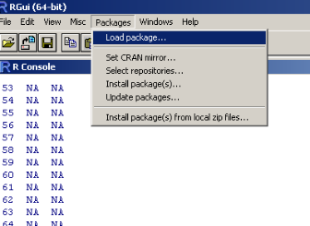
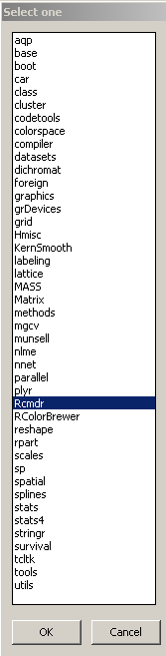
Load Rcmdr from R
Select packages on the R tool bars and
choose Load package.
2) Scroll To Rcmdr select and hit OK
3) If Rcmdr is not an option please see next slide

Slide 6
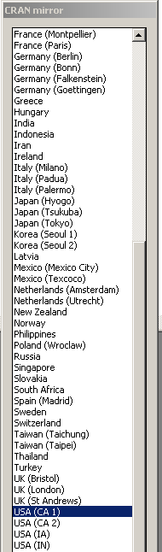
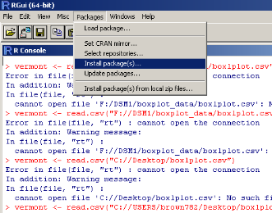
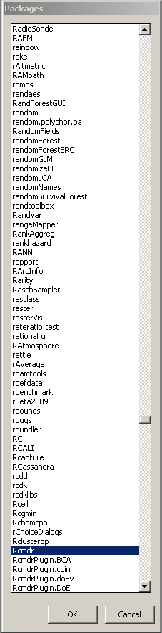
Install packages in R
Scroll to a mirror Repository I
usually use CA1 then select OK
2) Packages window will open: Scroll
to and select Rcmdr and select OK
3) Load Rcmdr package as in slide 5

Slide 7
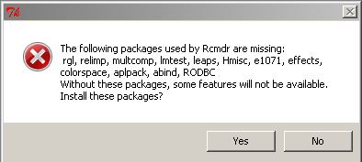
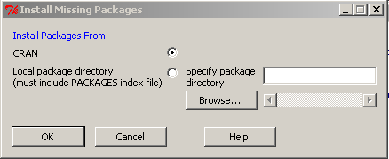
Possible messages
After the first time you load Package you will likely get an error indicating that Some packages are missing: Select OK
Another window will Pop-Up by default CRAN should be selected hit OK

Slide 8
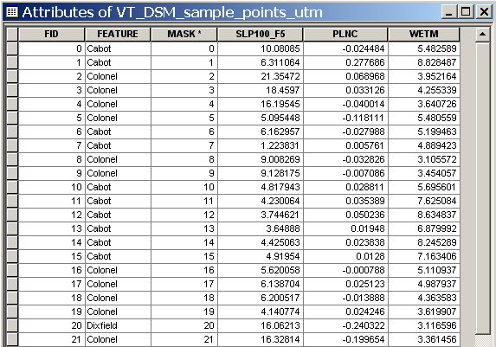
Exercise
The data to be input into R is developed using the Extract Multi Values to Points command in ArcGIS, which is described in the Appendix of this module
Dependent
Independent

Slide 9
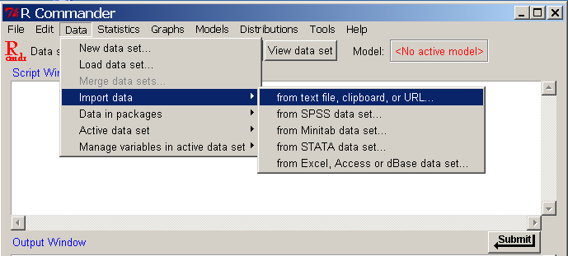
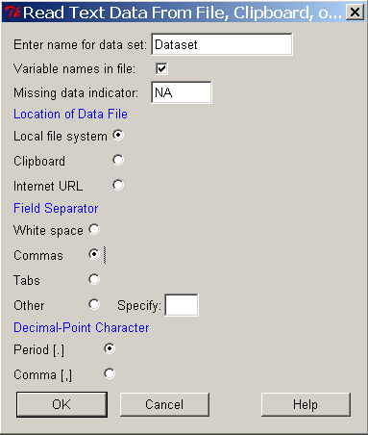
Load Data into RCmdr
Check Commas for Field Separator
Then click OK

Slide 10
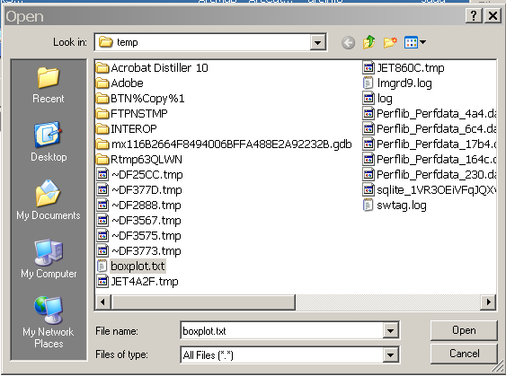
Load Data into RCmdr
Navigate to location of file and
select
Then hit Open

Slide 11
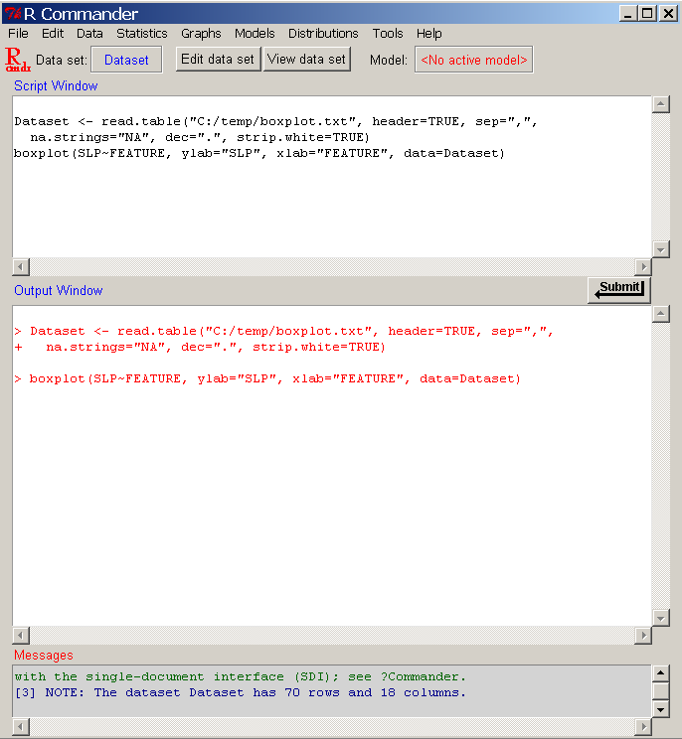
The Dataset is active in Rcmdr

Slide 12
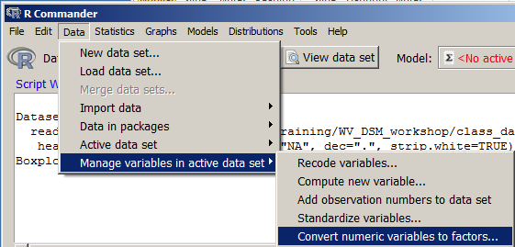
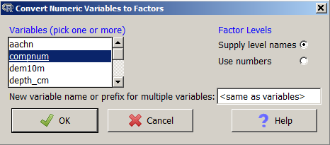
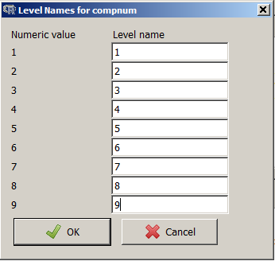
Manage data
Convert a numeric variable to a factor.
compnum is a categoric
data type as others like
spodic intensity or tip_mnd
could be treated

Slide 13
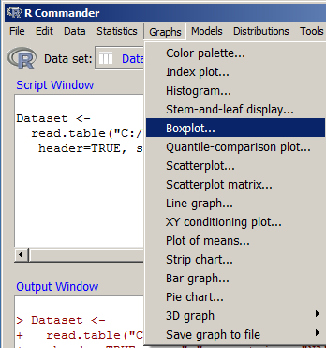
Graphical exploration
Commonly used

Slide 14
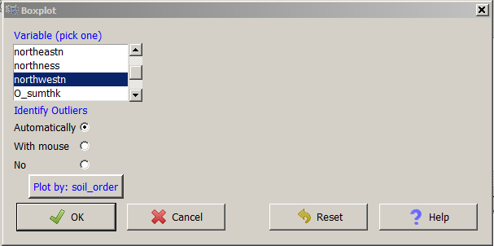
Boxplots
Plot northwestness by soil order

Slide 15
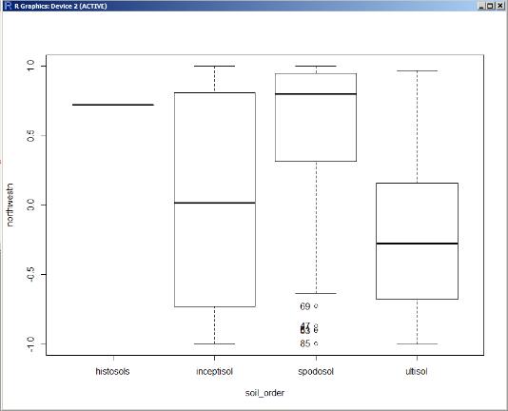
The plot is in the Rgui window
3rd quartile (75th quantile)
2nd quartile = Median (50th quantile)
1st quartile (25th quantile)
The “Box” is the interquartile range (IQR) or 3rd – 1st quartile
Whiskers extend 1.5x the IQR as a default

Slide 16

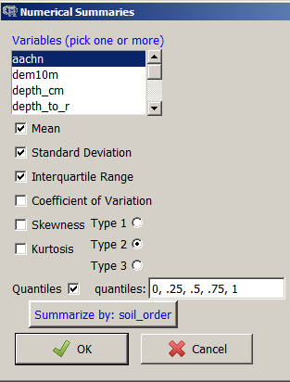
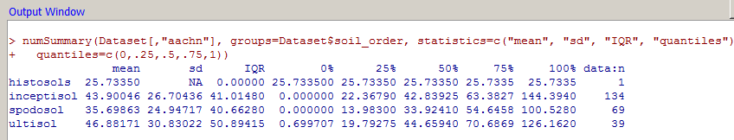
Descriptive statistics
Numerical summaries

Slide 17
Appendix
Developing data for input to R

Slide 18
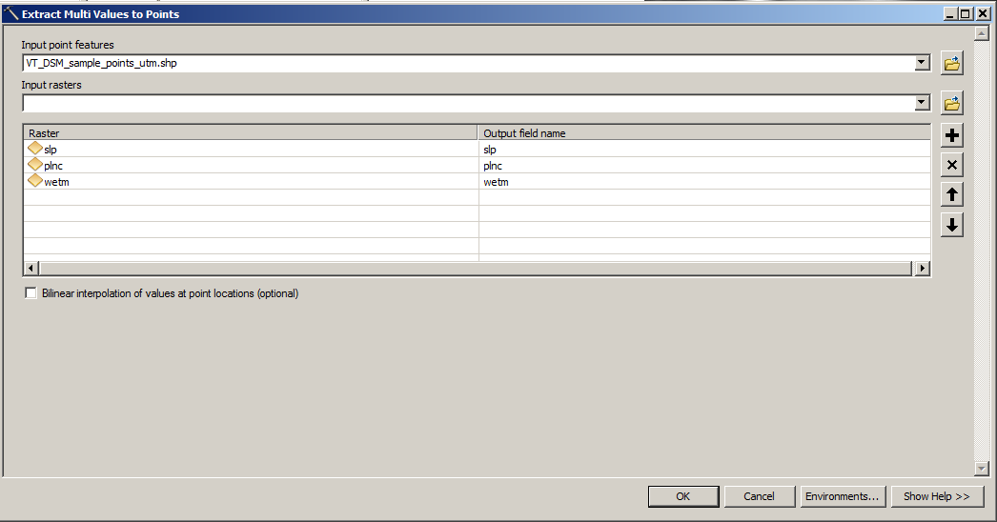
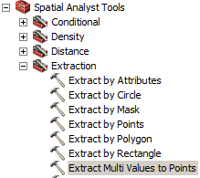
Exploring data Exercise
Open the project file
Open the Extract Multi Values to Points tool from Spatial Analyst Tools > Extraction Toolbox
Add “raster covariates of interest” as Input rasters and your sample points as
the point feature and hit “OK”

Slide 19
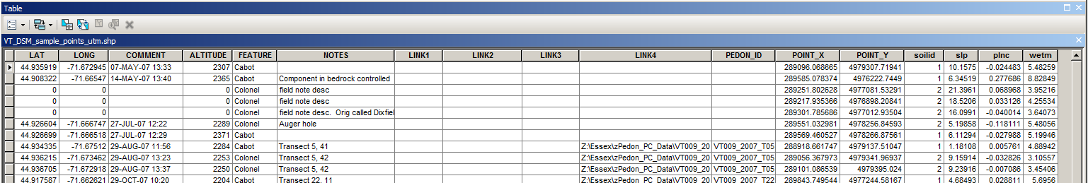
Exploring data Exercise
This example shows the corresponding pixel values of slope, plan curvature and wetness index to pedon locations.

Slide 20
Exploring data Exercise
Sample and Extract Values to Points are similar tools found under the same Extraction Toolbox as Extract Multi Values to Points. Extract Values to Points attaches the value from one raster and creates a new point file. This could be a data management problem if dealing with many covariates.
Sample creates a separate table with the attributes from the selected covariates, but requires a join back to the original point file to get all of the desired information of soil class and covariate data in one place.

Slide 21
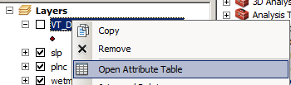
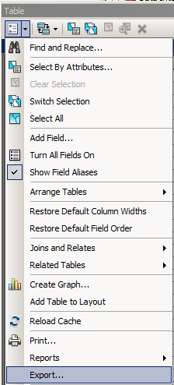
Exploring data formatting data for R
Arc Will Automatically Load the Dbf Table
into the Layer, to view it:
right Click on the point file and select
Open Attribute Table
Open Table Options
Exports

Slide 22
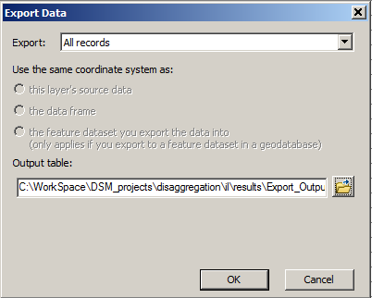
Exploring data formatting data for R
Export Data From the Dbf Table
Click on the Browse button

Slide 23
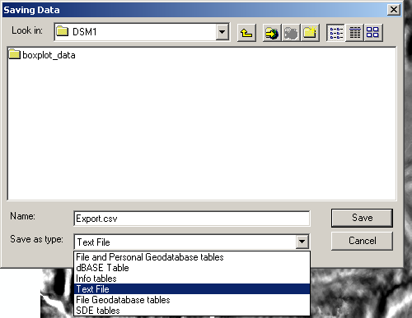
Exploring data formatting data for R
Select Text file for “Save as Type”
save as a Text (.txt) file
txt

Slide 24
Exploring data formatting data for R
The text file is ready for use with R

Slide 25
2. Using ArcMap Drawing Tool to Extract
Data from polygons
Assume you have few or no field collected points, and you have tacit knowledge of
anticipated soil-landform breaks. For example, you know drainage ways or concave/concave
curvatures will have soil X. You also know soil Y occurs on certain aspects and is associated
with a particular conifer that you can plainly identify on imagery.
You can use ArcGIS to draw polygons around the places that are typical soil X and Y settings.
If you are familiar with Image Processing, it is loosely analogous to selecting a training set for
Supervised classification.
The next 7 slides or so demonstrate compilation of covariate data from polygons.
The slides focus on one polygon, but in practice, you would draw a number of polygons of
soil X, soil Y, soil Z………etc
You would also attribute the polygons X, Y, Z….etc accordingly when the graphic is converted to
a feature

Slide 26
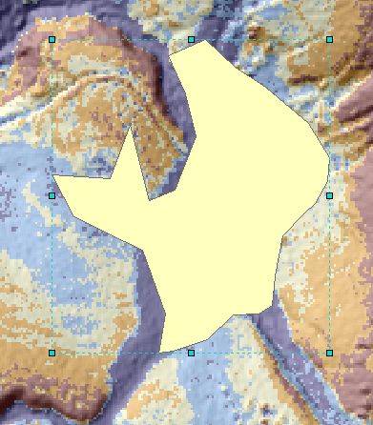
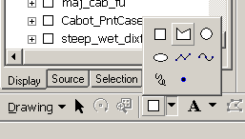
2. Using ArcMap Drawing Tool to Extract
Data from polygons
Select drawing
Polygons

Slide 27
2. Using ArcMap Drawing Tool to Extract
Data from polygons
Draw a polygon around the desired area
The polygons you draw represent
various soils (Dependent Variables),
analogous to the point file from the
previous exercise.

Slide 28
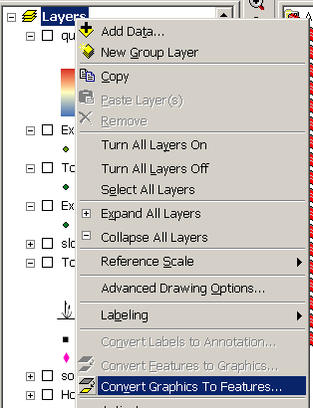
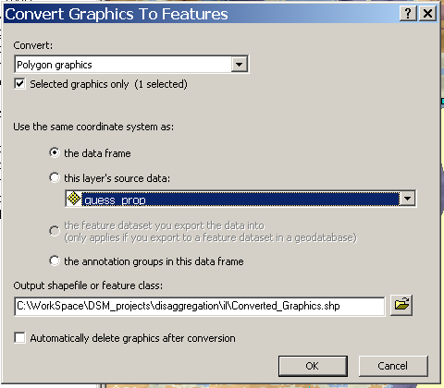
Convert graphic to feature
2. Using ArcMap Drawing Tool to Extract
Data from polygons
Right-click Layers
Convert Graphic to Features

Slide 29
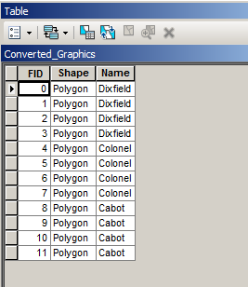
2. Using ArcMap Drawing Tool to Extract
Data from polygons
You will need to attribute these polygons with their respective soil IDs
(e.g. Dixfield, Cabot or Colonel)

Slide 30
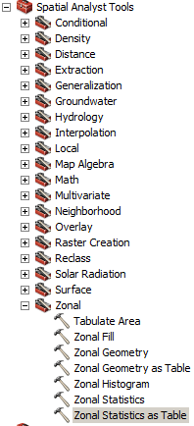
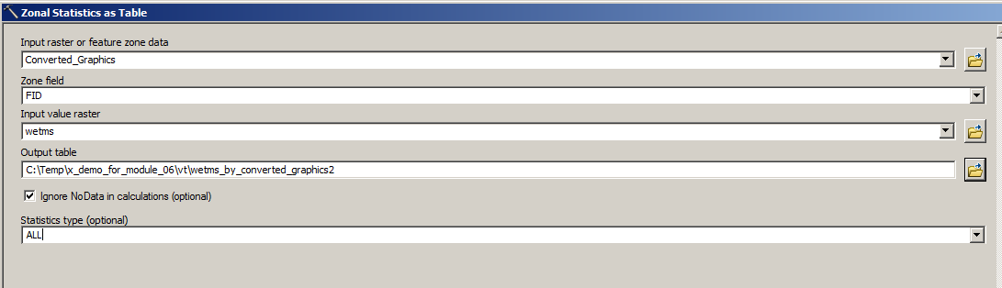
2. Using ArcMap Drawing Tool to Extract
Data from polygons
Use Zonal Statistics as Table
with FID as the Zone field
In this example – the output will
consist of descriptive statistics of
wetness index by polygon.

Slide 31
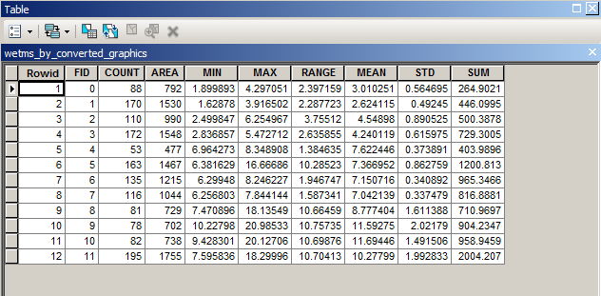
2. Using ArcMap Drawing Tool to Extract
Data from polygons
This is what the output table looks like. You will need to join this table to your “Converted Graphics” polygon to get the soil associated with each polygon

Slide 32
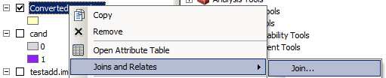
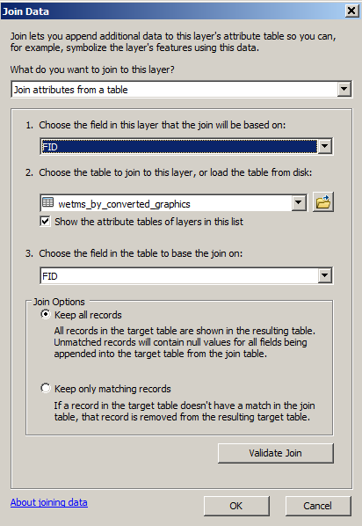
2. Using ArcMap Drawing Tool to Extract
Data from polygons
Right-click on the “Converted Graphics” layer and select Join and Relates -> Join
Use FID as the join field and hit OK

Slide 33
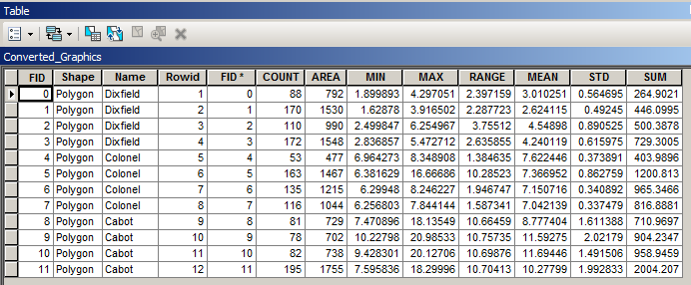
2. Using ArcMap Drawing Tool to Extract
Data from polygons
The joined table now contains soil names with associated statistics. Export this table as a text file.
At this point you may use this comma delimited file in Rcmdr just like the point
observation file was used.
Mean would be the most useful statistic to use

Slide 34
References and Useful Links
R: Copyright © 2004-2008
The R Foundation
for Statistical Computing
http://www.R-project.org
http://www.mathsisfun.com/data/quartiles.html

