Slide 1
Exploratory data analysis with ArcGIS

Slide 2
Overview
Histogram
Visualization
Descriptive statistics

Slide 3
Visualization
Symbology
Classified legend
Classification method
Hillshade draped with ‘transparent’ theme of interest

Slide 4
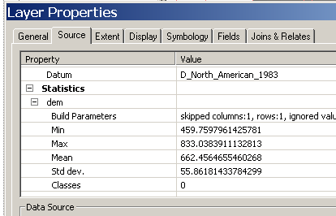

Descriptive statistics
1) Rght-click on layer
and select Properties
2) Hit Source Tab and
scroll down to Statistics

Slide 5
Exercise
Open ArcGIS
Add layers of interest from the “wv_DSM” folder:
“dem”
“slp”
.
.
.
“etc”

Slide 6
Exercise
Fill in the following for layers of interest
Layer | Minimum | Maximum | Mean | Std. Dev
dem
slope

Slide 7
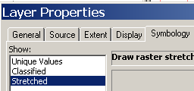
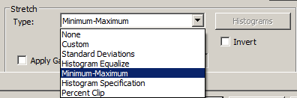
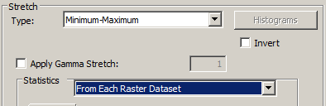
Exercise
Explore the histogram of a layer
1) Right-click on layer
and select Properties
2) Click on Symbology
tab and highlight
Stretched
3) Select Minimum-Maximum
for Stretch Type
4) Select From Each Raster Dataset

Slide 8
Exercise
Enable Spatial Analyst if needed
5) Select layer from drop-down menu
6) Click the histogram tool

Slide 9
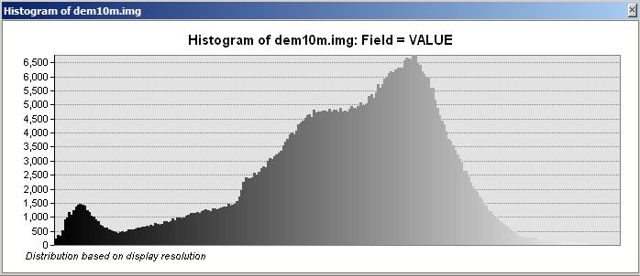
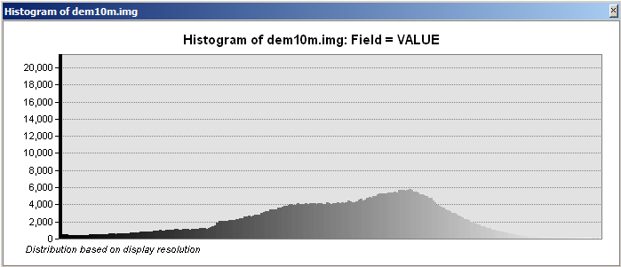
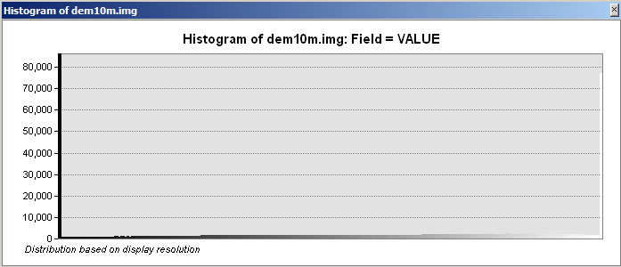
Exercise
Beware, Symbology effects the histogram
Histogram “Native”
Minimum-Maximum
From each dataset
Histogram Standard
Deviation n=2.5
Histogram Standard
Deviation n=1

Slide 10
Exercise
View the histograms for each layer and fill in the table below using the associated legend:
Layer | Distribution | Kurtosis (Shape)
dem
slope
Distribution
Normal (or close enough)
Skew positive
Skew negative
Bi-modal
Kurtosis
Normal (or close enough)
High (i.e. pointy)
Low (i.e. flat)

Slide 11
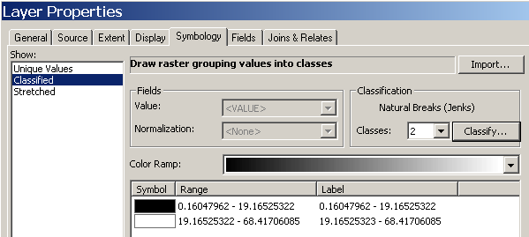
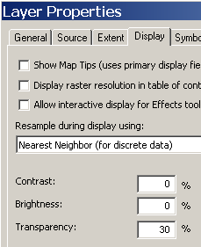
Exercise
Explore data through symbology
1) Open Layer Properties for slope Layer,
Select Classified
then select 2 classes from the
drop-down
2) Hit Classify
TIP Create a hillshade from dem layer and apply a transparency
to layers as you proceed to help visualize data with
theme draped over hillshade

Slide 12
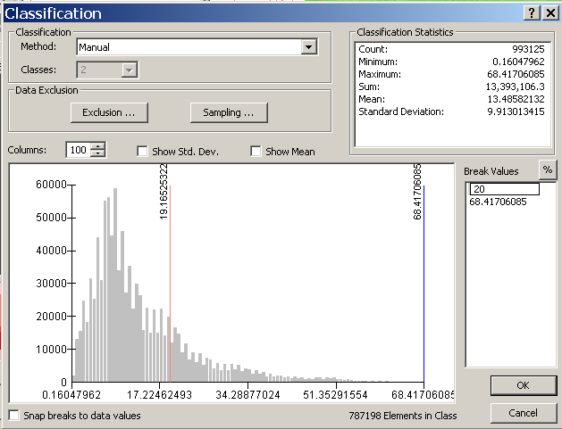
Exercise
Explore data through symbology
3) Open Classification Method and
Select Manual
4) Enter the value “20” in
Break Values

Slide 13
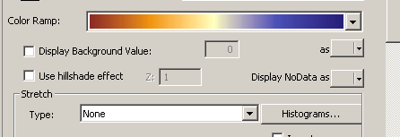
Exercise
5) Results display a two class map: <= 20% slopes
=> 20% slopes
This is a hard break that soil scientists think to be a threshold for a soil in the area
We can all relate to Slope, but what about something like curvature, with unfamiliar, small values?
How to relate the data values to what is on the ground?
Open Layer Properties for “plnc” and set Symbology to Stretched – Minimum-Maximum, with a ramp
of broad color spread
How does it look?
Any meaningful breaks?

Slide 14
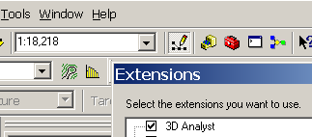

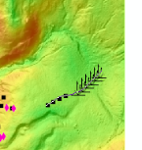
Exercise
The Cross-section/Profile tool is a useful visualization tool
Turn on 3DAnalyst
Tools->Extensions-> 3d Analyst
Select “dem” from 3D Dropdown
Click Interpolate line tool
Draw line along
transect of observations

Slide 15

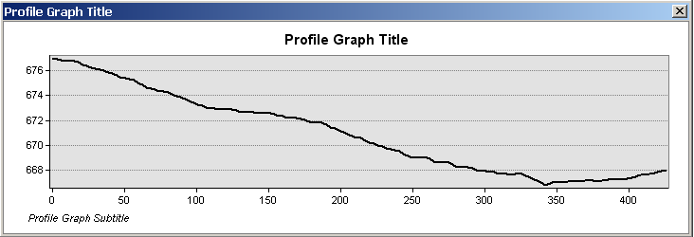
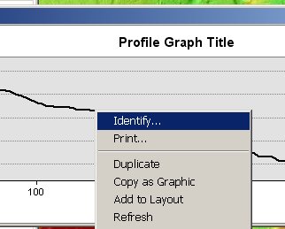
Exercise
Create profile graph
Right-click on profile
and select Identify to see which part of the profile corresponds to a point on the ground

Slide 16

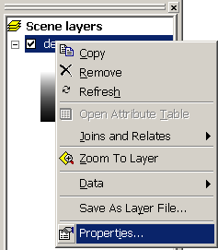
Exercise
A 3-D rendering in ArcScene may help you discern a pattern
Open ArcScene
From 3D Analyst Toolbar
Add layer “dem” to ArcScene
Right-click on “dem” and scroll to
Properties

Slide 17
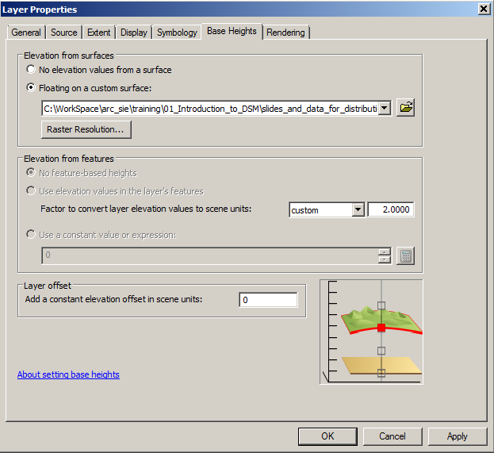
Exercise
Check “Floating
on a custom surface”
Select “dem”
Specify vertical
exageration if
desired
Use the Rendering
and Symbology tabs
to customize as
desired

Slide 18

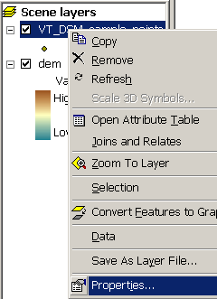
Exercise
Add sample points to ArcScene
Right-click sample point theme and open
Layer Properties

Slide 19
Exercise
Check “Floating
on a custom surface”
Select “dem”
Specify the same
vertical exaggeration
of “dem”
Symbolize points as categories using “FEATURE”

Slide 20
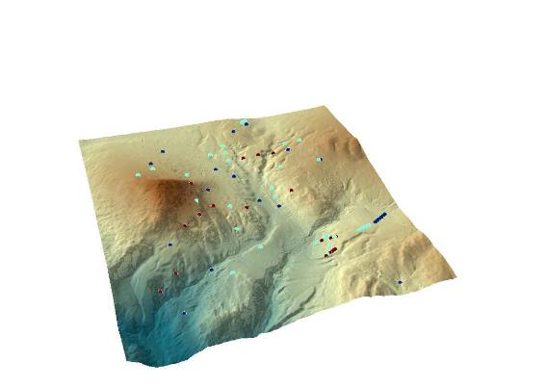
Exercise
These buttons control your
rendering. The Navigate Button
and left mouse and scroll
wheel provide enough to
introduce you to navigating ArcScene if it is new to you

Slide 21
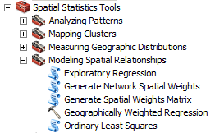
Regression tools in ArcGIS
The Modeling Spatial Relationships Toolbox provides a number of tools to use for point data that contains dependent and independent variables
Information from R presentations for evaluating regression models applies here

Slide 22
References
http://www.statsref.com/HTML/index.html

