Slide 1
TEUI Geospatial Toolkit
Terrestrial Ecological Unit Inventory
an ArcGIS Add-in by USFS

Slide 2
What is TEUI?
Zonal Statistics on steroids
You can install without Admin (my experience)
Great tool for comparing data composition between map units or polygons within map units
Download Add-In
http://www.fs.fed.us/eng/rsac/programs/teui/assets/downloads/5.2/TEUI.Addin.zip

Slide 3
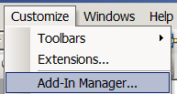
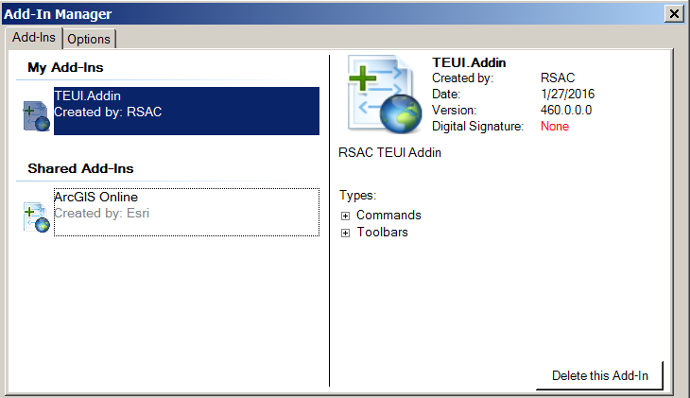
Remove old Add-In if installed
Install new version by double-click TEUI Add-In after unzipping

Slide 4
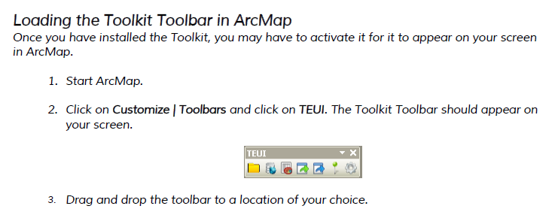
Load the Toolbar

Slide 5
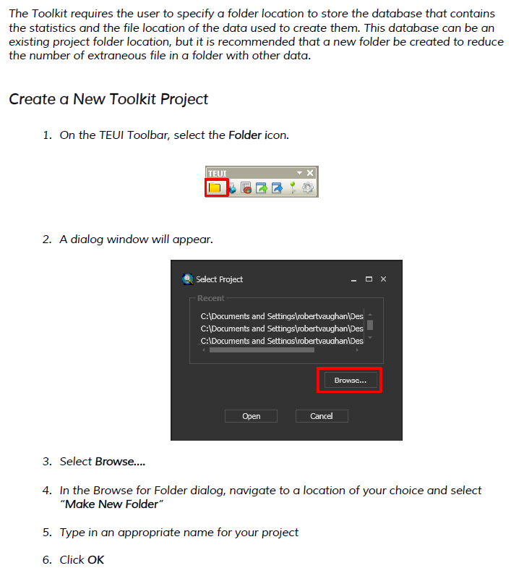
Create a project folder

Slide 6
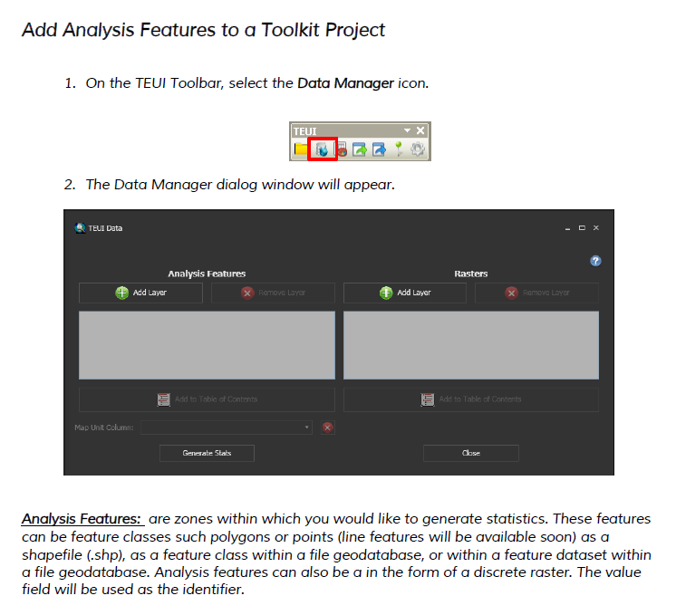
Add analysis features

Slide 7
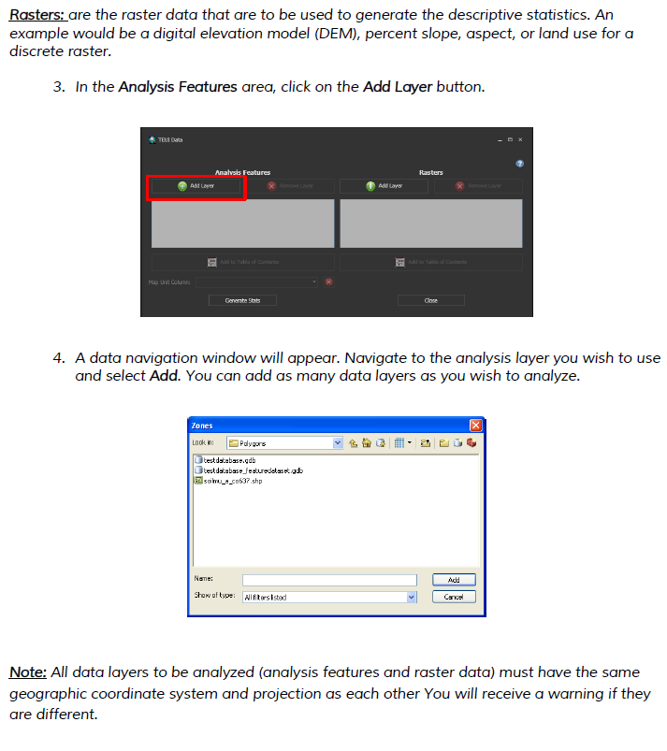
Add analysis features

Slide 8
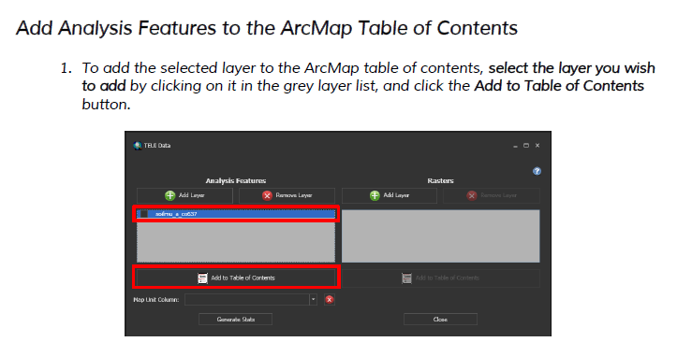
Add features to table of contents

Slide 9
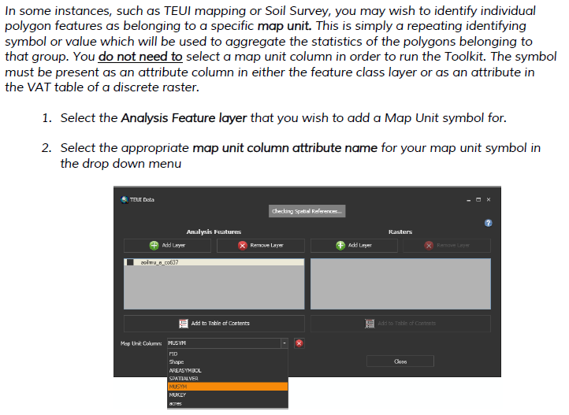
Choose a map unit

Slide 10
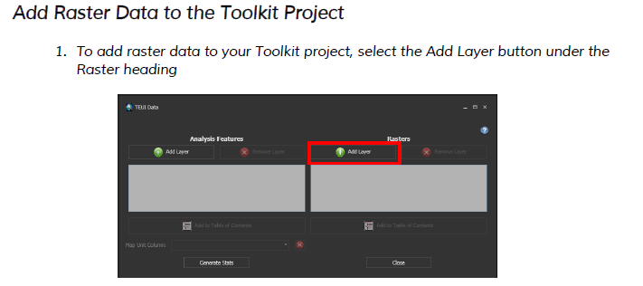
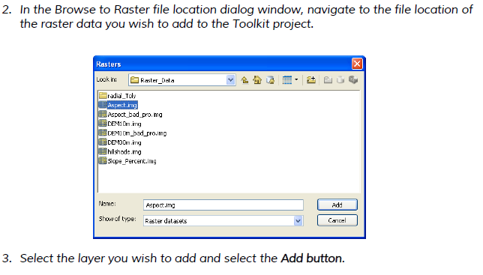
Add raster features

Slide 11
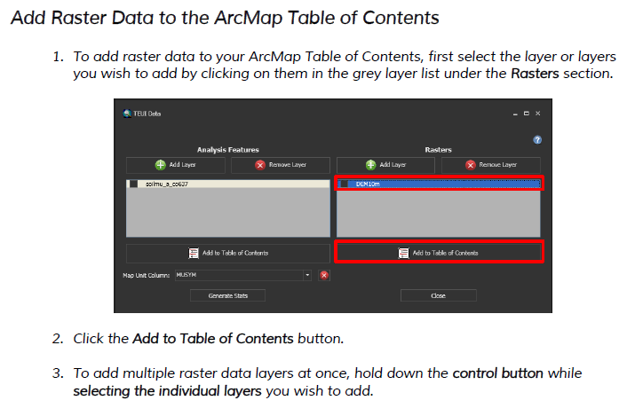
Add raster(s) to table of contents

Slide 12
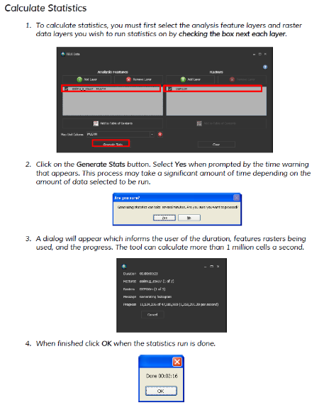
Calculate statistics

Slide 13
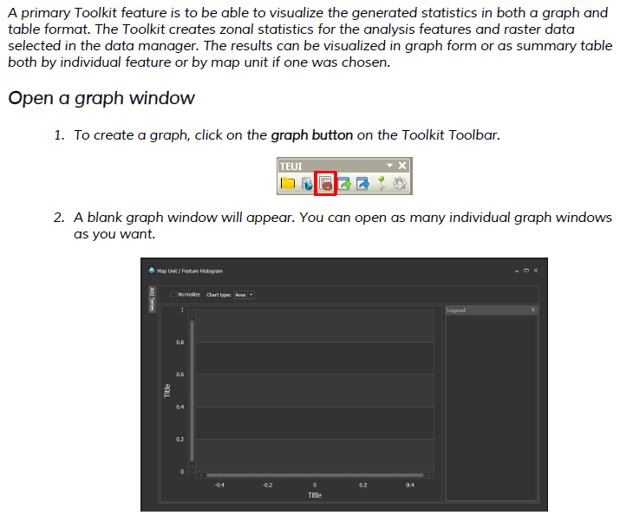
Create and visualize graphs

Slide 14
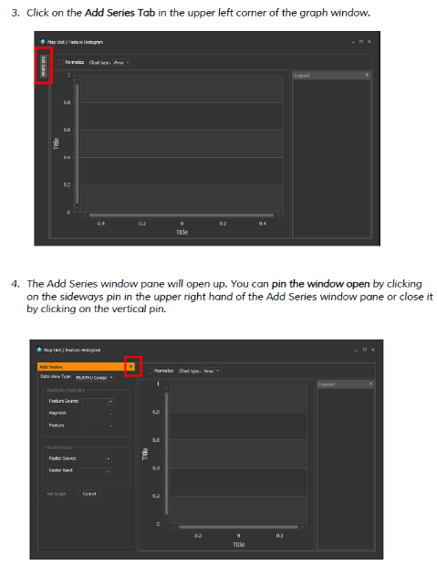
Create and visualize graphs

Slide 15
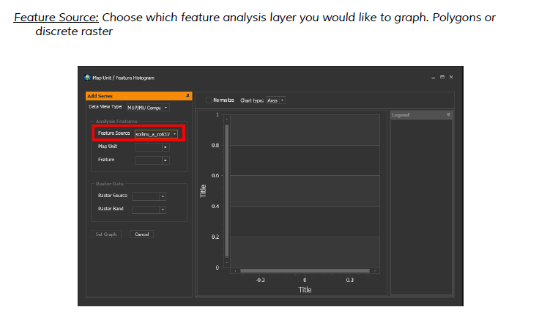
Choose feature analysis layer

Slide 16
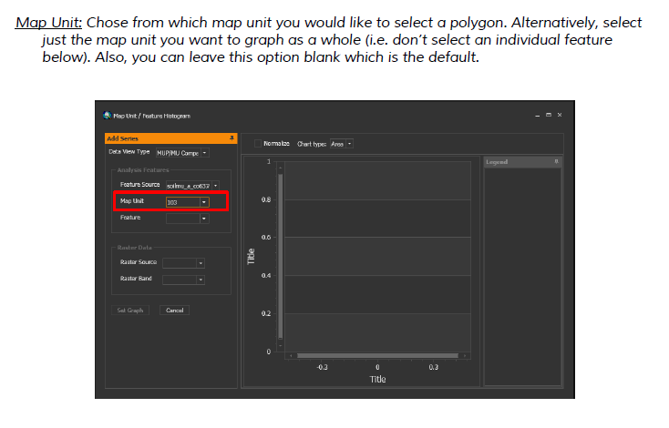
Select map unit

Slide 17
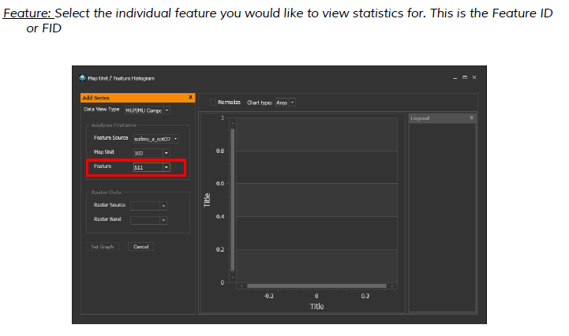
Select polygon if desired

Slide 18
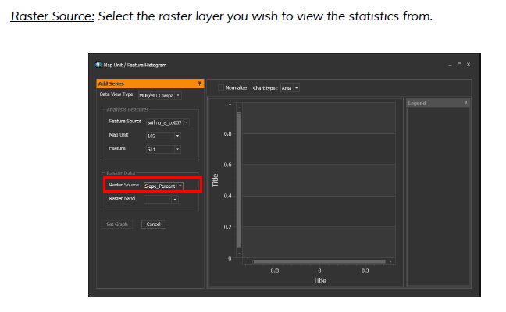
Select raster source

Slide 19
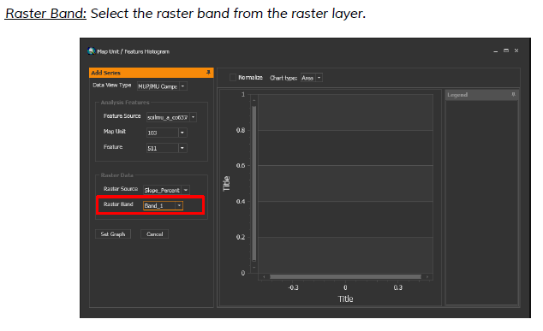
Select the raster band

Slide 20
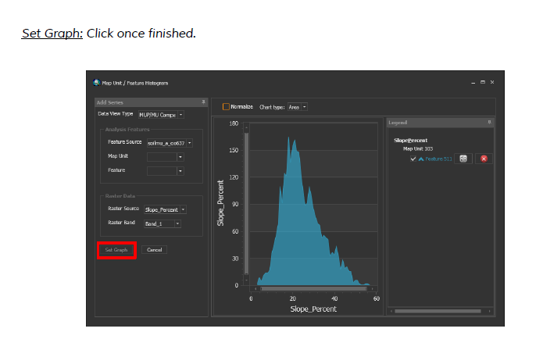
Set graph

Slide 21
Set graph
WARNING – Circular data type is not implemented if using to summarize slope aspect
Use radial chart as guide or circular statistics package in R

Slide 22
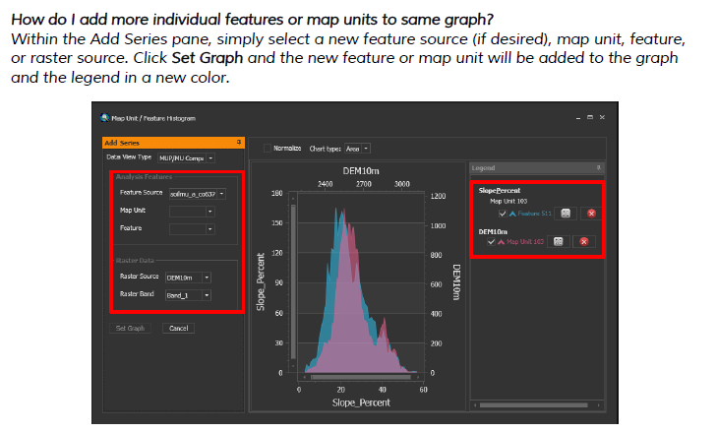
Adding more features e.g. compare CoC and CoC2

Slide 23
Downloads and User Guide
The software and more details are provided in the TEUI User Guide from the URL below
http://www.fs.fed.us/eng/rsac/programs/teui/downloads.html

