Slide 1
Logistic regression
Part of the family of regression models named “Generalized linear models”

Slide 2
Logistic regression
Technique used to analyze a dependent variable with a discrete response
The independent variables are used to estimate the probability of occurrence for the dependent variable
Output values range from 0 – 1.0 (indicating 0 – 100% probability)
A threshold value, often 0.5, is used to determine if the prediction is part of the modeled class

Slide 3
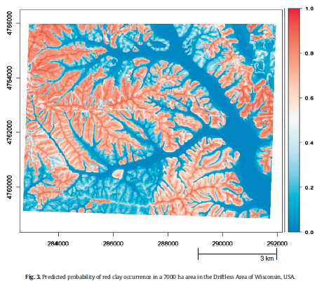
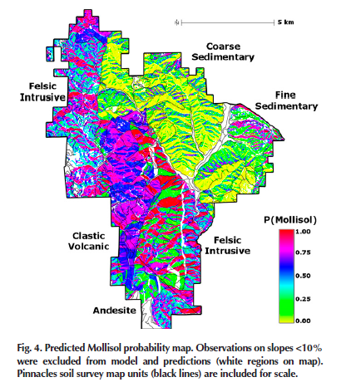
Logistic regression
Evans & Hartemink, 2014
Beaudette & O'Geen, 2009

Slide 4
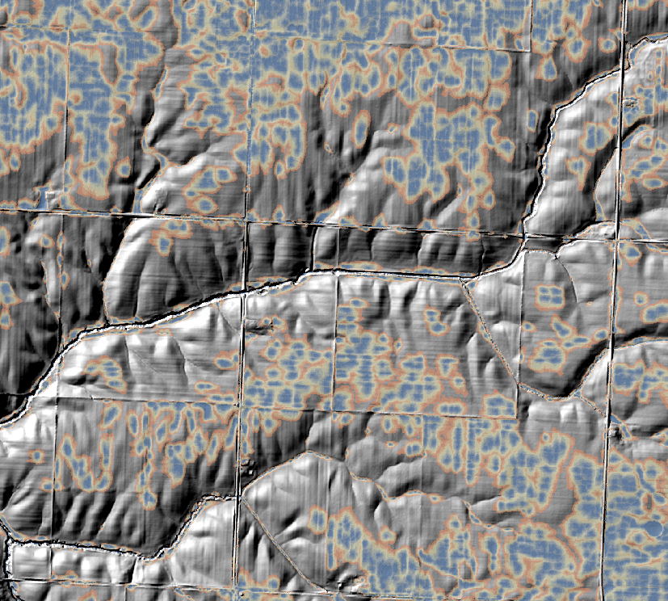
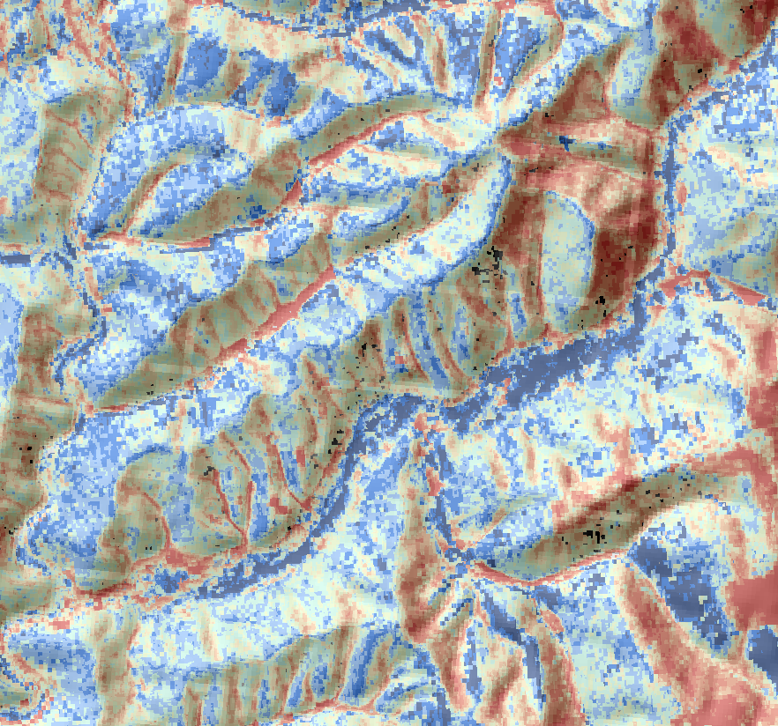


Logistic regression
Ponded probability, NRCS, unpub.
Spodic probability, NRCS, unpub.

Slide 5
Logistic regression
The response variable is discrete, i.e. binomial. For example:
spodic present/absent = 1/0
fragipan present/absent = 1/0
plant community or species present/absent = 1/0
gopher turtle present/absent = 1/0
etc
The independent variables can be numeric or dichotomous
No assumptions for normality among independent variables
Do check for highly correlated variables and select accordingly

Slide 6
Logistic regression
The minimum number of cases per independent variable is 10:1
The preferred number of cases per independent variable is 20:1
The preferred number of cases per independent variable is 50:1
when using stepwise logistic regression

Slide 7
Logistic regression
The measure of model fit is the likelihood value
A well fit model will have a small likelihood value
Testing the strength of relationship among independent variables is done by testing the model against another model without any independent variables (i.e. pure chance)

Slide 8
Logistic regression
Sometimes a model will report a “fail to converge” error
this seems to be a problem with small sample #s, or very few
cases of one outcome compared to another
Best to reject results if the Standard Error of any predictor is > 2
A pseudo R squared provides an idea of the strength of a relationship, but should only be used as a rough guide
The ultimate test of the model is an accuracy assessment comparing the predicted to observed

Slide 9
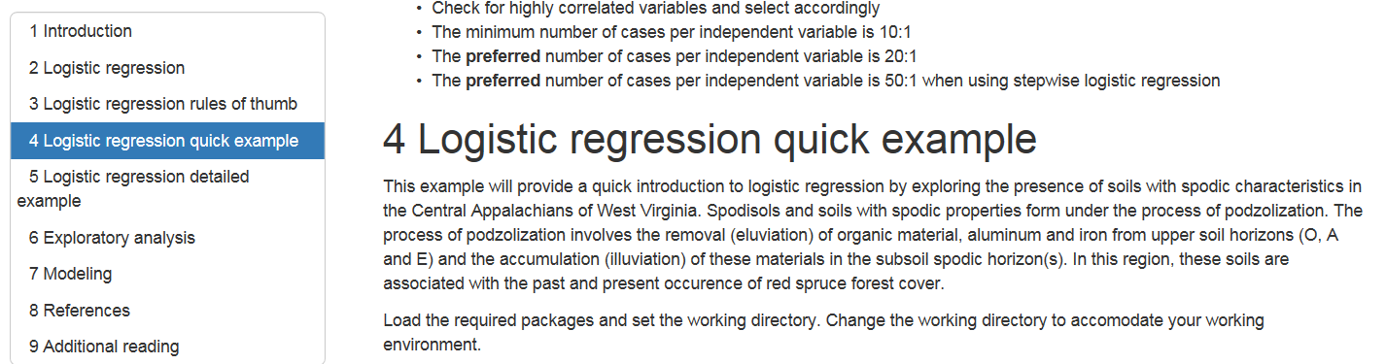
Logistic regression
Go to
http://ncss-tech.github.io/stats_for_soil_survey/chapters/7_generalized_linear_models/7_generalized_linear_models.html
Perform this quick exercise

Slide 10
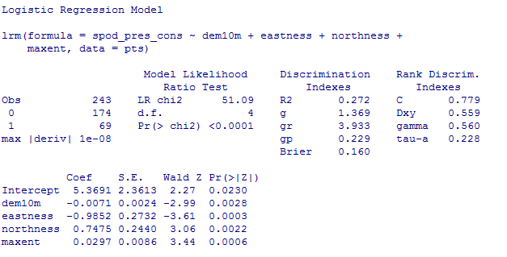
Logistic regression example
Evaluation of results
Is the ratio of cases to independent variables ok?
Notes:
Ratios of observations per independent variable
10:1 minimum
20:1 ideal for simultaneaous
50:1 for stepwise

Slide 11
Logistic regression example
Evaluation of results
The relationship between the dependent (DV) and independent variables (IV)
The low P value indicates there is a relationship between the DV and IV
A high value (e.g. > 0.05) indicates the model performs no better with the IVs than with a
constant

Slide 12
Logistic regression example
Evaluation of results
Is multicollinearity present?
The Standard Errors should be less than 2. This does not pertain to the intercept/constant.
What if Standard Error is > 2?
Notes:
If SE is greater than 2:
Reject entire model
Drop the offending variables from the model

Slide 13
Logistic regression example
Evaluation of results
Relationship of individual IVs to DV
Small “P” values indicate the IV is a meaningful predictor
What to do with IVs that have a large “P”?
Notes:
Ratios of observations per independent variable
10:1 minimum
20:1 ideal for simultaneaous
50:1 for stepwise

Slide 14
Logistic regression example
Evaluation of results
Does the model perform better than random chance?
“C” refers to the concordance aka c-index or AUC, with the following suggested scale (Hosmer & Lemeshow, 2013)
0.5 = no discrimination
0.7 – 0.8 acceptable discrimination
0.8 – 0.9 excellent discrimination
>0.9 outstanding discrimination
Notes:
Ratios of observations per independent variable
10:1 minimum
20:1 ideal for simultaneaous
50:1 for stepwise

Slide 15
Logistic regression example
Evaluation of results
What is the “Goodness of fit” for the model?
The R² of linear regression does not exist for Logistic regression. A measure called the pseudo R squared is only roughly analogous. There are several methods for calculating the pseudo R squared. In general, the higher the value the greater the variability that is explained by the IVs.
Notes:
pseudo R-squareds cannot be interpreted independently or compared across datasets, they are valid and useful in evaluating multiple models predicting the same outcome on the same dataset.
A pseudo R-squared statistic without context has little meaning.
A pseudo R-squared only has meaning when compared to another pseudo R-squared of the same type, on the same data, predicting the same outcome.
In this situation, the higher pseudo R-squared indicates which model better predicts the outcome.

Slide 16
Logistic regression References
Beaudette, D. E., & O'Geen, A. T. (2009). Quantifying the aspect effect: an application of solar radiation modeling for soil survey. Soil Science Society of America Journal, 73(4), 1345-1352.
Gessler, P. E., Moore, I. D., McKenzie, N. J., & Ryan, P. J. (1995). Soil-landscape modelling and spatial prediction of soil attributes. International Journal of Geographical Information Systems, 9(4), 421-432.
Gorsevski, P. V., Gessler, P. E., Foltz, R. B., & Elliot, W. J. (2006). Spatial prediction of landslide hazard using logistic regression and ROC analysis. Transactions in GIS, 10(3), 395-415.
Evans, D.M. and Hartemink, A.E., 2014. Digital soil mapping of a red clay subsoil covered by loess. Geoderma, 230, pp.296-304.
Hosmer Jr, D.W., Lemeshow, S. and Sturdivant, R.X., 2013. Applied logistic regression (Vol. 398). John Wiley & Sons.
Kempen, B., Brus, D. J., Heuvelink, G., & Stoorvogel, J. J. (2009). Updating the 1: 50,000 Dutch soil map using legacy soil data: A multinomial logistic regression approach. Geoderma, 151(3), 311-326.

Slide 17
Logistic regression example
Go to wv_DSM\class_data folder
Make a copy of your “csv” file that contains samples with associated values from covariates
Rename to “test_logistic_pts.csv”
Open Excel and the file“test_logistic_pts.csv”

Slide 18
Logistic regression example
Add a column named “spod_pres”
Populate this column using “spodic_inten” values
as a reference
Values for the “spod_pres” column should be?
Notes:
0 = no
1 = yes

Slide 19
Logistic regression example
You now have a column representing spodic presence

Slide 20
Logistic regression example
Open R and enter the following:
require(sp)
require(raster)
require(rgdal)
require(rms)
setwd("C:/wv_DSM/class_data")
pts = read.csv(“test_logistic_pts.csv")
head(pts, 1)
attach(pts)

Slide 21
Logistic regression example
GLM.1 <- lrm(spod_pres ~ dem10m + eastness + northness + maxent, data=pts)
spod_pres = dependent variable
dem10m, eastness, northness, maxent = independent variables aka
predictors

Slide 22
Logistic regression example
GLM.1 <- lrm(spod_pres ~ dem10m + eastness + northness + maxent, data=pts)
print(GLM.1)

Slide 23
Logistic regression example
For demonstration purposes use this to fit the model to your raster data
Type the following in R:
rasters=stack(list.files(getwd(),pattern="img$",full.names=FALSE))
rasters
predict(rasters,GLM.1, type="fitted",progress="window",overwrite=TRUE,filename="spodic_con_GLM1.img")
Add the raster ="spodic_con_GLM1.img“ to ArcGIS
Does it look reasonable?

Slide 24
Logistic regression example
Explore spodic presence using a new field with a different classification of presence as the dependent
variable
Test other potential variables for presence, like:
Folist
“off” drainage
Stoniness
Fragic
Create columns and populate as 0 or 1 as appropriate

Slide 25
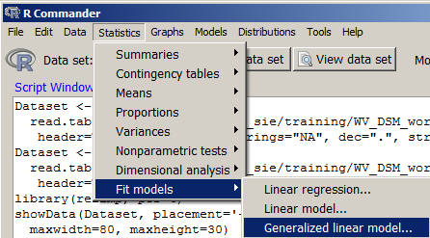
Logistic regression (Appendix) Rcmdr example
Rcmdr has logistic regression available

Slide 26
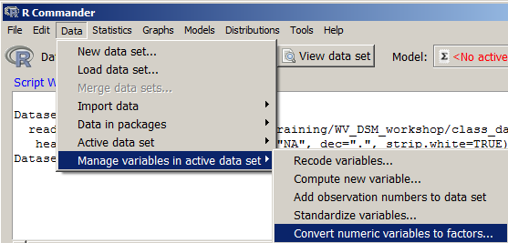
Logistic regression (Appendix) Rcmdr example
Convert the 0/1 values in “spod_pres” to a factor
spod_pres_cons

Slide 27
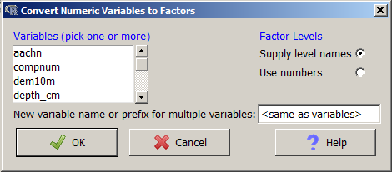
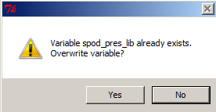
Logistic regression (Appendix) Rcmdr example
Select the “spod_pres”
Hit OK
When prompted to overwrite, hit Yes

Slide 28
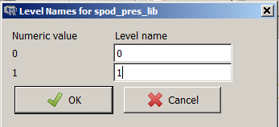
Logistic regression (Appendix) Rcmdr example
Recode and hit OK

Slide 29
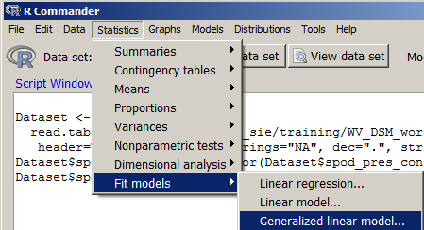
Logistic regression (Appendix) Rcmdr example
Open Generalized linear models

Slide 30
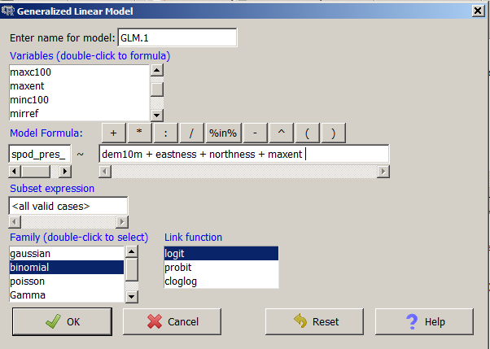
Logistic regression (Appendix) Rcmdr example
Create model formula

Slide 31
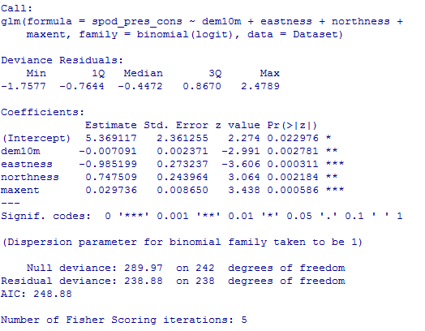
Logistic regression (Appendix) Rcmdr example
View output summary in Rcmdr Output Window

