Slide 1
Logistic regression
Part of the family of regression models named “Generalized linear models”

Slide 2
Logistic regression
The response variable is discrete, i.e. binomial. For example:
spodic present/absent = 1/0
fragipan present/absent = 1/0
ponding present/absent = 1/0
.
etc
The independent variables can be numeric
The independent variables can be dichotomous, i.e. binary
No assumptions for normality
Do check for highly correlated variables and select accordingly

Slide 3
Logistic regression
Sometimes the method will “fail to converge”
this seems to be a problem with small sample #s, or very few
cases of one outcome compared to another
Be leery of results if the Standard Error of any predictor is > 2
A pseudo R squared provides an idea of the strength of a relationship
The only reasonable test of the model is an accuracy assessment comparing the predicted to observed

Slide 4
Logistic regression example
Go to wv_DSM\class_data folder
Make a copy of your “csv” file that contains samples with associated values from covariates
Rename to “test_logistic_pts.csv”
Open Excel and the file“test_logistic_pts.csv”

Slide 5
Logistic regression example
Add a column named “spod_pres_cons”
Populate this column using “spodic_inten” values
as a reference as follows:
0, 0.5, 1 = 0
1.5, 2 = 1
Add a column named “spod_pres_lib”
Populate this column using “spodic_inten” values
as a reference as follows:
0, 0.5 = 0
1, 1.5, 2 = 1

Slide 6
Logistic regression example
You now have two columns with a binary classification for spodic presence:
“spod_pres_cons” is a conservative classification
“spod_pres_lib” is a liberal classification

Slide 7
Logistic regression example
Open R and enter the following:
require(sp)
require(raster)
require(rgdal)
require(rms)
setwd("C:/wv_DSM/class_data")
pts = read.csv(“test_logistic_pts.csv")
head(pts, 1)
attach(pts)

Slide 8
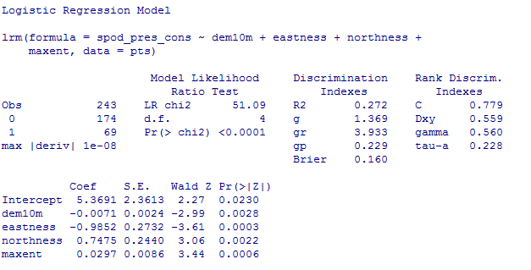
Logistic regression example
GLM.1 <- lrm(spod_pres_cons ~ dem10m + eastness + northness + maxent, data=pts)
print(GLM.1)
Strength of relationship
Regression parameters
Goodness of fit

Slide 9
Logistic regression example
For demonstration purposes we will use this to fit the model to your raster data
Type the following in R:
rasters=stack(list.files(getwd(),pattern="img$",full.names=FALSE))
rasters
predict(rasters,GLM.1, type="fitted",progress="window",overwrite=TRUE,filename="spodic_con_GLM1.img")
Add the raster ="spodic_con_GLM1.img“ to ArcGIS
Does it look reasonable?

Slide 10
Logistic regression example
Explore using “spod_pres_lib” as the dependent
variable
If interested, test other potential variables for presence, like:
Folist
“off” drainage
Stoniness
Fragic
You will need to create columns and populate as 0 or 1 as appropriate

Slide 11
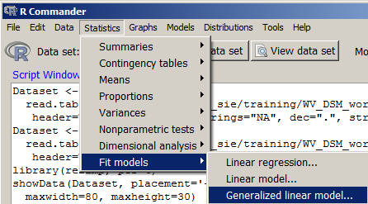
Logistic regression Rcmdr example
Rcmdr has logistic regression available

Slide 12
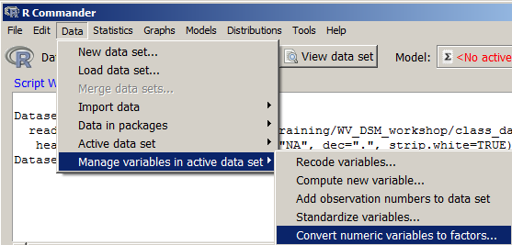
Logistic regression Rcmdr example
Convert the 0/1 values in “spod_pres_cons” to a factor
spod_pres_cons

Slide 13
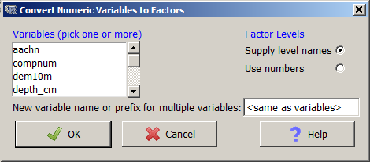
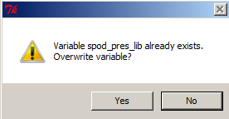
Logistic regression Rcmdr example
Select the “spod_pres_cons”
Hit OK
When prompted to overwrite, hit Yes

Slide 14
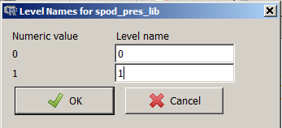
Logistic regression Rcmdr example
Recode and hit OK

Slide 15
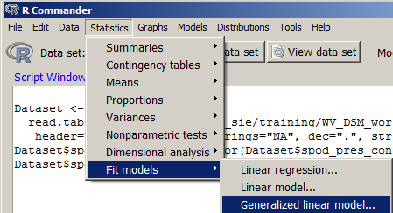
Logistic regression Rcmdr example
Open Generalized linear models

Slide 16
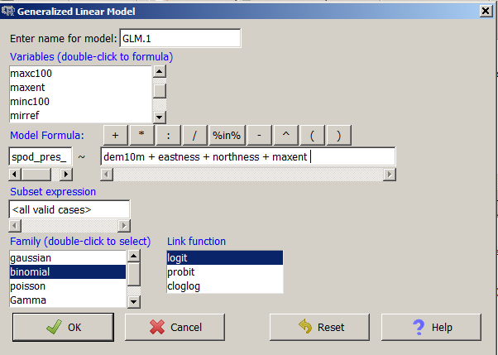
Logistic regression Rcmdr example
Create model formula

Slide 17
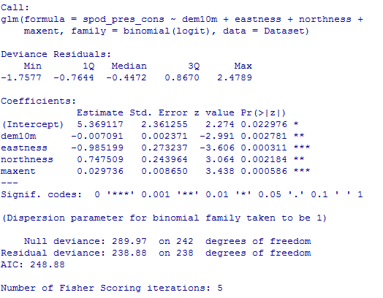
Logistic regression Rcmdr example
View output summary in Rcmdr Output Window

Slide 18
Logistic regression References
Beaudette, D. E., & O'Geen, A. T. (2009). Quantifying the aspect effect: an application of solar radiation modeling for soil survey. Soil Science Society of America Journal, 73(4), 1345-1352.
Gessler, P. E., Moore, I. D., McKenzie, N. J., & Ryan, P. J. (1995). Soil-landscape modelling and spatial prediction of soil attributes. International Journal of Geographical Information Systems, 9(4), 421-432.
Gorsevski, P. V., Gessler, P. E., Foltz, R. B., & Elliot, W. J. (2006). Spatial prediction of landslide hazard using logistic regression and ROC analysis. Transactions in GIS, 10(3), 395-415.
Kempen, B., Brus, D. J., Heuvelink, G., & Stoorvogel, J. J. (2009). Updating the 1: 50,000 Dutch soil map using legacy soil data: A multinomial logistic regression approach. Geoderma, 151(3), 311-326.

