Slide 1
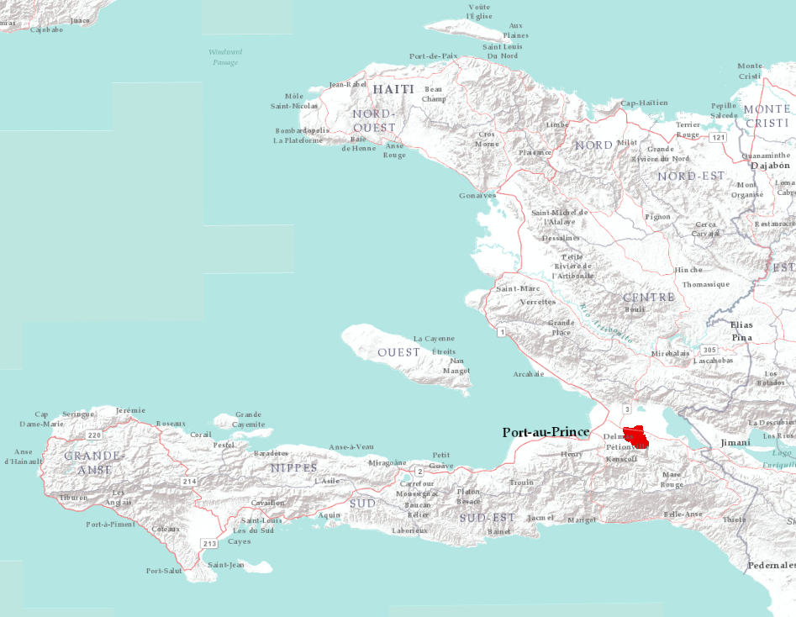
cLHS using ArcGIS and R
An example from the Republic of Haiti

Slide 2
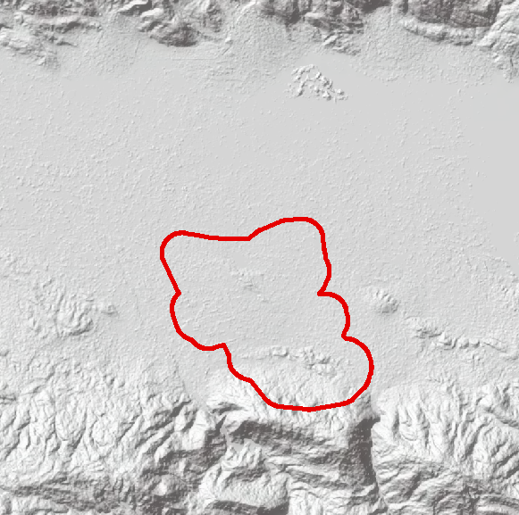
cLHS using ArcGIS and R
The project area is ~7,800 acres, largely in the Plaine du Cul-de-Sac region of Haiti
The objective is to select representative sample points in support of a soil mapping project
Develop datasets of 150 and 300 samples to support availability of small or large field staff

Slide 3
cLHS using ArcGIS and R
The following data layers were selected as strata:
Slope gradient
Slope curvature
Wetness Index (aka topographic wetness index, compound topographic index)
5m resolution data, derived from 1m LiDAR used to develop layers

Slide 4
cLHS using ArcGIS and R
5m resolution yields a population of 1.26 million points to draw from, or 162 points per acre
A machine with 8GB of RAM was unable to process this large dataset
It was considered overkill to draw from such a large population

Slide 5
cLHS using ArcGIS and R
Reduce the population to an acceptable number
A 35m spacing was determined adequate, yielding ~26,000 points, or ~3 points per acre
Why 35m, and not 10, 20, 30 or 17m?

Slide 6
cLHS using ArcGIS and R
The soil mapping project will use digital soil mapping techniques with 5m resolution data
Data from the samples of must contain data values that match the values of the covariate layers, since the sample points will serve as training data for modelling work
Blindly using resample or aggregate to a random output resolution would alter output data values with no correspondence between training point and the 5m cell values

Slide 7
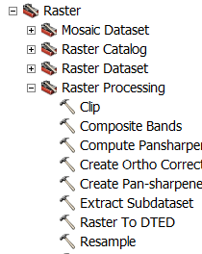
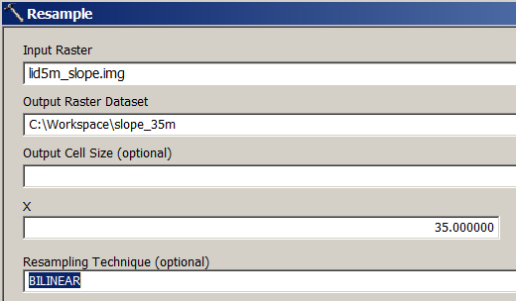
cLHS using ArcGIS and R
Resampling to resolutions that are odd, e.g. 3x,5x,7x,9x… will insure that the center coordinate of output cells will be coincident with input cells provided:
The processing extent and snap raster are set to
one of the 5m layers using the ArcGIS “Environment
Settings”
Resample one of the 5m rasters to 35m, e.g. slope gradient
Use “Bilinear”
or “Cubic”resampling

Slide 8
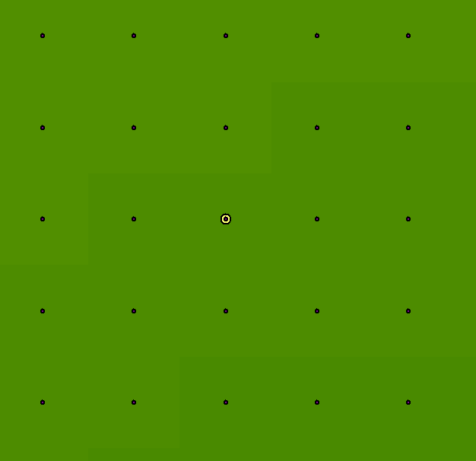
cLHS using ArcGIS and R
Convert the 35m raster to a point file
Verify the 35m points are centered in the 5m cells

Slide 9
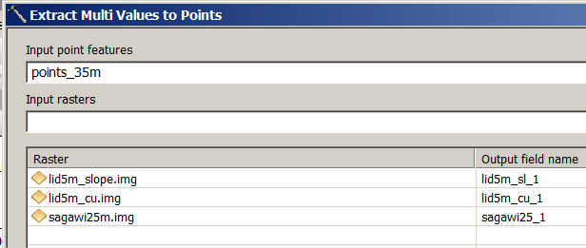
cLHS using ArcGIS and R
Run Extract Multi Values to Points to associate cell
values from the 5m slope gradient, slope curvature and
wetness index layers to points

Slide 10
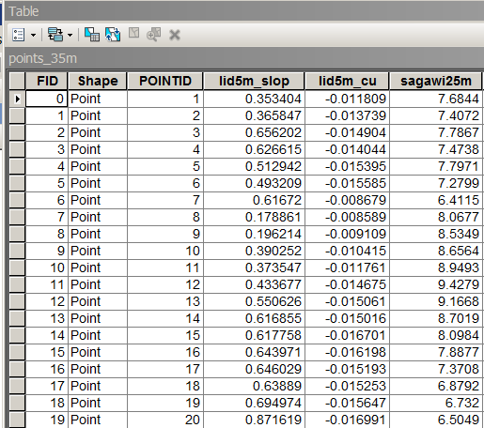
cLHS using ArcGIS and R
Sample of the attribute table of point file
An example shapefile named “points_35m.*”, that is the result of all previous steps is available for your use
Slope gradient, curvature, wetness index

Slide 11
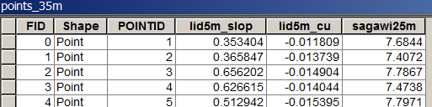
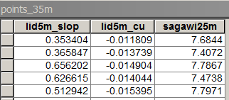
cLHS using ArcGIS and R
Open the attribute table of point file in ArcGIS
Sort by POINTID
Hide all data fields except slope gradient, slope curvature, and wetness index

Slide 12
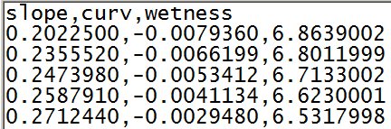
cLHS using ArcGIS and R
Export as a text file, e.g. “input_clhs.txt”
This will be the input file for the cLHS package in R
and has been supplied as a starting point for this
example

Slide 13
cLHS using ArcGIS and R
Sample R script
##Step 1## add packages and Read file
require(clhs)
require(sp)
Dataset <- read.table("C:/WorkSpace/input_clhs.txt",header=TRUE, sep=",", na.strings="NA", dec=".", strip.white=TRUE)
## Number of rows in frame##
nrow(Dataset)
attach(Dataset)

Slide 14
cLHS using ArcGIS and R
##Step 2##
##Conditioned Latin Hypercube Sampling - edit number of samples and iterations as needed
## in this case, 300 samples with 1,000 iterations
res <- clhs(Dataset, size = 300, iter = 1000, progress = FALSE, simple = FALSE)
##Calls Values that will be Sampled part of the clhs Model for Samplling
res
## Plots the iterations Objective Function vs Iterations and kernal density of
## Sampled Vs. Population##
plot(res, modes = c("obj", "dens"))

Slide 15
cLHS using ArcGIS and R
## Interfaces Object "res" into framework##
attach(res)
##creates an object "points" of the sampled data from "cLHS"
point = res$sampled_data
##Attach record number to data from the "points" object
coordinates = coordinates(point)
## Dump to text file - Put in your path and file name
write.table(point, file = "C:/WorkSpace/output_clhs.txt", sep = ",", col.names = NA, qmethod = "double")

Slide 16
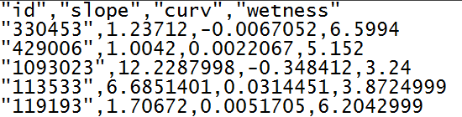
cLHS using ArcGIS and R
Open the output file in a text editor and edit the column header of the first field to be sure it is named “id” or “ID”
This insures that the output file from cLHS can be joined to the original point file in ArcGIS using the POINTID and ID respectively as join fields

Slide 17
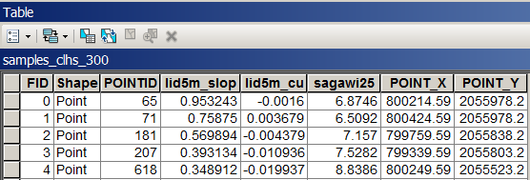
cLHS using ArcGIS and R
Run “Add XY Coordinates” in ArcGIS on the original point file
Join the original point file to the cLHS output text file
Run “Make XY Event Layer” in ArcGIS on the table from step #2
Convert the Layer from step #3 to a feature
Use the file from step #4 as input waypoints for use with a GPS receiver to navigate to samples

Slide 18
Compare Distribution of Source and Sample Data
Example from Beaver Creek, Wyoming
Took point extraction from raster of environmental covariates (All)
Another set of extractions from accessibl areas (Access)
Finally, a series of nested cLHS sample locations were drawn from the accessible areas (target)
https://raw.githubusercontent.com/ncss-tech/stats_for_soil_survey/master/presentations/sampling/pdf_example/target_pdf_rcode.R

Slide 19
Take the result of step 4
Can you modify the WY_beaver creek example to display the pdf of one ancillary variable for the entire dataset and for the selected sample set?

