Slide 1
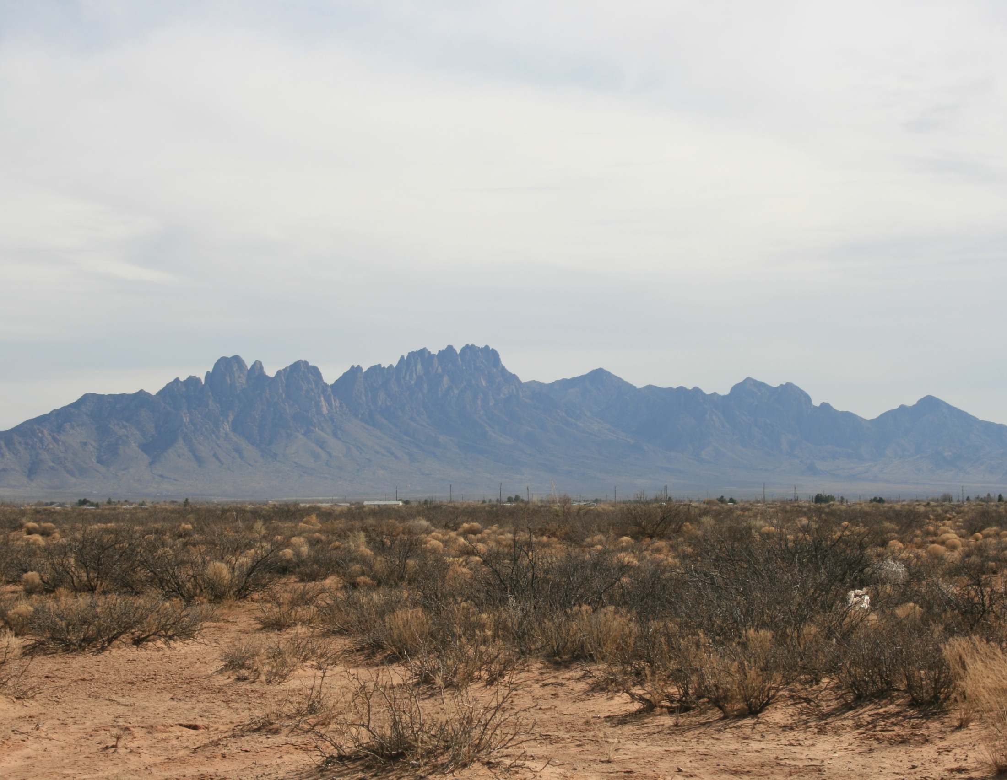
Statistics
(not the part with all the equations)

Slide 2
Overview
Statistics without equations?
Kinds of Data
How to summarize

Slide 3
Overview
Statistics without equations?
Kinds of Data
How to summarize
Inference Space and Sampling
How to determine what that summary represents
I don’t expect you to know everything I cover today;
But, I do want you to think about how to use data:

Slide 4
Think about what you do with data
Storytime…………AR forest interps

Slide 5
Problems?
LONG | LAT | ACRES | SEEDLINGSU | MLRA | MUSYM | MUKEY | SeedMortal | AWC_0_6
-93.69299 | 33.09362 | 60 | 60 | 133B | 1 | 564881 | High | 0.2
-93.87277 | 33.20831 | 70 | 70 | 133B | 82 | 564961 | High | 0.2
-93.92391 | 33.27395 | 27 | 27 | 133B | 2 | 564892 | High | 0.2
-93.94135 | 33.61500 | 40 | 40 | 135B | 82 | 564961 | High | 0.2
-94.08030 | 33.73043 | 35 | 35 | 135B | 29 | 564902 | High | 0.2
-94.15653 | 33.74911 | 50 | 50 | 135B | 29 | 564902 | High | 0.2
-94.34380 | 33.79173 | 20 | 20 | 135B | 2 | 564892 | High | 0.2
-93.17249 | 33.16598 | 24 | 24 | 133B | 28 | 565364 | High | 0.1
-93.45277 | 33.22083 | 40 | 40 | 133B | 1 | 565344 | High | 0.2
-93.28423 | 33.27211 | 37 | 37 | 133B | 16 | 565351 | High | 0.2
-93.28423 | 33.27211 | 10 | 10 | 133B | 16 | 565351 | High | 0.2
-93.43333 | 33.33333 | 28 | 28 | 133B | 29 | 564902 | High | 0.2
-93.34115 | 33.34302 | 92 | 92 | 133B | 2 | 565355 | High | 0.2
-93.43337 | 33.34658 | 40 | 40 | 133B | 29 | 564902 | High | 0.2
-93.50000 | 33.35000 | 14 | 14 | 133B | 82 | 564961 | High | 0.2

Slide 6
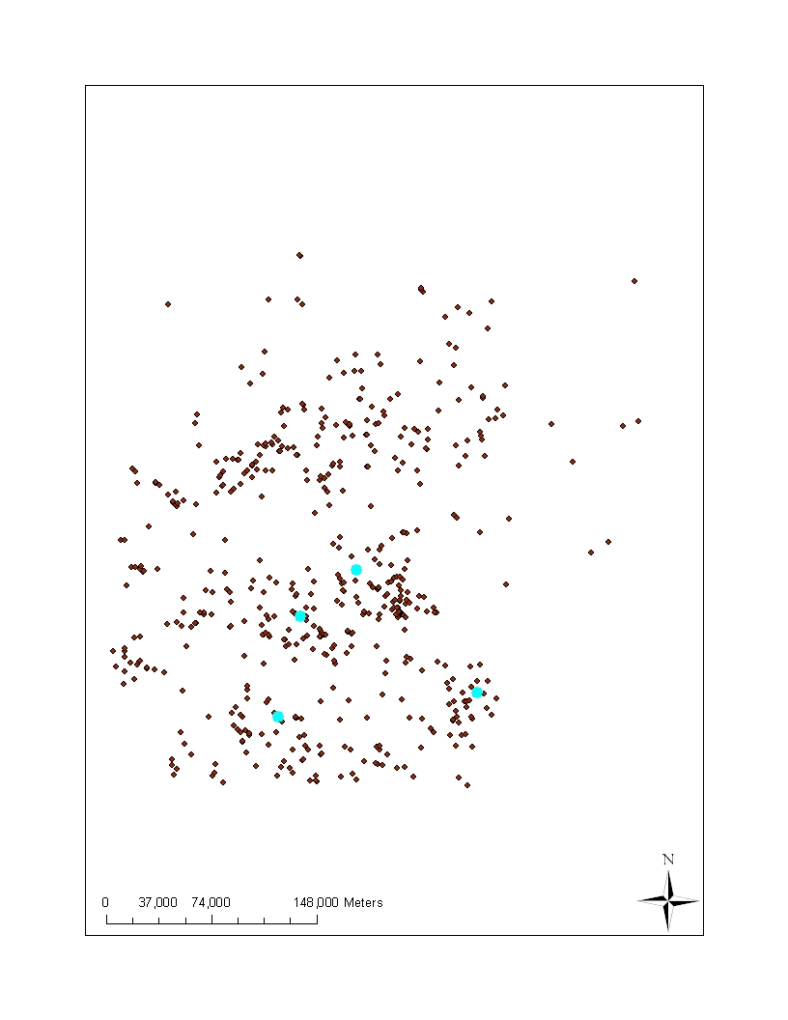
Problems?
LONG | LAT | ACRES | SEEDLINGSU | MLRA | MUSYM | MUKEY | SeedMortal | AWC_0_6
-93.69299 | 33.09362 | 60 | 60 | 133B | 1 | 564881 | High | 0.2
-93.87277 | 33.20831 | 70 | 70 | 133B | 82 | 564961 | High | 0.2
-93.92391 | 33.27395 | 27 | 27 | 133B | 2 | 564892 | High | 0.2
-93.94135 | 33.61500 | 40 | 40 | 135B | 82 | 564961 | High | 0.2
-94.08030 | 33.73043 | 35 | 35 | 135B | 29 | 564902 | High | 0.2
-94.15653 | 33.74911 | 50 | 50 | 135B | 29 | 564902 | High | 0.2
-94.34380 | 33.79173 | 20 | 20 | 135B | 2 | 564892 | High | 0.2
-93.17249 | 33.16598 | 24 | 24 | 133B | 28 | 565364 | High | 0.1
-93.45277 | 33.22083 | 40 | 40 | 133B | 1 | 565344 | High | 0.2
-93.28423 | 33.27211 | 37 | 37 | 133B | 16 | 565351 | High | 0.2
-93.28423 | 33.27211 | 10 | 10 | 133B | 16 | 565351 | High | 0.2
-93.43333 | 33.33333 | 28 | 28 | 133B | 29 | 564902 | High | 0.2
-93.34115 | 33.34302 | 92 | 92 | 133B | 2 | 565355 | High | 0.2
-93.43337 | 33.34658 | 40 | 40 | 133B | 29 | 564902 | High | 0.2
-93.50000 | 33.35000 | 14 | 14 | 133B | 82 | 564961 | High | 0.2

Slide 7
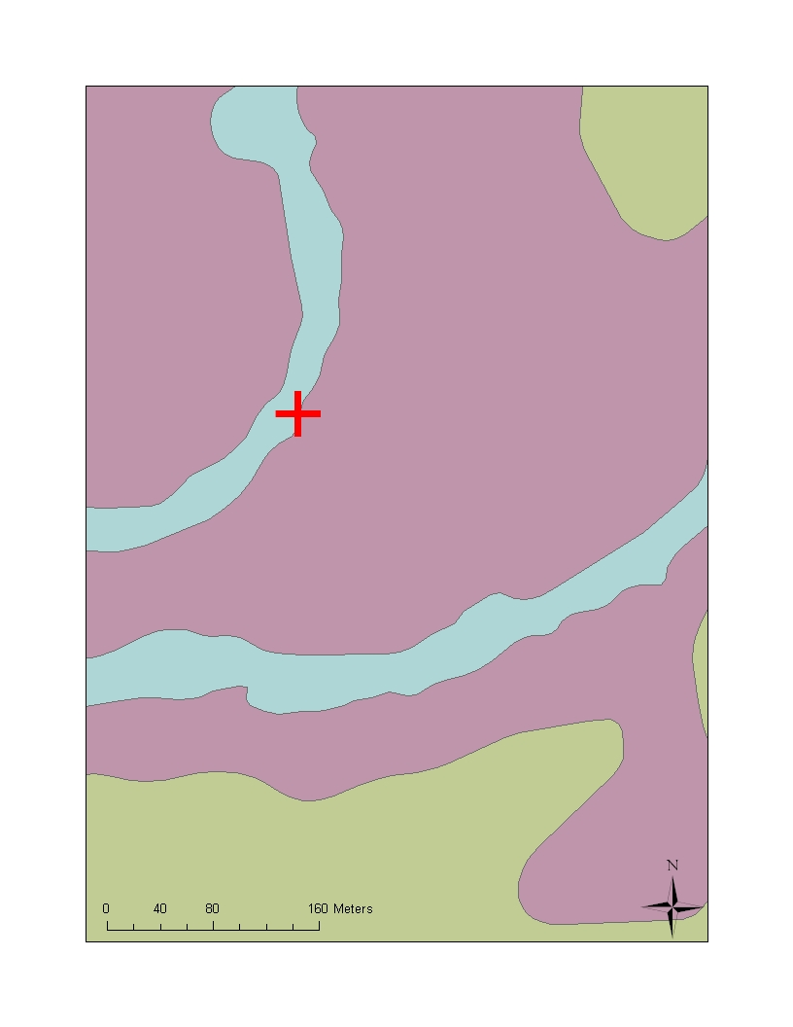
Problems
LONG | LAT | ACRES | Survival% | MUname
-93.69299 | 33.09362 | 60 | 100 | Acadia silt loam, 0 to 2 percent slopes
-93.87277 | 33.20831 | 70 | 84 | Wrightsville silt loam, 0 to 1 percent slopes
-93.92391 | 33.27395 | 27 | 95 | Adaton silt loam, 0 to 1 percent slopes
-93.94135 | 33.61500 | 40 | 55 | Wrightsville silt loam, 0 to 1 percent slopes
-94.08030 | 33.73043 | 35 | 70 | Guyton silt loam, frequently flooded
-94.15653 | 33.74911 | 50 | 44 | Guyton silt loam, frequently flooded
-94.34380 | 33.79173 | 20 | 70 | Adaton silt loam, 0 to 1 percent slopes
-93.17249 | 33.16598 | 24 | 98 | Smithton fine sandy loam, 0 to 2 percent slopes
-93.45277 | 33.22083 | 40 | 84 | Adaton-Felker association, 0 to 2 percent slopes
-93.28423 | 33.27211 | 37 | 55 | Guyton silt loam, frequently flooded
-93.28423 | 33.27211 | 10 | 86 | Guyton silt loam, frequently flooded
-93.43333 | 33.33333 | 28 | 28 | Guyton silt loam, frequently flooded
-93.34115 | 33.34302 | 92 | 60 | Amy silt loam, 0 to 1 percent slopes
-93.43337 | 33.34658 | 40 | 70 | Guyton silt loam, frequently flooded
-93.5 | 33.35 | 14 | 97 | Water

Slide 8
Statistics
2 parts
Philosophical and Common Sense
How do you conduct a study?
Framing hypotheses
What are your assumptions
Sampling and inference
Equations, algorithms etc.
Necessary to obtain measures and tests
Many programs that allow you to “push a button”
Notes:
You don’t have to remember everything in the this powerpoint, however, you do need to think about these issues when analyzing any dataset.

Slide 9
Statistics
2 parts
Philosophical and Common Sense
How do you conduct a study?
Framing hypotheses
What are your assumptions
Sampling and inference
Equations, algorithms etc.
Necessary to obtain measures and tests
Many programs that allow you to “push a button” or copy a script
An expert (you) with the study subject must be involved in this part. We’ll come back to this .
The key is to adapt simple scripts and processes to your situation
Notes:
You don’t have to remember everything in the this powerpoint, however, you do need to think about these issues when analyzing any dataset.

Slide 10
Three kinds of data
We’ll talk about some examples
We’ll apply the ideas to soil information.
No
math
Most
math
NOMINAL
ORDINAL
CONTINUOUS
Notes:
Nominal – names or classes
Ordinal – numbers or letters that can be ranked
Continuous – numbers that are continuous from zero

Slide 11
Height
How do we summarize this?
Statistically
Average
Mean
Median
Mode
What type of data is it?
Use histograms to determine which is most appropriate
Student | Height (in) | Student | Height (in)
1 | 68 | 13 | 77
2 | 68 | 14 | 67
3 | 60 | 15 | 62
4 | 59 | 16 | 77
5 | 62 | 17 | 69
6 | 70 | 18 | 65
7 | 68 | 19 | 64
8 | 71 | 20 | 66
9 | 75 | 21 | 67
10 | 67 | 22 | 70
11 | 63 | 23 | 72
12 | 62 | 24 | 71

Slide 12
Histogram: a graphical display of frequencies
Count or frequency: the number of times
values fell within each bin.
Range of values called “bins”.

Slide 13
How would I summarize height?
Average –
Usually arithmetic mean (add all values and divide by the number of values)
Student | Height | Student | Height
1 | 68 | 13 | 77
2 | 68 | 14 | 67
3 | 60 | 15 | 62
4 | 59 | 16 | 77
5 | 62 | 17 | 69
6 | 70 | 18 | 65
7 | 68 | 19 | 64
8 | 71 | 20 | 66
9 | 75 | 21 | 67
10 | 67 | 22 | 70
11 | 63 | 23 | 72
12 | 62 | 24 | 71
Average = 67.6
Notes:
Average is a fuzzy term, google “average vs. mean” and you’ll see what I mean. Most people use average to mean arithmetic mean – but it can also mean any value that represents the central tendency of a dataset, sample or population.

Slide 14
Height
Height is an example of continuous data. They are numbers that can be mathematically combined and fractions or decimals make some sense.
Means are usually a good way to summarize this kind of data
Student | Height | Student | Height
1 | 68 | 13 | 77
2 | 68 | 14 | 67
3 | 60 | 15 | 62
4 | 59 | 16 | 77
5 | 62 | 17 | 69
6 | 70 | 18 | 65
7 | 68 | 19 | 64
8 | 71 | 20 | 66
9 | 75 | 21 | 67
10 | 67 | 22 | 70
11 | 63 | 23 | 72
12 | 62 | 24 | 71

Slide 15
When does an mean not work for continuous data?
When the distribution is skewed or has a “tail”
Median
The middle of the distribution
mean | 79.5
median | 81.0
mode | 83.0
Median: 81.0
Average: 79.5
Notes:
The median has the same number of values above and below it. To get the median, list all the values from lowest to highest, the one in the middle is the median.

Slide 16
When does an mean not work for continuous data?
When you are really looking at more than one condition or population.
Average Women
Average Men
Average: 67.4

Slide 17
Other kinds of data
Did you groan, grimace or curse when you saw the word “statistics” on the agenda?
Yes or No

Slide 18
Reaction to “statistics” on the agenda
How do we summarize this information?

Slide 19
Can’t take an arithmetic mean of the response:
This is called nominal (or categorical) data: text, words or labels not usually numbers
Mode
The value that has the largest number of observations
Mode: No

Slide 20
Other kinds of data
In which month were you born?

Slide 21
What kind of data are months?

Slide 22
We can change months to numeric values
This is called ordinal data – numbers…with restrictions
mean | 7
median | 7
mode | 7
Notes:
Ordinal values have a rank but no true zero. January always come before February. Often the distance between values isn’t constant (January has 31 days, but February has 28). Therefore, 7.2 doesn’t have real meaning.

Slide 23
We can change months to numeric values
This is called ordinal data – numbers…with restrictions
mean | 7
median | 7
mode | 7
We can calculate an average but we must be careful. fractions and decimals don’t make sense with ordinal values
Mean = 7.24
7.24 = July 7, 5 am
Notes:
Ordinal values have a rank but no true zero. January always come before February. Often the distance between values isn’t constant (January has 31 days, but February has 28). Therefore, 7.2 doesn’t have real meaning.

Slide 24
Three kinds of data
more
math
No
math
NOMINAL
ORDINAL
CONTINUOUS
Notes:
Nominal – names or classes
Ordinal – numbers or letters that can be ranked
Continuous – numbers that are continuous from zero

Slide 25
What kind of data are these?
Nominal | Ordinal | Continuous
Classification
Color –
value/chroma
Color - hue
Structure – grade,
Structure –
size measurement
Structure - type
size class
Diagnostic horizon
- type
Diagnostic horizon
- thickness
% clay content
texture
Most lab data

Slide 26
What are mean, median and mode used to populate?

Slide 27
More than RV
Range
Low and high
Standard Deviation
Statistical measure (calculates the measure of the variability or dispersion)
Confidence Interval
Statistical measure of the certainty of the estimation of the mean
Notes:
Standard deviation is a property of the population (you don’t expect it to change dramatically as you collect more samples)
Confidence intervals are a property of the sample (this means increasing the number of samples will increase your certainty or shrink the confidence interval).

Slide 28
Range
Usually simple: max and min
Student | Height (in) | Student | Height (in)
1 | 68 | 13 | 77
2 | 68 | 14 | 67
3 | 60 | 15 | 62
4 | 59 | 16 | 77
5 | 62 | 17 | 69
6 | 70 | 18 | 65
7 | 68 | 19 | 64
8 | 71 | 20 | 66
9 | 75 | 21 | 67
10 | 67 | 22 | 70
11 | 63 | 23 | 72
12 | 62 | 24 | 71
Low | 59
High | 77

Slide 29
Which properties on you list can you create a range for?
Nominal | Ordinal | Continuous
texture
Classification
Color –
value/chroma
Color - hue
Structure – grade,
Structure –
size measurement
Structure - type
size class
Diagnostic horizon
- type
Diagnostic horizon
- thickness
Most lab data
texture

Slide 30
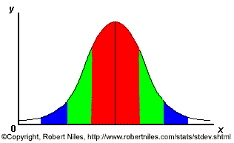
Red – 1 stdev (expect 68% within)
Green – 2 stdev (expect 95% within)
Blue – 3 stdev (expect 68% of samples)
Taken from RoberNiles.com
Notes:
Its expected that 68% of the samples will fall within one standard deviation (the red), 95 % within 2 standard deviations (red and greed) and 99% will fall within 3 std deviations (red, green and blue).

Slide 31
mean | 67.6
median | 67.5
mode | 68.0
Std. dev. | 4.84
Mean
2 stdev
1 stdev
60 65 67 70 75

Slide 32
mean | 78.3
median | 80.1
mode | 83.0
Std. dev. | 5.7
Mean
2 stdev
1 stdev

Slide 33
mean | 78.3
median | 80.1
mode | 83.0
Std. dev. | 5.7
Outlier: an observation that is numerically distant from the rest of the data
Mean
3 stdev
2 stdev
1 stdev
Notes:
A value that is far outside of the rest of the values is called an outlier.

Slide 34
Outliers can occur for many reasons.
That observation is outside of the population
Measurement error
median
not
mean
How do you deal with an outlier?
Remove it from the analysis
Use appropriate stats for a skewed distribution

Slide 35
Which properties on your list can you calculate a standard deviation for?
Nominal | Ordinal | Continuous
texture
Classification
Color –
value/chroma
Color - hue
Structure – grade,
Structure –
size measurement
Structure - type
size class
Diagnostic horizon
- type
Diagnostic horizon
- thickness
Most lab data

Slide 36
Confidence Interval
Gives a range of likely values
Depends of the confidence limit
Usually expressed as a %
For example – I am 80% certain that the class average was between 94 - 97 pts
The confidence interval changes based on the standard deviation, the number of samples and the confidence limit

Slide 37
Mean | 67.6
Std. dev. | 4.84
CI (80%) | 66.3 – 68.8
CI (90%) | 66.0 – 69.1
CI (99%) | 65.1 – 70.1
Mean
99% CI
80% CI
60 65 67 70 75
Notes:
CI and CL can be confusing. The higher the CL, the wider the CI
Alpha = 1 – the confidence limit
CI = t* x std dev/sqrt(N-1)
Get t from a standard table
t* = students t with alpha/2 and N-1 degrees of table

Slide 38
Mean | 70.9
Std. dev. | 10.5
CI (80%)
CI (99%)

Slide 39
Mean | 70.9
Std. dev. | 10.5
CI (80%) | 67.5 - 74.4
CI (90%) | 66.5 - 75.4
CI (95%) | 65.6 - 76.3
CI (99%) | 64.0 - 77.9

Slide 40
Mean + t*StdDev / n-1
N – number of samples
* where t* is the upper (1-C)/2 critical value for the t distribution with n-1 degrees of freedom, t(n-1)

