Slide 1
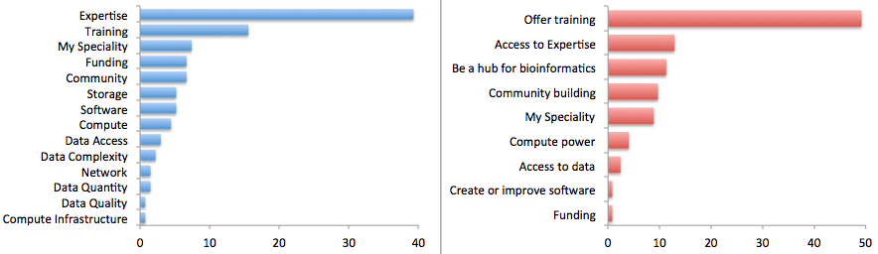
the challenge
a lack of expertise in how to develop software and analyze data effectively and efficiently
What is your biggest bioinformatics difficulty?
Survey, Bioinformatics Resource Australia—EMBL (BRAEMBL)

Slide 2
the challenge
a lack of expertise in how to develop software and analyze data effectively and efficiently
the opportunity
high quality, widely available training based on sound scientific principles and best practices
What is the most useful thing that [could be done] for you?
What is your biggest bioinformatics difficulty?
Survey, Bioinformatics Resource Australia—EMBL (BRAEMBL)

Slide 3


Teach basic lab skills
for scientific computing
so that researchers can do more
in less time and with less pain.
Teach basic concepts, skills and tools for working effectively with data
especially to those
without prior computational experience.

Slide 4
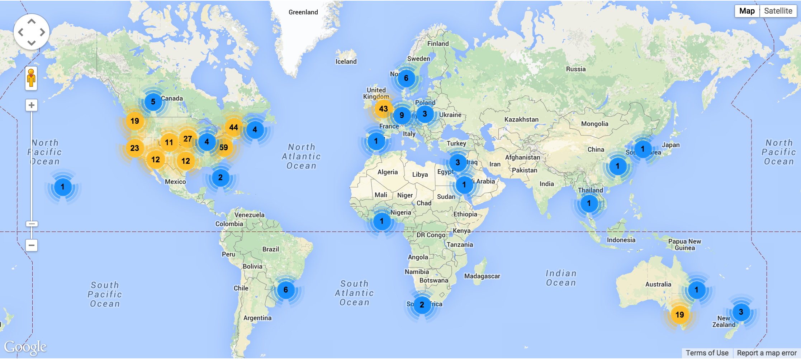
workshops
Since January 2012, we’ve taught
270+ two-day workshops
to 10,000+ learners
with 250+ volunteers
in 20+ countries.
Workshops, January 2012–April 2015

Slide 5

workshops
curriculum
Task automation (Unix shell)
Modular programming (Python, R, MATLAB; unit testing)
Reproducibility and collaboration (Git and GitHub)
Data management (SQL)

Slide 6
workshops
curriculum
outcomes
Enable researchers to save half a day a week (or more) for the rest of their careers.
Prepare researchers for reproducible research, high-performance computing, and open science.
Enable researchers to tackle entirely new kinds of problems.
http://software-carpentry.org

Slide 7
overview
Sister organization of SWC
Officially began November 2014 (with NSF support)
24 workshops planned in 2015

Slide 8
overview
curriculum
Domain-specific data focus (biology, genomics, geoscience, social sciences)
Data analysis in effective and reproducible way
Novices targeted (no prerequisites or prior assumed knowledge)
http://datacarpentry.org

