Slide 1
Prebiotic chemistry
A field of research dedicated to the study of how the building blocks of life formed spontaneously from energy and minerals present on the early earth.
Can be shown experimentally, but difficult to prove that it actually happened that way
Several schools of thought

Slide 2
How are these inorganic compounds converted to organic compounds?
Can happen spontaneously if these gases are subjected to intense energy sources:
1) UV radiation was the most important, because no UV-absorbing ozone layer existed. Ozone shield appeared about 2 BYA
2) Lightning discharge (Miller-Urey experiment).
3) Radioactivity (e.g. ionizing radiation from outer space).
4) Thermal energy from volcanic activity, hydrothermal vents,
or meteoritic impacts.

Slide 3
Origin of cellular life:
Two hypotheses: Surface and subsurface origin.
Surface origin hypothesis
Self-replicating cells arose out of a primordial soup rich in organic and inorganic compounds in a “warm little pond.” (primordial soup)
It is now believed that surface conditions of early Earth were hostile to life and to its inorganic and organic precursors.
Include dramatic temperature fluctuations, meteor impacts, dust clouds, storms, volcanic activity.

Slide 4
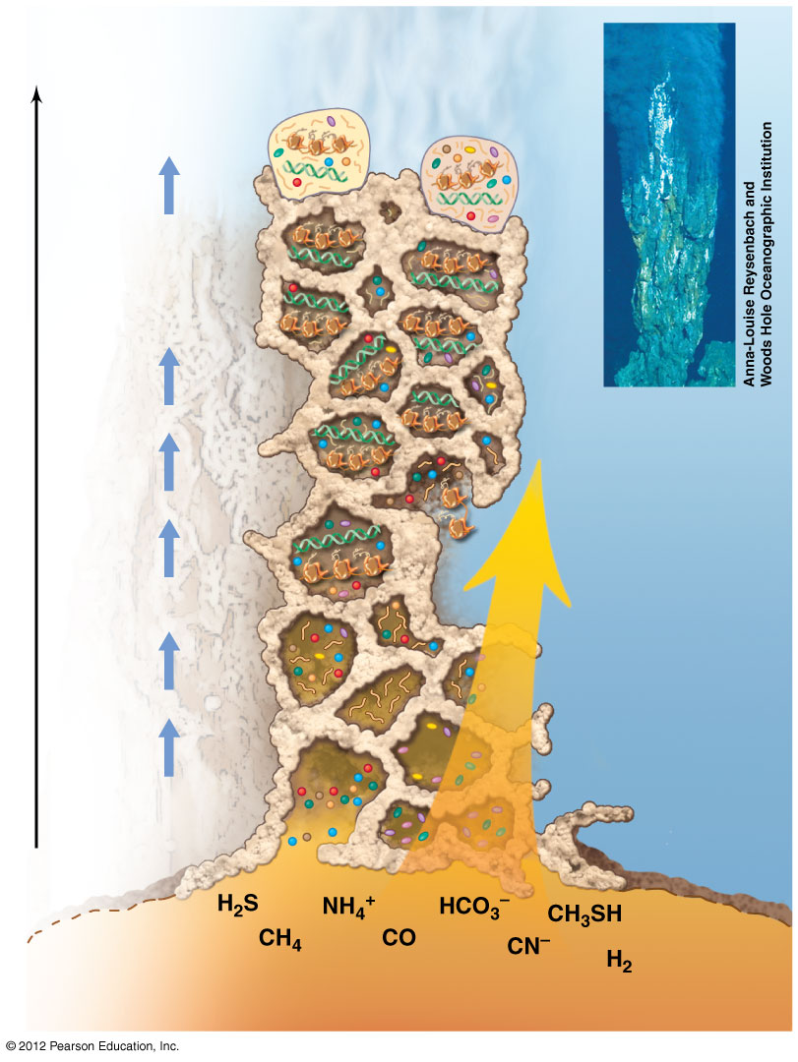
subsurface hypothesis (“metabolism first”)
Subsurface was more constant in conditions
Anaerobic, lots of minerals available for energy.
Accounts for the need of a continuous source of energy
Lane: Early life was energy inefficient (”leaky” membranes)
Evolutionary events
Early Bacteria
Early Archaea
Dispersal to other habitats
Diversification of molecular biology, lipids, and cell wall structure
LUCA
Mound: precipitates of clay, metal sulfides, silica, and carbonates
(−0.3 to 0.5 billion years)
Time
DNA
Ocean water (<20°C, containing metals, CO₂ and PO₄²⁻)
RNA and proteins
RNA life
Flow of substances up through mound
Amino acids
Nitrogen bases
Prebiotic chemistry
Sugars
Ocean crust
Nutrients in hot hydrothermal water
Brock Biology of Microorganisms, 15th ed

Slide 5
Some more info about subsurface…
Many known microbes today live by anaerobic respiration using alternative electron acceptors, reducing compounds and elements (DMSO, iron….)
If cells waste energy, why haven’t they evolved recycling or other systems? They have! Syntrophy

Slide 6
Why was Miller-Urey important?
First direct (and successful test) of Oparin’s hypothesis
Advanced the field of chemical synthesis
Captured imagination: the lay public was interested
Launched the field of experimental origins of life
But it has been challenged due to new evidence, but has also been supported by other new evidence.

Slide 7
Revisiting Miller experiment with updated data from newer methodology
Was the atmosphere of the early Earth so reducing? What was its true makeup and how do scientists know?
Did the surface have sufficient / consistent energy input? From what sources and how much?
What molecules were actually made in the Miller-Urey experiment and how much?
How could Miller change his methodology to more accurately simulate the environmental conditions of the early earth as we understand them today? Has anyone done this? What were the results?

