Slide 1
Eukaryogenesis
WEEK 11
AIKYA SONI

Slide 2
Schedule
3:05 – 3:30 Jigsaw
3:30 – 4:00 Lecture
4:00 – 5:00 TED Talk Planning/Break when needed
5:00 – 5:30 TED Talks!
Notes:
4 - 5:00 Ted Talk planning/rehearsing
5 - 5:30 TED Talks,

Slide 3
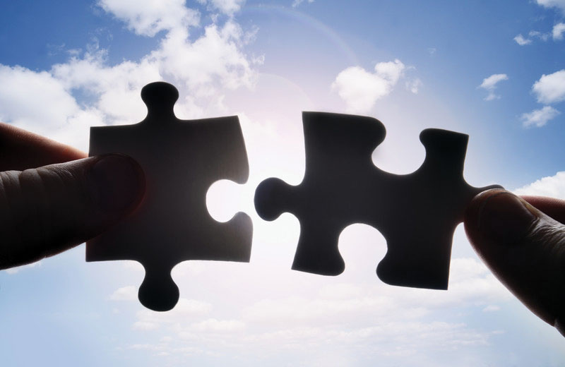
Jigsaw
Split into pairs
Sagan (Split into intro/part 1 and part 2/3)
Gray
Poole and Gribaldo
Summarize main points/takeaways, report back to group

Slide 4
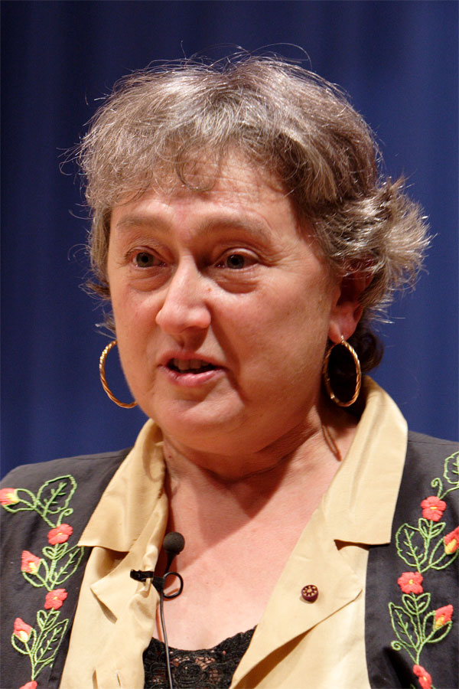
Lynn Margulis, 1938 - 2011
Video
Awesome scientist (#WomenInSTEM!)
Graduated from UChicago at 19
Master’s from UChicago, MS from University of Wisconsin, PhD from UC-Berkeley
Taught at Brandeis University, Boston University, and University of Massachusetts at Amherst
Distinguished Professor of Botany at Amherst
Many awards and accolades, including National Medal of Science in 1999
Married to Carl Sagan, Thomas Margulis -- "it’s not humanly possible to be a good wife, a good mother and a first-class scientist. No one can do it—something has to go."
(from Wikipedia)
Notes:
extremely influential scientist, especially known for the topic we’re covering today -- endosymbiosis
several interviews on youtube, peruse at your leisure
watch from 1:13 until 4:24

Slide 5
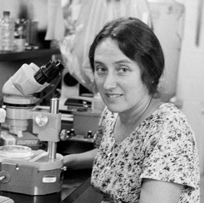
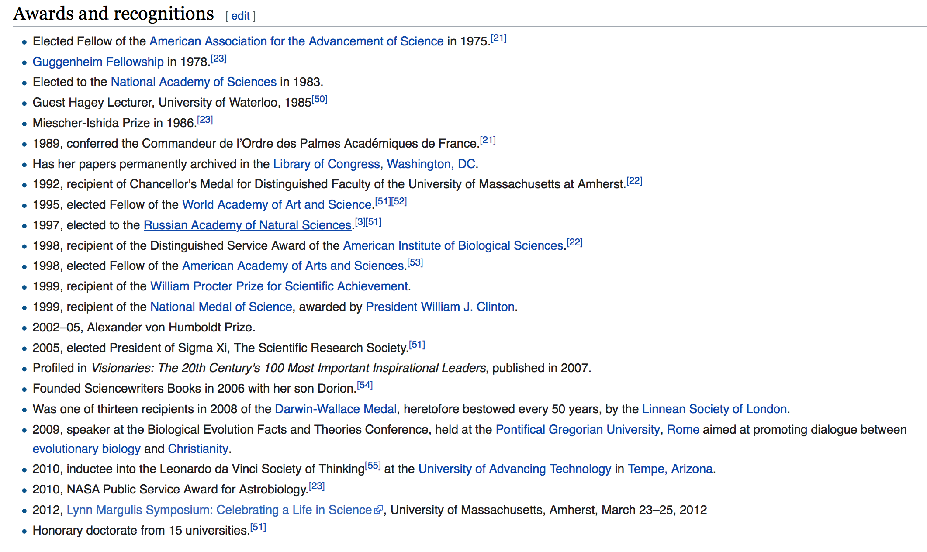
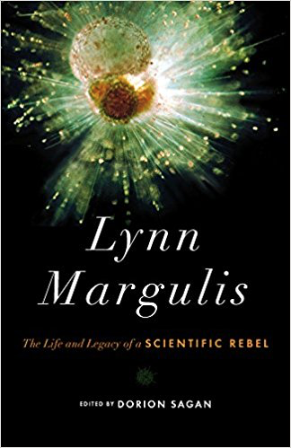

Slide 6
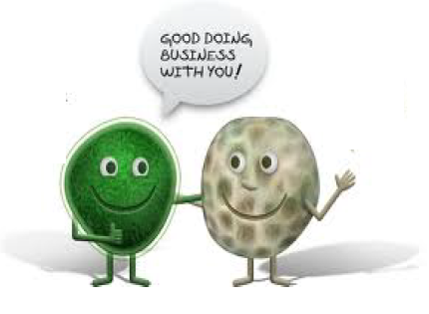
Endosymbiotic Theory
Symbiotic view of eukaryotic cell evolution (aka eukaryogenesis)
Notes:
Margulis/Gray info
Serial endosymbiosis?

Slide 7
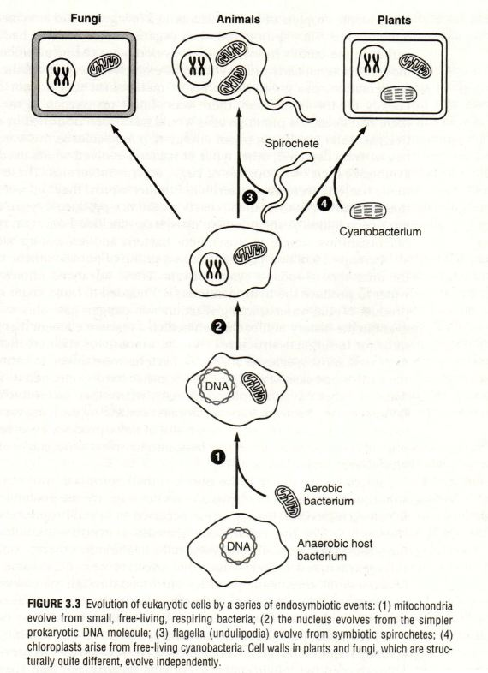
Endosymbiotic Theory
Symbiotic view of eukaryotic cell evolution (aka eukaryogenesis)
Margulis’ original theory
mitochondria, plastids, flagella all from free-living prokaryotes
Only the first 2 supported in later studies
(from Michigan State University)
Notes:
Margulis/Gray info
Serial endosymbiosis?

Slide 8
Endosymbiotic Theory
Symbiotic view of eukaryotic cell evolution (aka eukaryogenesis)
Margulis’ original theory
mitochondria, plastids, flagella all from free-living prokaryotes
Only the first 2 supported in later studies
Serial endosymbiosis?
(from Michigan State University)
Notes:
Margulis/Gray info
Serial endosymbiosis?

Slide 9
Endosymbiotic Theory
Short Video
Notes:
Before video, short definition of Margulis’ endosymbiotic theory
check Nick Lane Vital Question
https://www.youtube.com/watch?v=9i7kAt97XYU 2:44
Drive home evidence, why is this so

Slide 10
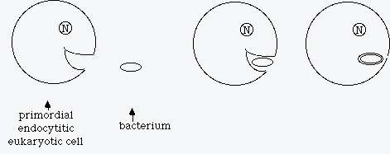
Evidence for Endosymbiosis
Gray and Doolittle, 1982 - mitochondria from alpha-Proteobacteria
Gray, 1992 - plastids from Cyanobacteria
Gray, 2012 - one partner in symbiosis was a bacterial cell
Muller et al., 2012 - mitochondrial acquisition ubiquitous in modern eukaryote biology; traces back to ancient endosymbiont
...and more!
Notes:
Drive home evidence, why is this so well accepted
main points of the video
own knowledge, ribosomes
problems w theory maybe
where did the archaeal membrane go (if archaea is a host)
Poole and Gribaldo what’s known

Slide 11
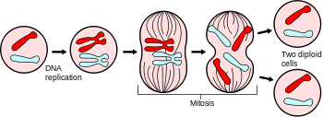
Endosymbiotic Theory
Definition of “eukaryote”?
Margulis: classical mitosis, higher, subcellular organelles, membrane-bound nuclei, “many other features in common”
(from Wikipedia)
Notes:
Definition of eukaryote question

Slide 12
Poole and Gribaldo
Timing
Notes:
Poole/Gribaldo -- Cover new research about each thing
emphasis on mechanism

Slide 13
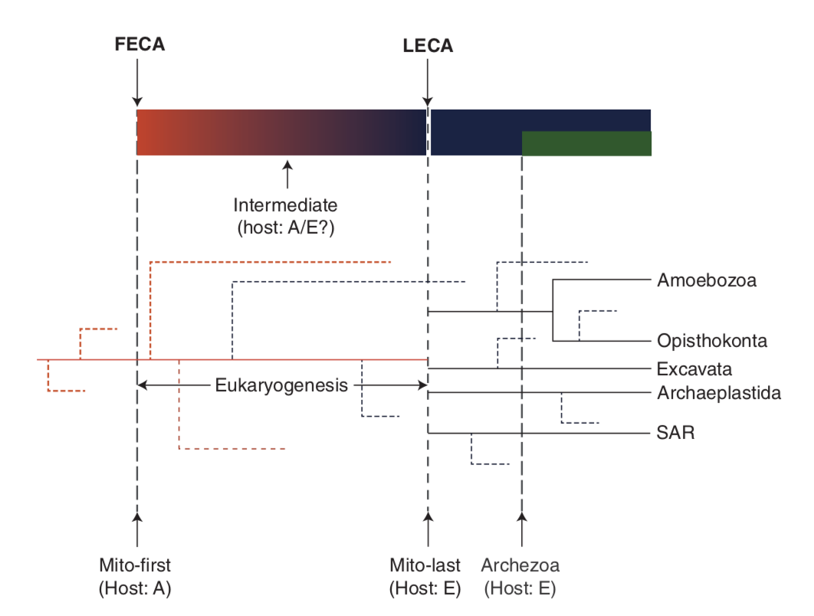
Poole and Gribaldo
Timing
early mito- vs. late mito-
not right before LECA (Amiri et al., 2003)
Poole and Gribaldo (2014) Cold Spring Harb Perspect Biol 6:1-12
Notes:
Poole/Gribaldo -- Cover new research about each thing
emphasis on mechanism

Slide 14
Poole and Gribaldo
Timing
Nature of host
Notes:
Poole/Gribaldo -- Cover new research about each thing
emphasis on mechanism

Slide 15
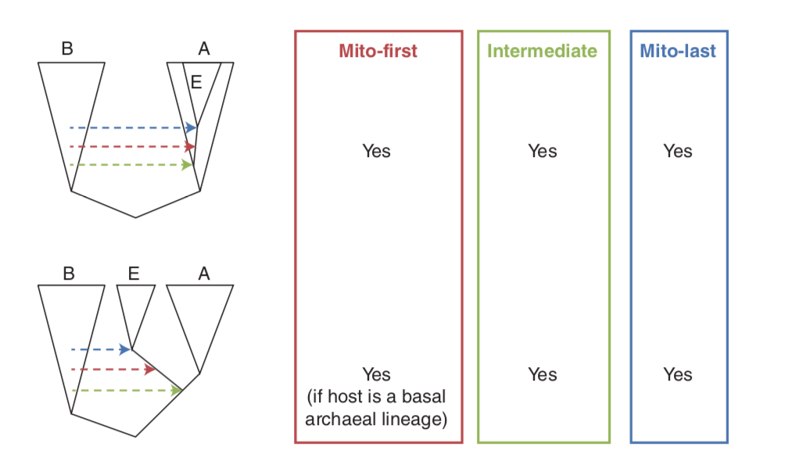
Poole and Gribaldo
Timing
Nature of host
bacterial? archaeal?
agreement that it was closest to modern archaea than any bacteria
Poole and Gribaldo (2014) Cold Spring Harb Perspect Biol 6:1-12
Notes:
Poole/Gribaldo -- Cover new research about each thing
emphasis on mechanism

Slide 16
Poole and Gribaldo
Timing
Nature of host
Mechanism of acquisition
Notes:
Poole/Gribaldo -- Cover new research about each thing
emphasis on mechanism

Slide 17
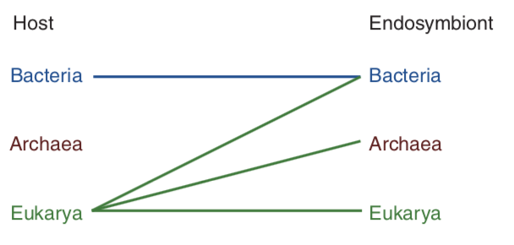
Poole and Gribaldo
Timing
Nature of host
Mechanism of acquisition
bacteriovory
syntrophy
phagocytosis
Poole and Gribaldo (2014) Cold Spring Harb Perspect Biol 6:1-12
Notes:
Poole/Gribaldo -- Cover new research about each thing
emphasis on mechanism

Slide 18
Poole and Gribaldo
Timing
Nature of host
Mechanism of acquisition
bacteriovory
syntrophy
phagocytosis
Bacteriovory - bacterial host/bacterial endosymbiont
bacterial predator invade periplasm Gram-negative host (and sometimes cytoplasm)
only a failed predatory event would result in endosymbiosis
both parasite and host survive, co-evolve
Notes:
Poole/Gribaldo -- Cover new research about each thing
emphasis on mechanism

Slide 19
Poole and Gribaldo
Timing
Nature of host
Mechanism of acquisition
bacteriovory
syntrophy
phagocytosis
Syntrophy - between archaea and bacteria
biochemical interaction, no endosymbiosis
more likely a factor in an endosymbiotic interaction than a stand-alone mechanism (i.e. phagocytosis)
Membrane bending: unsure, but might have to do with protein interactions
No contemporary examples of a bacterial endosymbiont in an archaeal host
Notes:
Cross feeding, using byproducts of each other

Slide 20
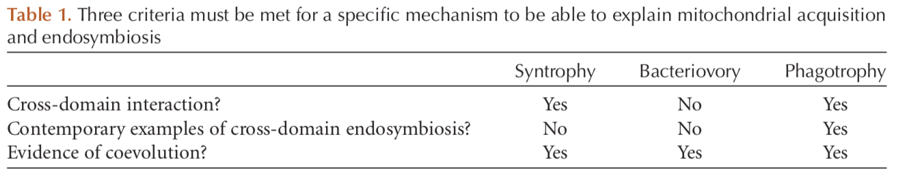
Poole and Gribaldo
Timing
Nature of host
Mechanism of acquisition
bacteriovory
syntrophy
phagocytosis
Phagocytosis - most likely candidate -- bacterial endosymbiont with an archaeal host
components of phagocytosis trace back to LECA
compatible with 2D and 3D trees
simplest answer (avoids need for syntrophic-endosymbiosis or failed predatory attempts) -- Occam’s razor
Poole and Gribaldo (2014) Cold Spring Harb Perspect Biol 6:1-12
Notes:
cell wall - many failed attempts at loss, but the successful one would allow phagotrophy to happen/develop
law of parsimony very relevant
if something fits everything we know, that’s what we’ll choose

Slide 21
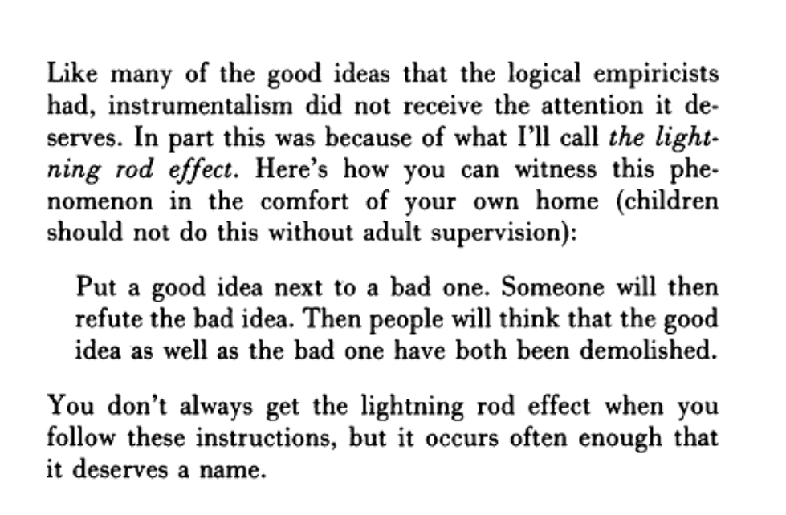
Poole and Gribaldo
“Lightning rod” effect
example: Lynn Margulis’ view on 5 kingdoms
Sober (1999) Crítica: Revista Hispanoamericana de Filosofía 31:3-39

Slide 22
Questions...?

Slide 23

TED Talk Activity
Research assigned topic/issue
Prepare 7-8 minute presentation -- TED talk style:
Introduce topic
Use lay terms
Be engaging (but succinct!)
Use chalk ted talk - drawings/keywords or visual aides of some sort
Notes:
Emphasize everyone needs to have some sort of active role, use drawings/keywords

Slide 24
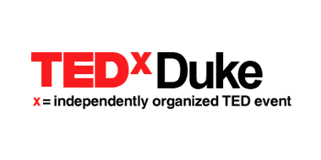
TED Topics (as they’re related to eukaryogenesis)
Mitochondria
Endosymbiont transition
Viral eukaryogenesis
Questions to consider...
Notes:
https://docs.google.com/document/d/1AA4CUfMSL7Q8g_B_HqswacSPKqh8ZPABRO-WakQQ_Cc/edit?usp=sharing
make 3 topics instead of 4

Slide 25
Bibliography
Gray, M.W. (1992) The Endosymbiont Hypothesis Revisited. In International Review of Cytology 141, Supplement C vols. (Wolstenholme, D. R. and Jeon, K. W., eds), pp. 233–357, Academic Press
Gray, M.W. (2017) Lynn Margulis and the endosymbiont hypothesis: 50 years later. Molecular Biology of the Cell 28, 1285–1287
Gray, M.W. et al. (1999) Mitochondrial Evolution. Science 283, 1476
Gray, M.W. and Doolittle, W.F. (1982) Has the endosymbiont hypothesis been proven? Microbiological Reviews 46, 1–42
Lane, N. (2015) The Vital Question, W.W. Norton & Company, Inc.
Martin, W. and Müller, M. (1998) The hydrogen hypothesis for the first eukaryote. Nature 392, 37
Poole, A.M. and Gribaldo, S. (2014) Eukaryotic Origins: How and When Was the Mitochondrion Acquired? Cold Spring Harbor Perspectives in Biology 6, a015990
Sagan, L. (1967) On the Origin of Mitosing Cells. J Theoret Biol 14, 225–274
Schweitzer, Y. and Kozlov, M.M. (2015) Membrane-Mediated Interaction between Strongly Anisotropic Protein Scaffolds. PLoS Computational Biology 11, e1004054
Sober, E. (1999) Instrumentalism Revisited. Crítica: Revista Hispanoamericana de Filosofía 31, 3–39

