Slide 1
Discovery of the Archaea
Jackie Vahey
10/25/2017
Bio590S

Slide 2
Phylogenetic Trees
http://www.pbs.org/wgbh/nova/labs/lab/evolution/research#/evo/deeptree

Slide 3
Building Phylogenetic Trees
Distance methods

Slide 4
Building Phylogenetic Trees
Distance methods
Rooted vs unrooted
Notes:
Draw picture of unrooted trees and how many rooted trees can be made by a single unrooted tree
How to choose a root?
- use an outgroup
- bad if there are confounding factors like reversions to WT or horizontal gene transfers

Slide 5
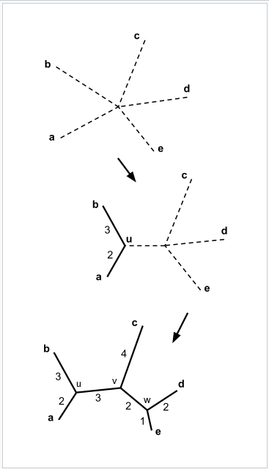
Building Phylogenetic Trees
Distance methods
Rooted vs unrooted
Neighbor joining
https://en.wikipedia.org/wiki/Neighbor_joining
Notes:
Start with each organism in its own clade and join the closest neighbors
Unrooted tree

Slide 6
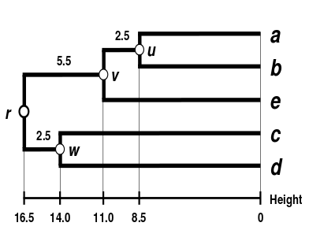

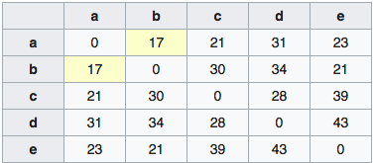
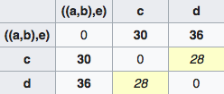
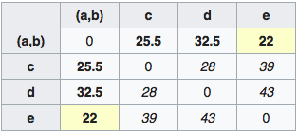
Building Phylogenetic Trees
Distance methods
Rooted vs unrooted
Neighbor joining
Unweighted pair group method with arithmetic mean (UPGMA)
https://en.wikipedia.org/wiki/UPGMA
Notes:
Two nearest clades are grouped together, repeat until all clades are grouped in one group
Rooted tree, but assumes molecular clock

Slide 7
Building Phylogenetic Trees
Distance methods
Rooted vs unrooted
Neighbor joining
Unweighted pair group method with arithmetic mean (UPGMA)
Maximum parsimony
Notes:
-potentially reverted bases could mislead investigators
-NP hard– no way to efficiently choose ideal tree. Must use a heuristic

Slide 8
Building Phylogenetic Trees
Distance methods
Rooted vs unrooted
Neighbor joining
Unweighted pair group method with arithmetic mean (UPGMA)
Maximum parsimony
Maximum likelihood
Notes:
Use probability and statistics to choose the most probable tree
Does not assume evolution is constant
Also NP hard--> impossible to find best tree in a reasonable amount of time

Slide 9
Building Phylogenetic Trees
Distance methods
Rooted vs unrooted
Neighbor joining
Unweighted pair group method with arithmetic mean (UPGMA)
Maximum parsimony
Maximum likelihood
Bayesian inference
Notes:
Uses Bayesian probability to adjust probability of trees given new information. Best way to combine molecular and physical trait data.
Long branch attraction

Slide 10
Build a tree
What type of information do you need?
Notes:
What are the qualities of the information we would want to build such a tree?
-something that will let us separate groups of species

Slide 11
Build a tree
What type of information do you need?
Physical characteristics and traits

Slide 12
Build a tree
What type of information do you need?
Physical characteristics and traits
Molecular data

Slide 13
Build a tree
What type of information do you need?
Physical characteristics and traits
Molecular data
rRNA
DNA

Slide 14
Build a tree
What type of information do you need?
Physical characteristics and traits
Molecular data
rRNA
DNA
Molecular clock

Slide 15
Build a tree
What type of information do you need?
What do you do if your information conflicts?
Notes:
Make lots of trees and judge how they match or where/how they differ

Slide 16
Phylogenetic Incongruence
http://www.talkorigins.org/faqs/comdesc/incongruent.html
Notes:
How could such phylogenetic incongruence occur?

Slide 17
Build a tree
What type of information do you need?
What do you do if your information conflicts?
How do you have confidence that your tree is correct?

Slide 18
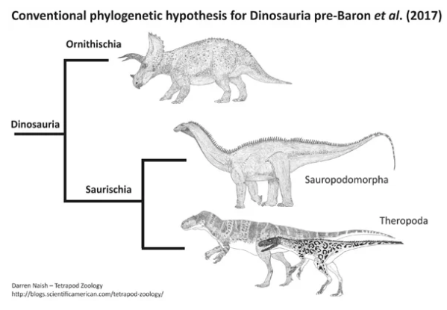
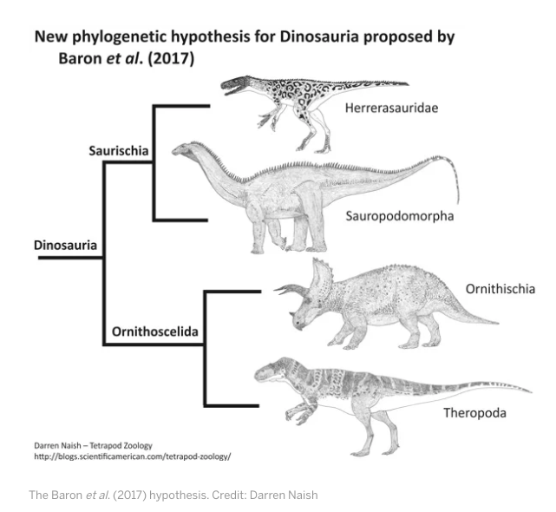
Build a tree
What type of information do you need?
What do you do if your information conflicts?
How do you have confidence that your tree is correct?
Notes:
Bootstrapping → how many trees are the same

Slide 19
Build a tree
What type of information do you need?
What do you do if your information conflicts?
How do you have confidence that your tree is correct?
Gene trees vs Species trees
https://biology.stackexchange.com/questions/53141/what-is-the-difference-between-a-species-tree-a-gene-tree-and-a-phylogenetic-tr
Notes:
Bootstrapping → how many trees are the same

Slide 20
Build a tree
What type of information do you need?
What do you do if your information conflicts?
How do you have confidence that your tree is correct?
http://www.pbs.org/wgbh/nova/labs/lab/evolution/research#/evo/buildatree/6
https://www.khanacademy.org/science/biology/her/tree-of-life/a/building-an-evolutionary-tree

