Slide 1
Origins of Cellular Life Bio522S
Welcome and introductions
Discuss the syllabus, course organization, and wiki
Discussion on the definition of life

Slide 2
Definition of life
Bio522S
2023-01-17

Slide 3
Is a virus alive?
Talk to your neighbor and discuss
Come up with an answer and be prepared to provide to the class 2 reasons to support your answer.
How should we define a "living organism"? Microorganism?

Slide 4
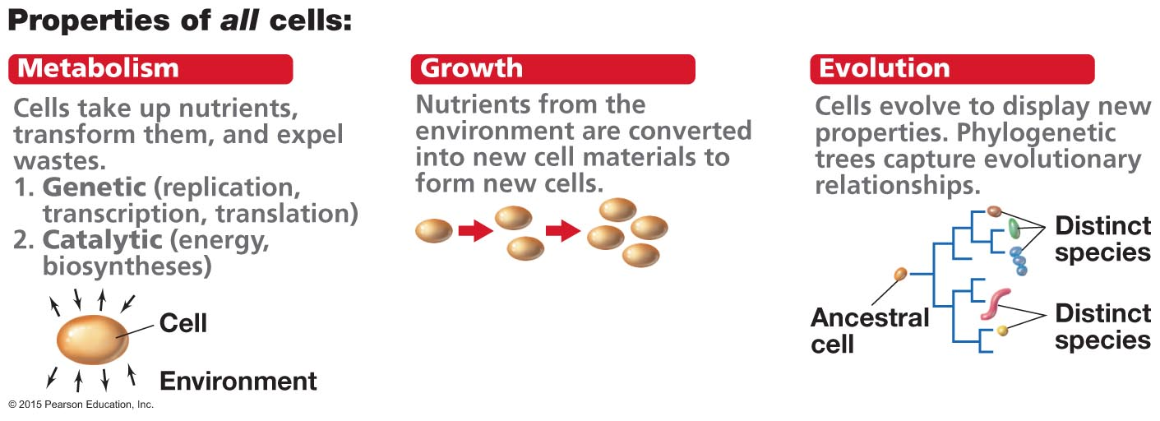
Attributes of microorganisms (textbook definition)

Slide 5
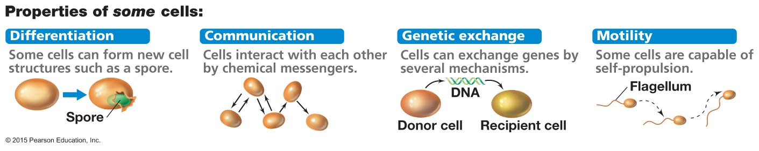
Attributes of microorganisms

