Slide 1
Astrobiology
Charles Huang
Duke University
BIO 590S

Slide 2
Schedule
3:05 - 3:35 Presentation
3:35 - 4:00 Group Research
4:00 - 4:30 Present Findings
4:30 - 4:40 Break
4:40 - 5:00 Class Evaluations
5:00 - 5:35 Skype with Dr. Carlos Mariscal

Slide 3
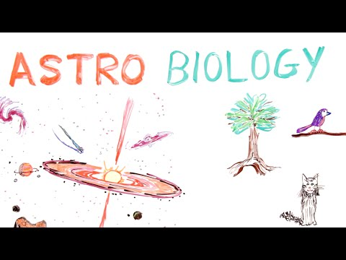

Slide 4


Slide 5
Key Questions in Astrobiology
What are the building blocks of life?
Where and how did Earth obtain the essential ingredients for life?
Is Earth the only planet with the necessary ingredient and conditions for life?
Is it possible that life exists elsewhere based on elements other than carbon and a system different than DNA?

Slide 6
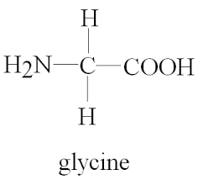

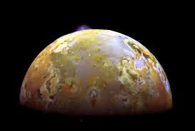
Nova Episode
Key Ingredients for Life:
Organic Molecules: Carbon, hydrogen, oxygen, etc.
Liquid (i.e. water): Medium in which basic organic molecules can mix and interact
Energy (i.e. sun): To power internal processes required for life
Planetary Formation
Repeated impacts from space debris, creating heat to produce oceans of magma
Steam resulting from impacts later create water that forms the oceans
Cosmic Bodies (asteroids, comets, meteorites)
Icy comets contain glycine
Late heavy bombardment (evident from impact craters) may have delivered building blocks of life to Earth
Other plantetary bodies with the ingredients for life
The moons of Jupiter (Io, Europa) contain building block necessary for life

Slide 7
Vreeland et al 2007
Six living strains from genera Halobacterium and Natronobacterium were isolated from Cretaceous era primary salt crystals, implicating mechanisms of long-term survival for some microbes

Slide 8
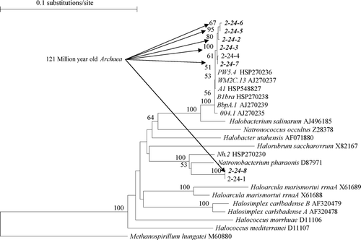
Results:
Six living strains from genera Halobacterium and Natronobacterium (5 strains and 1 strain, respectively) collected from 4/56 crystal samples
Age: Aptian Period (121 - 112.2 MYA)
Characteristics: Archaea, Non-Sporing
Vreeland et al 2007
Notes:
Methods: 16s rRNA
Results: the 4/56 is consistent with previous studies
Age: Formed during the early rifting phase of South Atlantic Ocean, crystals also maintained chemistry of older oceans
Characteristics:
Archaea due to characteristic glycerol di-ether moieties, no fatty acid methyl esters
Non-sporing organisms (previous examples of long-term survival in amber and ancient halites were only spore-forming organisms)

Slide 9
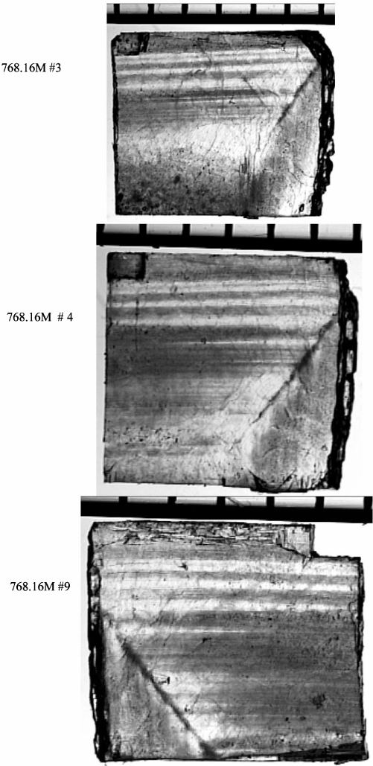
Discussion:
Reveal geochemical environment that foster survival
Implications for long-term survival of microbes
Necessitate investigation on more ancient environments for older organisms
Lack of selective pressure implies extreme genetic stability of microbes
What is the survival potential of microorganisms from salt on different planets?
Vreeland et al 2007
Notes:
Crystals protect microbes from harmful alpha and beta radiation using oppositely charged ions

Slide 10
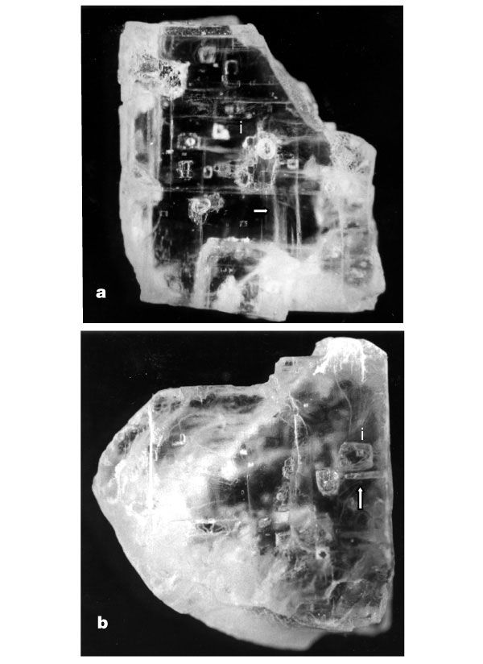
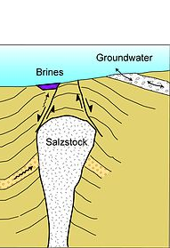
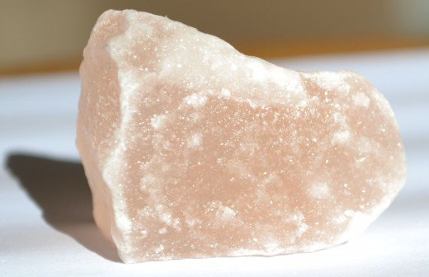
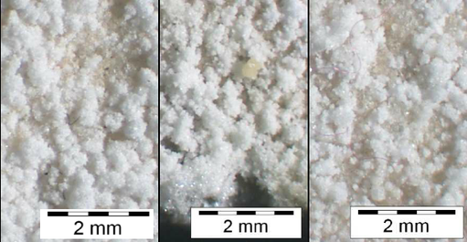
Contamination Concerns
Flowing Brine
Rock Salt
vs
Gonçalves et al 2000
Van Dover 2000
Vreeland et al 2000
Salt Efflorescence
Notes:
Earlier studies which found evidence of ancient life were often criticized for possibility of contamination
Provide little to no assurance of origin of the rock
Flowing brines and salt efflrescnes may be young and contaminated
Recrystallized salts may be indeterminate in age
However, crystals (especially primary crystals) are stable

Slide 11
Goordial et al 2016
The combination of severe cold, aridity, and oligotrophic permafrost soils of the McMurdo Valleys in Antarctica severely limit microbial activity and survival.

Slide 12
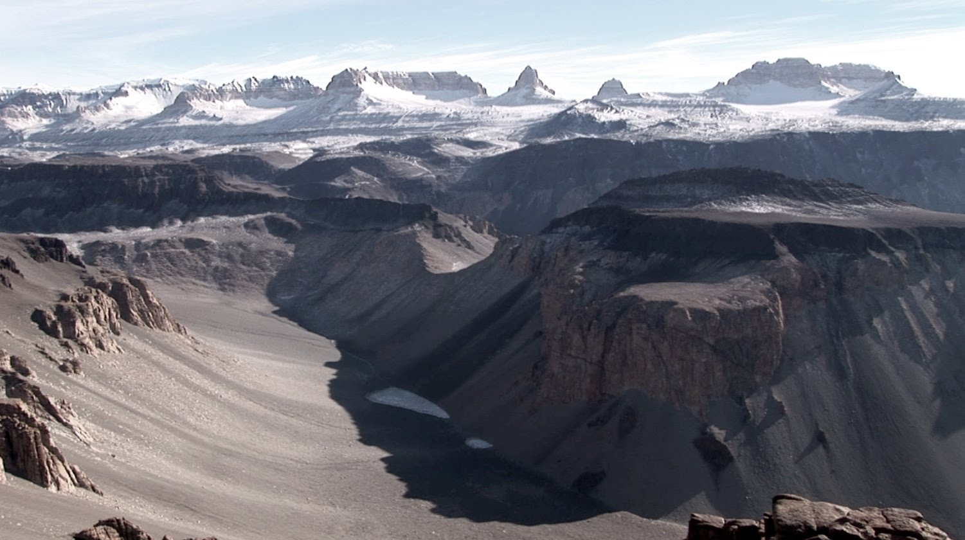
Results:
Mean Temperature -23.5 °C to -26.5 °C, Soil samples highly oligotrophic
Only 6 heterotrophic isolates on over 1000 agar plates in 2 years
Of the culturable isolates, required liquid enrichment indicating dormancy or damage
Notes:
Methods: 16s rRNA
Results: the 4/56 is consistent with previous studies
Age: Formed during the early rifting phase of South Atlantic Ocean, crystals also maintained chemistry of older oceans
Characteristics:
Archaea due to characteristic glycerol di-ether moieties, no fatty acid methyl esters
Non-sporing organisms (previous examples of long-term survival in amber and ancient halites were only spore-forming organisms)

Slide 13
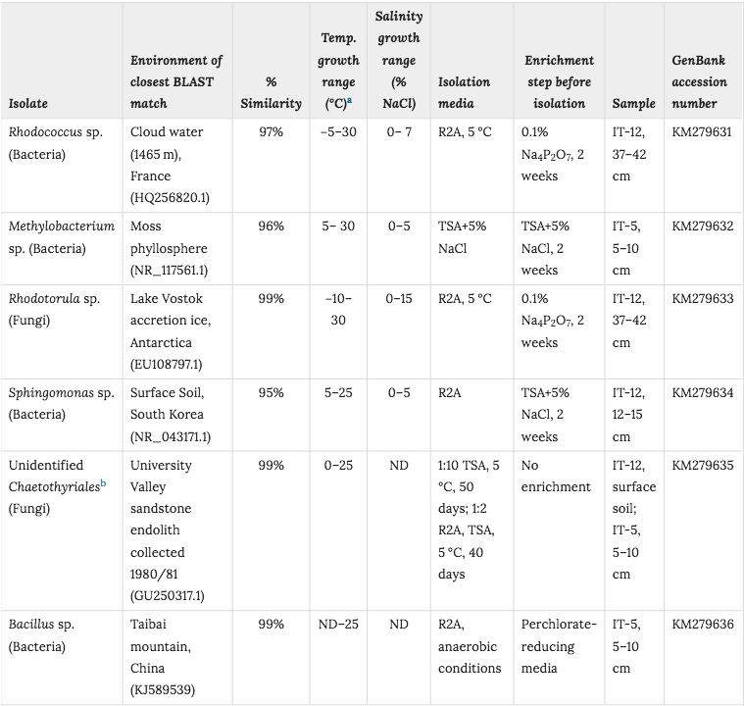
Goordial et al 2007

Slide 14
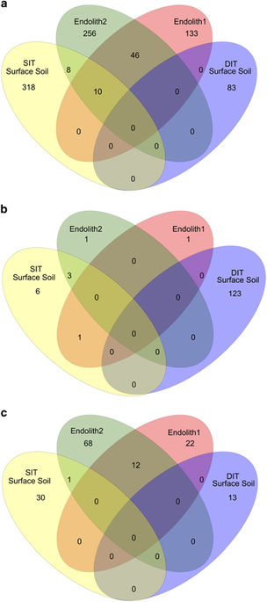
Discussion:
Places limits on the possibilities of life in cold and arid environment due to inability to metabolize and grow
Combination of lack of water, cold, and oligotrophy severely constrain survival
Microbes found may not be fully cold-adapted, but instead a transient phase
Life is currently limited to lithic habitats
Dry permafrost is commonplace in northern polar regions of Mars
Goordial et al 2007
Notes:
Crystals protect microbes from harmful alpha and beta radiation using oppositely charged ions

Slide 15
Break-up and Discuss!
How might radiation-resistant microbes alter our beliefs about the mechanisms of panspermia? Just how irradiating is outer space?
How feasible would it be to have a life-form based around liquid methane instead of liquid water? What about other liquid compounds? What adaptations for life might be necessary in these situations?
How are astrobiological exploration missions kept completely sanitary and free of spores or extremely durable microbes/extremophiles? What past examples of accidental contamination are there?
What is the viability of biomolecules over the timeframe suggested by the Vreeland et al paper? What mechanisms are there for long-term stabilization of DNA to prevent breakdown over time?

Slide 16
Break + Class Evaluations

Slide 17

Guest Speaker: Carlos Marsical
Assistant Professor of Philisophy at the University of Nevade, Reno
Ph.D, Philisophy, Duke University, 2014
M.A., Philisophy, Duke University, 2012
B.A., Journalism & Mass Communication, New Mexico State University, 2006
Notes:
One of specialization is in Philosophy of Astrobiology, one of the only philosophers of astrobiology, especially in respect to synthetic biology
Co-founder, vice president, and organizer for the upcoming annual Social and Conceptual Issues in Astrobiology conference in Reno
Member of International Society for the History, Philosophy, and Social Studies of Biology
Given various talks about the subject, etc.

Slide 18
Bibliography
Brito, V., & Gonçalves, T. (2012). Effects of NaCl and NaNO3 on the capillary suction, drying kinetics and vapour permeability of three building stones. In DRYMASS (pp. 1–2). Retrieved from http://www-ext.lnec.pt/drymass/pdfs/workshop_abstracts.pdf#page=31
Vreeland, R. H., Rosenzweig, W. D., & Powers, D. W. (2000). Isolation of a 250 million-year-old halotolerant bacterium from a primary salt crystal. Nature, 407(6806), 897–900. https://doi.org/10.1038/35038060
Goordial, J., Davila, A., Lacelle, D., Pollard, W., Marinova, M. M., Greer, C. W., … Whyte, L. G. (2016). Nearing the cold-arid limits of microbial life in permafrost of an upper dry valley, Antarctica. ISME Journal, 10(7), 1613–1624. https://doi.org/10.1038/ismej.2015.239
Vreeland, R. H., Jones, J., Monson, A., Rosenzweig, W. D., Lowenstein, T. K., Timofeeff, M., … Grant, W. D. (2007). Isolation of live cretaceous (121-112 million years old) halophilic Archaea from primary salt crystals. Geomicrobiology Journal, 24(3–4), 275–282. https://doi.org/10.1080/01490450701456917

