Slide 1
Rooting the Tree of Life
Ivana Premasinghe
Notes:
Okay first, can everyone move so they are sitting in a circle?

Slide 2
Schedule
3:05-3:35 → Skype with Dr. Gribaldo
3:35-3:55 → Introduction: Two Domain Hypothesis
3:55- 4:30 → Research: Three Domain Hypothesis
4:30-5:00 → Three Domain Hypothesis Discussion
5:00-5:15 → Follow Up Discussion: Two or Three Domains?
5:15-5:30 → Looking to the Future
Notes:
Here’s the basic schedule for today
We don’t have *too* much wiggle room so it is easiest to have the break whenever you need it during the research three domain hypothesis time period

Slide 3
Introduction: Two Domain Hypothesis
Notes:
A lot of people asked questions about the mitochondria and endosymbiosis, and while Dr. Gibraldo briefly answered those questions, there is not much more I will say about the topic. that kind of goes into the topic for the next few weeks so it is not something I will touch on, but many of those points will be revisited in later weeks

Slide 4
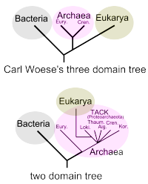
Which tree shows the two domain hypothesis?
Wikipedia
Notes:
Just to make sure everyone is awake and has the broad idea of things, answer this question

Slide 5
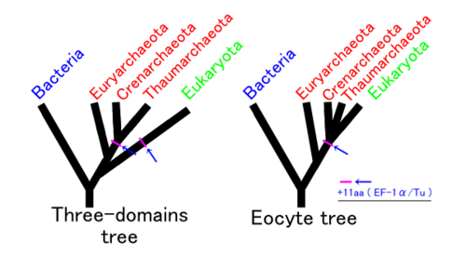
Which tree shows the two domain hypothesis?
Wikipedia

Slide 6
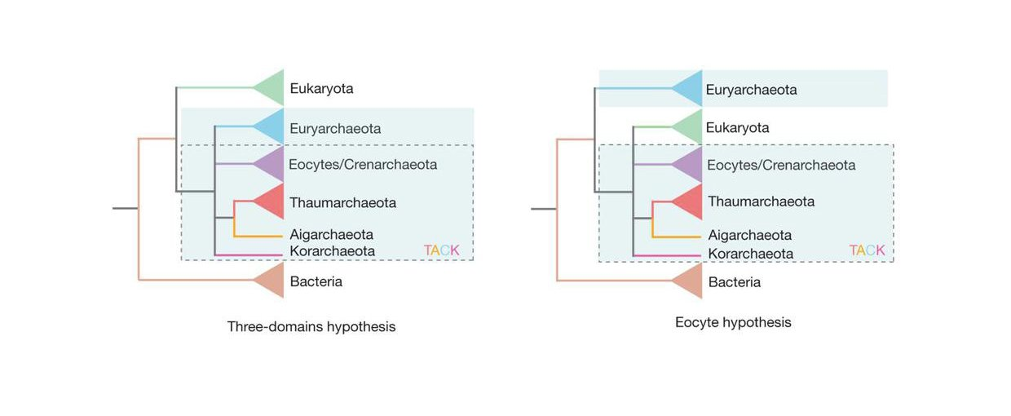
Which tree shows the two domain hypothesis?
Williams et. al. 2013, Nature
Notes:
Alright, and here is the last one. This one is from the Williams paper, so you should be able to get this one
Also just wanted to point out what we were all talking about last time with the Williams paper, wondering about the dotted line box – the box actually doesn’t extend into euryakarcheota on the eocyte hypothesis tree, so it is likely that the blue shading and the box from last week’s image is just to show the same groups of organisms and where they are on the new tree

Slide 7
Two vs. three domain hypothesis
Notes:
Aside from all of them being on the right in all of the slides I showed you, there is another trend that is actually key in understanding the difference between these two hypotheses
The two domain tree has eukaryotes as a sister group to archaeal phyla and is within the archaea as a whole, while the three domain tree has eukaryotes as a sister group to the Archaea
So, just to get the basic jist, the two domain hypothesis says that eukaryotes originate from archaea while the three domain hypothesis says they originate from bacteria

Slide 8
Topics:
New discoveries
Genes with eukaryotic complexity
Improvements in phylogenetic analysis
Room for improvement
Notes:
Now while talking about the two domain hypothesis, these are the four themes and topics that I will stick to
Just keep in mind these four ideas, because I will be explaining how they relate to the two domain hypothesis, but later during class, we will use the same four topics when researching the three domain hypothesis and then to do a comparison of the two hypotheses
So just keep the four categories in mind

Slide 9
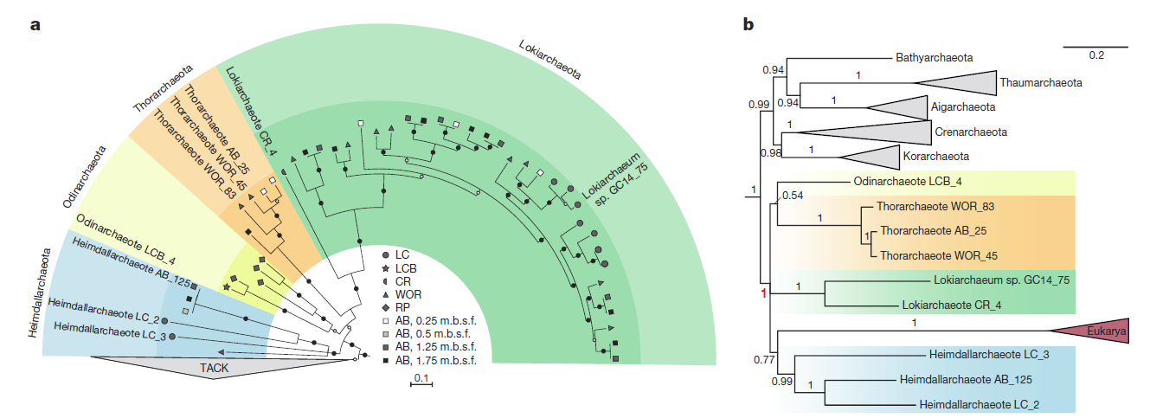
New discoveries
Lokiarchaeota, Asgard superphylum, and TACK superphylum
Zaremba-Niedzwiedzka et. al, 2017, Nature
Notes:
Lokiarchaeota were recently discovered and placed as the most closely related group to eukaryotes, embodying many similarities to eukaryotes in terms of complexity, which I will address in the next slide
After the discovery of Lokiarchaeota, other lineages were discovered (including the Odinarchaeota and Heimdallarchaeota mentioned in the Raymann paper), allowing for the creation of the Asgard superphylum, which included the Lokiarchaeota taxa
Through the results, Asgard archaea as placed as a sister clade to eukaryotes
This was great because people were originally super skeptical about the discover of Lokiarchaeota because it was only one lineage and people thought it could be something like contamination, but then they found the other lineages to make up Asgard so this was settled more and included the discovery of the
The recent classification and phylogenetic analyses of the TACK superphylum notes that is also has a potential sister relationship to eukaryotes as well
All of these discoveries provide some evidence for the two domain hypothesis, since eukaryotes would have a sister relationship to the Asgard superphylum and TACK superphylum
The picture is from the Zaremba-Niedzwiedzka paper and shows discovery of the Asgard superphylum. This is after the did a maximum likelihood approach using small and large rRNA genes and inferred that Asgard archaea and eukaryotes have an affiliation
The part on the left is also a maximum likelihood tree

Slide 10
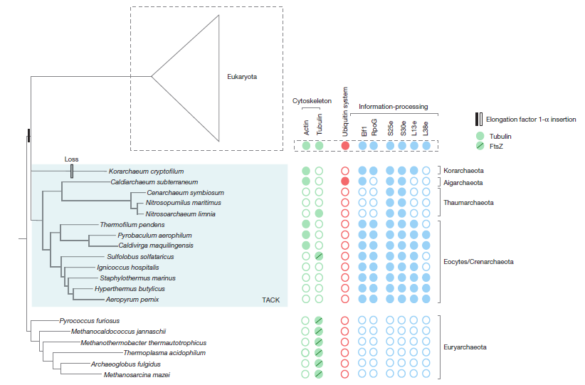
Genes with eukaryotic complexity
What does this mean about the complexity of the eukaryotic archaeal common ancestor?
Williams et. al. 2013, Nature
Notes:
The figure is from the Williams paper showing TACK and that there were actin and tubulin ortholgoues in TACK
The genomes of many of the new discoveries archaeal phyla and superphyla include genes that were previously thought to be “eukaryotic specific”
Loki is most like the ancestor and is the most complex out of them all and the most similar to eukaryotes
Asgard archaea
Have a bona fide tubulin orthologue → involved in mitosis
Homologues of subunit 4 of ARP2/3, which is an actin related protein (muscle contractions, etc.)
Lokiarchaeota
Expanded set of GTPases
Actin homologues
Ubiquitin modifier components
TACK
TACK has a homolog of the bacterial FtsZ, which is similar to tubulin in eukaryotes, which is involved in mitosis
It also has eukaryotic-like histones and DNA polymerase PolD, involved in synthesizing the lagging strand of DNA
Also has some eukaryote-like genes involved in transcription and translation that have been found so far only among the TACK archaea → four ribosomal proteins, RNA polymerase subunit RpoG, elongation factor ELf1, and a short amino acid insertion
Also you can see that the elongation faction 1-alpha is only found in TACK archaea and eukaryotes, which you can actually see in the picture from the vertical bar
Question answer: probably more complex than we thought
the eukaryotic archaeal common ancestor must have already had some of this eukaryotic complexity
since the sister groups have some of these traits similar to eukaryotes (sister → archaeal superphylum + eukaryotes)
Current day archaea differ in complexity
Now looking at some of the similarities between the groups, it is apparent that Lokiarchaeota are very similar in complexity to the eukaryotes
While this leads to evidence that the eukaryotic archaeal common ancestor was likely more complex than we thought, it is interesting to look at archaea today
Some of the current day archaea like Loki are very complex and retain some of this eukaryotic complexity, while others like some of the thermophiles are less complex
So maybe there could have been some horizontal gene transfer from bacteria or some sort of reductive evolution
Just some ideas to keep in mind
And also to note that as we discover archaeal groups that are more complex, this may appear to conflict with knowledge of other common day archaea that are less complex, but this is not conflicting if you take into consideration some of these possibilities

Slide 11
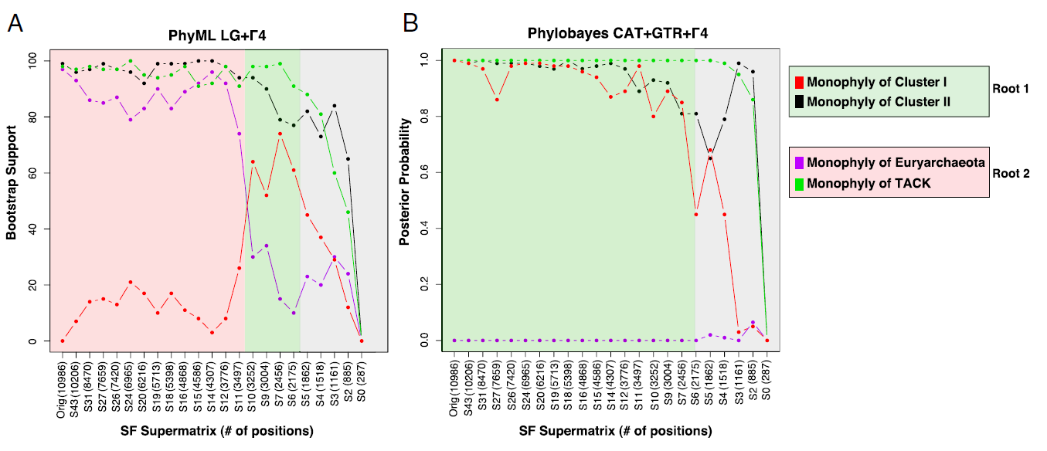
Improvements in phylogenetic analysis
Fast vs. slow evolving lineages and Long Branch Attraction
Raymann et. al, 2015, PNAS
Notes:
One thing I actually did not realize is that the inclusion of fast evolving lineages in phylogenetic reconstruction can actually lead to long branch attraction
Fast vs. slow evolving lineages
One things to note is that not all lineages evolve at the same rate
This applies to species as well as various genes
For example, when there are a lot of nucleotide changes over a short period of time, you would call this fast evolving. This could actually lead to what we call long branch attraction because it will clump together certain groups that would then cluster together, making them seem closely related while they are actually only associated because of the long branch
Therefore the branch length is proportional to the number of nucleotide changes
And fast evolving sites are where you have a gene that has a huge number of substitutions over time, basically having one gene evolve fast over time
So the best thing to do is to eliminate the fast evolving lineages and only do the reconstruction with slowly evolving lineages
Points directly from the paper:
Inclusion of super fast-evolving lineages in phylogenetic reconstruction can distort the phylogeny and lean towards interdomain relationships (Raymann)
Raymann → taking out some of the fast-evolving lineages shorted the branch and thus made results more accurate
“Fast evolving sites are indeed quickly saturate but the slowest sites can still retain useful phylogenetic information,” (Williams)
Applying strategies to get rid of fast-evolving sites makes the analysis more accurate
This figurew actually shows the effects of removing the fast-evolving positions from the A/B supermatrix so look how it changes just based off of this

Slide 12
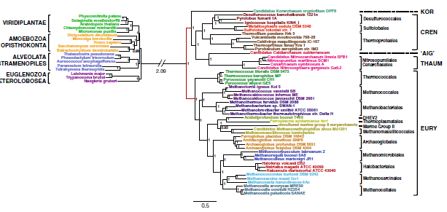
Improvements in phylogenetic analysis
Separately analyzing the markers
Raymann et. al, 2015, PNAS
Notes:
Separately analyzing the markers
This comes from the unique strategy mentioned in the Raymann paper that we kind of talked about last week during class
Examining all three domains at once is difficult because the number of markers are reduced and artifacts can be produced (Raymann paper)
Looking at eukaryotes/archaea and eukaryotes/bacteria allows to use more markers, better artifact detection, and uses a larger sampling (Raymann paper)
The figure just shows A/E supermatrix and there was a separate figure showing the A/B supermatrix but it didn’t fit nicely on the slide
Just showing how they did these separately
Just showing how they did both separately
Both Bayesian and unrooted

Slide 13
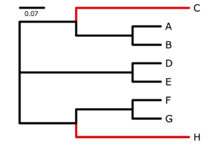
Improvements in phylogenetic analysis
Compositional heterogeneity
Given the limited manpower, machine power, and time, how do we optimize discovery of new analysis methods? With the limitations mentioned, is it in our best interest to redo old analyses from previous experiments or to use these news methods on new discoveries?
Wikipedia
Notes:
This figure shows something I found online explaining this concept
All of the branches in black were rich in AT while the ones in red were rich in GC but both C and H independent acquired the GC from the AT rich ancestor, so although it is tempting to put them together, doing this would be inaccurate
Something mentioned by the Williams paper
Certain methods such as the parsimony and distance methods assume constant homogeneity of bases and of evolutionary rates
This may cause issues because in may cause groups with similar base pairs to incorrectly clump together
Two newer studies used methods to correct for this and recovered the two domain tree
As technology continues to evolve, we are seeing some people redo old analyses methods but using different correction techniques and there are actually many examples of people doing this and recovering the two domain tree instead of the previously-recovered three domain tree
Basically, we can’t do it all because there are issues with machines not being able to run ever single possible combination and we have limited time and manpower to find new discoveries and also to run some of these analyses
Completely your own opinion- I don’t really have an answer for this either!

Slide 14
Room for improvement
Raymann et. al, 2015, PNAS
Notes:
Still need to discover more phyla and reexamine archaeal ancestor complexity
Address the bacterial vs. archaeal membrane issue
Some methods still give the three domain hypothesis, or are not statistically significant even if they conclude the two domain hypothesis
Return back to the picture showing the difference when fast evolving lineages are taken out
We can see what a difference something like this makes for our data and conclusions, so we must keep working towards resolving issues and improving our methods of analysis

Slide 15
Research: Three Domain Hypothesis

Slide 16
Pointers while searching for information
New discoveries
Genes with eukaryotic complexity
Improvements in phylogenetic analysis
Room for improvement

Slide 17
New discoveries
New discoveries
Have there been any new discoveries that support the three domain hypothesis as opposed to the two domain hypothesis?

Slide 18
Genes with eukaryotic complexity
Genes with eukaryotic complexity
Have any genes been discovered that contradict the theory that the eukaryotic archaeal common ancestor had eukaryotic complexity?
Also, think about counterarguments to the information presented earlier, such as the membrane argument in the Williams paper

Slide 19
Improvements in phylogenetic analysis
Improvements in phylogenetic analysis
Have analyses using the new phylogenetic analysis improvements resulted in the three domain tree instead of the two domain tree?
Also think about times when the two domain tree was generated but without statistical significance, as listed in the Williams paper

Slide 20
Room for improvement
Room for improvement
Are there any gaps or unresolved questions within the three domain hypothesis? What sort of data do we need to fill these gaps?
Notes:
Scroll back up to the beginning of this section while the people are presenting their findings!

Slide 21
Follow up Discussion: Two or Three Domains?
Notes:
Now if any of you have some super cool articles, be sure to forward them to me too, cause they actually might be useful in my paper!

Slide 22
Follow-up discussion: Two or three domains?
Keeping in mind the four categories- new discoveries, eukaryotic gene complexity, improvement in phylogenetic analysis, and room for improvement- which hypothesis are you more convinced by?
Notes:
Keeping in mind the four topics that we talked about, which are you more convinced by?

Slide 23
Looking to the Future

Slide 24
Looking to the Future
The three domain hypothesis is the one that is still used in textbook. If you to teach it, how would you teach it?
Will we ever be able to look at the fossil record without having to worry about contamination? Similarly, how could we continue to get rid of tree reconstruction issues caused by horizontal gene transfer?
How does the idea of endosymbiosis challenge our definition of “life”? How should it be incorporated into the tree of life?
Notes:
The last question is a Segway into what we will talk about in upcoming weeks, so keep this idea in mind while reading future articles!

Slide 25
Bibliography
Guy, Lionel, and Thijs J. G. Ettema. “The Archaeal ‘TACK’ Superphylum and the Origin of Eukaryotes.” Trends in Microbiology 19, no. 12 (December 1, 2011): 580–87. doi:10.1016/j.tim.2011.09.002.
Nunoura, Takuro, Yoshihiro Takaki, Jungo Kakuta, Shinro Nishi, Junichi Sugahara, Hiromi Kazama, Gab-Joo Chee, et al. “Insights into the Evolution of Archaea and Eukaryotic Protein Modifier Systems Revealed by the Genome of a Novel Archaeal Group.” Nucleic Acids Research 39, no. 8 (April 2011): 3204–23. doi:10.1093/nar/gkq1228.
Raymann, Kasie, Céline Brochier-Armanet, and Simonetta Gribaldo. “The Two-Domain Tree of Life Is Linked to a New Root for the Archaea.” Proceedings of the National Academy of Sciences of the United States of America 112, no. 21 (May 26, 2015): 6670–75. doi:10.1073/pnas.1420858112.
Spang, Anja, Jimmy H. Saw, Steffen L. Jørgensen, Katarzyna Zaremba-Niedzwiedzka, Joran Martijn, Anders E. Lind, Roel van Eijk, Christa Schleper, Lionel Guy, and Thijs J. G. Ettema. “Complex Archaea That Bridge the Gap between Prokaryotes and Eukaryotes.” Nature 521, no. 7551 (May 14, 2015): 173–79. doi:10.1038/nature14447.
Williams, Tom A., Peter G. Foster, Cymon J. Cox, and T. Martin Embley. “An Archaeal Origin of Eukaryotes Supports Only Two Primary Domains of Life.” Nature 504, no. 7479 (December 12, 2013): 231–36. doi:10.1038/nature12779.
Zaremba-Niedzwiedzka, Katarzyna, Eva F. Caceres, Jimmy H. Saw, Disa Bäckström, Lina Juzokaite, Emmelien Vancaester, Kiley W. Seitz, et al. “Asgard Archaea Illuminate the Origin of Eukaryotic Cellular Complexity.” Nature 541, no. 7637 (January 19, 2017): 353–58. doi:10.1038/nature21031.
Notes:
This also includes some extra sources from my paper, in case any of you want to check more things out about some of the things mentioned, like the discovery of Lokiarchaeota for example

