Slide 1
Announcements
Syllabus updated
Reminders
Send in your topic choices by Friday at 11:59pm
Top 3 choices
Your partner’s name OR whether you’d like to be paired by topic choice.
Class roster is now 15 not 16 –One person won’t have a partner, but only needs to do lead discussion for ½ the time (like everyone else), I’ll do the other ½.

Slide 2
Signs of life
The early Earth and first biosignatures

Slide 3
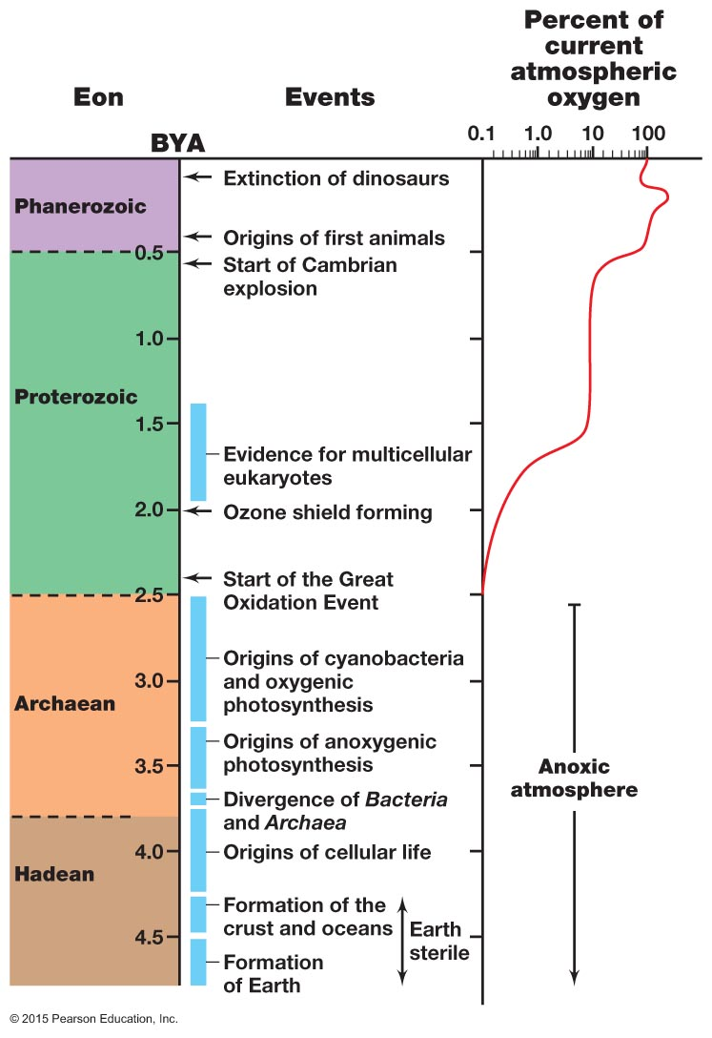
Origins: an overview & deep time
Diversification
Endosymbiosis
Oxygenation
Anaerobic life; mostly chemolithotrophic
Origin of earth
Brock Biology of Microorganisms, 15th ed
Notes:
What happened during the gap between earth’s formation and the origins of cellular life?

Slide 4
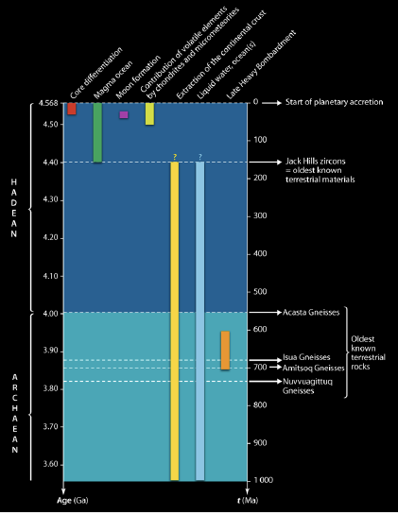
Summary of events in the formation of Earth (Hadean era)
Accretion
Separation of the iron core from the liquid mantle
(formation of magnetic poles – timing unclear, maybe 4.4 Ga)
Moon
Crust
Water oceans
Late Heavy Bombardment

Slide 5
How do we know about the early earth?
Radioisotope ratio dating
Meteorite analysis
Old rocks that remain relatively undisturbed by geological activity (Jack Hills zircons, Greenland gneisses, etc)
Zircons are the most reliable. They are very hard minerals, grow in layers like tree rings, and contain uranium, a radioactive mineral that is a highly accurate chronometer.
Still many parts of the Earth’s history are debated, unknown.

Slide 6
Origin of the earth vs origin of life: how do these fit on the deep timeline?
Earth is 4.5-4.6 Billion years old (BYA)
According to fossil evidence, life was estimated to begin 3.9-4 BYA (Gray et al., 2017).
What happened during those 0.5 BYA?
Violent early earth during the Hadean
Cooling and condensation of the oceans

Slide 7
Why is the Oparin paper important?
Oparin discusses :
how disproof of spontaneous generation led scientists to ask how life first originated if all extant life descended from other life. Provides a motivation for the entire Origins field.
Definition of life
Origin of the earth
First TESTABLE hypothesis about the origin of life.

Slide 8
Oparin’s ”surface origin” hypothesis
As the oceans formed, organic molecules had a place to aggregate to make more and more complex macromolecules
Eventually these molecules were encapsulated to make the first primordial cells
We can study living microorganisms to understand how the first cells formed.
Subsurface hydrothermal vents were not yet been discovered

