Slide 1
Universal Molecular Characteristics: Transcription
Mera Liccione Bio590S November 8, 2017

Slide 2
Overview
3⁰⁵ – 3²⁰: Review Key Topics
Transcription Mechanisms
Transcription Regulation
Elongation First Hypothesis
Other RNA polymerases
3²⁰ – 3⁴⁵: Journal Club of Smollett Paper
3⁴⁵ – 4¹⁵: Research discussion questions
4¹⁵ – 4³⁰: Discuss Findings
4³⁰ – 5¹⁰: “Elevator-Pitch R21” Activity

Slide 3
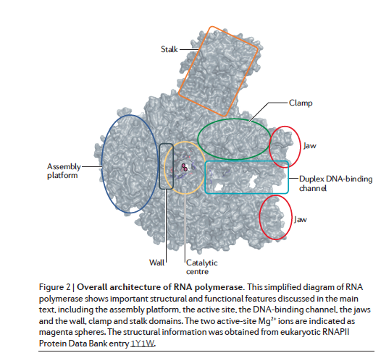
Core of Transcription

Slide 4
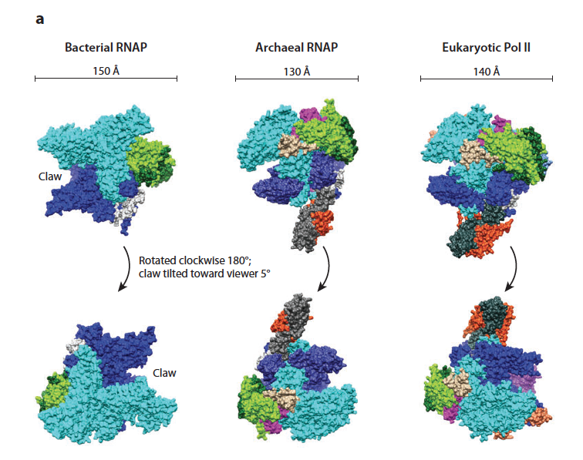
Core of Transcription
Hinton (2013) Annual Rev Microbiol 67:113-39

Slide 5
Conserved Mechanism

Slide 6
Key Differences
RNA Pol
σ
A
R
Bacteria
TTGACA
TATAAT
-35
-10
+1
RNA Pol
A
TBP
TFB
Archaea
R
TTTA(A/T)A
+1
-30
RNA Pol
TBP
TFIIB
Eukarya
TATA
+1
-30
Hinton (2013) Annual Rev Microbiol 67:113-39

Slide 7
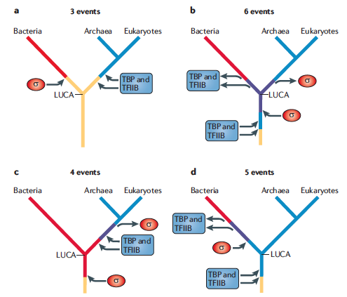
Elongation First Hypothesis
What’s there? What isn’t?
Conserved transcription factors
Spt5-SPT5-NusG Family
Absence of homologues
Sigma factors
TBP/TFIIB
Number of evolutionary events
Significance of Elongation

Slide 8
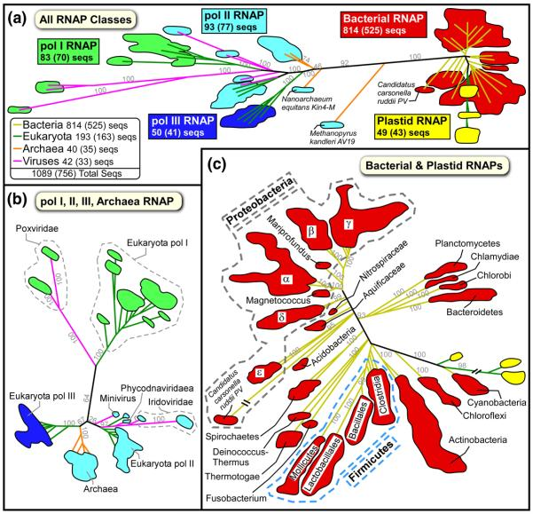
Other RNAPs
“Right handed” RNA polymerases
RNA-dependent RNA polymerases
Viral DNA-dependent DNA polymerases

Slide 9
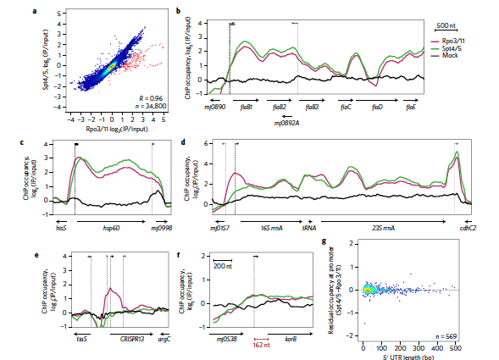
Smollett’s Work

Slide 10
Evaluating Smollett’s Methods
What is it? How does it work? What does it tell us?
What are the strengths of or advantages to using the technique?
What are the weaknesses or disadvantages to using the technique?
Evaluate the use of it in Smollett (2017)
ChIP Seq
Alignment Motifs
Pairwise Genome-wide Correlation

Slide 11
Discussion Questions
What does the current data (since 2011) say about the validity of the elongation-first hypothesis? Does it corroborate or challenge it?
What is known about “simple” eukaryotes, such as protists, regarding their transcription machinery? How do these mechanisms fit in with what we know about other transcription mechanism, and what could it tell us about the machinery of LUCA?
What influence, if any, does analysis of transcription machinery data exert on the three versus two domain tree argument?
What is known about non-canonical RNAPs and how does that data fit in to the evolutionary history of transcription?

Slide 12
The Elevator Pitch R21

Slide 13
Critical Anatomy of an R21
Specific Aims
Research Strategy
Significance
Innovation
Approach

Slide 14
Your challenge!
From your discussion question, identify a gap in the current literature
What do we not know?
Formulate a research question and hypothesis
Select one aim
What’s one piece of the puzzle you can solve with an experiment/analysis?
Describe your methods and rationale
What do we think? What do we know? What can we prove?

