Slide 1
Introduction to statistical methods and regression

Slide 2
The plan
Summary statistics and T-testing
“I collected all this data, how do I summarize my measurements”
“How do I know data from group A and group B are really different”
Regression
“How can I think about the process underlying my data using math”

Slide 3
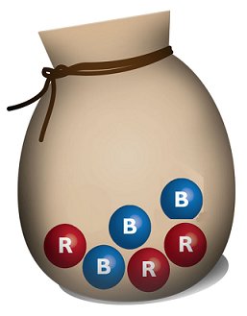
Probability versus statistics
Probability:
Given the underlying model, lets predict the future!
“What is the chance of pulling a blue ball?”
“What is the chance of pulling 3 red balls and no blue?”

Slide 4
Probability versus statistics
Probability:
Given the underlying model, lets predict the future!
“What is the chance of pulling a blue ball?”
“What is the chance of pulling 3 red balls and no blue?”
Statistics:
Given some data, lets recreate the underlying model!
“If we sample 11 blue and 9 red balls with replacement”
“What is the likely ratio of balls in the bag?”
“How confident are we in our prediction (model)?”
“If we sample from 10 more bags from the bag factory, what can we say about the population of all bags?”

Slide 5


The sample versus the population
We can’t study the whole population, so we take a sample and apply what we learn to the whole population.
What could go wrong here?

Slide 6
Lets collect a dataset!

Slide 7
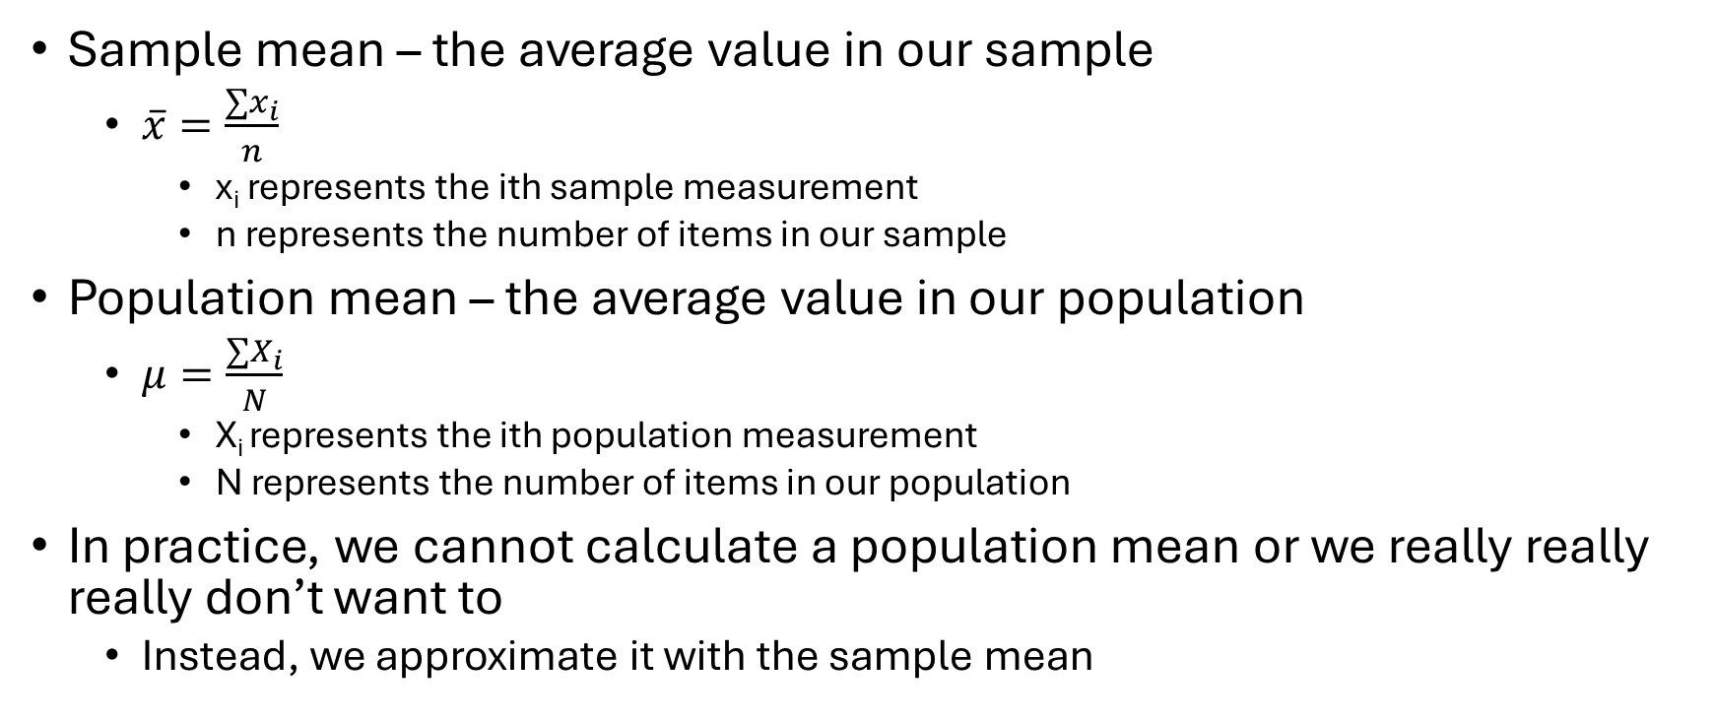
Summary statistics - Mean
Sample mean – the average value in our sample
$\overline{x}=\frac{∑x_{i}}{n}$
x_{i} represents the ith sample measurement
n represents the number of items in our sample
Population mean – the average value in our population
$μ=\frac{∑X_{i}}{N}$
X_{i} represents the ith population measurement
N represents the number of items in our population
In practice, we cannot calculate a population mean or we really really really don’t want to
Instead, we approximate it with the sample mean

Slide 8
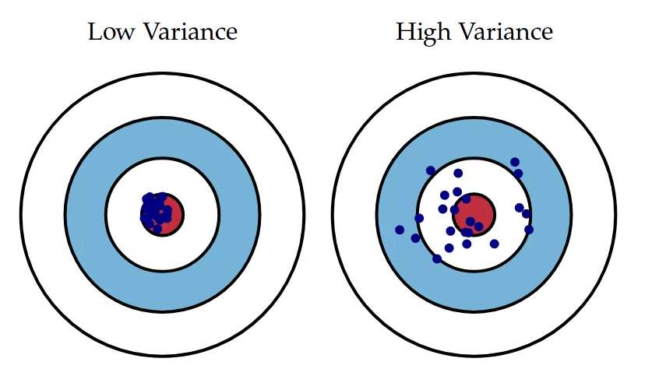
Summary statistics – Standard Deviation and Variance
Measures of central tendency
“How far from the mean do samples tend to fall”
Important for understanding
The variability we expect to see in repeated samples and the population
Why?
How well does our sample mean approximates the population mean
Variance and SD measure the same thing, SD is just the square root of variance

Slide 9
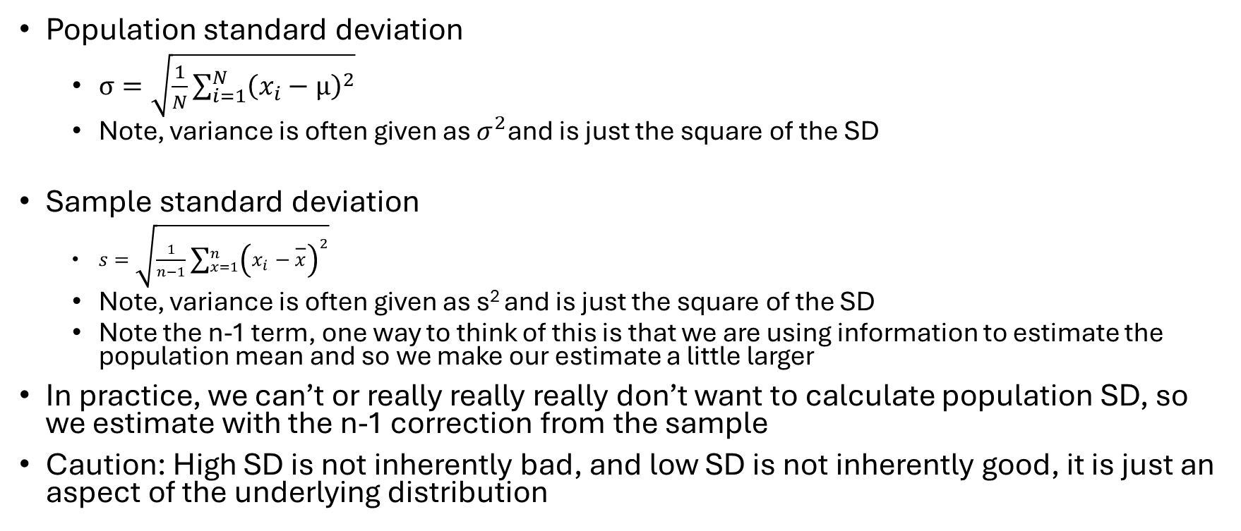
Summary statistics – Standard Deviation
Population standard deviation
$σ=\sqrt{\frac{1}{N}\sum_{i=1}^{N}{{\left(x_{i}−μ\right)}^{2}}}$
Note, variance is often given as $σ^{2}$and is just the square of the SD
Sample standard deviation
$s=\sqrt{\frac{1}{n−1}\sum_{x=1}^{n}{{\left(x_{i}−\overline{x}\right)}^{2}}}$
Note, variance is often given as s² and is just the square of the SD
Note the n-1 term, one way to think of this is that we are using information to estimate the population mean and so we make our estimate a little larger
In practice, we can’t or really really really don’t want to calculate population SD, so we estimate with the n-1 correction from the sample
Caution: High SD is not inherently bad, and low SD is not inherently good, it is just an aspect of the underlying distribution

Slide 10
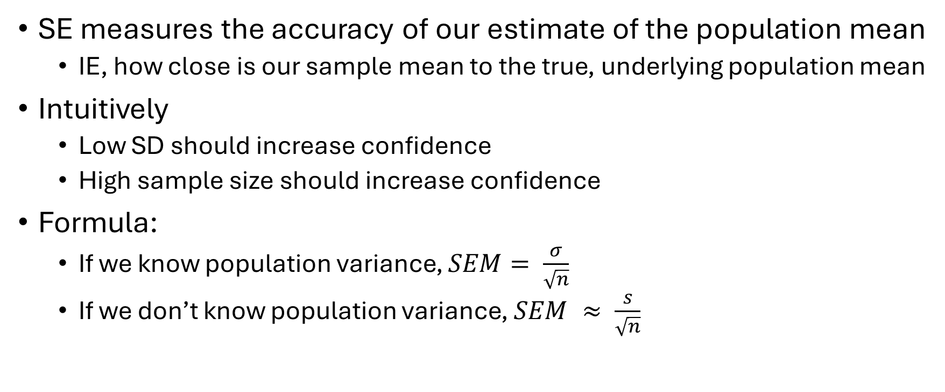
Summary statistics – Standard Error (of the mean)
SE measures the accuracy of our estimate of the population mean
IE, how close is our sample mean to the true, underlying population mean
Intuitively
Low SD should increase confidence
High sample size should increase confidence
Formula:
If we know population variance, $SEM= \frac{σ}{\sqrt{n}}$
If we don’t know population variance, $SEM ≈ \frac{s}{\sqrt{n}}$

Slide 11
Standard Error technical details
Consider our measurement experiment:
Lets say we want to know about the population of NCSSM students and we do not want to sample every student
Each of our two groups is an independent (?) sample of the population
Each group produces a sample mean
Lets now say we take more samples, each with their own sample mean
Given some mild conditions, the central limit theorem tells us that these sample means follow a normal distribution
Mean = population mean
SD = SE
Essentially, SE estimates how distant our sample mean is from the true mean
Here, lower is better!

Slide 12
T-tests
AKA, how do I know that 2 groups are mathematically different?
How do I know that the differences I’m observing are (likely) not due to noise
First lets test your intuition, consider the following scenario
2 groups
10 individuals in each group
All individuals measured identically, same method etc.

Slide 13
Question 1
Group 1 mean = 5.5
Group 2 mean = 6.5
Are these groups different?
Group 1 mean = 5.5
Group 2 mean = 600.5
Are these groups different?

Slide 14
Question 2
Group 1 mean = 5.5
Group 2 mean = 6.5
Population SD = .05
Group 1 mean = 5.5
Group 2 mean = 600.5
Population SD = 1000

Slide 15
Question 3
Group 1 mean = 5.5
Group 2 mean = 6.5
Population SD = 1
Group 1 mean = 5.5
Group 2 mean = 600.5
Population SD = 150

Slide 16
T-tests and hypothesis testing
Lets try and formalize our question a bit
Null Hypothesis:
The default, boring, status quo
How we expect the world would be if we had no data to tell us otherwise
H_{o} : There is no difference between population A and B
Alternative hypothesis:
The exciting possibility that breaks our assumption
A change in our views that requires proof, negation of H_{o}
H_{A}: There is a difference between population A and B
Given information about the mean AND spread of our data, do we have enough data to reject the null hypothesis

Slide 17
T-Test intuition
Assume each of our samples is normally distributed
Then, the difference between group A and B follows a T-distribution centered at 0
Basically normal, but fatter tails and a nastier equation
Given our distribution, calculate the probability of obtaining a value AT LEAST as extreme as what we did
This is our p-value
If our p-value is smaller than some threshold (traditionally .05), we reject H_{o} and accept H_{A}
Otherwise, we fail to reject H_{o}
We do NOT reject H_{A}

Slide 18
T-Test in practice
We can calculate these by hand, typically with a table in a textbook
You probably have or will have to in a class
In practice, we plug these into a computer and have it do the calculation for us, lets take a look in R

Slide 19
T-test assumptions
The observations in each sample must be normally distributed
The variance in each group is identical
Every sample is independent
A t-test will NOT work for all data, but it will work for most
You can always run one, no one will stop you. It’s up to you as a researcher to decide whether your test is valid
Assumption 1 we can check with a qq-plot, is a bit fudgable in most cases
Assumption 2 we generally ignore and do a slight variation of the test that relaxes this constraint at the cost of power
Assumption 3 is critical and needs to be baked into your experimental design

Slide 20
Regression
Generally: Linking a set of independent variables to a dependent variable through a mathematical equation
Tangentially: Learning the values of the those parameters given observed data to better understand and think about our observed data.

Slide 21
Example: Linear Regression
Equation: Y = mX + b
Outcome value Y is equal to parameter m times input variable X, plus parameter b
We first need to estimate the parameter values given X,Y data
Then, if we want, we can predict new values of Y given only X data
Parameter
Dependent variable
Independent variable
Parameter
Notes:
Draw some examples on the board

Slide 22
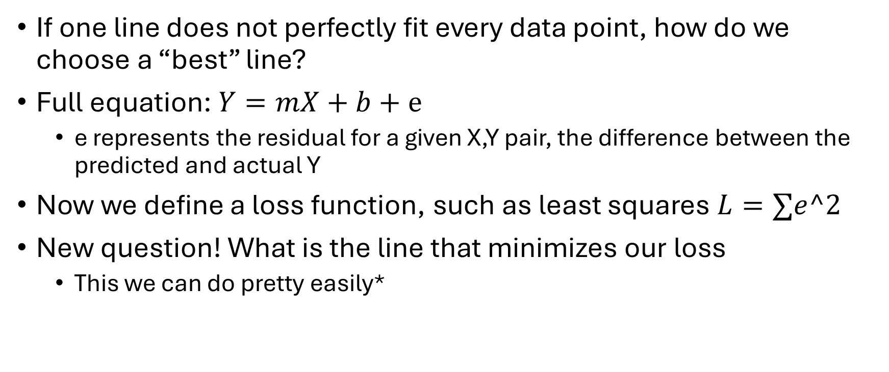
Linear Regression technical details
If one line does not perfectly fit every data point, how do we choose a “best” line?
Full equation: $Y=mX+b+e$
e represents the residual for a given X,Y pair, the difference between the predicted and actual Y
Now we define a loss function, such as least squares $L=∑e^2$
New question! What is the line that minimizes our loss
This we can do pretty easily*

Slide 23
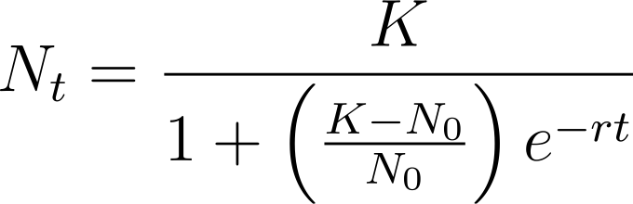
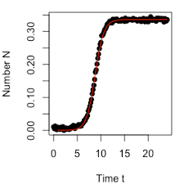
Logistic Regression – An equation to fit a growth curve
t = time
N_{t} = observed growth at time t
K = carrying capacity
N_{o} = initial growth
r = growth rate
AUC (area under curve): a single number
summarizing growth quality in a condition

Slide 24
Your job: R analysis
Steps:
Clean your data, remove anything that looks obviously bad that you can justify
Normalize your data to the level of your blanks
These machines are noisy! But consistently noisy
Initial data exploration and a principal component analysis
Plotting raw data and figure making
Logistic regression using growthcurver package
Plotting fitted models, calculating AUC and more figure making
T-tests between groups using AUC

