Slide 1
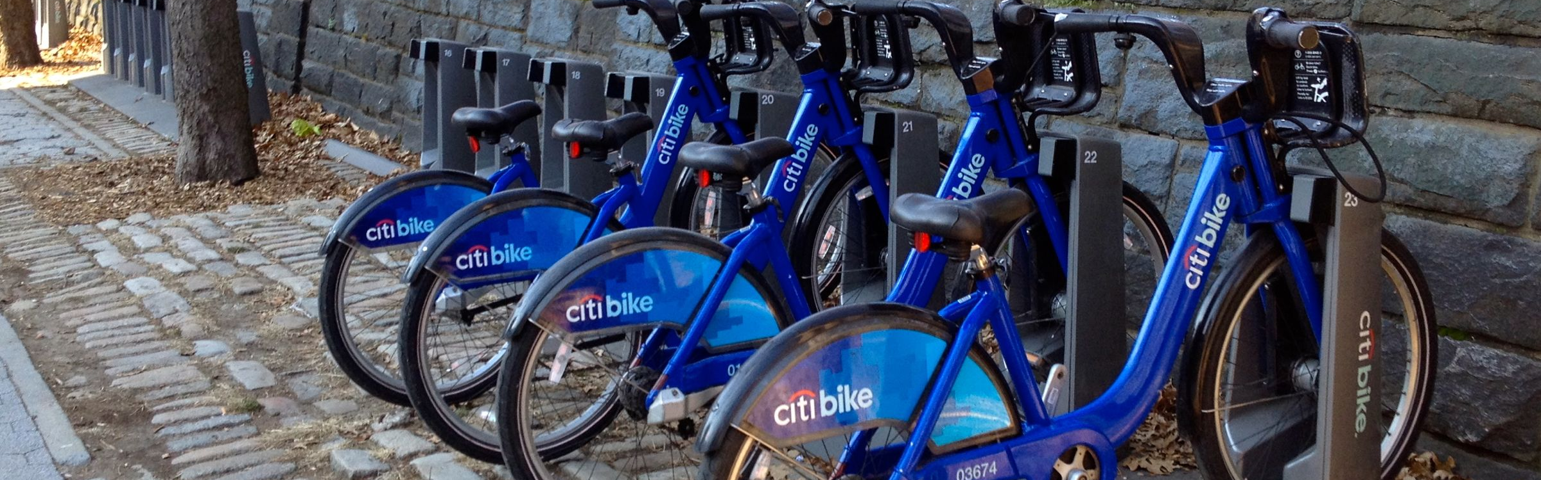
Next best spot?
Prediction of Bike share usage in NYC based on census data
Type to enter a caption.

Slide 2
Citi bike share is the nations largest bike share program
Background on Citi Bike share
12,000 bikes and 750 stations within Manhattan, Brooklyn, Queens and Jersey City.
Designed for quick, convenient , and affordable trips
Have Annual Member or Day Passes
One year of bike share is cheaper than two monthly subway passes
Can be more convenient than owning your own bike (no locks, no storage needed)

Slide 3
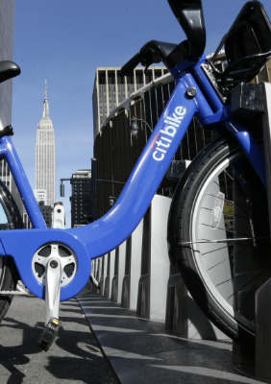
Scope
Text
Analyze bike usage in the five boroughs based off of census data
Using NY Census Data predict the next best spot to place a bike share station.
Linear Regression, Random Forest Regression, Gradient Boosting Regressor, PLSRegression

Slide 4
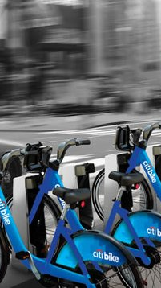
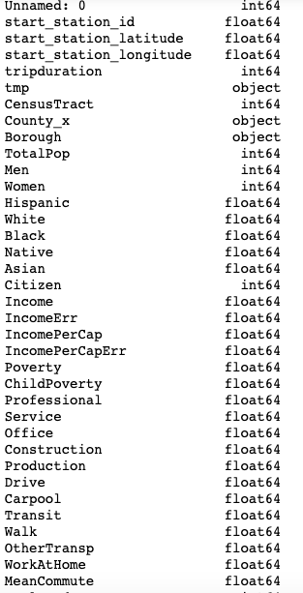
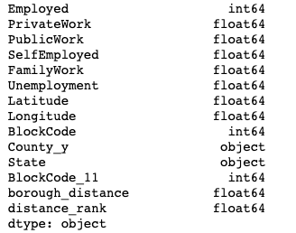
DATA:
Two Datasets
Merged:
Data Set 1: from Kaggle-https://www.kaggle.com/muonneutrino/new-york-city-census-data
Data Set 2:from Citi Bike Share- https://www.citibikenyc.com/system-data

Slide 5
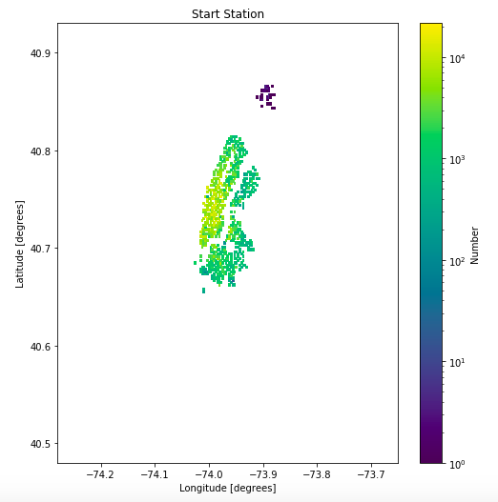
Start Share Stations- Map of NYC
Text
Type to enter a caption.

Slide 6
Text

