Slide 1

Customer Personality Analysis
Presented by:
Kalyani Ambulkar, Brian Frank, Sandra Joseph, Amelia Mazer, Shaheen Nazar

Slide 2
Agenda
Overview of Dataset
Clean-Up Techniques
Interesting Finding #1
Interesting Finding #2
Interesting Finding #3
Questions?

Slide 3
Overview of Dataset

Slide 4
Customer Personality Analysis Dataset by Akash Patel
Customer Personality Analysis Dataset by Akash Patel
https://www.kaggle.com/imakash3011/customer-personality-analysis
Customer Personality Analysis is a detailed analysis of a company’s ideal customers.
Benefits:
Helps a business to better understand its customers
Makes it easier for them to modify products according to the specific needs, behaviors and concerns of different types of customers.
Notes:
Customer personality analysis helps a business to modify its product based on its target customers from different types of customer segments. For example, instead of spending money to market a new product to every customer in the company’s database, a company can analyze which customer segment is most likely to buy the product and then market the product only on that particular segment.

Slide 5
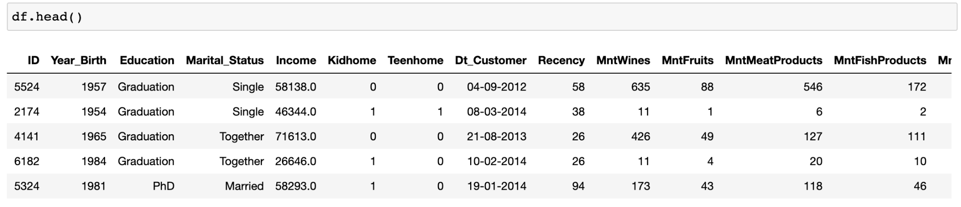
Dataset

Slide 6
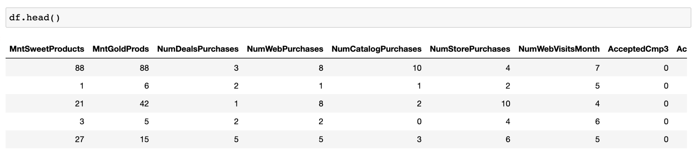
Dataset

Slide 7
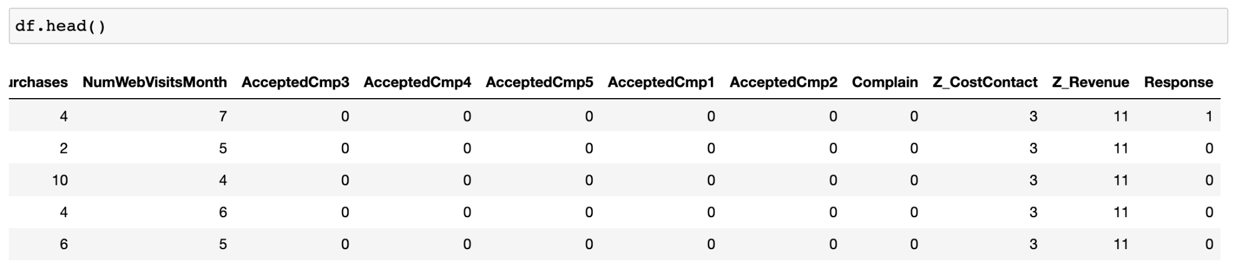
Dataset

Slide 8
Clean-Up Techniques

Slide 9
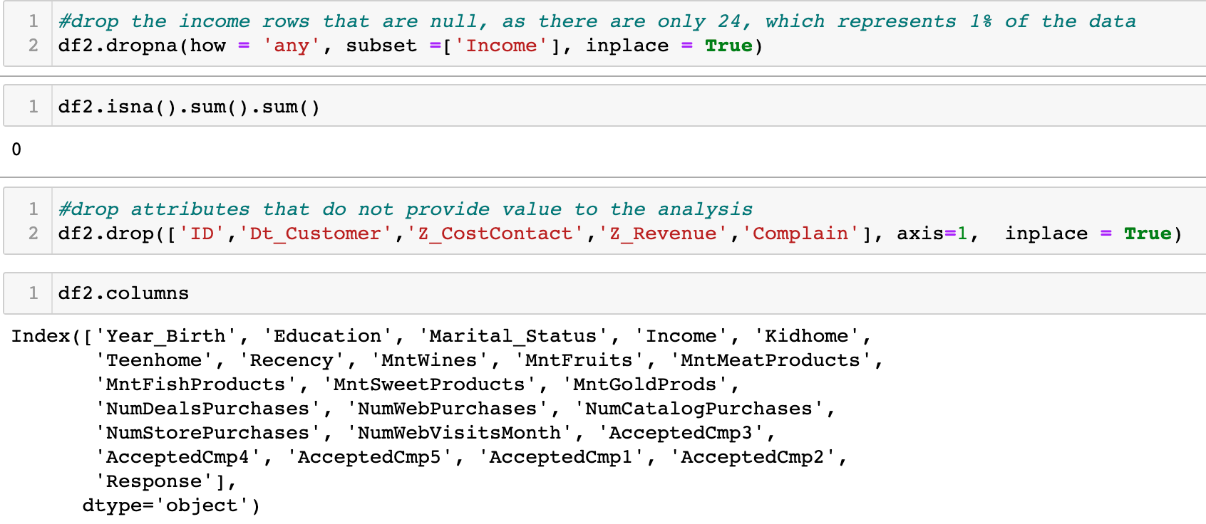
Drop Columns and Rows

Slide 10
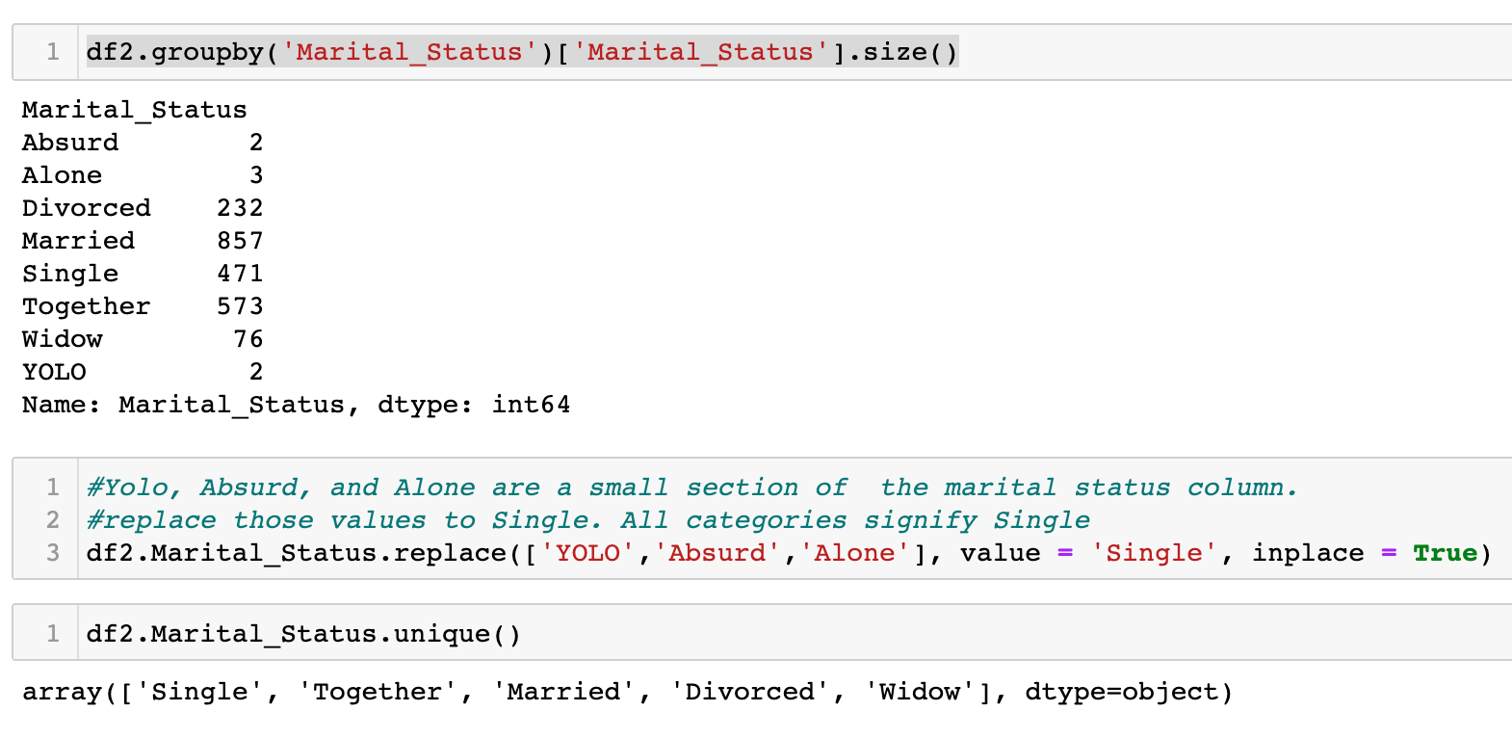
Replace Values

Slide 11
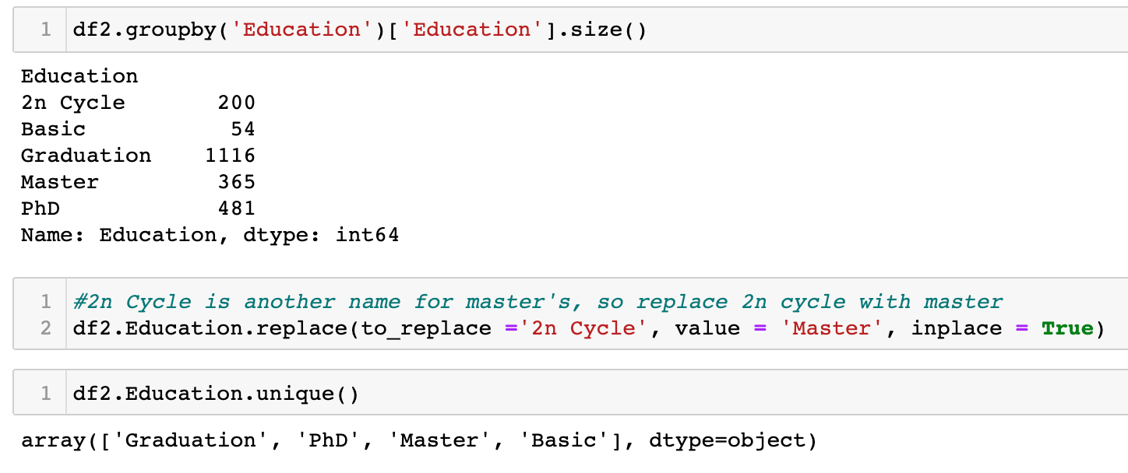
Replace Values Continued

Slide 12
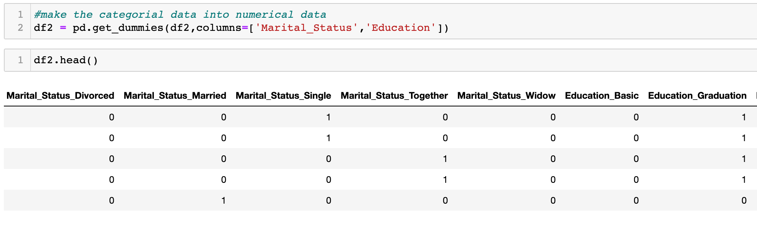
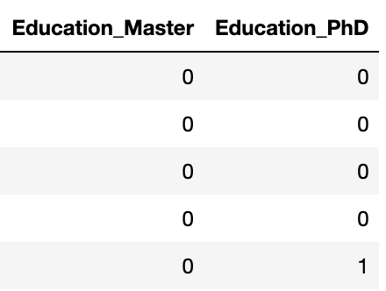
Use get_dummies

Slide 13
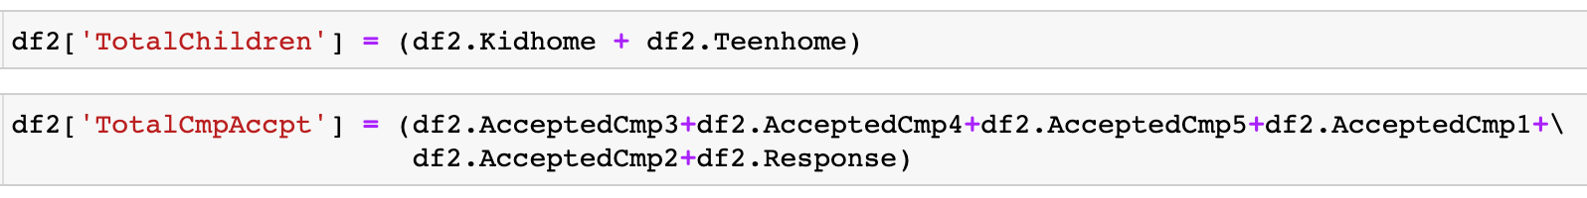
Add Calculated Columns

Slide 14
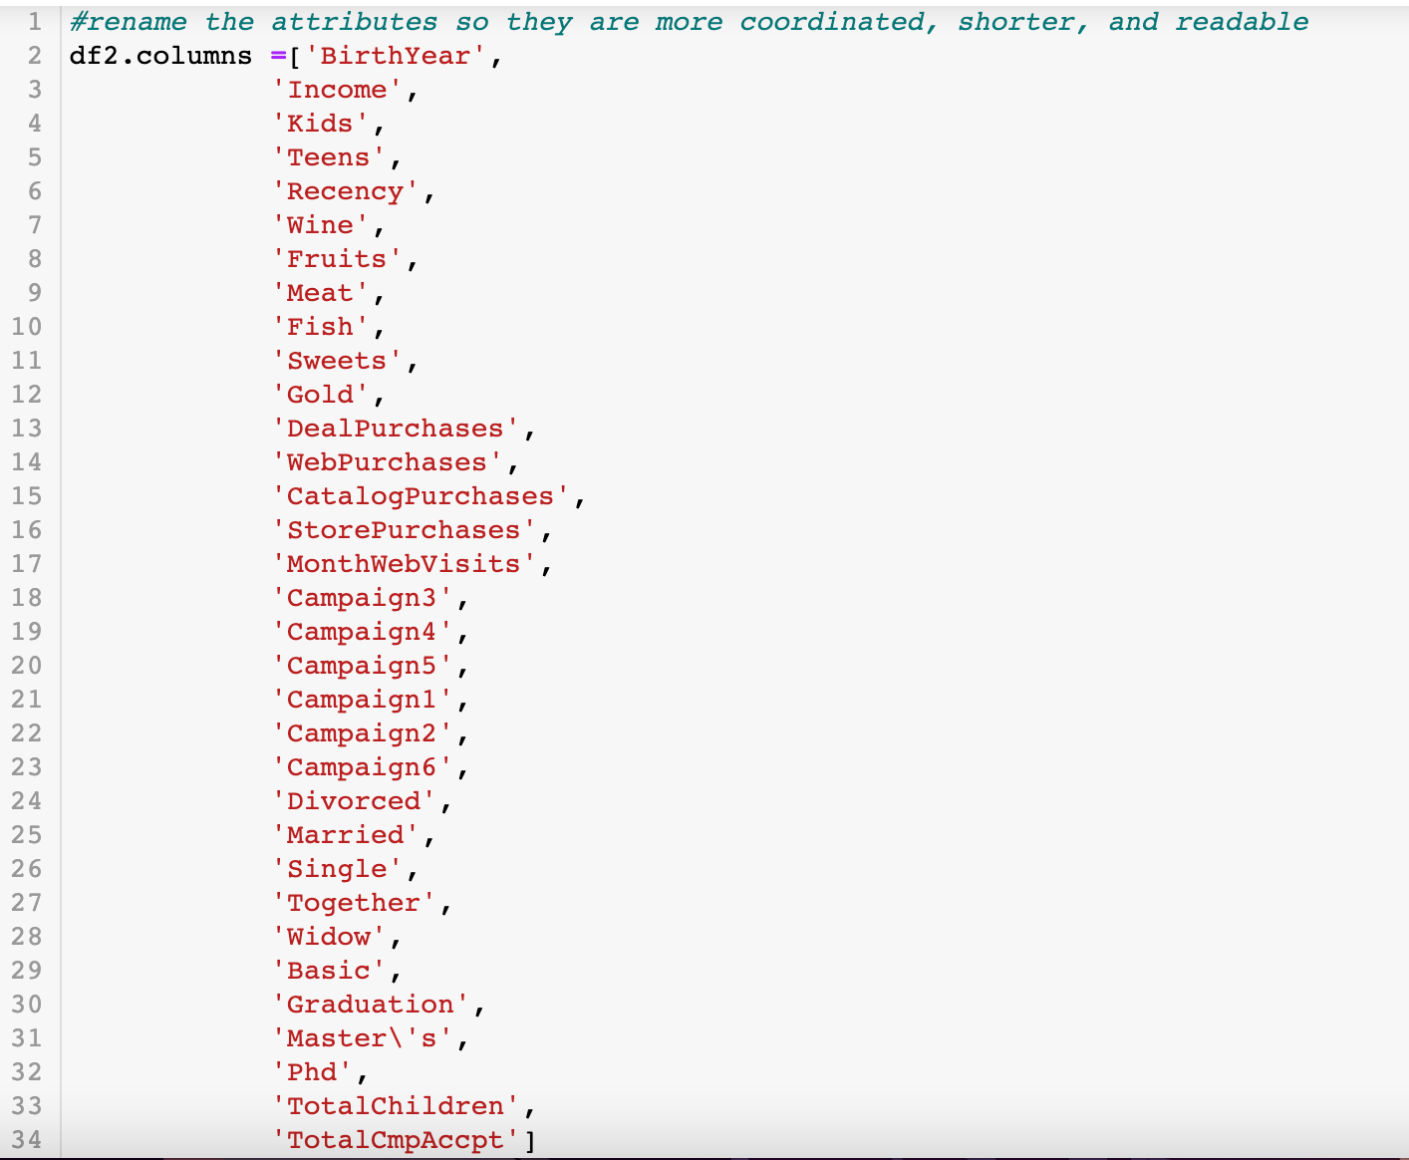
Change Column Names

Slide 15
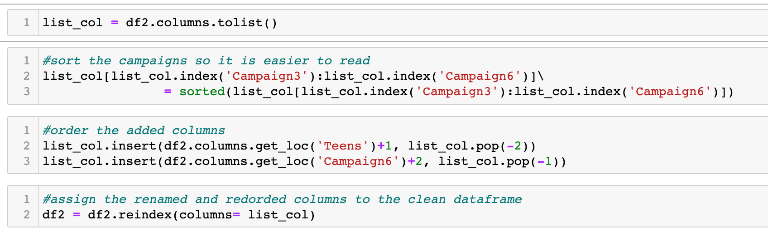
Sort Columns

Slide 16
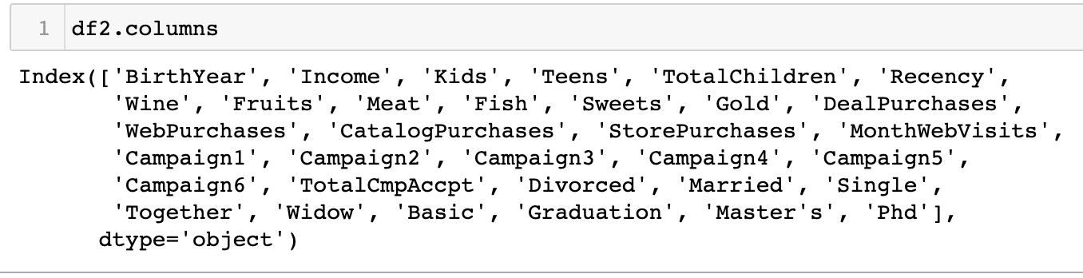
Sorted Columns

Slide 17
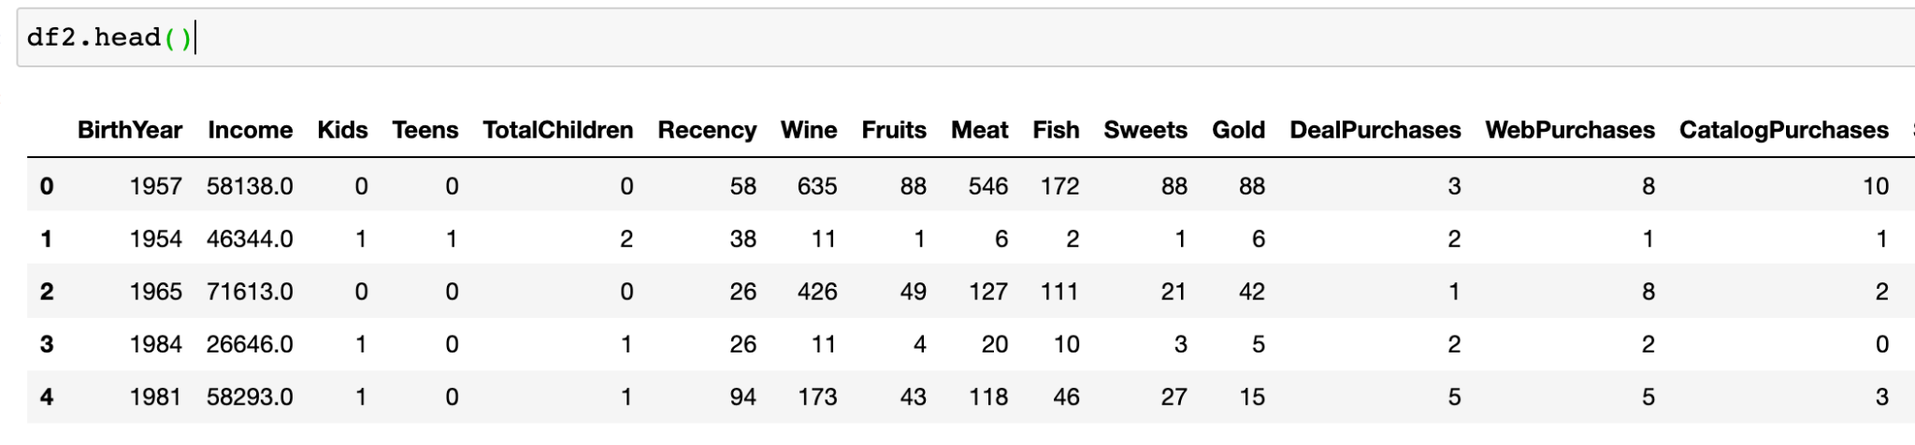
Cleaned Data

Slide 18
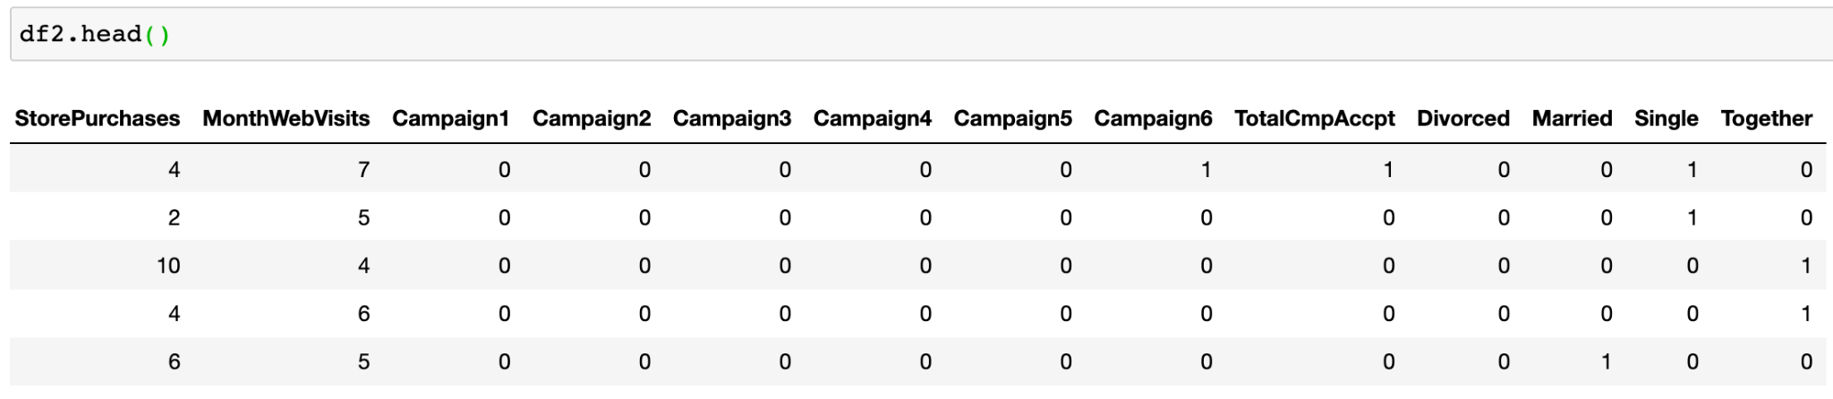
Cleaned Data

Slide 19
Interesting Finding 1
Sweets and Children Correlation

Slide 20
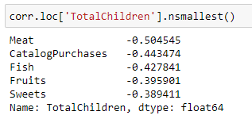
Negative Correlation between Children and Sweets
A negative correlation was found between the amount of sweets purchased and the total number of children. While it wasn’t the highest inverse relationship, it seemed unusual.

Slide 21
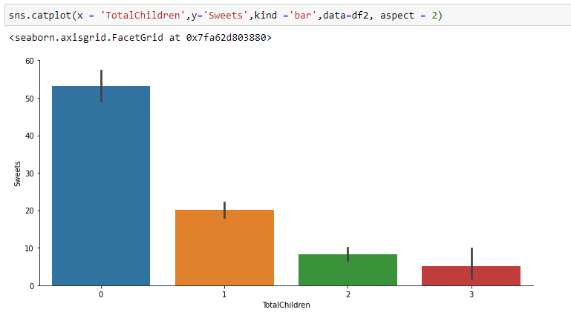
Plotting the Data
By graphing the relationship, it is clear that the more children you have the less you spend on sweets.

Slide 22
Interesting Finding 1 - Managerial Insight
71.44% of customers have at least one child.
To encourage these customers to buy more of sweets products, a discount on sweets can be given to these customers.
At the same time, offering more child-oriented sweets may also increase the sale of sweets to this demographic.
Another option to entice customers with children would be to provide other items besides sweets that parents and children would prefer.
Notes:
Offer products to replace sweets that are targeted towards customers with children

Slide 23
Interesting Finding 2
The Relationship between Monthly Web Visits,
Web Store Purchases, and Income

Slide 24
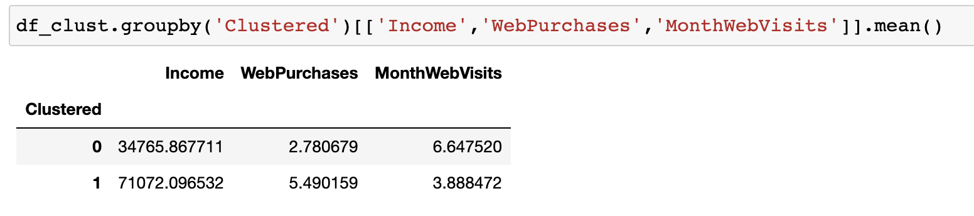
Clustering
Clustering showed that lower income was linked to lower web purchases and higher monthly web visits while higher income had the reverse relationship.

Slide 25
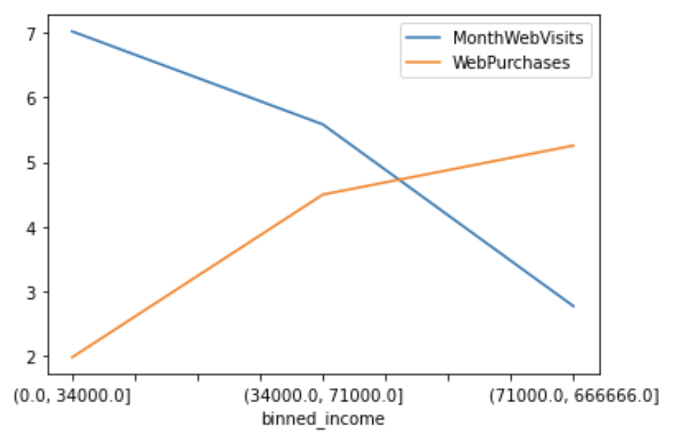
Plotting the Data
After binning income based on the clusters, the graph shows that the number of monthly web visits decreases with income range while the number of purchases increases.

Slide 26
Interesting Finding 2 - Managerial Insight
In order to increase the purchase rate of lower income customers, they should be targeted with online discounts after they have visited the website 3 times in one month.
Notes:
3 times in one month was chosen because that is the average number of web visits for a person in the highest income bracket.

Slide 27
Interesting Finding 3
Classify who has accepted a previous campaign
Notes:
Our dataset had lots of information about who accepted previous campaigns.
For our 3rd interesting finding, we wanted to classify who these customers were.

Slide 28
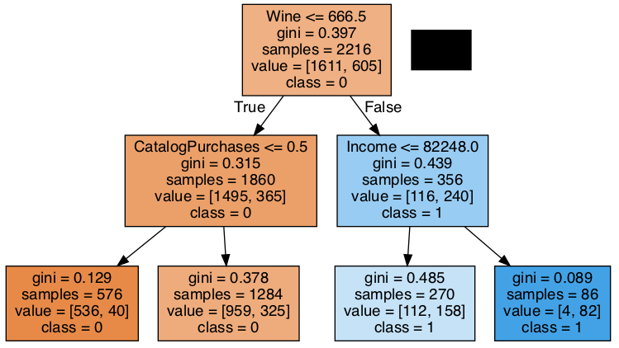
Decision Tree
A decision tree was used to find the attributes linked to those who had accepted a previous campaign.
Notes:
As you can see, the right side of the tree, going from Wine to Income, is what lead to the class 1 outcomes.

Slide 29
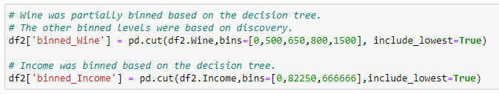
Binning Wine and Income
Wine and Income were binned, partially based on the decision tree and partially through discovery.

Slide 30
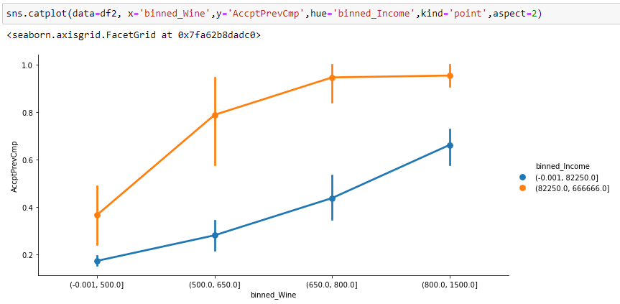
Plotting the Data
The plotted data shows a clear distinction.
Notes:
Once we plotted the data, it clearly showed that higher income customers, which is the orange line, were more likely to accept a campaign, especially those who had purchased more wine.

Slide 31
Interesting Finding 3 - Managerial Insight
In order to reduce campaign marketing costs and increase campaign participation rates, the next campaign should be targeted at those who have income over $82,250 and have purchased at least $500 in wine.
Another option would be to create an elite club for the customers who have purchased at least $500 in wine and target them with specific campaigns dedicated to high-end wine.
Notes:
Create an elite group to purchase wine: target them in a campaign

Slide 32
Conclusion
Customers with children need more encouragement to purchase sweets
Lower income customers visit the website more often but purchase from the website less, while higher income customers do the opposite
Higher income customers who purchased more wine are more likely to accept marketing campaigns
Notes:
In conclusion, our first finding showed that…
Our second finding showed that…
And our third finding showed that…

Slide 33
Questions?
Presented by:
Kalyani Ambulkar, Brian Frank, Sandra Joseph, Amelia Mazer, Shaheen Nazar
Notes:
Thank you for your attention and we hope you’ve enjoyed our Customer Personality Analysis.

