Slide 1
Detecting natural selection from genomic data
Matteo Fumagalli
2019

Slide 2
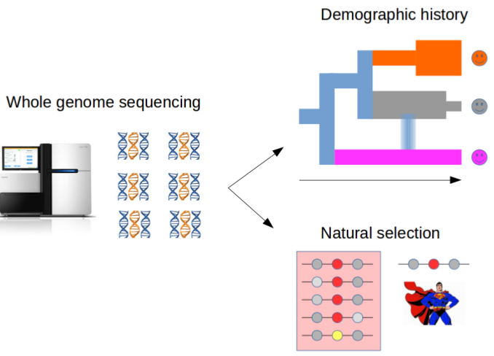
Motivation
Notes:
I am a computational biologist interested in developing methods for the analysis of DNA data for population genetic purposes, both for reconstructing the species demography and for detecting signatures of natural selection.

Slide 3
Natural selection
Heritable traits that increase the fitness of the become more common.
Mutations arise randomly and evolve according to their effect on the fitness of the carrier
Neutrality
1
(slow) Fixation
Frequency in the population
Polymorphism
0
t=T
(slow?) Removal
t=present
Time
Notes:
Yes, but lines are built up step by step
So a strategy to understand molecular basis of adaptation is to look for sign of selection

Slide 4

Natural selection
Heritable traits that increase the fitness of the become more common.
Mutations arise randomly and evolve according to their effect on the fitness of the carrier
Negative selection
1
Frequency in the population
0
t=T
(quick) Removal
t=present
Time
Notes:
Yes, but lines are built up step by step
So a strategy to understand molecular basis of adaptation is to look for sign of selection

Slide 5

Natural selection
Heritable traits that increase the fitness of the become more common.
Mutations arise randomly and evolve according to their effect on the fitness of the carrier
Positive selection
t=Selective pressure
1
(quick) Fixation
Frequency in the population
0
t=T
t=present
Time
Notes:
Yes, but lines are built up step by step
So a strategy to understand molecular basis of adaptation is to look for sign of selection

Slide 6

Natural selection
Heritable traits that increase the fitness of the become more common.
Mutations arise randomly and evolve according to their effect on the fitness of the carrier
Balancing selection
t=Selective pressure
1
Frequency in the population
Balanced
polymorphism
0
t=T
t=present
Time
Notes:
Yes, but lines are built up step by step
So a strategy to understand molecular basis of adaptation is to look for sign of selection

Slide 7
Natural selection
Heritable traits that increase the fitness of the become more common.
Mutations arise randomly and evolve according to their effect on the fitness of the carrier
Sites targeted by natural selection are likely to harbour functionality
Natural selection
t=Selective pressure
1
(quick) Fixation
Frequency in the population
Balanced
polymorphism
Polymorphism
0
t=T
(quick) Removal
t=present
Time
Notes:
Yes, but lines are built up step by step
So a strategy to understand molecular basis of adaptation is to look for sign of selection

Slide 8
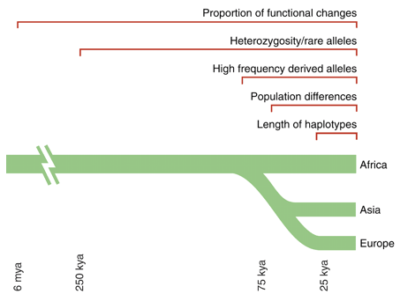
Methods to infer recent selection
Sabeti et al. 2006 Science

Slide 9
Methods to infer recent selection
Sabeti et al. 2006 Science

Slide 10
Allele frequency differentiation
Time
Present time

Slide 11
Allele frequency differentiation
Time
Separation
Environmental change
Present time

Slide 12
Allele frequency differentiation
Time
Separation
Environmental change
Onset of beneficial
mutation
Present time

Slide 13
Allele frequency differentiation
Time
Separation
Environmental change
Onset of beneficial
mutation
Present time

Slide 14
Allele frequency differentiation
Time
Separation
Environmental change
Onset of beneficial
mutation
Present time
Notes:
How can we quantify this?

Slide 15
F_{ST}
Common measure for quantifying population subdivision.
H_{B}: between populations
H_{W}: average within populations
if H_{W} << H_{B}0 then F_{ST}~1
if H_{B}=0 then F_{ST}=0
F_{ST} = H_{B} / (H_{W} + H_{B})

Slide 16
Haplotype-based F_{ST}
F_{ST} based on haplotype differentiation between populations
F_{ST} = 1 – (H_{W} / H_{B})
A
B
C
Within populations
Between populations
What is the variation within populations?
e.g. A vs B
The differ by 1 site
D
E
F
As defined by Eq. 3 in Hudson, Slatkin and Maddison 1992
Notes:
Here develop our own estimator based on haplo differences

Slide 17
Haplotype-based F_{ST}
F_{ST} = 1 – (H_{W} / H_{B})
A
B
C
Within populations
Between populations
What is the variation within populations?
A | B
A | C
B | C
Mean=?
D
E
F
D | E
D | F
E | F
Mean=?
H_{W} is the average within-populations: ?
Notes:
Here develop our own estimator based on haplo differences

Slide 18
Haplotype-based F_{ST}
F_{ST} = 1 – (H_{W} / H_{B})
A
B
C
Within populations
Between populations
What is the variation within populations?
A | B | 1
A | C | 2
B | C | 1
Mean=4/3
D
E
F
D | E | 0
D | F | 0
E | F | 0
Mean=0/3
H_{W} is the average within-populations: (4/3+0/3)/2=2/3
Notes:
Here develop our own estimator based on haplo differences

Slide 19
Haplotype-based F_{ST}
F_{ST} = 1 – (H_{W} / H_{B})
Within populations
Between populations
A
B
C
What is the variation between populations?
A | D | 0
A | E | 0
A | F | 0
B | D | 1
B | E | 1
B | F | 1
C | D | 2
C | E | 2
C | F | 2
D
E
F
Mean=9/9
H_{B} is the average between-populations: 9/9=1
Notes:
Here develop our own estimator based on haplo differences

Slide 20
Haplotype-based F_{ST}
F_{ST} based on haplotype differentiation between populations
A
B
C
F_{ST} = 1 – (H_{W} / H_{B}) = 1 – ((2/3)/1) = 1/3 ~ 0.33
D
E
F
Notes:
Here develop our own estimator based on haplo differences

Slide 21
Allele frequency differentiation
From standing variation
Difference in
allele frequency
Time

Slide 22
Allele frequency differentiation
With migration
Difference in
allele frequency
Time

Slide 23
Allele frequency differentiation
With recent divergence
Difference in
allele frequency
Time

Slide 24


Population genetic differentiation
T
C
F_{ST}(T-C)

Slide 25
Population genetic differentiation
T
C
T(T-A)
T(C-A)
A
F_{ST}(T-C)~T(T-A-C)

Slide 26
Population genetic differentiation
F_{ST}(T-C)~T(T-A-C)
?
T
C
T(T-A)
T(C-A)
C
T
T(T-A)
T(C-A)
A
A

Slide 27

Population genetic differentiation
T
C
T(T-A)
A
T(C-A)
T(E-A)
E

Slide 28
Population genetic differentiation
T
C
T(T-A)
A
T(C-A)
T(T-A-C)=-log(1-F_{ST}(T-C))
T(E-A)
E
T(T-A)?

Slide 29
Population genetic differentiation
T
C
T(T-A)
A
T(C-A)
T(T-A-C)=-log(1-F_{ST}(T-C))
T(E-A)
E
T(T-A) = (T(T-E)+T(C-T)-T(C-E))/2

Slide 30
Inference of positive selection
How can we calculate these summary statistics from low-depth sequencing data?

Slide 31
Methods to infer selection
Sabeti et al. 2006 Science

Slide 32
Positive selection: effect on haplotypes
t<T_{sel}
Notes:
Under neutrality, each haplotype will accumulate it own mutations

Slide 33
Positive selection: effect on haplotypes
t<T_{sel}
t=T_{sel}
Notes:
Under neutrality, each haplotype will accumulate it own mutations

Slide 34
Positive selection: effect on haplotypes
t<T_{sel}
t=T_{sel}
t>T_{sel}
Notes:
Under neutrality, each haplotype will accumulate it own mutations

Slide 35


Positive selection: effect on haplotypes
t<T_{sel}
t=T_{sel}
t>T_{sel}
t>>T_{sel}
Selective sweep
Genetic hitch-hiking
Adaptation
Notes:
Selective sweep: the beneficial allele is driven to fixation
Partial sweep: when the beneficial allele hasn’t reached fixation yet.

Slide 36
Positive selection
t<T_{sel}
…
t>>T_{sel}
?
Notes:
Reduced number of polymorphisms, but need to derive some indexes of nucleotide diversity taking into account the sample size for instance

Slide 37
Positive selection
t<T_{sel}
…
t>>T_{sel}
- Reduction of polymorphisms levels
(e.g. from 7 to 5 SNPs)
Notes:
Reduced number of polymorphisms, but need to derive some indexes of nucleotide diversity taking into account the sample size for instance

Slide 38

Positive selection
t<T_{sel}
…
t>>T_{sel}
- Reduction of polymorphisms levels
(e.g. from 7 to 5 SNPs)
Nucleotide diversity index: Watterson’s Theta
with K SNPs and n chromosomes
Notes:
Under neutrality, each haplotype will accumulate it own mutations

Slide 39
Positive selection
t<T_{sel}
…
t>>T_{sel}
Reduction of polymorphisms levels (Theta)
?
Notes:
Not only the number of SNPs but their frequency as well

Slide 40

Positive selection
t<T_{sel}
…
t>>T_{sel}
Reduction of polymorphisms levels (Theta)
Excess of low-frequency variants
Nucleotide diversity index: average pairwise nucleotide differences (Pi)
with k_{i,j} equal to the number of nucleotide differences between sequences i and j
Notes:
Not only the number of SNPs but their frequency as well

Slide 41

Positive selection
t<T_{sel}
…
t>>T_{sel}
Reduction of polymorphisms levels (Theta)
Excess of low-frequency variants (Pi)
Under neutrality, Theta and Pi are expected to be the same.
Tajima’s D measures their difference.
D<0 is suggestive of an excess of low-frequency variants
Notes:
Not only the number of SNPs but their frequency as well

Slide 42
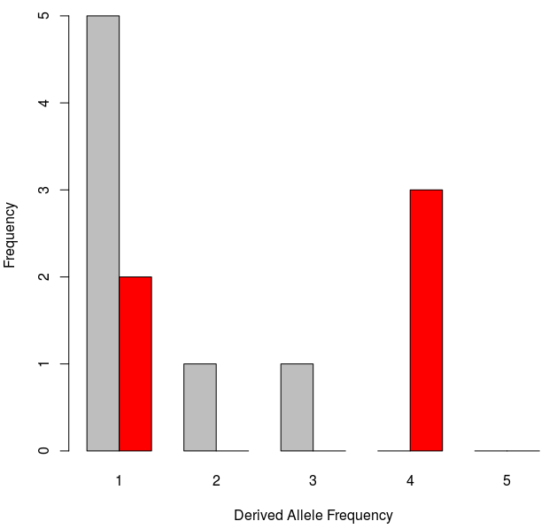
The Site Frequency Spectrum
t<T_{sel}
…
t>>T_{sel}
Notes:
Show the site frequency spectrum here for these cases

Slide 43
The Site Frequency Spectrum
t<T_{sel}
…
t>>T_{sel}
Tajima’s D?
~0.33=1/3
= 10, the number of comparisons you need to make
Notes:
Show the site frequency spectrum here for these cases

Slide 44
The importance of being…
The Site Frequency Spectrum
t<T_{sel}
…
t>>T_{sel}
K=5
a_{n}=1/1 + 1/2 + 1/3 + 1/4=(12+6+4+3)/12=25/12
Theta=5/(25/12)=12/5
Pi=(5+5+5+5+0+0+0+0+0+0)/10=20/10=2
sd(D)=1/3
D=(2-12/5)/(1/3)=((10-12)/5)*3=-6/5=-1.2
D<0
Notes:
Show the site frequency spectrum here for these cases

Slide 45
Inference of positive selection
How can we calculate these summary statistics from low-depth sequencing data?

Slide 46
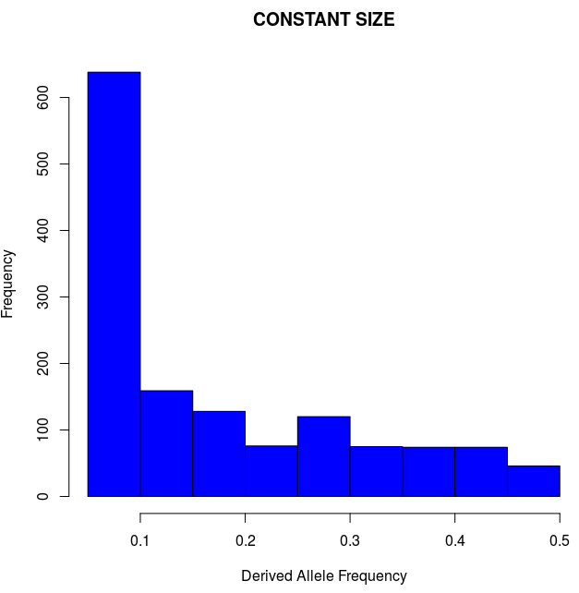
Confounding factor
n=20; L=500kbp; no selection
K=1,390
Theta=392
Pi=390
D=-0.016
Minor Allele Frequency
Notes:
Here run some simulations assuming expansion (Africans?)… and show tajima’s D negative.
Draw together some conclusions on the effect of pop size expansion?
Then introduce 2 ways of correcting for this, empirical and simulations
Then show what D>0 means? Balancing selection and introduce it.

Slide 47
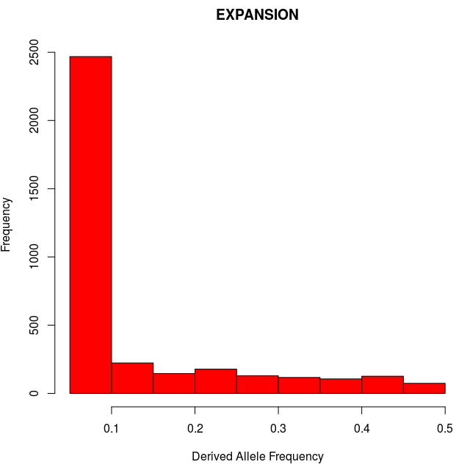
Confounding factor
n=20; L=500kbp; no selection
n=20; L=500kbp; no selection
K=1,390
Theta=392
Pi=390
D=-0.016
K=3,566
Theta=1,005
Pi=732
D=-1.14
Minor Allele Frequency
Minor Allele Frequency
Notes:
Here run some simulations assuming expansion (Africans?)… and show tajima’s D negative.
Draw together some conclusions on the effect of pop size expansion?
Then introduce 2 ways of correcting for this, empirical and simulations
Then show what D>0 means? Balancing selection and introduce it.

Slide 48
Demography matters!
n=20; L=500kbp; no selection
n=20; L=500kbp; no selection
K=1,390
Theta=392
Pi=390
D=-0.016
K=3,566
Theta=1,005
Pi=732
D=-1.14
Minor Allele Frequency
Minor Allele Frequency
Excess of segregating sites
Excess of low-frequency variants
SFS-derived summary statistics may fail to distinguish between the effects of demography and selection
Notes:
Here run some simulations assuming expansion (Africans?)… and show tajima’s D negative.
Draw together some conclusions on the effect of pop size expansion?
Then introduce 2 ways of correcting for this, empirical and simulations
Then show what D>0 means? Balancing selection and introduce it.

Slide 49
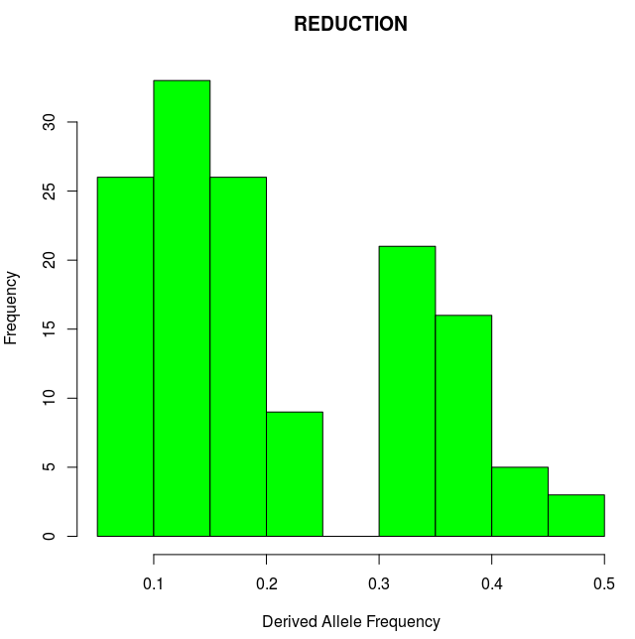
Demography matters?
n=20; L=500kbp; no selection
n=20; L=500kbp; no selection
K=1,390
Theta=392
Pi=390
D=-0.016
K=139
Theta=39
Pi=47
D=0.83
Minor Allele Frequency
Minor Allele Frequency
Notes:
Here run some simulations assuming expansion (Africans?)… and show tajima’s D negative.
Draw together some conclusions on the effect of pop size expansion?
Then introduce 2 ways of correcting for this, empirical and simulations
Then show what D>0 means? Balancing selection and introduce it.

Slide 50
Demography matters!
n=20; L=500kbp; no selection
n=20; L=500kbp; no selection
K=1,390
Theta=392
Pi=390
D=-0.016
K=139
Theta=39
Pi=47
D=0.83
Minor Allele Frequency
Minor Allele Frequency
Depletion of segregating sites
Excess of intermediate-frequency variants
SFS-derived summary statistics may fail to distinguish between the effects of demography and selection
Notes:
Here run some simulations assuming expansion (Africans?)… and show tajima’s D negative.
Draw together some conclusions on the effect of pop size expansion?
Then introduce 2 ways of correcting for this, empirical and simulations
Then show what D>0 means? Balancing selection and introduce it.

Slide 51
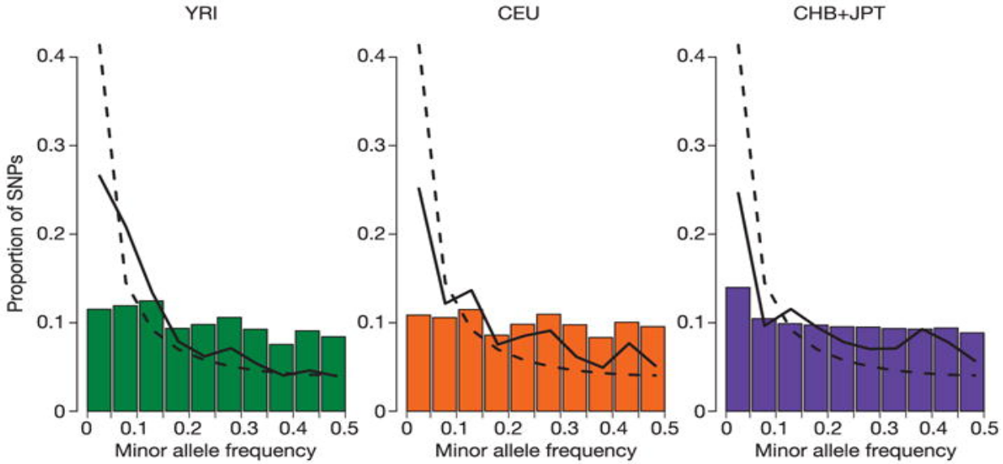
Experimental design matters?
The effect of ascertainment bias
Deficiency of low-frequency variants
HapMap Consortium. Nature 2005
Notes:
Another bias that may mimic balancing selection (mention also ancient pop structure)

Slide 52
How to take neutral confounding factors into account?
Under constant population size:
Tajima’s D
2
.
.
.
.
.
.
.
.
.
.
.
.
.
.
.
E[D]~0
0
-2
Genome / Chromosome
Notes:
Here run some simulations assuming expansion (Africans?)… and show tajima’s D negative.
Draw together some conclusions on the effect of pop size expansion?
Then introduce 2 ways of correcting for this, empirical and simulations
Then show what D>0 means? Balancing selection and introduce it.

Slide 53
How to take neutral confounding factors into account?
Under expanding population size:
Tajima’s D
2
0
.
.
.
.
.
.
.
.
.
.
.
.
.
.
.
E[D]<0
-2
Genome / Chromosome
Notes:
Here run some simulations assuming expansion (Africans?)… and show tajima’s D negative.
Draw together some conclusions on the effect of pop size expansion?
Then introduce 2 ways of correcting for this, empirical and simulations
Then show what D>0 means? Balancing selection and introduce it.

Slide 54
How to take neutral confounding factors into account?
Under expanding population size and positive selection:
Tajima’s D
2
0
.
.
.
.
.
.
.
.
.
.
.
.
.
.
E[D]<0
.
-2
Genome / Chromosome
Demography affects all loci equally, while selection changes local patterns
Notes:
Here run some simulations assuming expansion (Africans?)… and show tajima’s D negative.
Draw together some conclusions on the effect of pop size expansion?
Then introduce 2 ways of correcting for this, empirical and simulations
Then show what D>0 means? Balancing selection and introduce it.

Slide 55
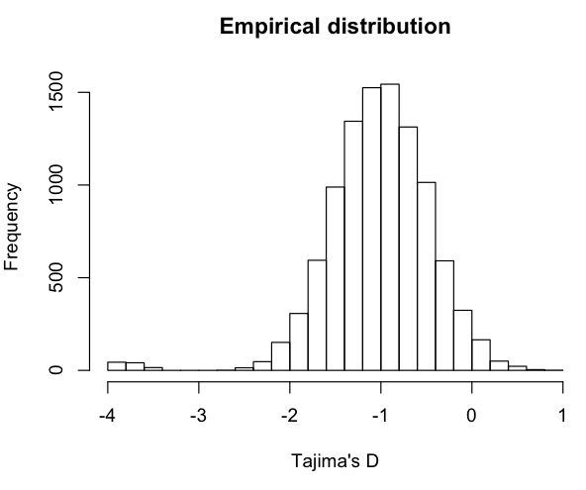
Outlier approach
Tajima’s D
2
0
.
.
.
.
.
.
.
.
.
.
.
.
.
.
E[D]<0
.
-2
Genome / Chromosome
Assign empirical p-values
(ranked percentiles)
Notes:
Here run some simulations assuming expansion (Africans?)… and show tajima’s D negative.
Draw together some conclusions on the effect of pop size expansion?
Then introduce 2 ways of correcting for this, empirical and simulations
Then show what D>0 means? Balancing selection and introduce it.

Slide 56
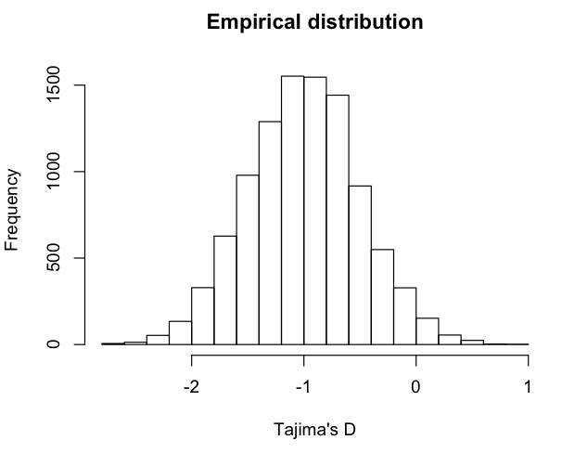
Outlier approach
Tajima’s D
2
0
.
.
.
.
.
.
.
.
.
.
.
.
.
.
E[D]<0
.
-2
Genome / Chromosome
?
Assign empirical p-values
(ranked percentiles)
Notes:
Gene ontology or pathway enrichment analyses, you will always get some outliers
An alternative is to use a demographic model

Slide 57
How to take neutral confounding factors into account?
Under expanding population size and positive selection:
Tajima’s D
2
But we know what’s driving the expected distribution
0
E[D]<0
.
-2
Genome / Chromosome
Demography affects all loci equally, while selection changes local patterns
What should we do if we don’t have genome-wide data?
Notes:
Here run some simulations assuming expansion (Africans?)… and show tajima’s D negative.
Draw together some conclusions on the effect of pop size expansion?
Then introduce 2 ways of correcting for this, empirical and simulations
Then show what D>0 means? Balancing selection and introduce it.

Slide 58
Simulations-based approach
Tajima’s D
2
0
E[D]<0
.
-2
Genome / Chromosome
Known demographic model
N0
T
N1
N1
Notes:
Here run some simulations assuming expansion (Africans?)… and show tajima’s D negative.
Draw together some conclusions on the effect of pop size expansion?
Then introduce 2 ways of correcting for this, empirical and simulations
Then show what D>0 means? Balancing selection and introduce it.

Slide 59
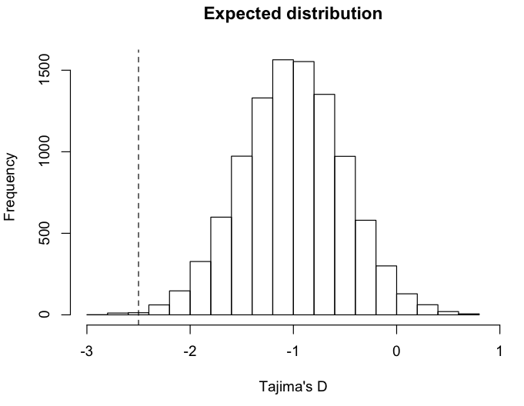
Simulations-based approach
Tajima’s D
2
0
E[D]<0
.
-2
Assign p-values
(based on ranked percentile of observed value)
Genome / Chromosome
Known demographic model
N0
T
N1
N1
Let’s assess statistical significance for our test of selection on EDAR.
Notes:
Here run some simulations assuming expansion (Africans?)… and show tajima’s D negative.
Draw together some conclusions on the effect of pop size expansion?
Then introduce 2 ways of correcting for this, empirical and simulations
Then show what D>0 means? Balancing selection and introduce it.

Slide 60
Positive selection
t<T_{sel}
…
t>>T_{sel}
Reduction of polymorphisms levels (Theta)
Excess of low-frequency variants (Pi, Tajima’s D, SFS)
?
Notes:
Not only the number of SNPs but their frequency as well
LD-based approaches:
identifying variants under partial or incomplete selective sweep
EHH from a core allele to a specified distance
EHH decreases with distance by the action of recombination

Slide 61
Positive selection
t<T_{sel}
…
t>>T_{sel}
Reduction of polymorphisms levels (Theta)
Excess of low-frequency variants (Pi, Tajima’s D, SFS)
Extended haplotype homozygosity / Extended LD
Notes:
How can we quantify such extension of haplotype homozygosity?

Slide 62
Extended Haplotype Homozygosity
t>>T_{sel}
…
t>>>T_{sel}
…
Notes:
In practise it is more complicated due to mutation….

Slide 63
Extended Haplotype Homozygosity
t>>T_{sel}
…
t>>>T_{sel}
…
t>>>T_{sel}
Notes:
…and recombination.
For instance, if just looking at Theta W we might get the same value as for neutrality (6 SNPs)

Slide 64

Extended Haplotype Homozygosity
1
1
1
1
1
0
Core haplotype is 1
(Biallelic: 0 is ancestral, 1 is derived allele)
Core SNP
Notes:
…and recombination.
For instance, if just looking at Theta W we might get the same value as for neutrality (6 SNPs)

Slide 65
Extended Haplotype Homozygosity
1
1
1
1
1
0
Core haplotype is 1
(Biallelic: 0 is ancestral, 1 is derived allele)
Until marker x_{i}
(starting from x₀)
Notes:
…and recombination.
For instance, if just looking at Theta W we might get the same value as for neutrality (6 SNPs)

Slide 66
Extended Haplotype Homozygosity
1
1
1
1
1
0
Core haplotype is 1
(Biallelic: 0 is ancestral, 1 is derived allele)
Sum across all unique haplotypes carrying the core SNP
Notes:
…and recombination.
For instance, if just looking at Theta W we might get the same value as for neutrality (6 SNPs)

Slide 67

Extended Haplotype Homozygosity
1
1
1
1
1
0
Core haplotype is 1
(Biallelic: 0 is ancestral, 1 is derived allele)
n_{h} is haplotype frequency of h
n_{h} is haplotype frequency of the core SNP
Sum across all unique haplotypes carrying the core SNP
Notes:
…and recombination.
For instance, if just looking at Theta W we might get the same value as for neutrality (6 SNPs)

Slide 68
Extended Haplotype Homozygosity
1
1
1
1
1
0
Core haplotype is 1
(Biallelic: 0 is ancestral, 1 is derived allele)
n_{h} is haplotype frequency of h
n_{h} is haplotype frequency of the core SNP
Sum across all unique haplotypes carrying the core SNP
Notes:
…and recombination.
For instance, if just looking at Theta W we might get the same value as for neutrality (6 SNPs)

Slide 69

Extended Haplotype Homozygosity
1
1
1
1
1
0
Core haplotype is 1
(Biallelic: 0 is ancestral, 1 is derived allele)
n_{h} is haplotype frequency of h
n_{c} is haplotype frequency of the core SNP
Sum across all unique haplotypes carrying the core SNP
Notes:
…and recombination.
For instance, if just looking at Theta W we might get the same value as for neutrality (6 SNPs)

Slide 70
Extended Haplotype Homozygosity
1
1
1
1
1
1
1
1
1
0
0
0
x=0
x=+1
1
0
How many unique haplotypes carrying the core SNP?
What is their frequency?
Notes:
…and recombination.
For instance, if just looking at Theta W we might get the same value as for neutrality (6 SNPs)

Slide 71

Extended Haplotype Homozygosity
1
1
1
1
1
1
1
1
1
0
0
0
x=0
x=+1
1
0
Notes:
…and recombination.
For instance, if just looking at Theta W we might get the same value as for neutrality (6 SNPs)

Slide 72
Extended Haplotype Homozygosity
1
1
1
1
1
1
1
1
1
1
1
1
1
0
0
0
0
0
x=0
x=+1
x=+2
1
0
Notes:
…and recombination.
For instance, if just looking at Theta W we might get the same value as for neutrality (6 SNPs)

Slide 73
Extended Haplotype Homozygosity
1
1
1
1
1
1
1
1
1
1
1
1
1
0
0
0
0
0
x=0
x=+1
x=+2
1
0
Notes:
…and recombination.
For instance, if just looking at Theta W we might get the same value as for neutrality (6 SNPs)

Slide 74
Extended Haplotype Homozygosity
1
1
1
1
1
1
1
0
1
1
1
0
1
1
1
1
1
0
0
0
0
0
0
0
x=0
x=+1
x=+2
x=+3
1
0
How many unique haplotypes carrying the core SNP?
What is their frequency?
Notes:
…and recombination.
For instance, if just looking at Theta W we might get the same value as for neutrality (6 SNPs)

Slide 75
Extended Haplotype Homozygosity
1
1
1
1
1
1
1
0
1
1
1
0
1
1
1
1
1
0
0
0
0
0
0
0
x=0
x=+1
x=+2
x=+3
1
0
How many unique haplotypes carrying the core SNP?
What is their frequency?
1111 with freq=2
1110 with freq=2
1000 with freq=1
Notes:
…and recombination.
For instance, if just looking at Theta W we might get the same value as for neutrality (6 SNPs)

Slide 76

Extended Haplotype Homozygosity
1
1
1
1
1
1
1
0
1
1
1
0
1
1
1
1
1
0
0
0
0
0
0
0
x=0
x=+1
x=+2
x=+3
1
0
How many unique haplotypes carrying the core SNP?
What is their frequency?
1111 with freq=2
1110 with freq=2
1000 with freq=1
Notes:
…and recombination.
For instance, if just looking at Theta W we might get the same value as for neutrality (6 SNPs)

Slide 77

Extended Haplotype Homozygosity
1
1
1
1
1
1
0
0
1
1
1
0
0
1
1
1
1
0
1
1
1
1
1
1
1
0
1
0
0
0
0
1
0
0
0
0
x=-2
x=-1
x=0
x=+1
x=+2
x=+3
n | n choose 2
1 | 0
2 | 1
3 | 3
4 | 6
5 | 10
6 | 15
1
0
Comment on differences (if any) between EHH(x=+2) and EHH(x=-2).
Notes:
…and recombination.
For instance, if just looking at Theta W we might get the same value as for neutrality (6 SNPs)

Slide 78
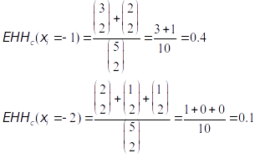
Extended Haplotype Homozygosity
1
1
1
1
1
1
0
0
1
1
1
0
0
1
1
1
1
0
1
1
1
1
1
1
1
0
1
0
0
0
0
1
0
0
0
0
x=-2
x=-1
x=0
x=+1
x=+2
x=+3
n | n choose 2
1 | 0
2 | 1
3 | 3
4 | 6
5 | 10
6 | 15
1
0
+ (1 choose 2)
Comment on differences (if any) between EHH(x=+2) and EHH(x=-2)?
Notes:
Rather than actual values of EHH, the decay (against physical of genetic map) is the important feature

Slide 79
Integrated Haplotype Score
1
1
1
1
1
1
0
0
1
1
1
0
0
1
1
1
1
0
1
1
1
1
1
1
1
0
1
0
0
0
0
1
0
0
0
0
x=-2
x=-1
x=0
x=+1
x=+2
x=+3
1
For the derived allele
0
cM
1
For the ancestral allele
0
cM
Notes:
Rather than actual values of EHH, the decay (against physical of genetic map) is the important feature

Slide 80
Integrated Haplotype Score
1
1
1
1
1
1
0
0
1
1
1
0
0
1
1
1
1
0
1
1
1
1
1
1
1
0
1
0
0
0
0
1
0
0
0
0
x=-2
x=-1
x=0
x=+1
x=+2
x=+3
1
iHH₁
Integrated haplotype homozygosity (iHH)
0
cM
1
iHH₀
0
cM
Notes:
Rather than actual values of EHH, the decay (against physical of genetic map) is the important feature
iHS compares the area under the curve defined by EHH for the derived and ancestral variants as one travels further in genetic distance from the core region
cross-population extended haplotype homozygosity (XP-EHH) compares haplotype lengths between populations.

Slide 81
Integrated Haplotype Score
1
1
1
1
1
1
0
0
1
1
1
0
0
1
1
1
1
0
1
1
1
1
1
1
1
0
1
0
0
0
0
1
0
0
0
0
x=-2
x=-1
x=0
x=+1
x=+2
x=+3
1
iHH₁
Integrated haplotype homozygosity (iHH)
0
cM
1
iHH₀
0
cM
Integrated haplotype score:
iHs = ln(iHH₁/iHH₀)
Genome-wide normalization in frequency bins
(to mean=0 and sd=1)
Notes:
Rather than actual values of EHH, the decay (against physical of genetic map) is the important feature

Slide 82
Cross-population
Extended Haplotype Homozygosity
1
1
1
1
1
1
0
0
1
1
1
0
0
1
1
1
1
0
1
1
1
1
1
1
1
0
1
0
0
0
0
1
0
0
0
0
x=-2
x=-1
x=0
x=+1
x=+2
x=+3
1
iHH_{A}
Integrated haplotype homozygosity (iHH)
for populations A and B
0
cM
1
iHH_{B}
0
cM
Integrated haplotype score:
XP-EHH = ln(iHH_{A}/iHH_{B})
Genome-wide normalization in frequency bins
(to mean=0 and sd=1)
Notes:
Rather than actual values of EHH, the decay (against physical of genetic map) is the important feature

Slide 83


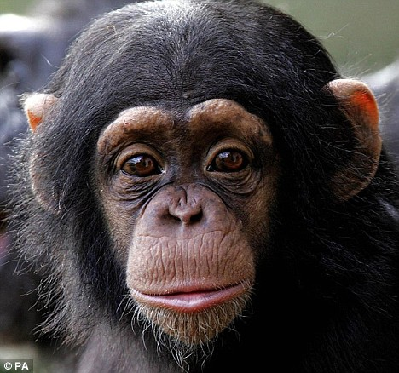
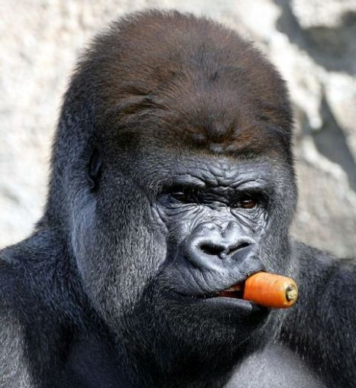
Inferring inter-species selection
Inter-species
Fixed substitutions
Polymorphisms
Intra-species
Notes:
Polymorphism levels depends on local mutation rates: under neutral evolution, the amount of within- and between-species diversity is expected to be similar across all loci in the genome.

Slide 84
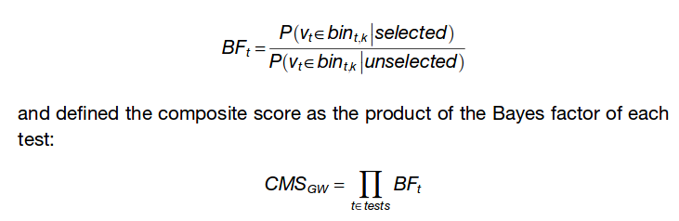
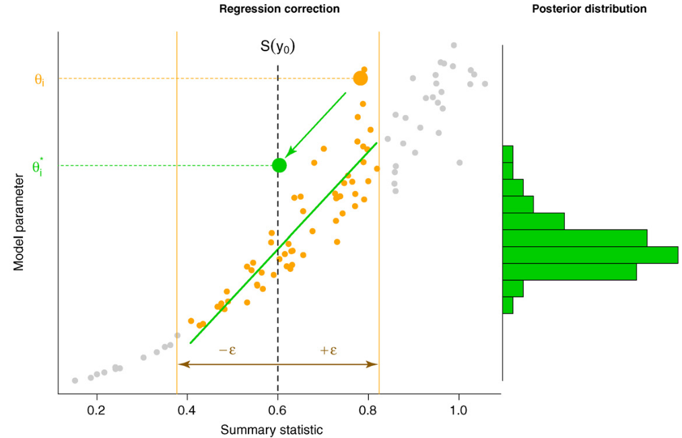
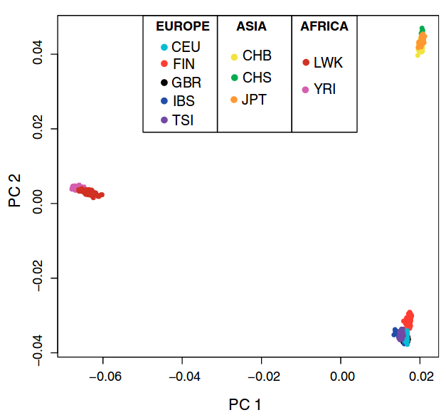
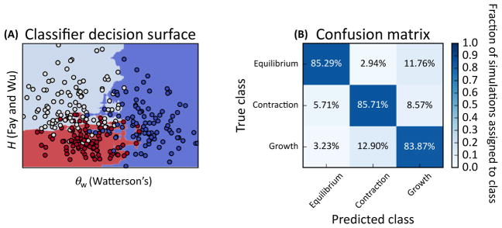
State-of-the-art methods to detect natural selection
1. Composite scores (Grossman et al. 2013)
2. Simulations-based (rejection, ABC)
3. Unsupervised machine learning
(PCA, Duforet-Frebourg et al. 2016)
4. Supervised machine learning
(SVM, Schrider & Kern 2018)

