Slide 1
The Global Carbon Cycle
Introduction to Biological Processes

Slide 2
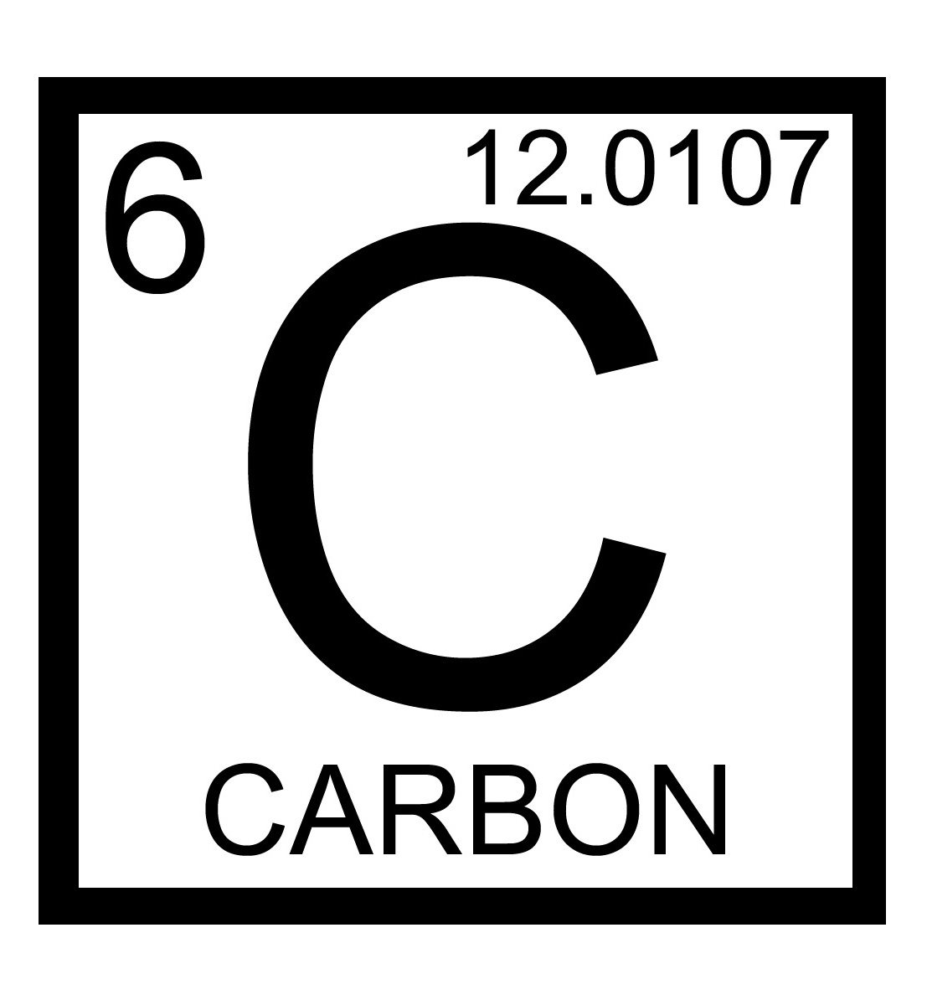
What will we be talking about?
Why is Carbon Important?
The Geological and Biological Carbon Cycle Processes
Carbon Fixation
Redox Reactions
Chemoautotrophs
Photoautotrophs
Net Primary Production
Summary

Slide 3
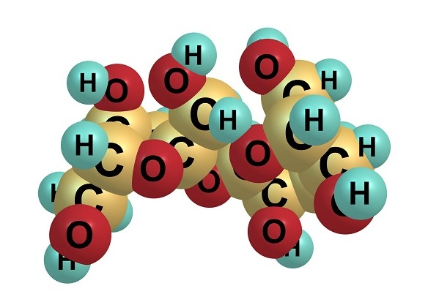
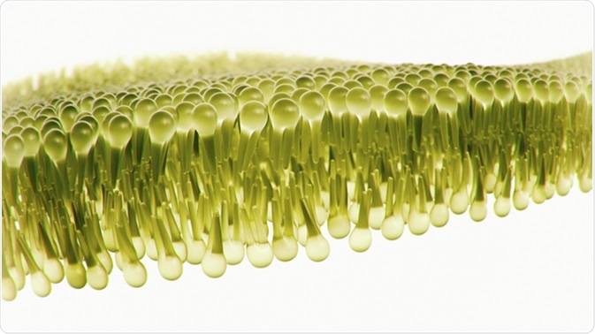
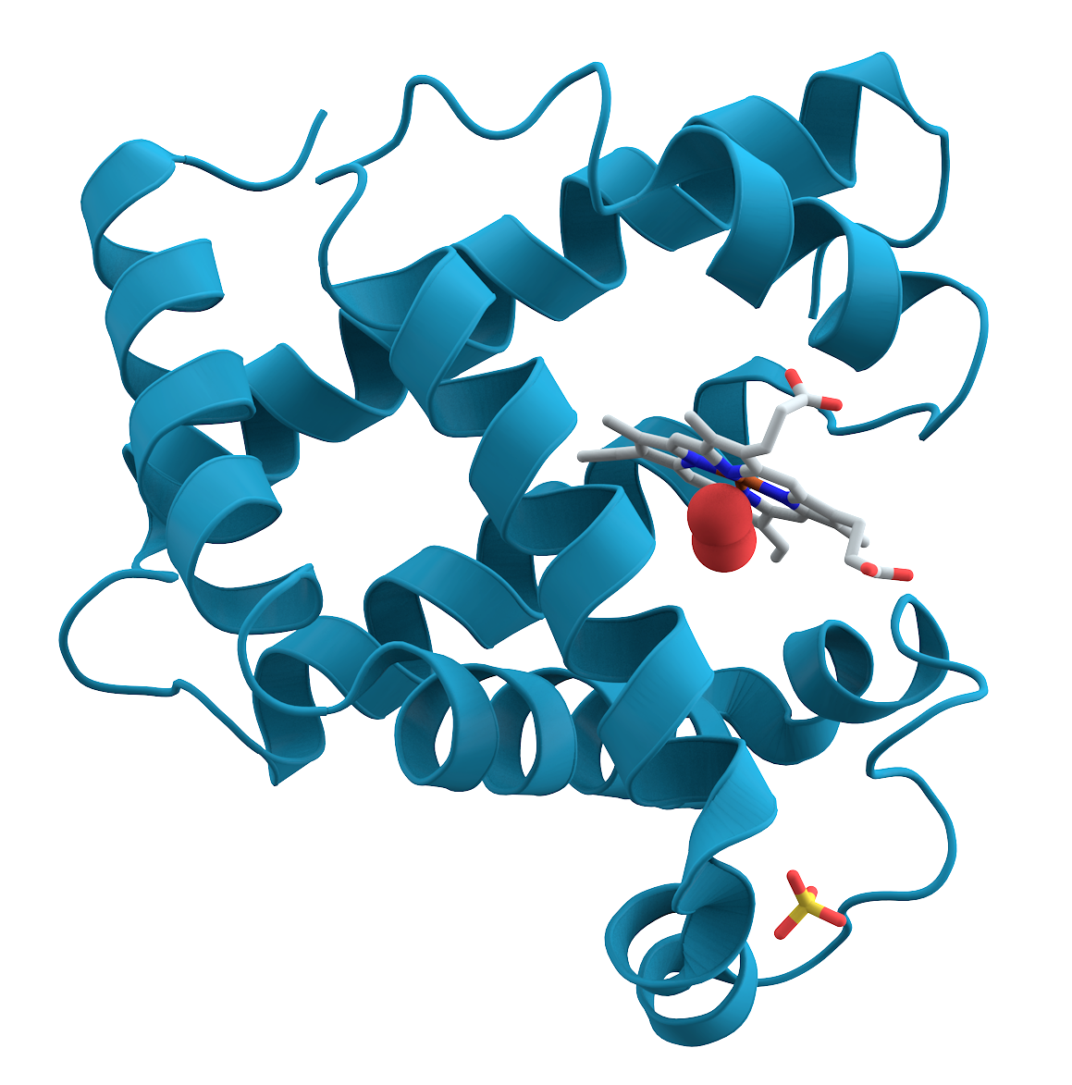
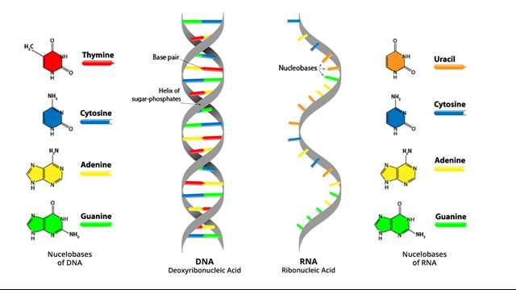
Why is Carbon Important?
Carbohydrates
Lipids
Proteins
Nucleic Acids
Importance?
The Carbon Cycle
Carbon Fixation
Redox
Chemoautotrophs
Photoautotrophs
NPP
Summary
Notes:
Why is carbon important?
It is the most important element to life. Without it life as we know it would not exist. Carbon is the main element used in the organic compounds we find on Earth.
But why carbon and why not any other element? Because carbon is a promiscuous element, meaning it can bond with with lots of other elements, as well as itself. So it can form the nearly 10 million carbon based compounds we see in life on this planet. It can bond in different ways: it can form stable bonds with elements like hydrogen, less stable more reactive bonds with elements like oxygen, it can also form lots of different shaped molecules.
Those millions of compounds fall into four major groups, that you might be familiar with: carbohydrates (sugars/starches that provide and stores energy), lipids (fats/oils that store energy, forms cell membranes, carries messages), proteins (enzymes/antibodies, that helps cells keep their shape, makes muscles, speeds chemical reactions, carries messages and materials) and nucleic acids (DNA/RNA instructions for proteins, passes genetic instructions to offspring).

Slide 4
The Geological and Biological Carbon Cycle Processes
Inorganic carbon: carbon dioxide, carbonic acid, bicarbonate, and carbonate
Inorganic carbon in the lithosphere, ocean and atmosphere
Rock weathering
Volcanic degassing
Metamorphism
Inorganic carbon in the lithosphere, ocean and atmosphere
Fixation by chemoautotrophs and photoautotrophs
Organic carbon available to higher trophic levels (chemoheterotrophs)
Organic carbon transformed into inorganic carbon by respiration, decomposition and fossil fuel burning
Geological Processes
Biological Processes
Importance?
The Carbon Cycle
Carbon Fixation
Redox
Chemoautotrophs
Photoautotrophs
NPP
Summary
Notes:
What is the carbon cycle?
The carbon cycle is the biogeochemical cycle by which carbon is exchanged between the biosphere (the global ecosystem of living things), pedosphere (the soil layer), geosphere (the rock layer), hydrosphere (oceans and aquatic systems) and atmosphere of the Earth.
The carbon cycle is composed of geological and biological processes.
Geological processes include chemical rock weathering, volcanic degassing and metamorphism where during subduction and mountain building, rocks may release CO2.
Biological processes include carbon fixation (via photosynthesis or chemosynthesis), transfer of organic carbon to higher trophic levels and transformation of organic carbon to inorganic carbon (such as carbon dioxide, carbonic acid, bicarbonate, and carbonate) through respiration, decomposition and fossil fuel burning.

Slide 5
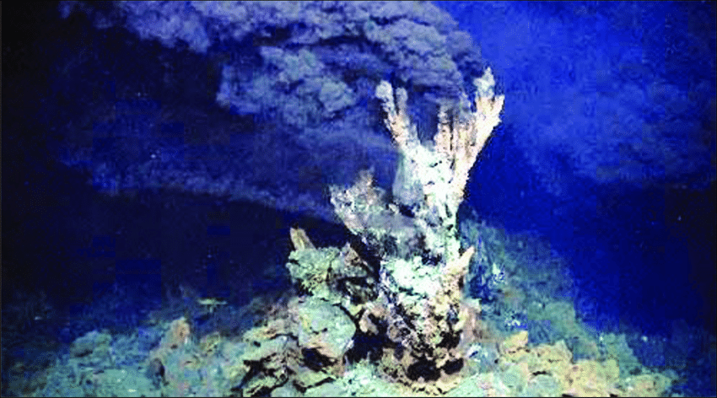
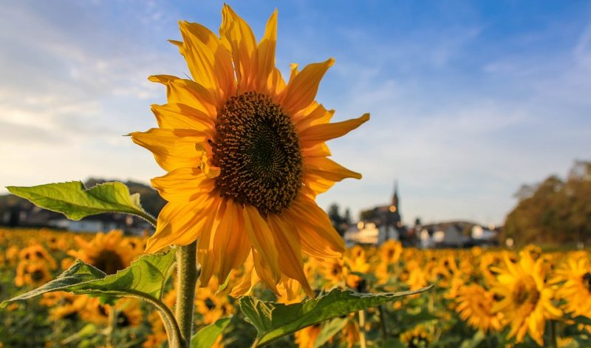
Carbon Fixation
Inorganic Carbon (CO₂₎
Chemical Energy
Carbon Fixation
Chemoautotrophs
Inorganic Carbon (CO₂₎
Light Energy
Carbon Fixation
Photoautotrophs
Importance?
The Carbon Cycle
Carbon Fixation
Redox
Chemoautotrophs
Photoautotrophs
NPP
Summary
Notes:
What is carbon fixation?
Carbon fixation refer to the way in which inorganic carbon is transformed into organic carbon.
Carbon fixation can occur via two mechanisms: chemoautotrophy where inorganic carbon is fixed using chemical energy (the sort of thing you might find in hydrothermal vents) and photoautotrophy where inorganic carbon is fixed using light energy (that we are more familiar with in plants).

Slide 6
Redox Reactions
Loss of electron (oxidation)
0
0
e⁻
+
-
+
+
Gain of electron (reduction)
Importance?
The Carbon Cycle
Carbon Fixation
Redox
Chemoautotrophs
Photoautotrophs
NPP
Summary
Notes:
So what is a redox reaction and why is it important to carbon fixation and the biological processes of the carbon cycle?
Redox stands for reduction-oxidation reaction and describes a chemical reaction that involves a transfer of electrons between two species.
Electrons are the money of chemistry. Who has them? Who wants them? Electrons allow atoms to bond with other atoms to form molecules (so electrons are the currency that allow carbon to make all the amazing molecules like DNA and proteins that we need for life)
Reduction is when a substance gains electrons. Oxidation is when a substance loses electrons.

Slide 7
Redox Reactions
Photosynthesis
+4 -2 -2 0. -2 0
6 CO₂ + 6 H₂O + LIGHT ENERGY C₆H₁₂O₆ + 6 O₂
Carbon dioxide Water Glucose Oxygen
Respiration
0 -2 0 +4 -2 -2
C₆H₁₂O₆ + 6 O₂ 6 CO₂ + 6 H₂O + ENERGY
Glucose Oxygen Carbon dioxide Water
Importance?
The Carbon Cycle
Carbon Fixation
Redox
Chemoautotrophs
Photoautotrophs
NPP
Summary
Notes:
Under Earth surface conditions, the addition of hydrogen atoms to carbon requires addition of energy (primary production like photosynthesis or chemosynthesis), while oxidation of carbon-hydrogen yields energy (respiration). Oxidation of C-H bonds forms basis of energy production for all life.
Photosynthesis takes carbon dioxide from the environment then uses the carbon fixation process to convert it to organic compounds such as sugars (water + carbon dioxide + light energy = simple carbohydrate).
We can see this with glucose production: 6 mols of carbon dioxide plus 6 mols of water plus light energy yields a mol of glucose plus 6 mols of oxygen. Carbon here is reduced, going from oxidation number of plus 4 to 0 and oxygen goes from negative 2 to 0.
This is a redox reaction, carbon is reduced (gains electrons and becomes negatively charged) and the oxygen is oxidized (losses electrons becomes positively charged).
The carbohydrates produced by these carbon fixation reactions are the most sort after currency among Earths living things. Because organisms can use them in two ways: as building materials and as fuel. Some carbohydrates go through additional reactions to become the more complex carbon compounds mentioned earlier: starches, fats, proteins, nucleic acids.
Lots of carbon dioxide is released as the direct produce of cellular respiration. For mammals that happens mostly when we exhale. That carbon dioxide can be recycled immediately by photosynthesizes. For organisms that live in water the carbon they release largely ends up dissolved in that water and oceans and other surface water can also dissolve carbon dioxide directly from the air.
Like carbon fixation respiration in an extremely complex group of reactions. Respiration reaction is basically the reverse of carbon fixation. Carbohydrate react with oxygen to produce carbon dioxide, water and energy. Most commonly written with glucose. Like carbon fixation, it’s also a redox reaction. The oxygen is reduced from an oxidation number of 0 to negative 2, carbon is oxidized from 0 to +4. The cells of living things reoxidize the reduced carbon and rereduce the oxidized oxygen to produce all the energy that keeps living things alive.
Chemoautotrophs also use redox reactions to fix inorganic carbon into organic carbon. So redox reactions are at the heart of the biological processes driving the carbon cycle.
……………………………….
Carbon dioxide reacts with water to form carbonic acid, a weak acid that dissociates into hydrogen and biocarbonate ions. The hydrogen ions can react with various rocks and other substances in fairly typical neutralization reactions. This results in weathering.
The carbonate ions have a whole bunch of functions especially in marine animals which use them to build their shells and skeletons in the form of calcium carbonate. The carbon remains trapped there until those animals die and their structures break down which happens on huge slow geological timescales. If the conditions are just right (like the super high temperatures and pressures in the Earth’s crust) large deposits of calcium carbonate can eventually form rocks like limestone. 80% of all the carbon on Earth is locked up in rocks, as inorganic carbonates in the Earth’s crust, mantel or lithosphere. Fossil fuels count for only 0.006% of all the carbon on Earth. Those carbon deposits are made from dead organism like plants that managed to not have their carbon released. Coal, petroleum and natural gas. But this is leading me onto a whole other talk for another time… Let’s look a little closer at photoautotrophs and chemoautotrophs.

Slide 8
Chemoautotrophs
Energy Source
Chemical
Light
Chemotrophs
Carbon Source
Organic Compounds
CO₂
Chemoheterotrophs
Final Electron Donor
O₂
Not O₂
Organic compound
Inorganic Compound
Fermentative, e.g. Streptococcus
Electron transport chain, e.g. Clostridium
Chemoautotrophs
Hydrogen, sulfur, iron, carbon monoxide oxidizing bacteria
Phototrophs
Carbon Source
Organic compounds
Photoheterotrophs
Green nonsulfur bacteria, purple nonsulfur bacteria
CO₂
Photoautotrophs
Use H2O to reduce CO2?
Yes, oxygenic photosynthesis (plants, algae, cyanobacteria)
No, Anoxygenic photosynthetic bacteria (green and purple bacteria)
Animals, most fungi, protozoa, bacteria
Importance?
The Carbon Cycle
Carbon Fixation
Redox
Chemoautotrophs
Photoautotrophs
NPP
Summary
Notes:
Chemoautotrophs (chemical self feeders) are organisms capable of reducing sufficient inorganic carbon to grow and reproduce in the absence of light energy and without an external organic carbon source.
Chemoautotrophs are able to synthesize their own organic molecules from the fixation of carbon dioxide. These organisms are able to produce their own source of food, or energy. The energy required for this process comes from the oxidation of inorganic molecules such as iron, sulfur or magnesium. Chemoautotrophs are able to thrive in very harsh environments and include nitrogen fixing bacteria located in the soil, iron oxidizing bacteria located in the lava beds, and sulfur oxidizing bacteria located in deep sea thermal vents.
Likely evolved early in Earth’s history and exclusively carried out by archaea and bacteria.
Chemoautotrophy supplies <1% organic carbon to the planet but is an important process in sediments and anoxic basis and helps with nitrogen and sulphur cycling.

Slide 9
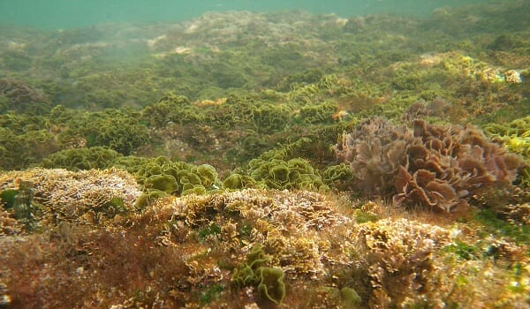
Photoautotrophs
Energy Source
Chemical
Light
Chemotrophs
Carbon Source
Organic Compounds
CO₂
Chemoheterotrophs
Final Electron Donor
O₂
Not O₂
Organic compound
Inorganic Compound
Fermentative, e.g. Streptococcus
Electron transport chain, e.g. Clostridium
Chemoautotrophs
Hydrogen, sulfur, iron, carbon monoxide oxidizing bacteria
Phototrophs
Carbon Source
Organic compounds
Photoheterotrophs
Green nonsulfur bacteria, purple nonsulfur bacteria
CO₂
Photoautotrophs
Use H2O to reduce CO2?
Yes, oxygenic photosynthesis (plants, algae, cyanobacteria)
No, Anoxygenic photosynthetic bacteria (green and purple bacteria)
Animals, most fungi, protozoa, bacteria
Importance?
The Carbon Cycle
Carbon Fixation
Redox
Chemoautotrophs
Photoautotrophs
NPP
Summary
Notes:
Photoautotrophy (self feeding on light) biological conversion of light energy to the fixation of CO2, in the form of organic carbon compounds.
All photoautotrophs are photosynthetic, but not all photosynthetic organisms are photoautotrophs. Whilst many organisms can photosynthesize, many supplement their metabolic strategy with organic carbon, therefore they are not true photoautotrophs.
Photoautotrophs include cyanobacteria, algae and higher plants.

Slide 10
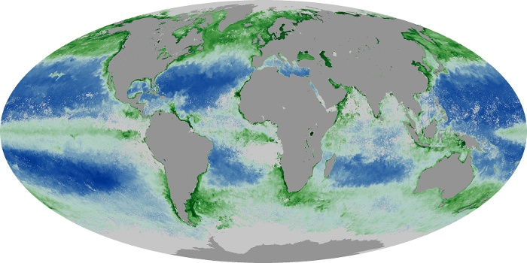
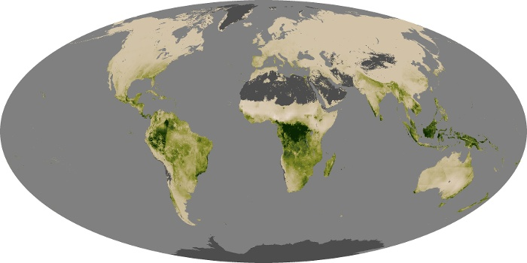
Net Primary Production
Importance?
The Carbon Cycle
Carbon Fixation
Redox
Chemoautotrophs
Photoautotrophs
NPP
Summary
Notes:
Net primary production Is defined as the fraction of photosynthetically produced carbon that is retained following all respiratory costs of photoautotrophs and is available to the next trophic level in the ecosystem. Whilst photosynthesis allows an organism to convert inorganic carbon to organic matter, it must also use some of that organic matter for it’s own metabolic demands. Net primary production is important because it sustains all heterotrophs, including us!
Satellite images of terrestrial vegetation and ocean water leaving radiances (i.e. the visible light scattered back to space from the ocean) can be used to construct global maps of NPP.
NPP can be limited by some of the major elements C H N O P S (carbon, hydrogen, nitrogen, oxygen, phosphorus, sulfur). CO2 and water limits NPP on land. Nitrogen and phosphorus limit NPP in oceans.

Slide 11
Summary
Inorganic carbon in the lithosphere, ocean and atmosphere
Fixation by chemoautotrophs and photoautotrophs
Organic carbon available to higher trophic levels
Organic carbon transformed into inorganic carbon by respiration, decomposition and fossil fuel burning
Importance?
The Carbon Cycle
Carbon Fixation
Redox
Chemoautotrophs
Photoautotrophs
NPP
Summary
Notes:
In summary…
Inorganic carbon is present in the lithosphere, the ocean and the atmosphere.
Inorganic carbon is fixed into organic carbon by chemoautotrophs using chemical energy, and photoautotrophs using light energy.
The net primary production is the organic carbon that is retained after all the metabolic costs of the primary producer. That organic carbon is then available to higher trophic levels, such as chemoheterotrophs.
Through respiration, decomposition (via fungi and bacteria), fossil fuel burning, organic carbon is transformed back into inorganic carbon.
And all the magic of the carbon cycle gives all living things on Earth the energy and materials to keep on living. And this is the only known example of life in the Universe.

Slide 12
Thank you!

