Slide 1
MESS
Massive eco-evolutionary synthesis simulations
﻿A unified model of species abundance, genetic diversity, and functional diversity reveals the mechanisms structuring ecological communities (Overcast et al., 2020)

Slide 2
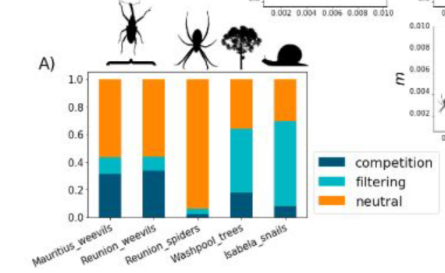
Mess: inputs and outputs
The relative contributions of neutral and non-neutral community assembly processes
If TRAIT VARIATIONS are included then, within non-neutral processes, the relative influence of competition and environmental filtering can be discerned
With two of three biodiversity data types:
Species richness and abundance
Population genetic diversities
Trait variations in a phylogenetic context
MESS

Slide 3
Mess: the grizzly innards
For each of neutral, competition and environmental filtering models
Local Community component
Population genetics coalescence component
Machine Learning for model selection
Metacommunity component
Proportional predicted model class for empirical dataset

Slide 4
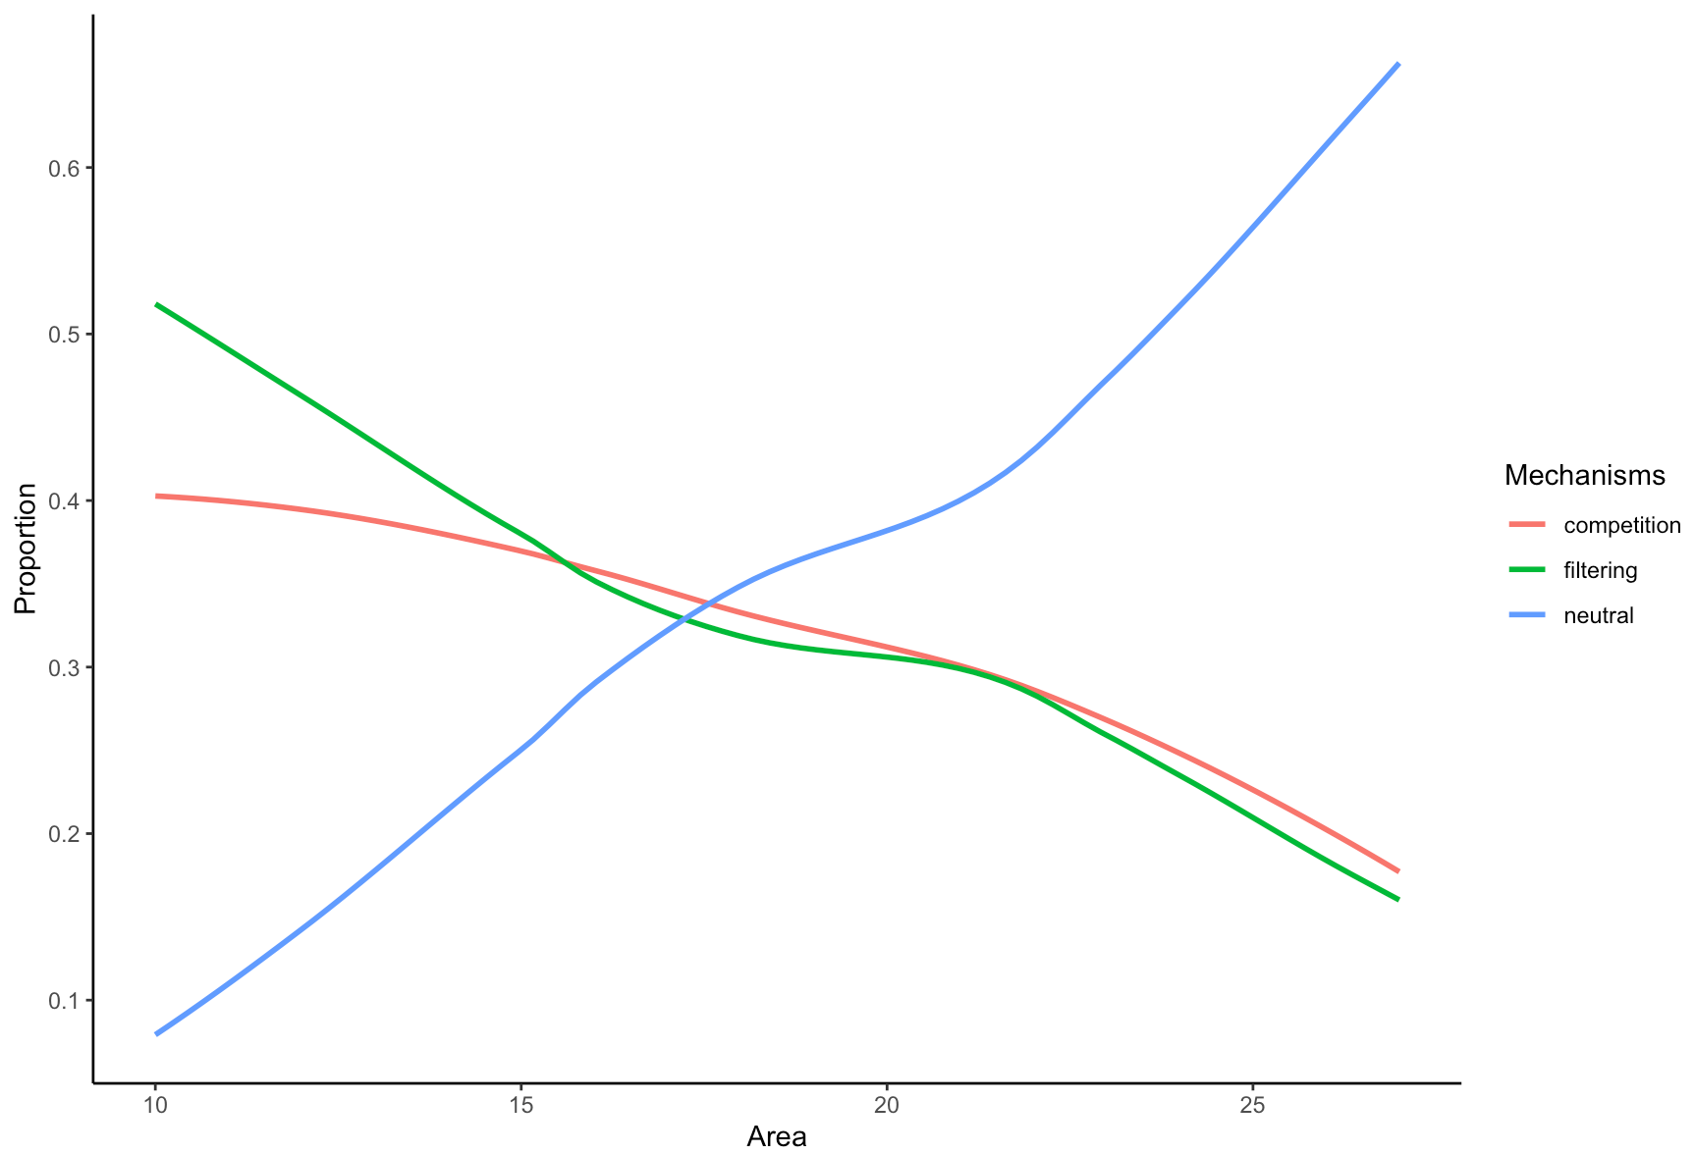
Applications

